Slide 1
Wireless Analytics for 3D Printed Objects
Vikram Iyer, Justin Chan, Ian Culhane, Jennifer Mankoff, Shyam Gollakota

Slide 2
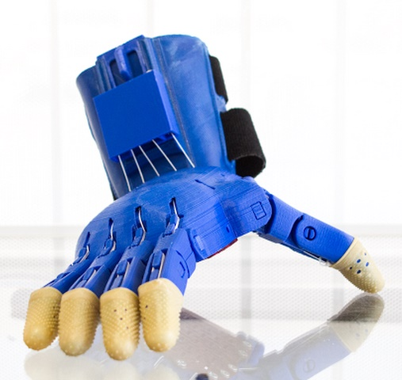
What do we mean by analytics?
Track the use of printed objects over time
Embed wireless sensing in printed objects

Slide 3
What else could we do with wireless analytics?

Slide 4
Why not use electronics?
Requires designers to understand electronics
Requires power source
Enable communication using plastic objects

Slide 5
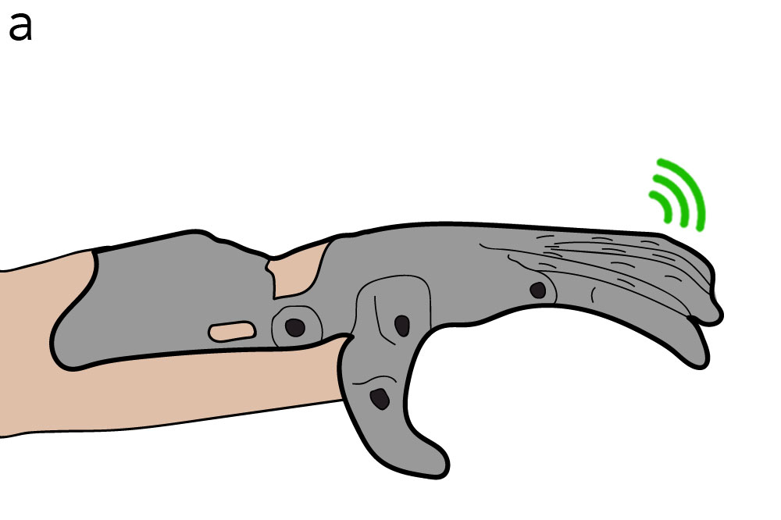
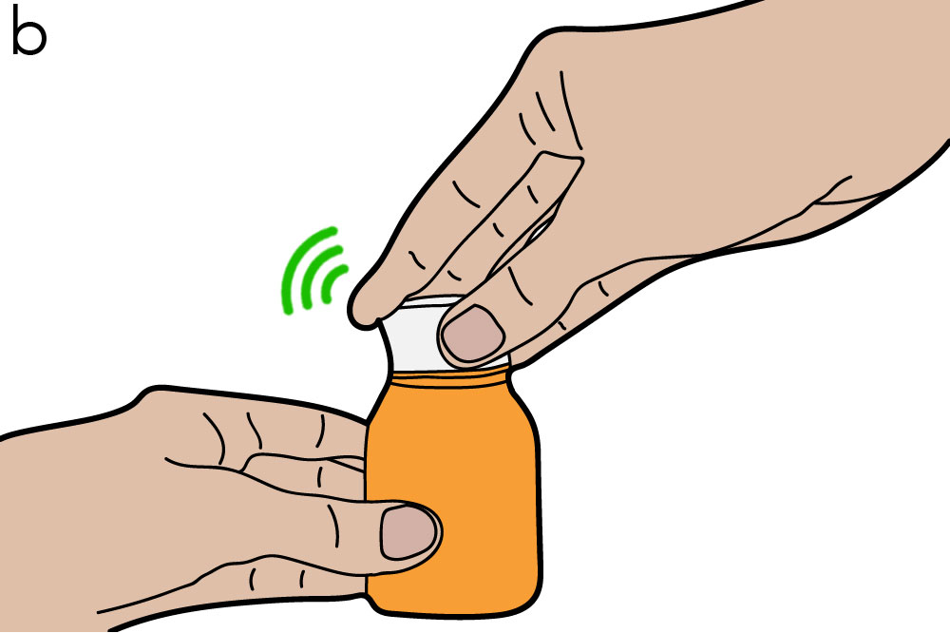
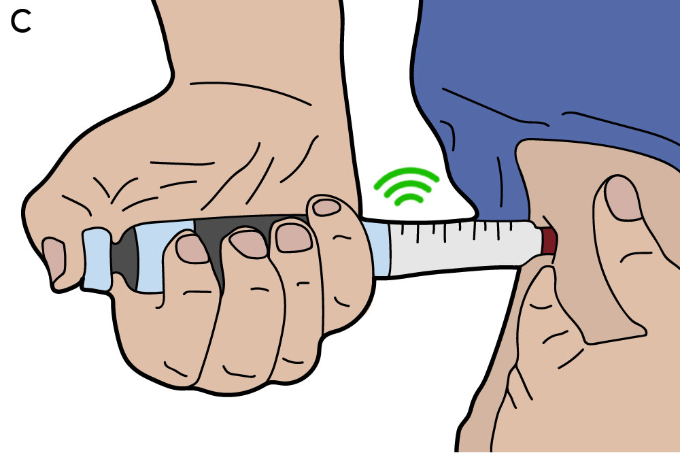
Printed Analytics
Wireless, circuitless physical analytics capture for 3D printed objects
Printed prosthetics
Smart pill bottle
Wireless insulin pen

Slide 6
3D printing wireless devices
Decoding wireless signals
Tracking rotational motion
Analytics outside wireless range

Slide 7
How can plastic objects communicate?

Slide 8
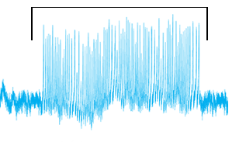
Printed objects communicate using reflections
Incoming radio signal
Reflected signal
Message
Antenna
0 1 0
Switch
Switch produces changing reflections

Slide 9
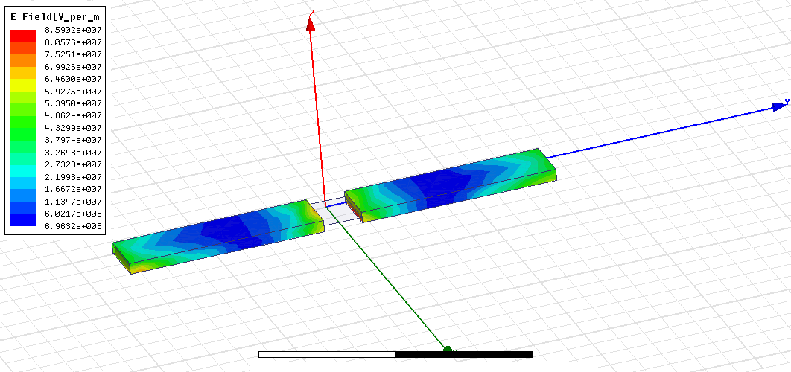
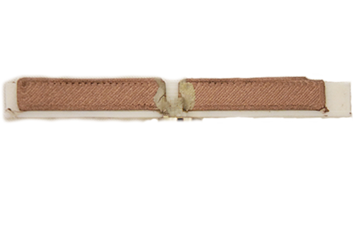
How do we 3D print an antenna?
Start with reference metal antenna designs
Optimize length, width, thickness for printed materials
Fabricate using a dual-material printer
Dipole Antenna

Slide 10
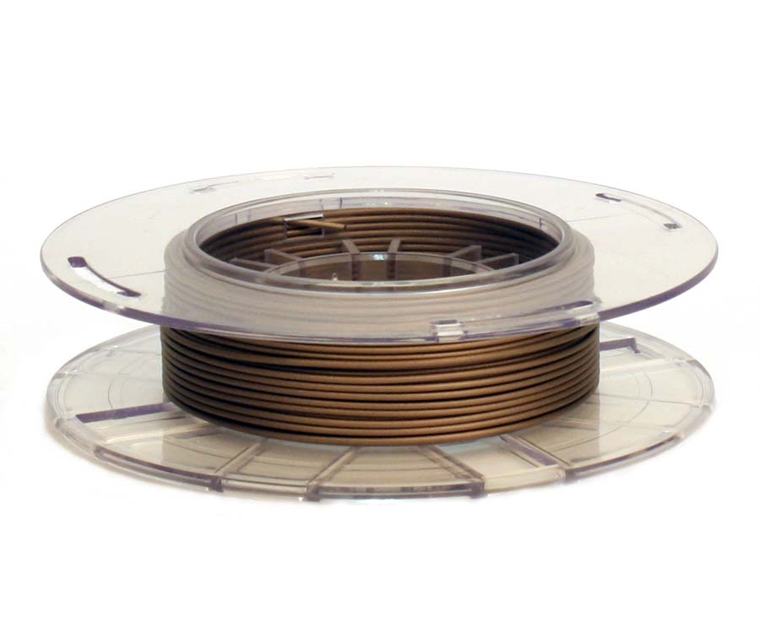
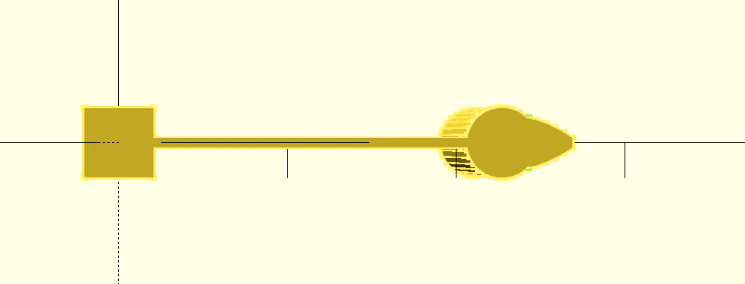
How do we build a switch?
1. Conductive contact
2. Bi-directional spring
Conductive filament
Cantilever spring

Slide 11
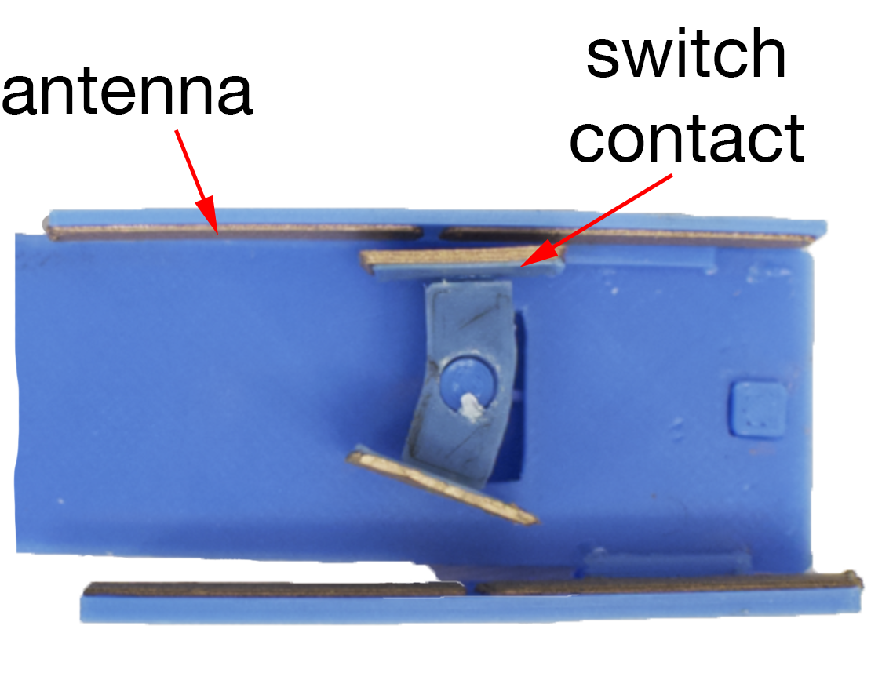
How does our switch work?

Slide 12
Switch in action

Slide 13
3D printing wireless devices
Decoding wireless signals
Tracking rotational motion
Analytics outside wireless range

Slide 14
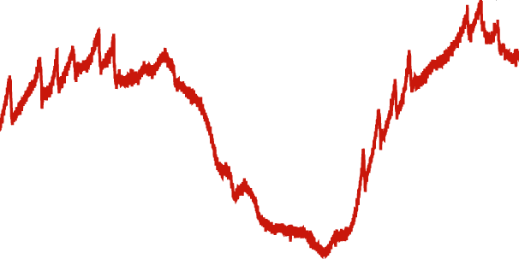
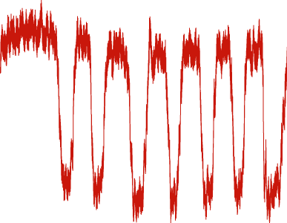
How do we decode the data?
Raw signal
Filtered signal
Data
Count = 8

Slide 15
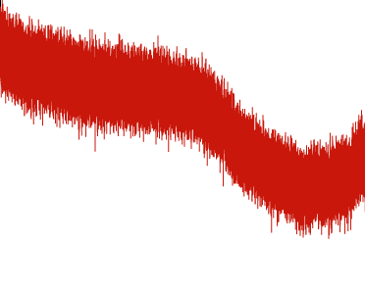
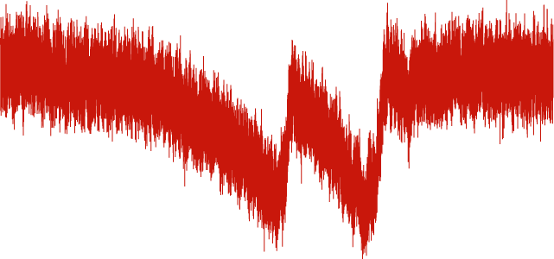
What happens at long range?
Close distance
Medium distance
Far distance
Incoming radio signal
Reflected signal
Problem: Self-interference limits range

Slide 16
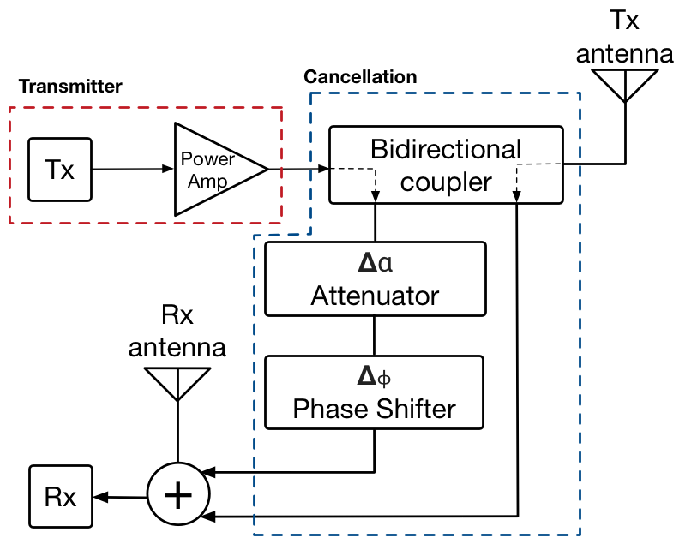
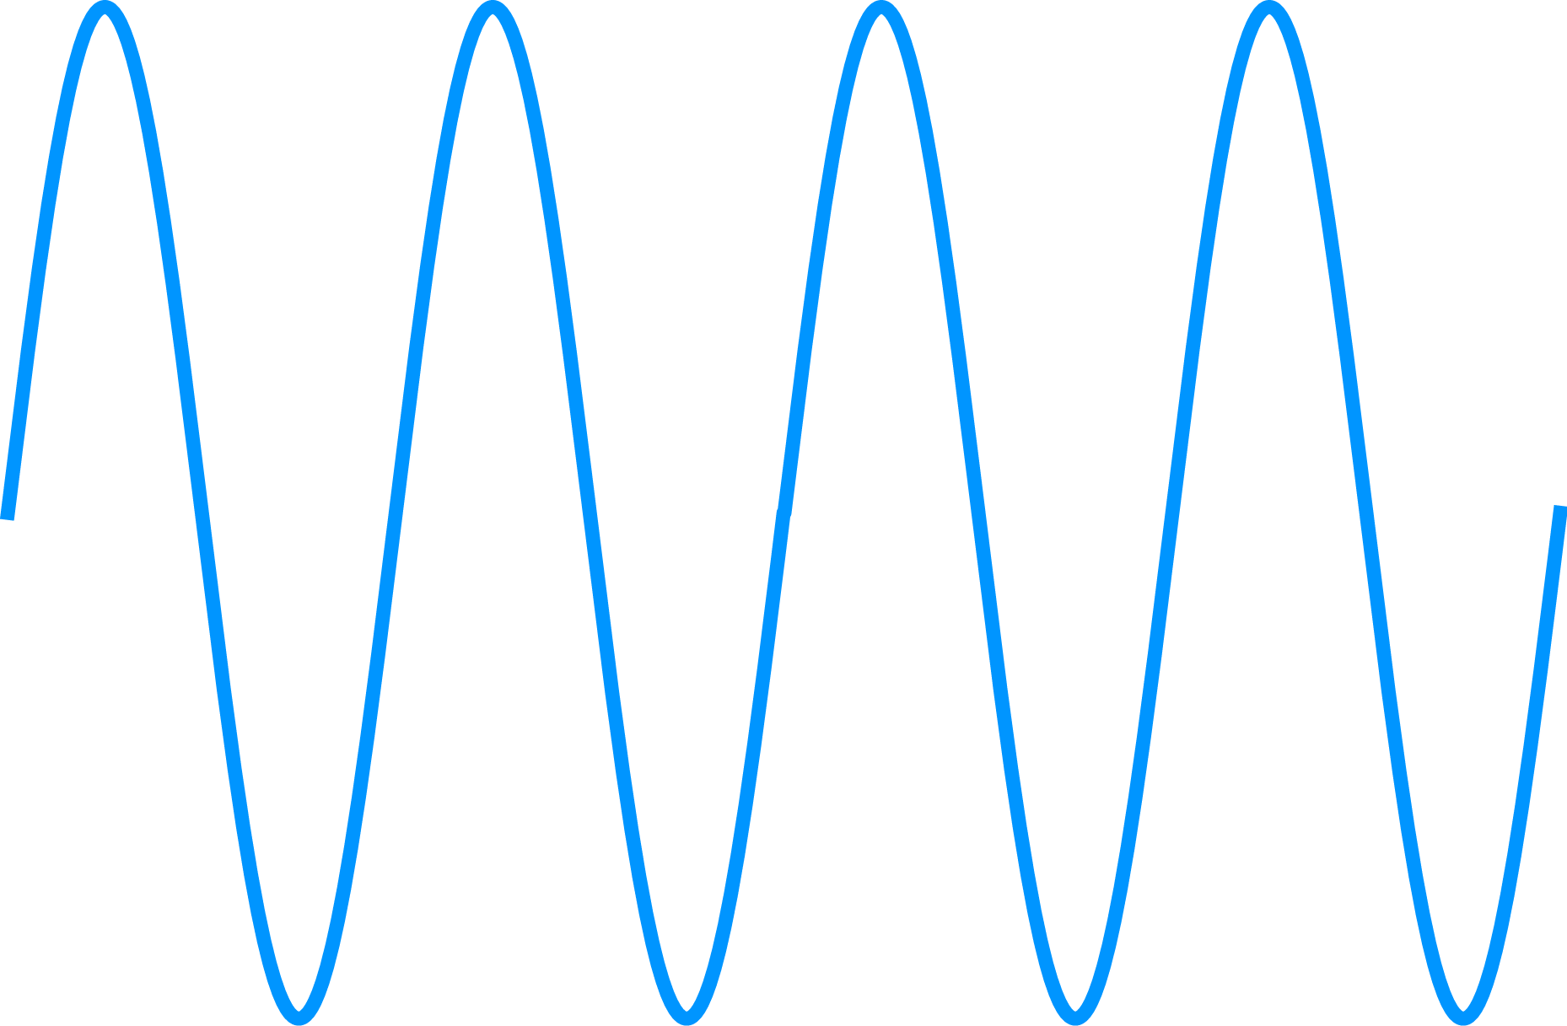
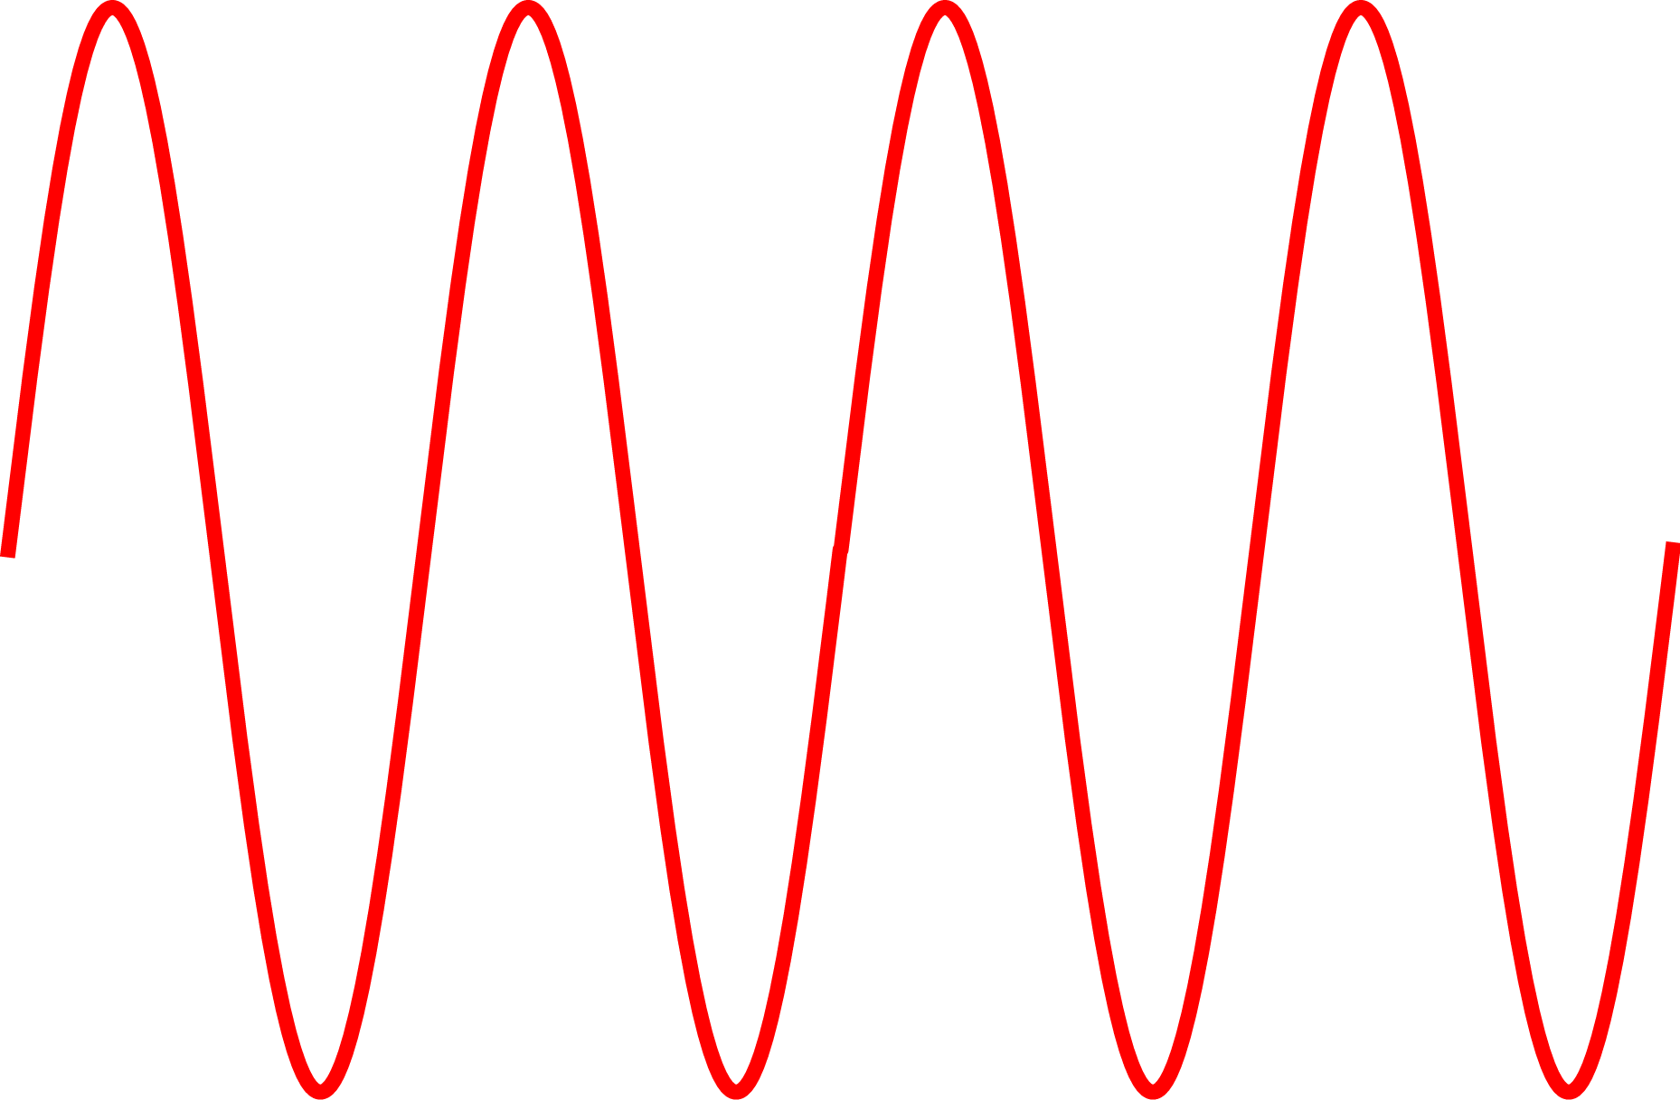
Solution: Cancel out the interference
Transmitter signal
Inverted signal
+
=

Slide 17
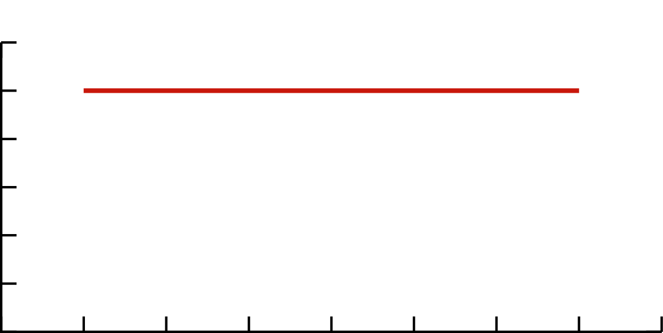
How well does cancellation work?
No Cancellation
With Cancellation
Transmitted signal
60%
40%
20%
0
Backscatter
signal
Bit Error Rate
d1
d2
Transmitter
(TX)
Printed
Object
Receiver
(RX)
0 1 2 3 4
TX Distance (m) RX
Works up to transmitter receiver distance of 4 m

Slide 18
3D printing wireless devices
Decoding wireless signals
Tracking rotational motion
Analytics outside wireless range

Slide 19
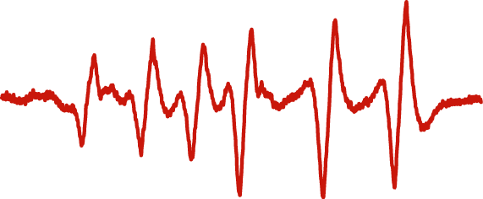
How do we measure angle?
6 peaks → 90 deg
10
8
6
4
2
0
Number of peaks
45°
90°
180°
Angle
Number of peaks → angle

Slide 20
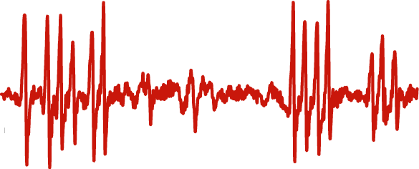
How do we measure direction?
Use an asymmetric gear
6
4
3

Slide 21
3D printing wireless devices
Decoding wireless signals
Tracking rotational motion
Analytics outside wireless range

Slide 22
Insulin pen requirements
Store count of presses
Accumulate each press
Upload the data when back in range

Slide 23
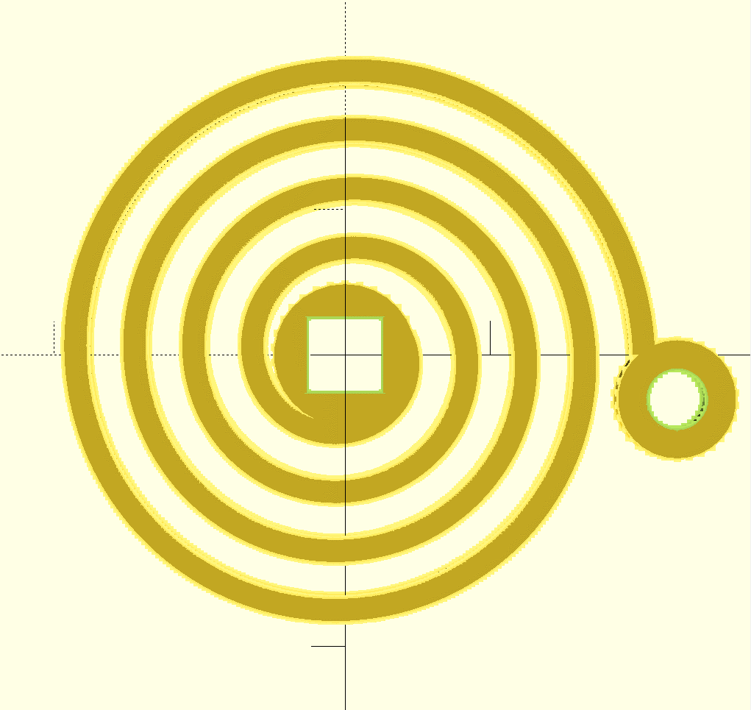
Solution: Store information mechanically
Store information in a spring

Slide 24
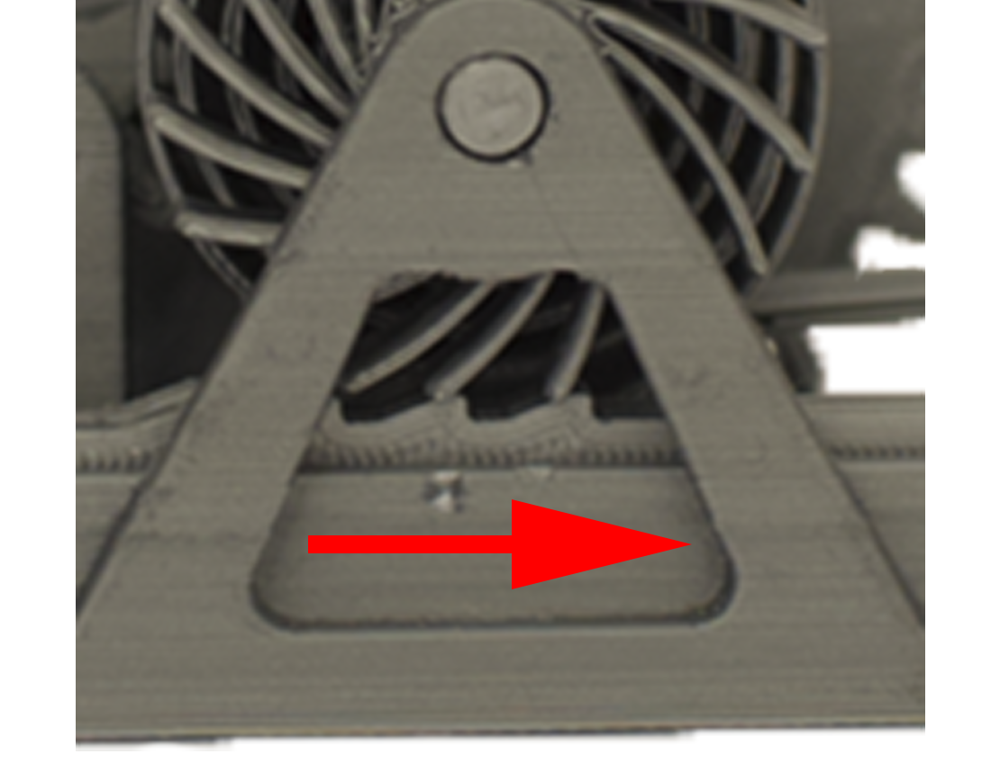
How do we keep the spring coiled?
Key idea: Use a ratchet to coil the spring
Ratchet accumulates rotation in spring

Slide 25
Storing data from an insulin pen

Slide 26
Future work
Improving form factor
Storing additional data
Increasing range to work across a whole home

Slide 27
Printed Analytics
Wireless, circuitless physical analytics capture for 3D printed objects
Printed prosthetics
Smart pill bottle
Wireless insulin pen

Slide 28
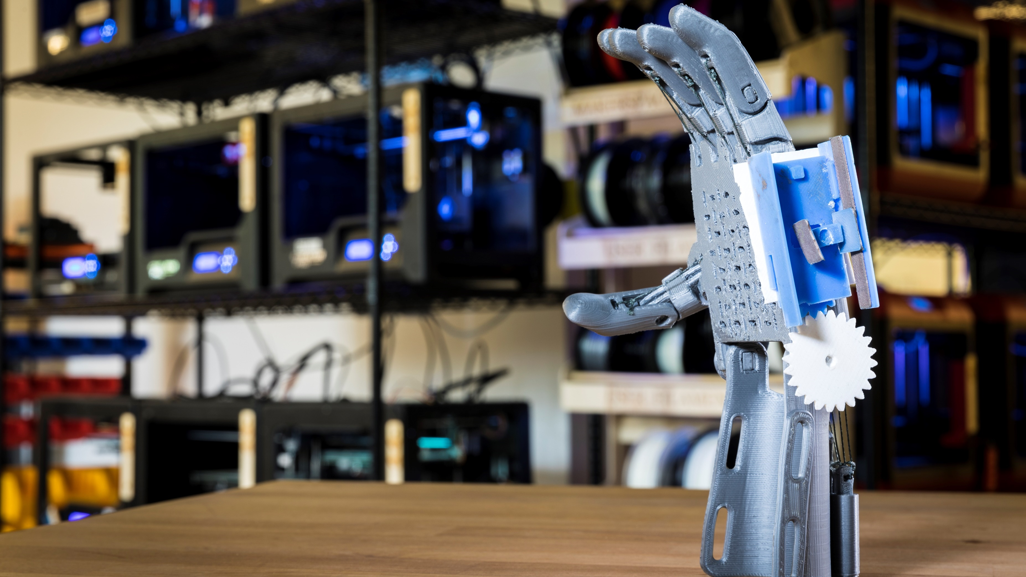
printedanalytics.cs.washington.edu

