Slide 1
Predictors of Postsecondary Web Accessibility, 2012 to 2022
Terrill Thompson UW-IT Accessible Technology Services University of Washington
Jared Smith WebAIM Utah State University

Slide 2
Acknowledgements / Credits
“Predictors of Postsecondary Web Accessibility, 2012 to 2022”, Journal on Technology & Persons with Disabilities (CSUN, 2024)
Co-authors
Terrill Thompson, UW
Dan Comden, UW
Scott Ferguson, UW
Dustine Bowker, UW
Sheryl Burgstahler, UW
Jared Smith, WebAIM, Utah State University
Elizabeth Moore, Applied Inference

Slide 3
Two studies: 10 Years Apart
Thompson, T., Comden, D., Ferguson, S., Burgstahler, S., Moore, E. (2013). Seeking Predictors of Web Accessibility in U.S. Higher Education Institutions. Information Technology and Disabilities E-Journal, 13(1).
Thompson, T., Comden, D., Ferguson, S., Bowker, D., Burgstahler, S., Smith, J., Moore, E. (2024). Predictors of Postsecondary Web Accessibility, 2012 to 2022. The Journal on Technology and Persons with Disabilities, Vol. 12, pp 290-305.

Slide 4
Our idea in 2012
Measure the accessibility of the “Top 10” web pages at all higher education institutions in the United States.
Collect a bunch of additional data (independent variables) about all institutions
Analysis: Which independent variables are the best predictors of web accessibility?

Slide 5
Basic web accessibility in 2012
% of <img> elements with alt attributes
% of <input> elements with "labels"
% of pages with HTML headings
% of pages with a lang attribute
% of pages with ARIA landmark regions

Slide 6
Independent variables in 2012
Demographic data (Carnegie Foundation)
Top 10 HTML pages at each institution (via Google)
An automated check of institution home pages for an “Accessibility” link
A list of URLs searching Google for "web technology accessibility policy”, narrowed to verified policies, in specific categories, after manual inspection

Slide 7
Four Categories of “Policies” in 2012
Formal-standalone
Formal-incorporated
Standards or guidelines
General statement

Slide 8
Better web accessibility in 2022
Used two samples of URLs for each institution
Method 1 – Top 10 web pages at each institution
(Example: “site:washington.edu”)
the method used in the original study
pages tend to be decentralized
Method 2 - Top 10 web pages at & about each institution
Example (“University of Washington site:washington.edu”)
pages tend to be centralized
Used WAVE API
100+ automated measures for each web page
Each institution gets an automated accessibility score range: 1 to 10, normalized against the WebAIM Million
Used the original 5 basic measures too
For comparison over time

Slide 9
More independent variables in 2022
More demographics
100+ variables in Carnegie Classifications data set
Endowment assets from National Center for Ed. Statistics
More policy variables
Yes/No fields for 8 specific characteristics
A “Policy Score” (0-8, count of measured characteristics)
Federal Funding
National Science Foundation (NSF)
National Institutes of Health (NIH)
OCR Resolutions
Yes/No, plus data about each
Lawsuits
Yes/No, plus data about each

Slide 10
Eight characteristics of policies
Includes effective dates/milestones
Names the issuing authority
Specifies a standard
Identifies responsible parties
Defines scope
Applies to third party/procurement
Provides a feedback mechanism
Includes enforcement/penalties

Slide 11
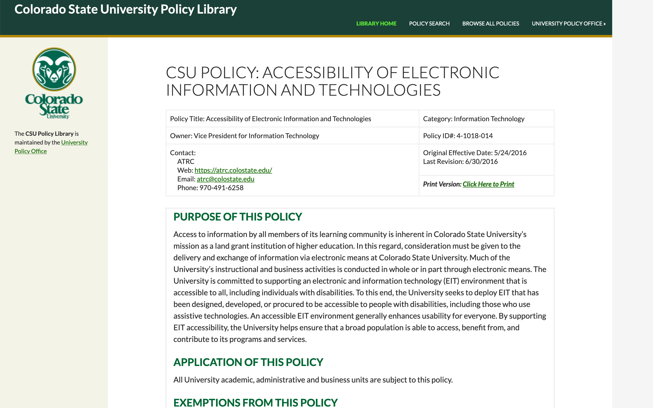
Example Policy 1

Slide 12
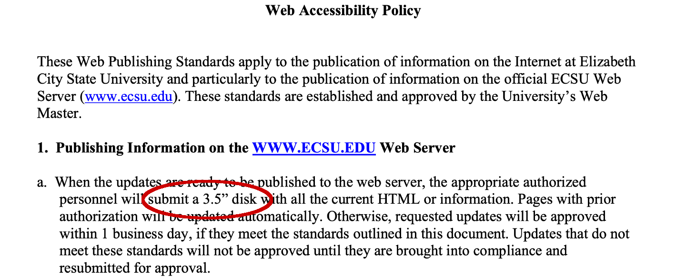
Example Policy 2

Slide 13
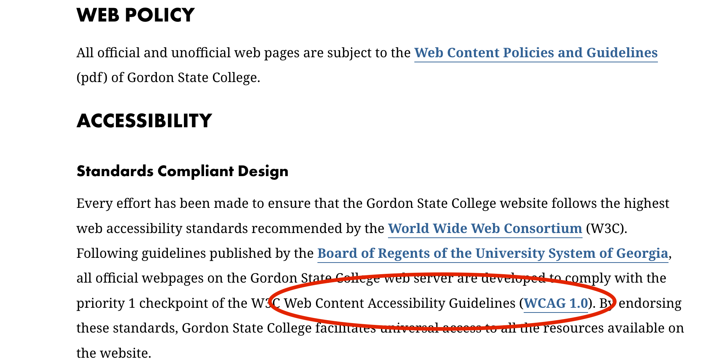
Example Policy 3

Slide 14
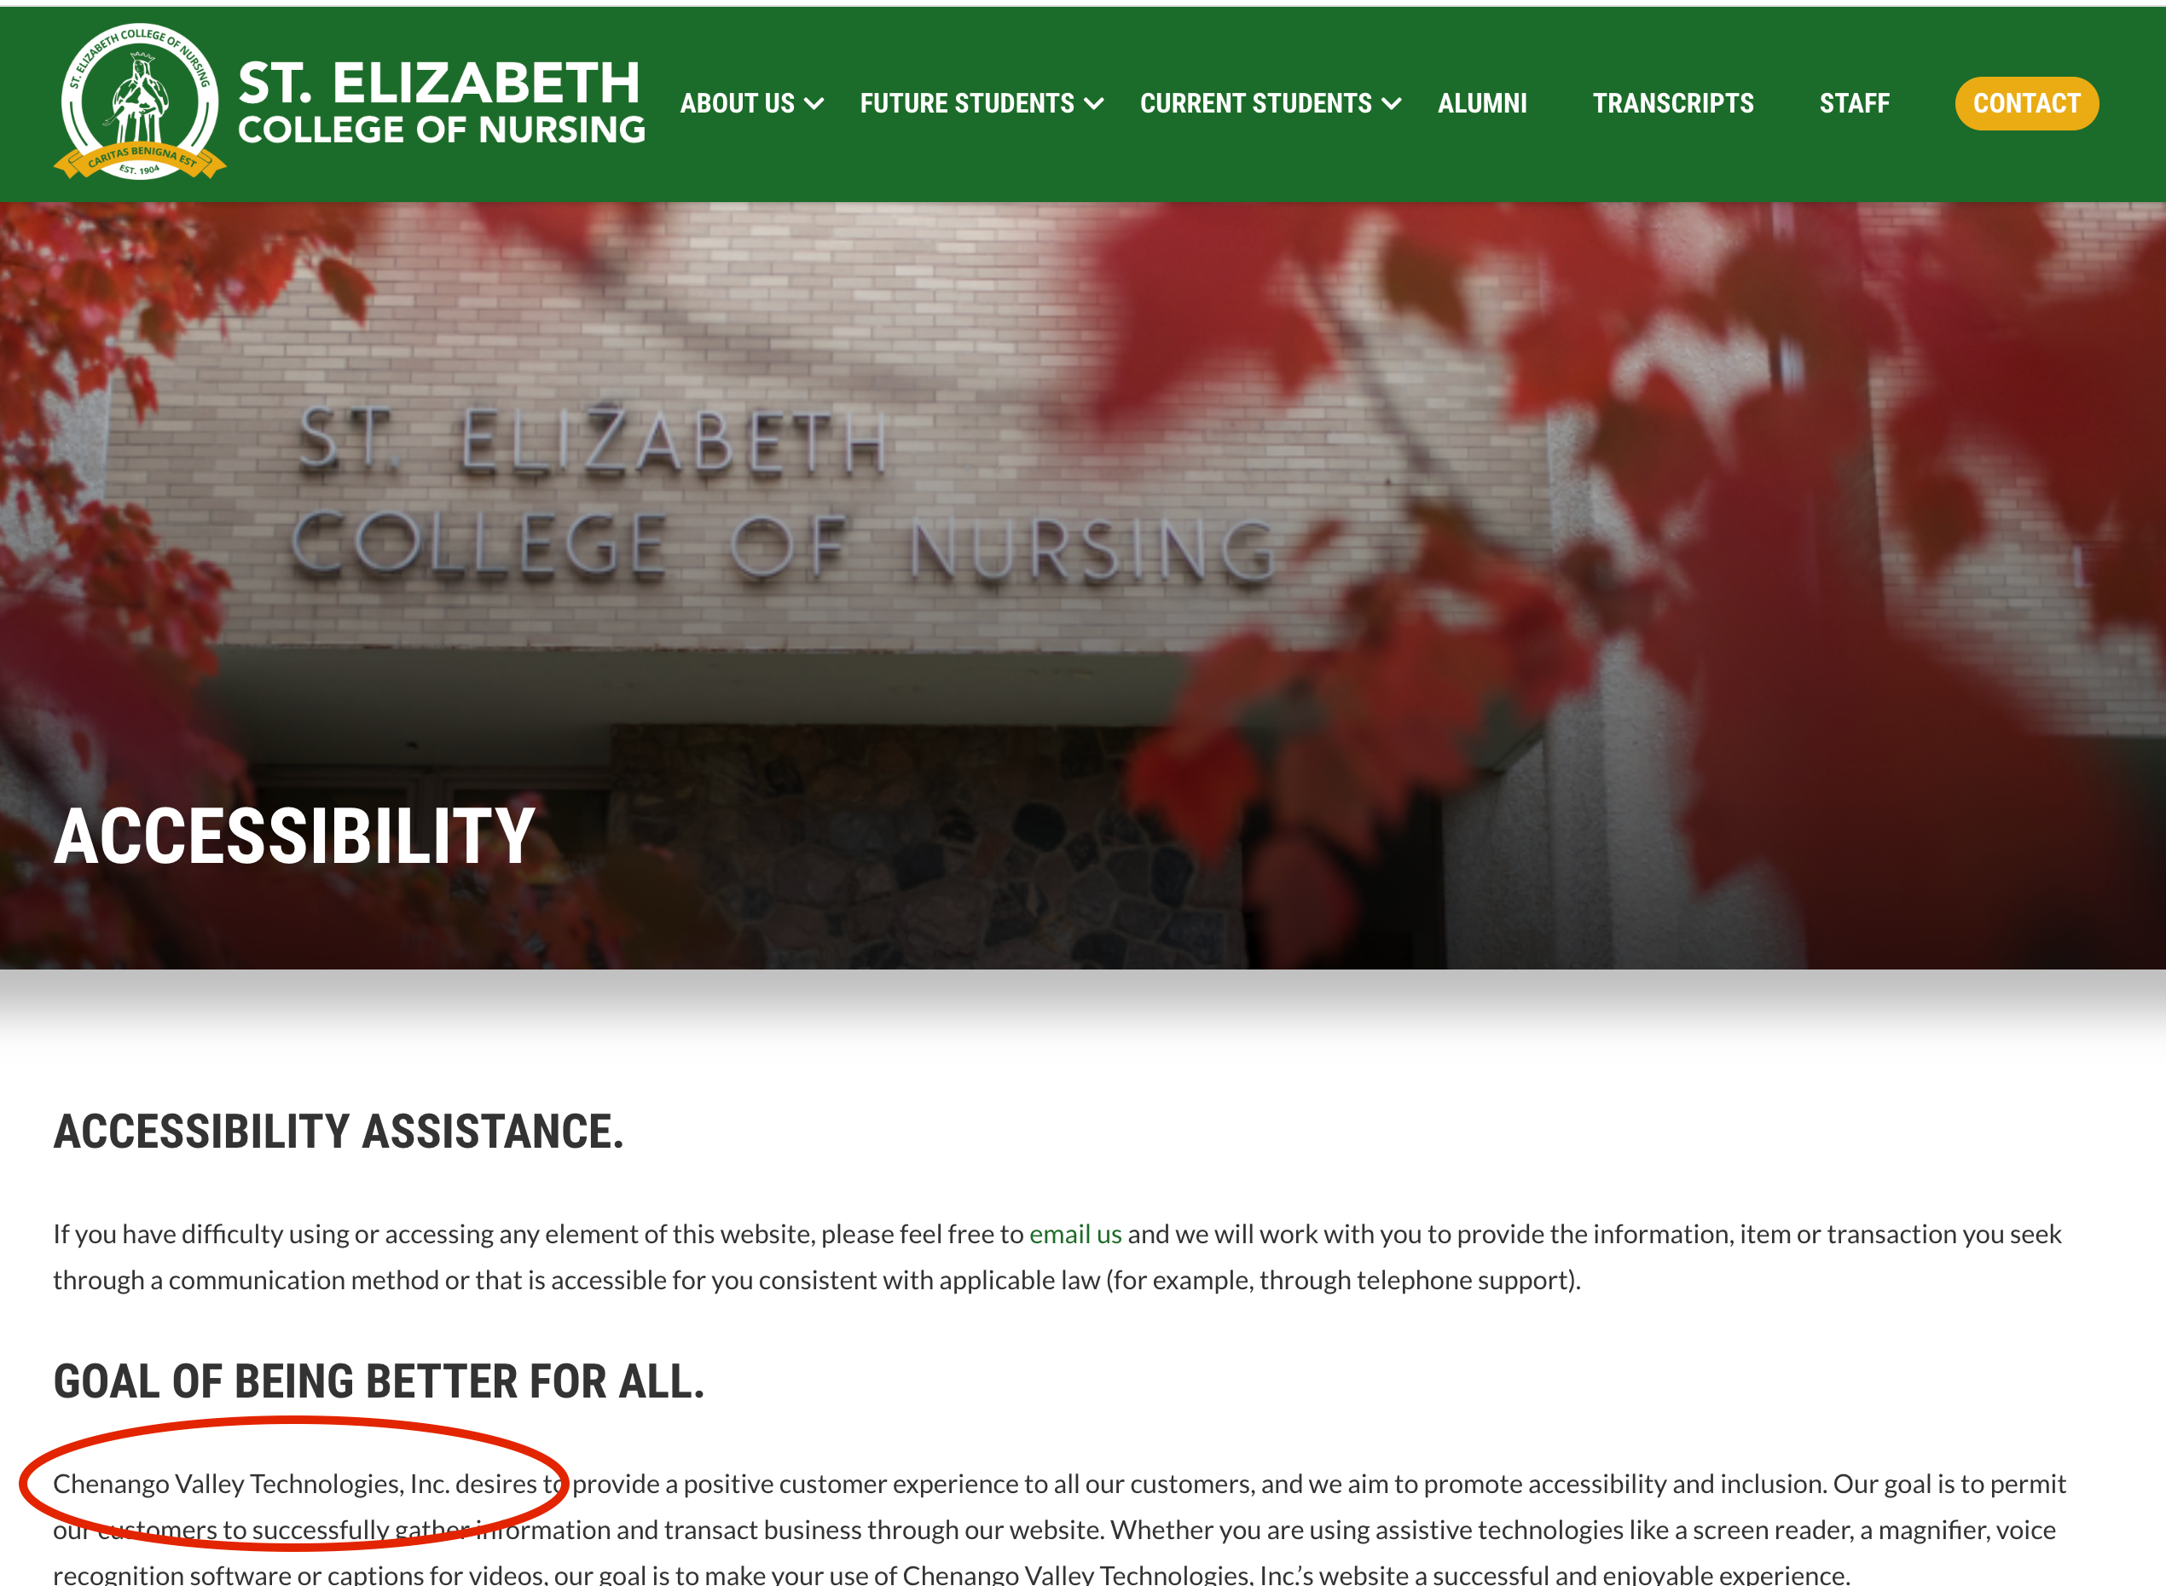
Example Policy 4

Slide 15
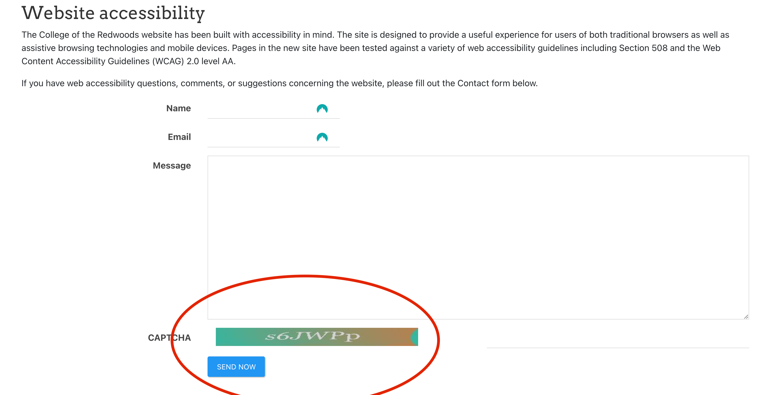
Example Policy 5

Slide 16
Example Policy 6

Slide 17
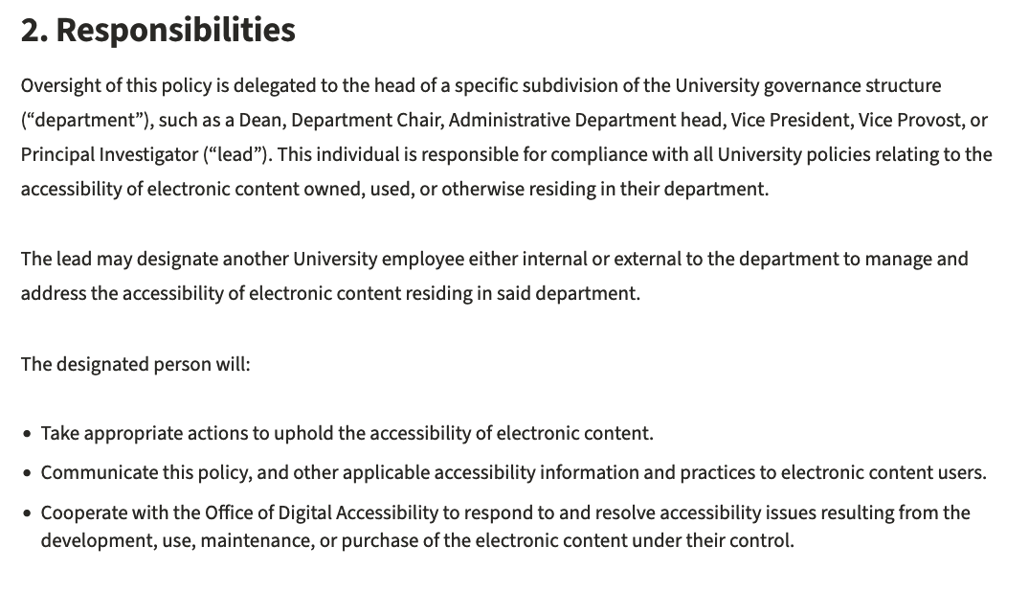
Example Policy 7
Stanford University
6.8.1 Accessibility of Electronic Content

Slide 18
The new study: Overall population
3,386 U.S. higher education institutions
2,653 have a match in the 2012 study (78.35%)
1,197 institutions have a web/technology accessibility policy (35.4%)
There have been 482 OCR resolutions related to web/online accessibility since 2010
There have been 204 lawsuits related to digital accessibility since 2010

Slide 19
About those lawsuits
70.1% were against Doctorate or Master’s schools
They were filed in 17 different U.S. District Courts
81.4% were filed in Southern District of New York
84.3% were filed by serial plaintiffs (individuals who have filed 3 or more lawsuits)
4 individuals have filed 54, 43, 22, and 15 lawsuits
76.0% were filed by Gottlieb & Associates

Slide 20
The new study: Research questions
Has the accessibility of postsecondary websites improved in 10 years?
How have institutions’ web/technology accessibility policies changed in 10 years?
Has the number of institutions with “accessibility” links in on their home pages changed in 10 years?
What variables are most strongly associated with institutions' automated accessibility scores?

Slide 21
Automated Accessibility Scoring using the AIM (Accessibility IMpact) Methodology
The WAVE API is used to scan all pages. Accessibility data is collected and analyzed.
Scores are aligned to the WebAIM Million results to provide a comparison to web pages generally.
Scores based on:
Number of detected errors (60% weighting)
Error density (number of errors per page element – 30% weighting)
Alerts (potential or likely accessibility issues – 10% weighting)
20 detected errors on average per page (n=61703)
The WebAIM Million average is 50

Slide 22
Results

Slide 23
Q1. Has the accessibility of postsecondary websites improved in 10 years?
 | 2012 | 2022
Document language | 37.1% | 98.9%
Headings | 77.9% | 98.3%
Page regions | 2.9% | 93.4%
Alt Text | 61.5% | 87.1%
Form labels | 40.7% | 67.8%

Slide 24
Q2. How have institutions’ web/technology accessibility policies changed in 10 years?
2012
274 policies (8.4% of institutions)
Most commonly "Formal, standalone" (35% of policies)
Institutions with policies tended to be:
public (83.2%)
medium to very large (77.8%)
with 4-year degrees (71.5%)

Slide 25
Q2. Policy changes (Slide 2 of 3)
2022
1,197 policies (35.4% of institutions)
Most commonly ”General statements" (53.2% of policies)
Institutions with policies tended to be:
public, medium to very large, with 4-year degrees (same as 2012). BUT…
Substantial increases in policies were observed at:
private not-for-profit institutions
two-year schools
small/very small schools.

Slide 26
Q2. Growth in Formal/Standalone Policies
 | 2012 | 2022
Associates | 21 (1.7%) | 74 (6.5%)
Doctorate | 35 (12.4%) | 152 (33.0%)
Masters | 36 (5.8%) | 79 (12.5%)
Baccalaureate | 1 (0.2%) | 44 (7.9%)
Special Focus | 3 (0.6%) | 9 (1.6%)
Tribal | 0 | 2 (6.1%)
Total | 96 (3.0%) | 359 (10.6%)

Slide 27
Q3. Has the number of institutions with “accessibility” links in on their home pages changed in 10 years?
 | 2012 | 2022
”Accessibility” links | 240 (7.4%) | 1.438 (42.5%)

Slide 28
Q4. What variables are most strongly associated with institutions' automated accessibility scores?
Analysis of variance and Pearson’s correlation coefficient were used to test the relationship between characteristics of the institutions and web accessibility while exploratory multiple regressions were used to develop a multivariate model of web accessibility.

Slide 29
Q4. The best predictors of web accessibility
Size of the institution
Having resolved an OCR complaint re. web accessibility
Having a web accessibility policy of any type
Control of the institution (public is positive, private-for-profit is negative)
Having received an NIH or NSF award
Indication of a responsible party in the web accessibility policy
Total degrees conferred
Being the recipient of a lawsuit re. web accessibility
Being a Tribal College (negative)
Being an HBCU (negative)

Slide 30
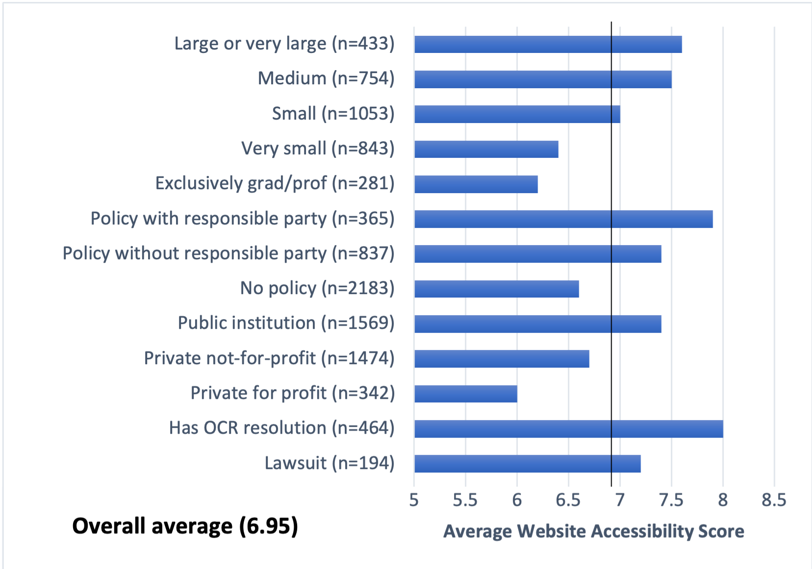
Q4. Average website accessibility scores (1 of 2)

Slide 31
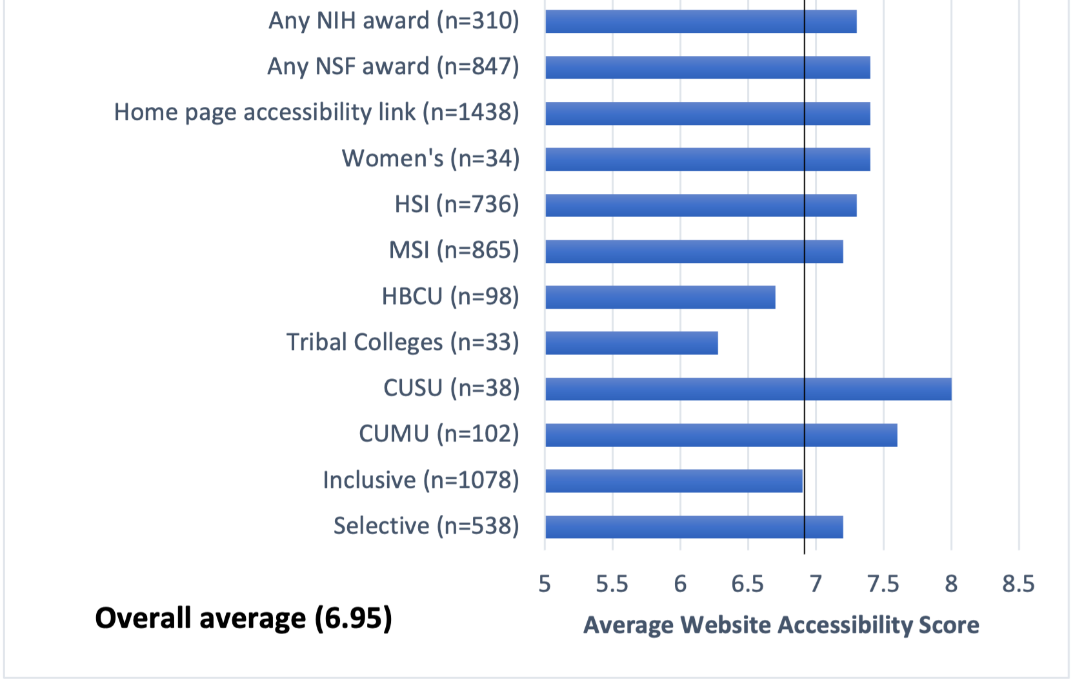
Q4. Average website accessibility scores (2 of 2)

Slide 32
Limitations of this Study
An institution’s “Top 10” web pages may be indicative of the institutions’ top-level, centralized commitment to accessibility, but not necessarily the institution’s overall website accessibility. Future studies could utilize a larger sample of web pages.
An automated assessment of web accessibility may not be a true indication of functional web accessibility. Future studies could include manual testing.
We did not control for the effect of time on the predictive effect of policies, OCR resolutions and lawsuits. Future studies could specifically examine changes over time relative to these milestone stimuli.

Slide 33
The Future of Web Accessibility
Join us for a fireside chat
When: Today (Wednesday 3/20, 2:20pm)
Where: Platinum 6
Who: Terrill, Jared, and Rob Carr of WebAIM

