Slide 1
Microsoft vs Google: Accessibility of Docs & Slides
Gaby de Jongh Document Accessibility Specialist gabyd@uw.edu
Terrill Thompson Manager, IT Accessibility Team tft@uw.edu

Slide 2
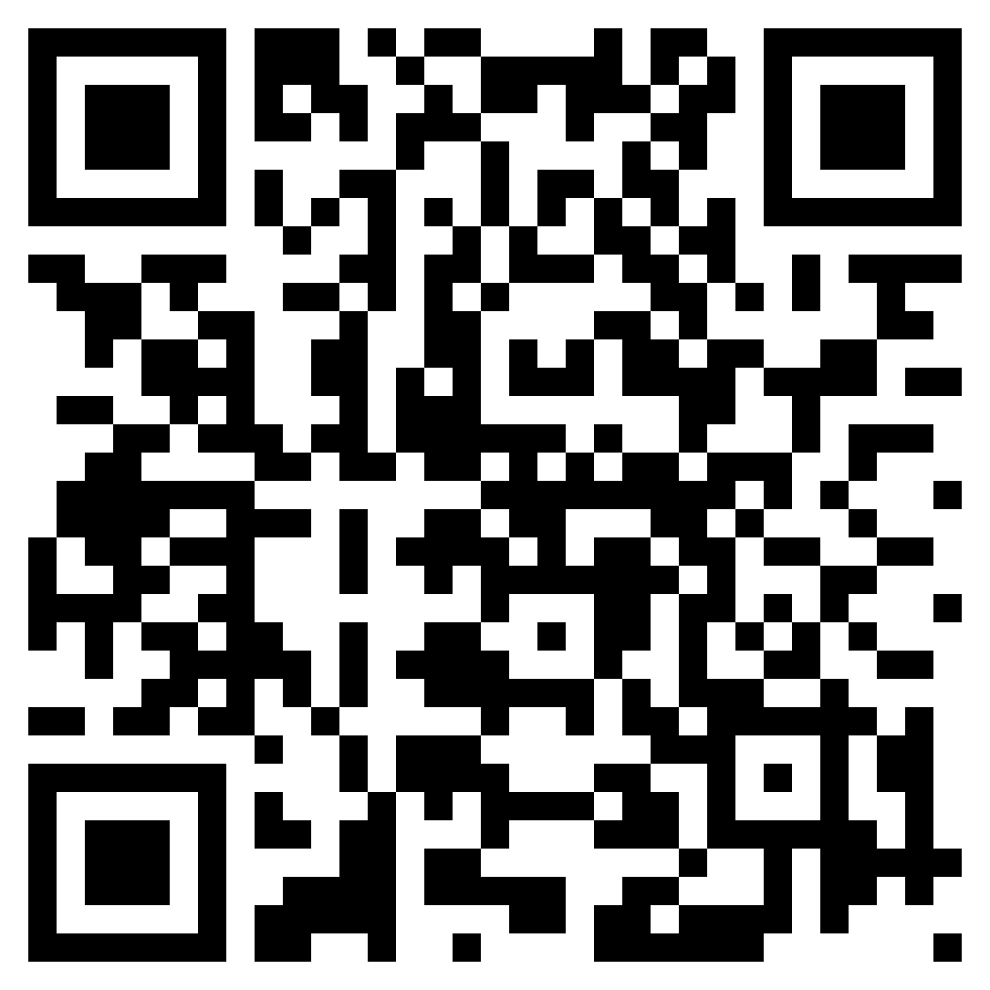
These slides
https://staff.washington.edu/tft/talks/csun2024/ CSUN2024-MS-v-Google.pptx

Slide 3
Our Goals
Share our Top Ten Techniques for authoring accessible documents and slides.
Document which authoring tools support them
Microsoft Word and PowerPoint
Google Docs and Slides
Grackle Docs/Slides (See them at CSUN Booth #1215)
Test how well the output is supported by screen readers.
Document how well accessibility survives if content is exported to PDF.

Slide 4
Technique #1 Alt Text

Slide 5
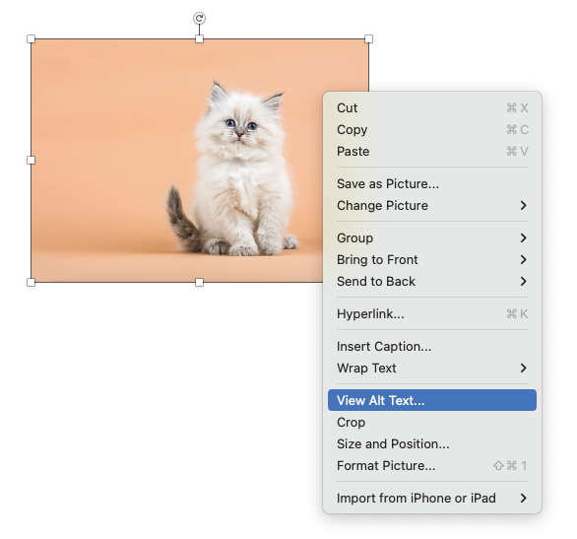
Alt Text in Microsoft Word & PowerPoint (desktop)
Right click image to show context menu
Select “Add Alt text” or “View Alt Text” from the menu

Slide 6
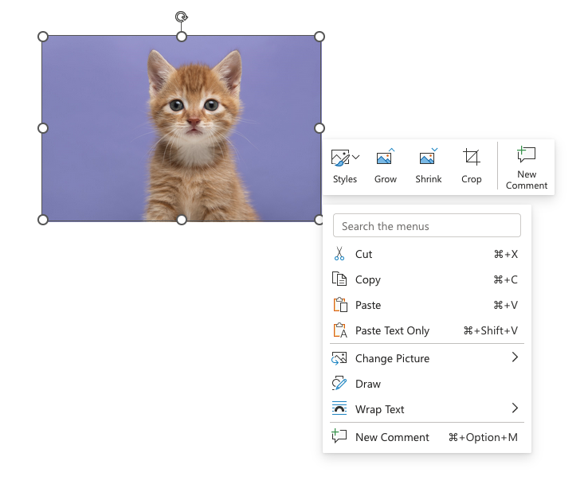
Alt Text in Word & PowerPoint for the Web
In Office for the Web, there is no option to add or edit alt text. This critical option is hidden by default. Users must know to type “Alt” in the search field in order to reveal menu options for adding or entering alt text.

Slide 7
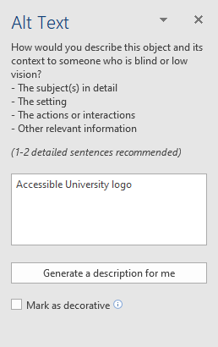
Alt Text Panel (Word desktop, PPT desktop & web)
Images that are purely decorative, select “Mark as decorative” checkbox
“Generate a description for me” automatically creates a description, but use with caution (or not at all)

Slide 8
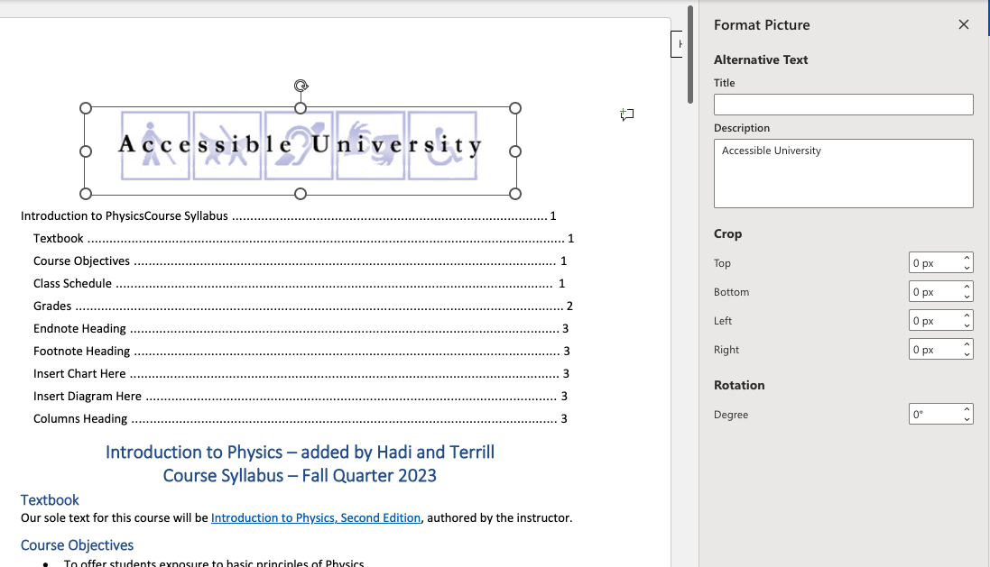
Format Picture Panel (Word for the Web)
Add Alt text in "Description" field
Optionally, add “Title” but:
Know that “Title” will not survive if document is exported to PDF
Can’t mark images as decorative

Slide 9
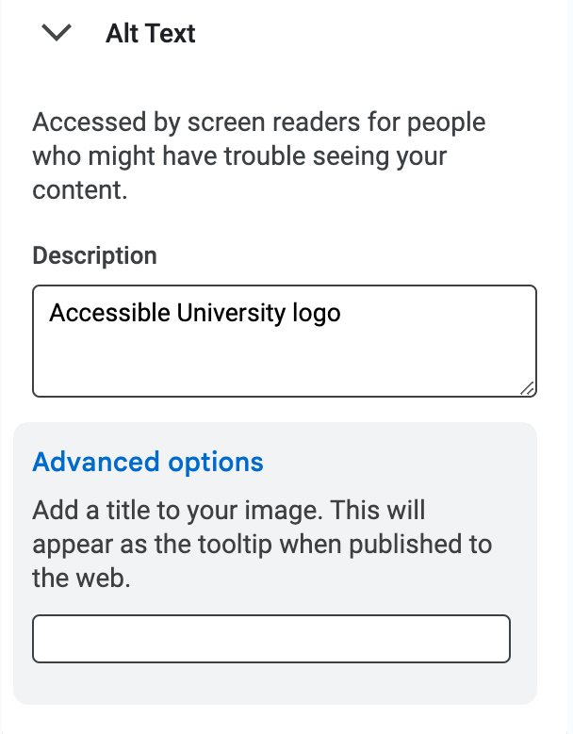
Alt Text in Google Docs & Google Slides
Right click image
Select “Alt text” from the context menu
Add Alt text in "Description" field
Optionally, add “Title” but:
Know that “Title” will not survive if document is exported to Word, PPT, PDF
Can’t mark images as decorative

Slide 10
Background images on Master Slide in PowerPoint Desktop only
Select the "View" tab, choose "Slide Master"
Select image, right click > Alt text
Check "Mark as decorative" checkbox

Slide 11
Background images on Master Slide (Theme) in Google Slides
There is no option to mark an image as decorative in Google products
Every image will be announced
So, they must have Alt text!

Slide 12
Technique #1: Screen Reader Support (Slide 1)
In Microsoft products (both Win and Mac), all screen readers announce alt text on images.
If an image is marked as decorative, screen readers ignored images in our original tests.
Recent tests: If an image is marked as decorative, screen readers announce “Decorative image” (probably MS bug).
In Google products, screen readers announce the title (prefaced with “Alt text title:”) followed by the description (prefaced with “Alt text description:”).

Slide 13
Technique #1: Screen Reader Support (Slide 2)
JAWS and Narrator read images from Master Slide if they have alt text; NVDA and VoiceOver do not .
Conclusions:
Images you want to be read should not be on the Master Slide – they won’t be read reliably
If you follow the above advice, images on the master slide will all be decorative. Therefore, do not add alt text to images on the Master Slide (since some screen readers will read them).

Slide 14
Converting to PDF
Google does not support tagged PDF.
Grackle fixes this.
PowerPoint for Mac does not support tagged PDF.
There are many ways to export from Microsoft Office in Windows
All methods result in similar output.
Look for a checkbox or radio button to enable tags and be sure it’s checked!

Slide 15
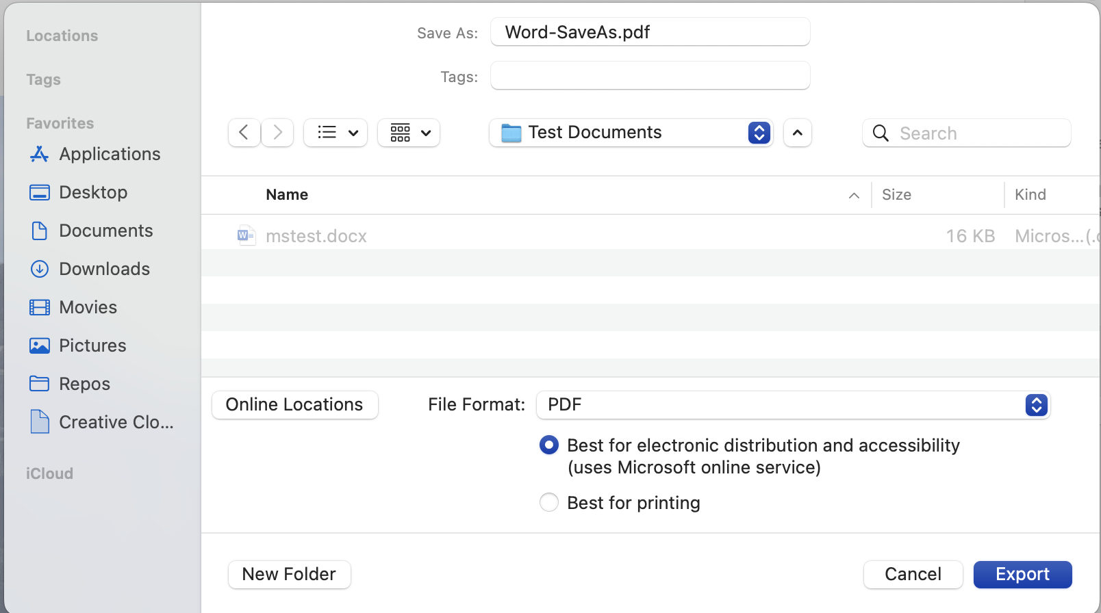
Save As… PDF

Slide 16
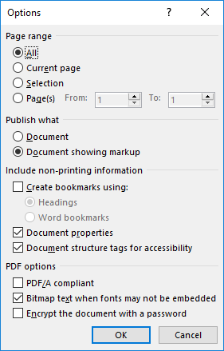
Export > PDF
In “Options”, be sure “Document structure tags for accessibility” is checked
If you chose “Minimize size” (outside of the Options dialog), that will uncheck the above checkbox. Be sure to check it back on.

Slide 17
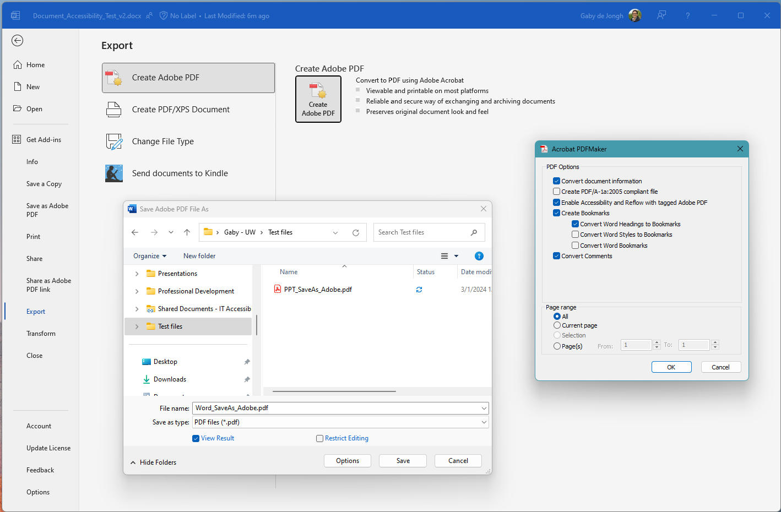
Export > Create Adobe PDF (PDFMaker)

Slide 18
Technique #1: Results after Export
Google cannot export to tagged PDF.
With the Grackle plugin, the description is passed to the <Figure> tag in PDF (the title is lost)
In Microsoft products:
Alt text is passed to the <Figure> tag in PDF
Images marked as decorative are not included in the tag tree of the PDF (i.e., they are hidden to screen readers)
Exporting to Word Desktop:
From Google: Only description survives (not title).
From Word Online: The title and description are combined as one text string in alt text field

Slide 19
Technique #2 Complex Images + Alt Text

Slide 20
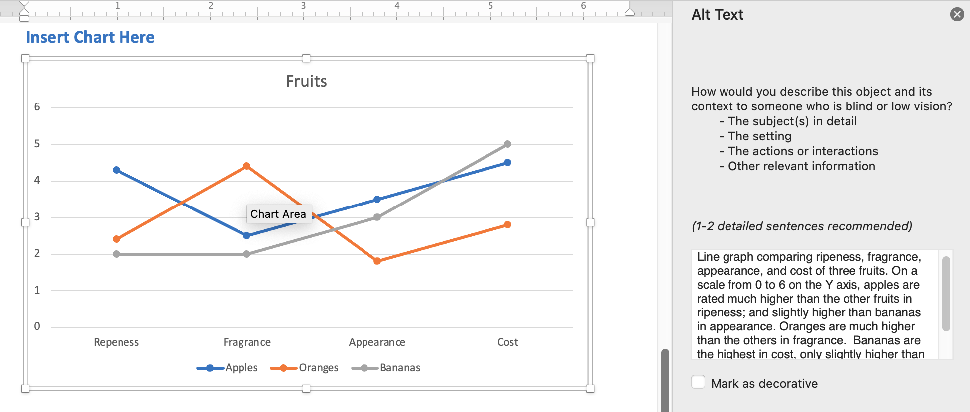
Complex images in Word & PowerPoint – Charts and Graphs
Select object ensuring entire chart (not individual components) is outlined
Word & PowerPoint desktop:
Right click, select "View Alt text" from context menu
Word & PowerPoint for the Web:
Adding charts or graphs is not supported

Slide 21
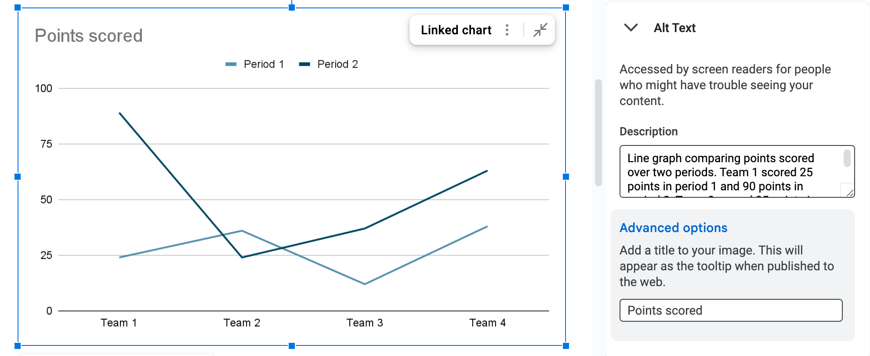
Complex images in Google (Charts, Graphs, Diagrams)
Select object ensuring entire chart is outlined
Google Docs & Slides:
Right click, select "Alt text" from context menu
Add Alt Text in "Description" filed (Title is optional)

Slide 22
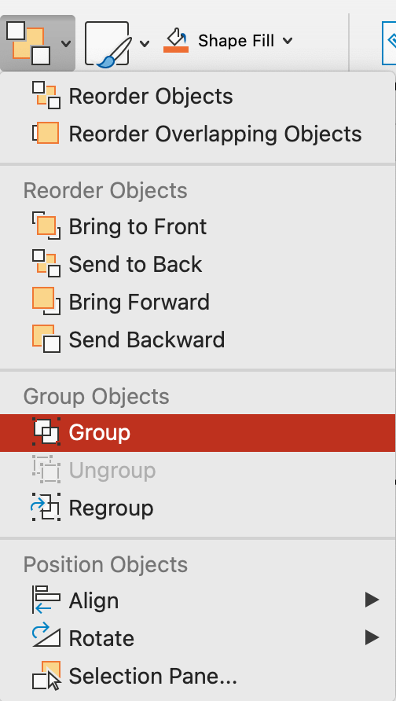
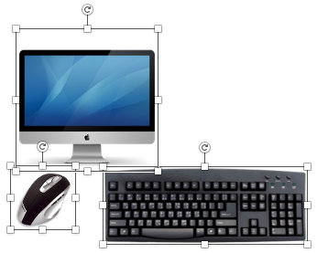
Complex images in PowerPoint - Grouping
Select all images in the group
From the Home ribbon choose "Arrange" drop down and choose "Group"
Then provide alt text for the Group

Slide 23
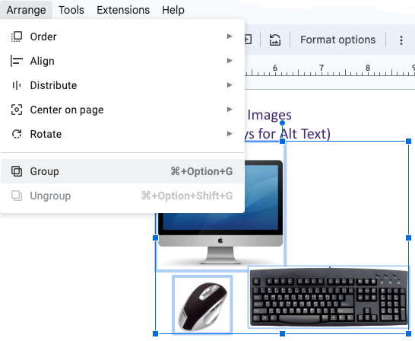
Complex images in Google Slides – Grouping
Select all images in the group
Choose "Arrange" from the menu and choose "Group"
IMPORTANT! It is not possible to add Alt text to a group in Google

Slide 24
Technique #2: Screen Reader Support
Grouped images in PowerPoint: Screen readers are inconsistent:
NVDA does not announce alt text on grouped images in PowerPoint.
JAWS and Narrator (correctly) announce the alt text on the group and ignore components.
VoiceOver (Mac) announces the alt text on the group, then makes exploring the group components optional.
Graphs, charts, and diagrams
Our expectations (not currently met):
Screen readers read alt text as a summary
Users can drill in to explore details if desired
All charts, graphs, and diagrams are consistent

Slide 25
Technique #2: Results after Export from Word or PowerPoint to PDF
This is messy. Results vary. So many variables:
Word vs PowerPoint
Export method
Desktop vs Online
Example: Grouped images
If individual components have alt text, the result is a <figure> for the entire group with alt text; plus nested individual component <figure> tags inside that, also with alt text. Testing with JAWS & NVDA reveal that only the alt on the parent <figure> is announced.
If individual components are marked as decorative: the entire collection is artifacted (i.e., not included in the PDF tag tree). There is no outer <figure> tag with alt text.

Slide 26
Technique #3 Headings & Slide Titles

Slide 27
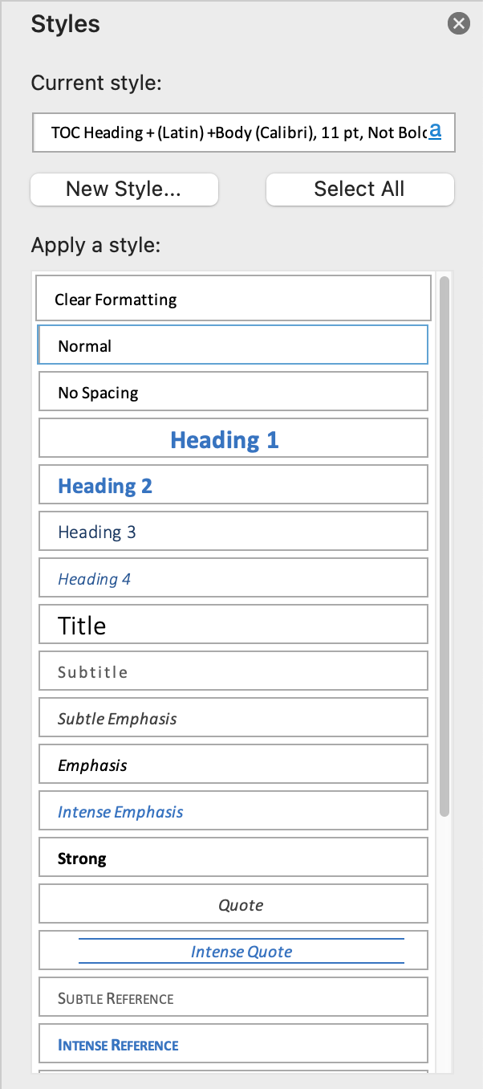
Headings in Word
Use Heading Styles from Home ribbon
Making text big and bold does not make it a heading

Slide 28
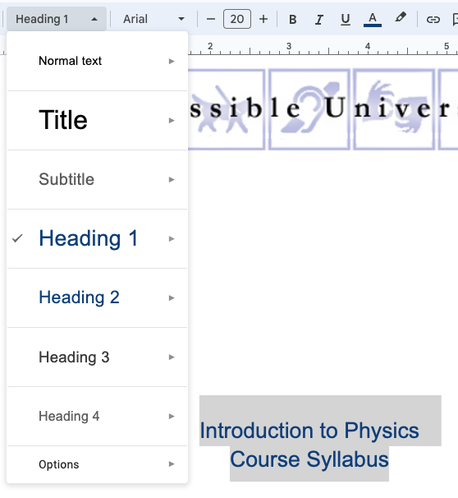
Headings in Google Docs
From the menu bar
Select the proper Style from the Rich Text Editor drop down

Slide 29
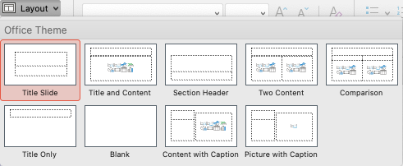
Slide Titles in PowerPoint & Google Slides
Slide titles act as headings
Every slide must have a unique slide title
Use Templates and built-in Layouts

Slide 30
Technique #3: Screen Reader Support
Screen readers can read headings in all tools.

Slide 31
Technique #3: Results after Export
Google does not support tagged PDF.
Headings always survive from Microsoft to PDF.
When exporting from PowerPoint to PDF:
Slide titles are exported as <H1> from the “Title Slide” layout within the template
Slide titles are exported as <H2> from all content slide layouts within the template

Slide 32
Technique #4 Lists

Slide 33
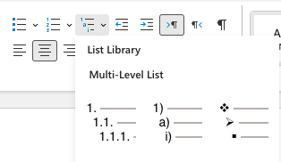
Lists in Word & PowerPoint
From the Home ribbon, choose Bulleted, Numbered, or Multilevel

Slide 34
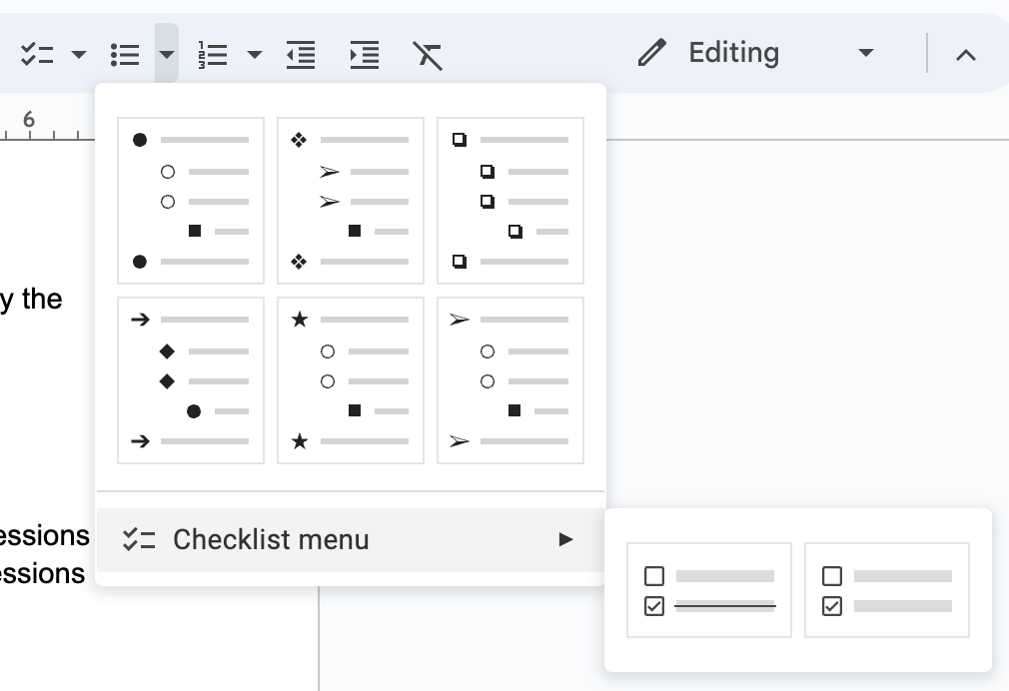
Lists in Google Docs & Slides
From the menu bar select
checklist
bulleted list
numbered list

Slide 35
Technique #4: Screen Reader Support
Screen readers generally support lists. However…
Word for the Web
Lists are not lists
Each list is a <div> and each list item is a <p>
There is no ARIA role=“list” or role=”listitem”

Slide 36
Technique #4: Results after Export
Google does not export to tagged PDF.
From Word and PowerPoint to PDF:
Lists are tagged appropriately as lists.
PDF only includes an <L> tag, not <UL> or <OL>.
NOTE: This is even true when saving as PDF from Word for the Web, despite the list not being a list!

Slide 37
Technique #5 Tables

Slide 38
Tables in Word & PowerPoint
Simple tables can be made accessible by defining the table header(s)
Table Design tab, select the proper row/column option(s)
Check “Header Row” for column headers
Check “First Column” for row headers
“Banded Rows” is for visual purposes only
Complex tables should be simplified for clarity

Slide 39
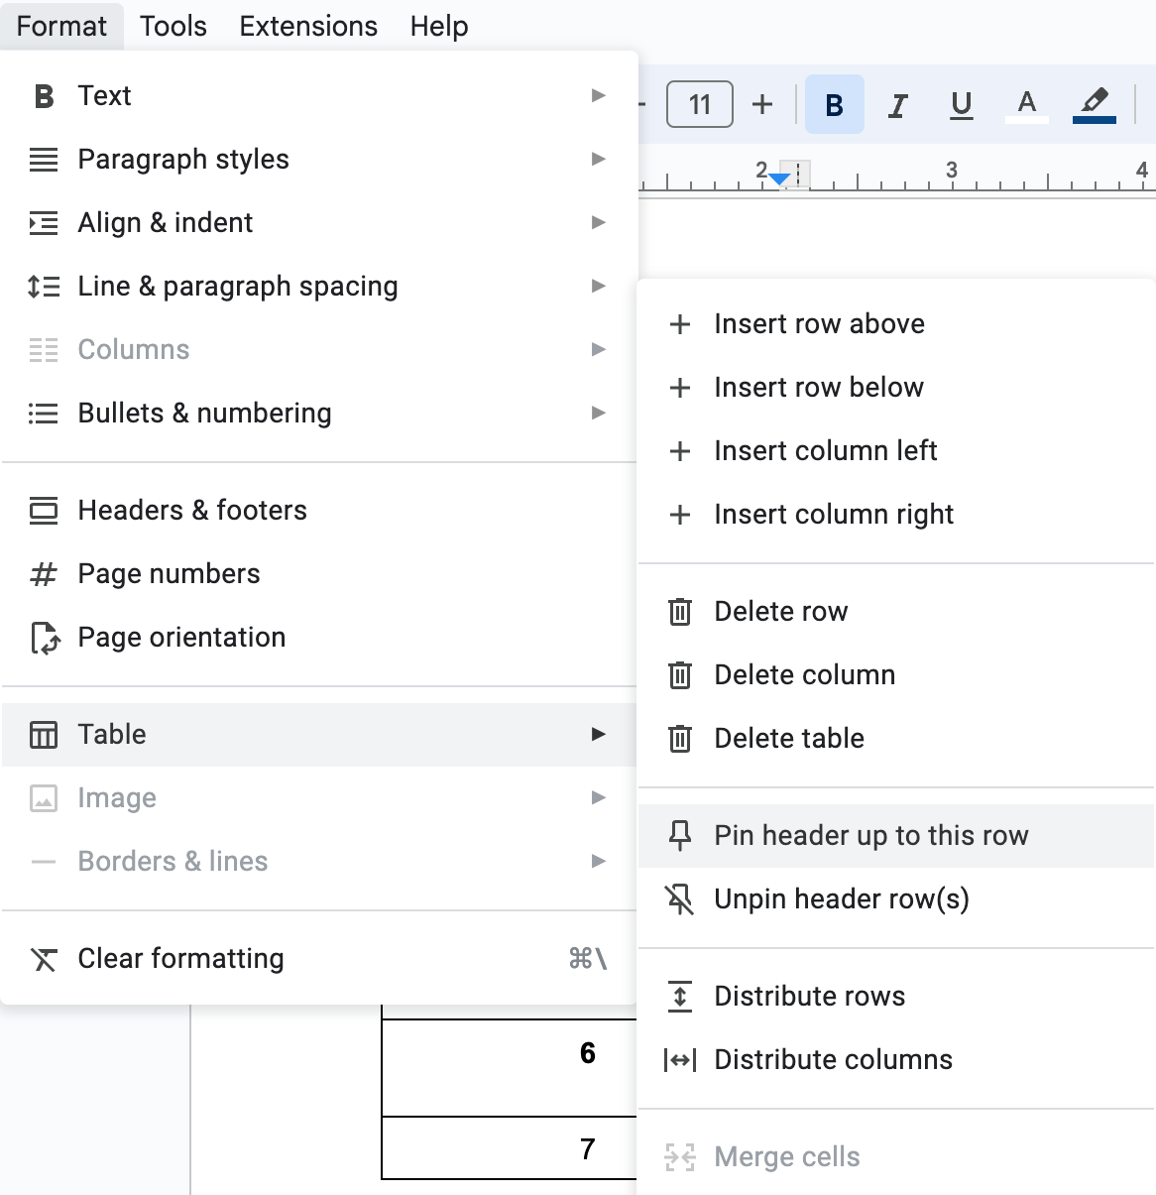
Tables in Google Docs
Select top row of table
From the menu bar choose "Format," then "Table" > "Pin header up to this row"
In Google Slides it is not possible to pin a header row in a table

Slide 40
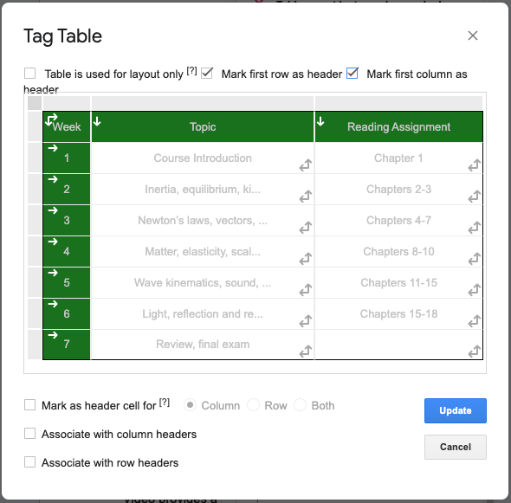
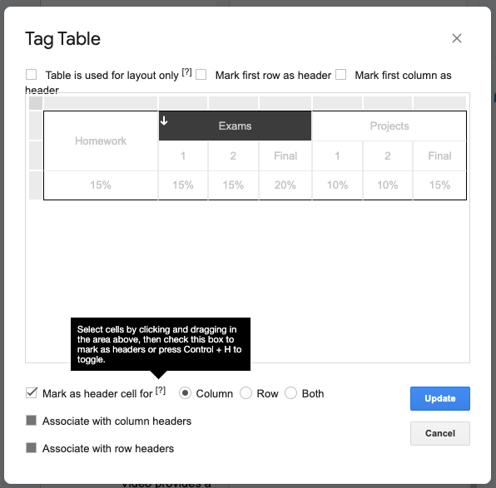
Tables can be tagged using Grackle Docs

Slide 41
Technique #5: Screen Reader Support
Simple tables in Word are generally well supported, we think
“Header Row” (for columns headers)
“Left column” (for row headers)
Complex tables are not (this is not unexpected)
Narrator announces the rowspan and colspan, which can be very helpful information for figuring out a complex table. No other screen readers do this.
BUG: In PowerPoint (not Word), NVDA reads the table's content, but does not recognize it as a table. Table navigation keys do not work.

Slide 42
Technique #5: Results after Export
In Word or PowerPoint:
If “Header Row” and/or “Left Column” are checked, simple tables are properly tagged in PDF.
Word and PowerPoint have no mechanism for marking up complex tables. These will need to be tagged in PDF after export.
Google does not support tagged PDF.
Grackle Docs “automatically tag tables” feature results in a properly tagged complex table from Google Docs, with colspan, rowspan, and headers attributes.
Grackle Slides (possible bug): If using their dialog to add row headers, that does not result in row headers and strips out column headers. Requires more investigation.

Slide 43
Technique #6 Links

Slide 44
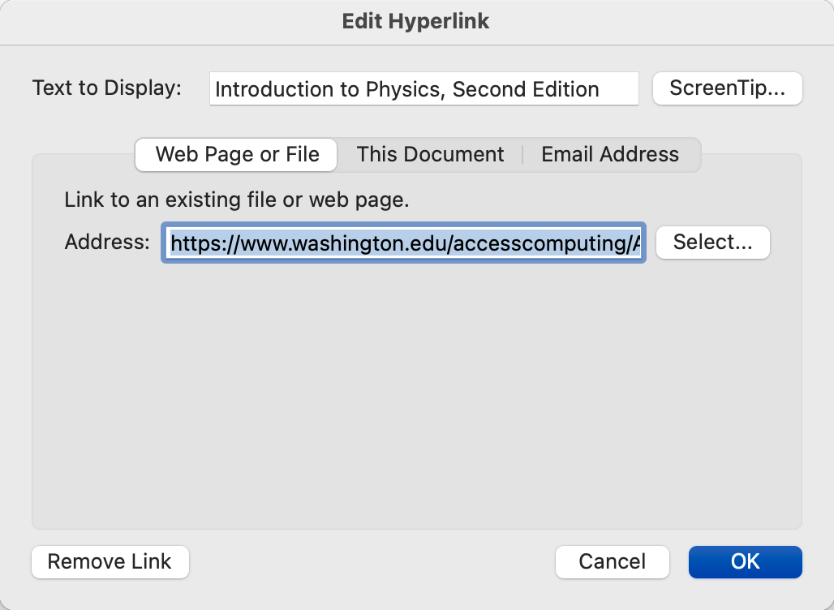
Links in Word, PowerPoint, Google Docs & Slides
Select text, then right click and select “Hyperlink” from context menu
Enter URL in Address field

Slide 45
Technique #6: Screen Reader Support
Apparent bug with NVDA in PowerPoint desktop:
In slide show mode: NVDA does not announce “link” when reading content. The user can tab to the link, but the link text is not announced. (pressing Enter to trigger the link does work).
In edit mode: NVDA does not announce “link” when reading. The link is discoverable if browsing with arrow keys.
Other screen readers read links in-line.

Slide 46
Technique #6: Results after Export
Google does not support tagged PDF.
In Word and PowerPoint:
Links are exported properly to PDF as <Link - OBJR>

Slide 47
Technique #7 Document Title

Slide 48
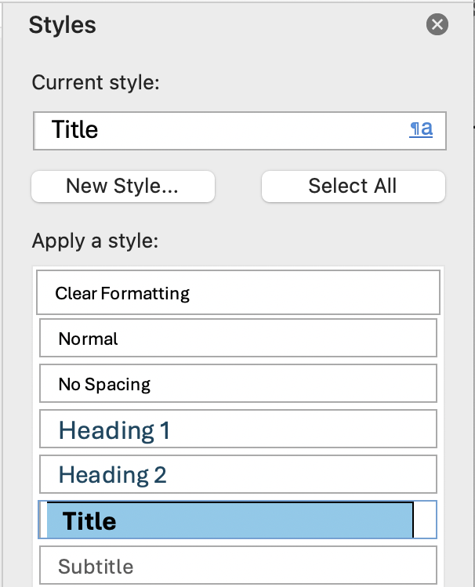
Document Title in Word & PowerPoint
Office Desktop apps
In Windows: File > Info > Show All Properties
In MacOS: File > Properties > Summary tab
Title style is not the same as Document Title
Title styles are just paragraphs <P> when exported to PDF
In Word & PowerPoint for the Web, the file name appears in an editable field in the upper left. This is used in a <title> element.

Slide 49
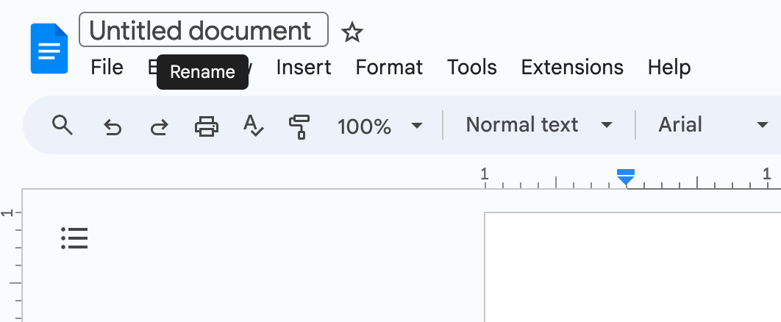
Document title in Google Docs & Slides
Add Document Title In the upper left text field

Slide 50
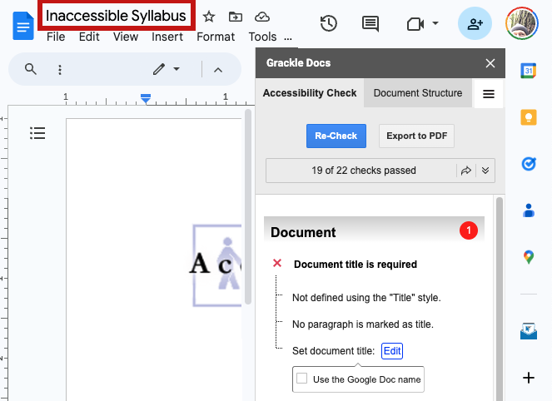
Document Title not recognized by Grackle

Slide 51
Technique #7: Screen Reader Support
Titles are well supported by screen readers.

Slide 52
Technique #7: Results after Export
Word for the Web and Google Docs:
The file name (i.e., <title>) is not passed to the PDF as the document title (as would appear in Document Properties).
Author is passed to the PDF.
Reminder: In Word desktop, Title styles are just paragraphs <P> when exported to PDF (“Heading 1” style is exported as <H1>).

Slide 53
Technique #8 Language

Slide 54
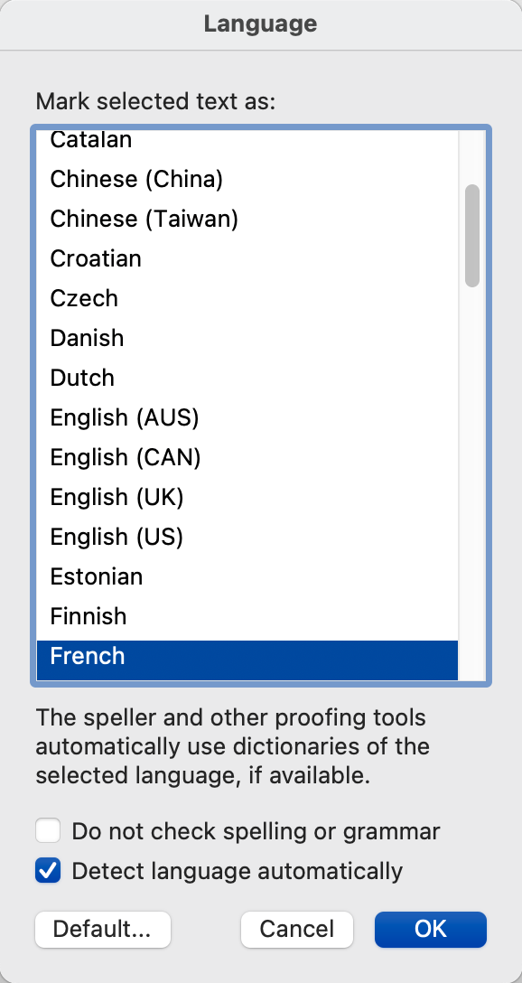
Language in Word and PowerPoint
To set the document language:
From the Review tab select “Language”
Choose proper language from the list
To set ”language of parts”:
Select the foreign language text
Repeat the above process
It is not currently possible to assign language in:
Word or PowerPoint for the Web

Slide 55
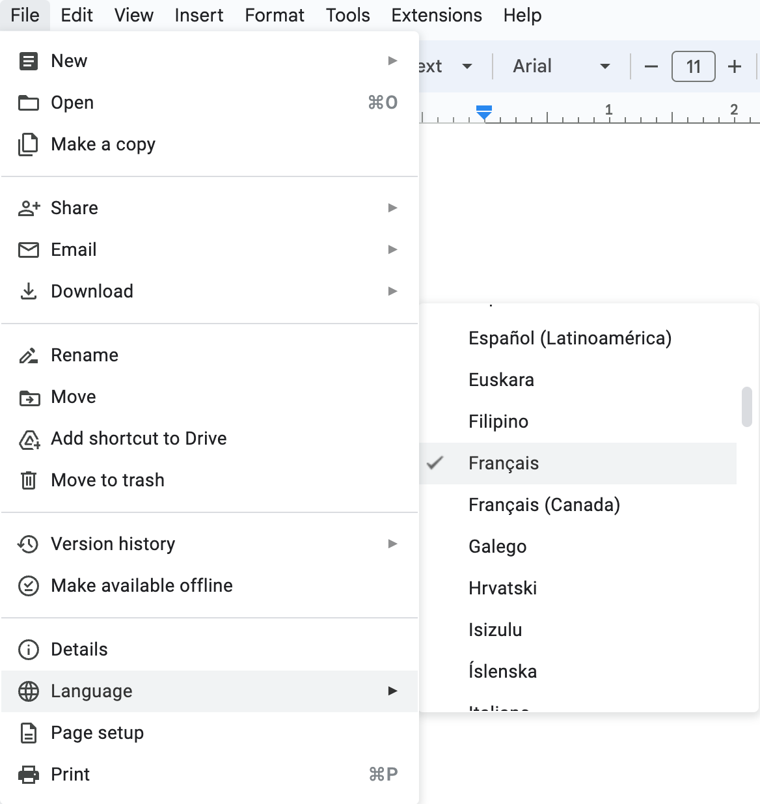
Language in Google Docs & Slides
From the File menu choose "Language”
It is not possible to set a different language for foreign language parts within a document. (Grackle doesn’t fix this).

Slide 56
Technique #8: Screen Reader Support
Language changes in Microsoft desktop apps are dependent on speech synthesizer
NVDA supports it with eSpeak
JAWS supports it with Eloquence
In Narrator, Microsoft Jenny (Natural) does not recognize the language change. Microsoft David says (for example) "Enter French" before reading French content but does not pronounce the content in French.
Identifying the document language in Google does not trigger an automatic pronunciation change for screen readers, even with synthesizers that support language changes in Microsoft

Slide 57
Technique #8: Results after Export
Language of the document and language of parts survives the export from Word and PowerPoint to PDF.
Language of the document does not survive the export from Google Docs or Slides to PDF.

Slide 58
Technique #9 Read Order

Slide 59
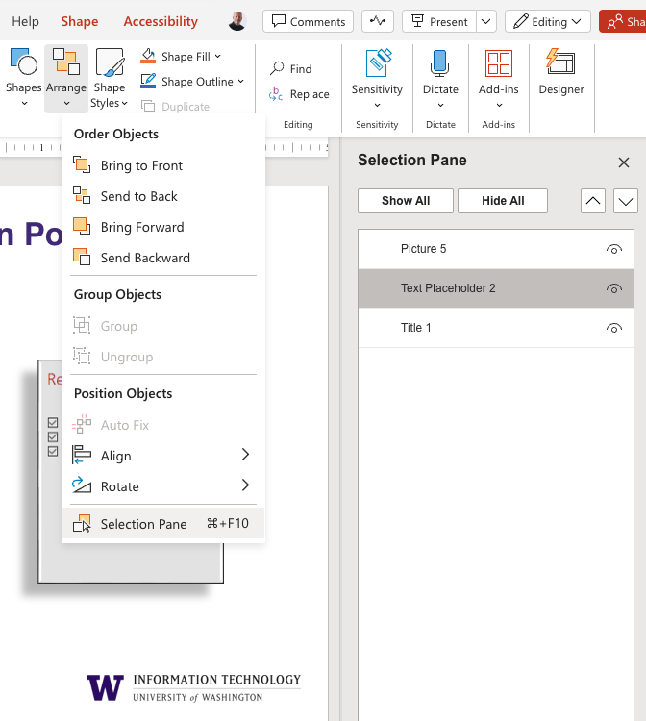
Selection Pane in PowerPoint
Arranged in reverse order, bottom to top
From the Home ribbon
Select the “Arrange” drop down then “Selection Pane”

Slide 60
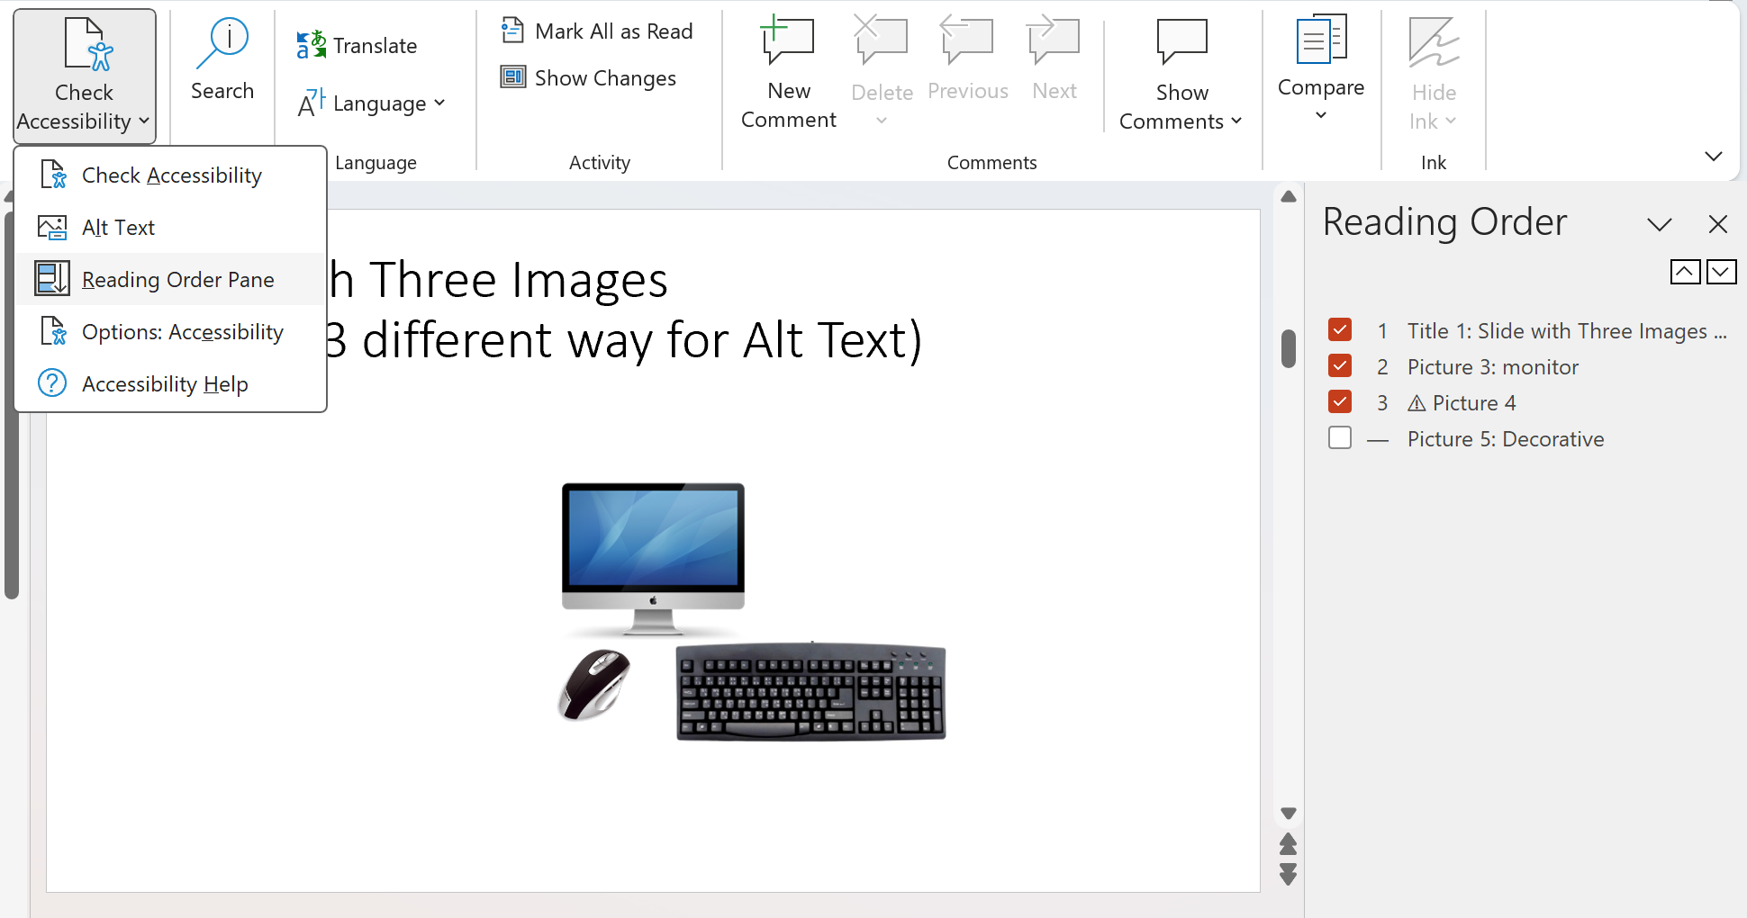
Reading Order Pane in PowerPoint (Windows desktop only)
Arranged top to bottom
From the Review tab
Select ”Check Accessibility” then “Reading Order Pane”

Slide 61
Controlling read order in Google Slides
Google Slides provides no means of controlling reading order.

Slide 62
Technique #9: Screen Reader Support
All screen readers read the slide title when the slide receives focus.
Then, all Windows screen readers read slide content in the expected order
From bottom to top as listed in Selection Pane
From top to bottom as listed in Reader Order Pane
VoiceOver (MacOS) always reads content from top to bottom.

Slide 63
Technique #10 Accessibility Checker

Slide 64
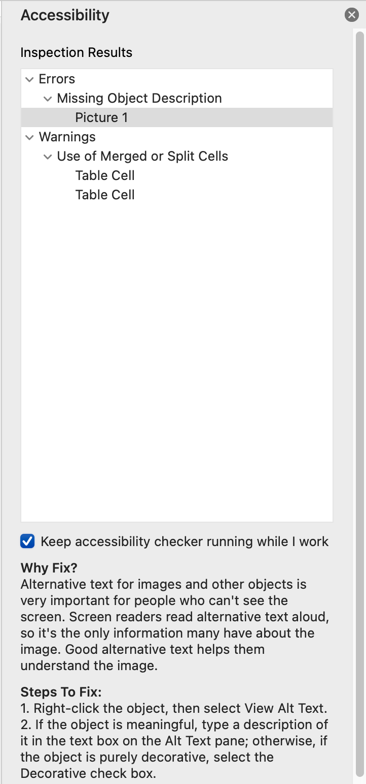
Checking accessibility in Word and PowerPoint
From the Review tab
Select "Accessibility" from the ribbon
Explanations and Steps to Fix are provided

Slide 65
Checking accessibility in Google Docs & Slides
There is no accessibility checker.
Grackle fills this gap.

Slide 66
Conclusions

Slide 67
Documents & Slides
Google does not support tagged PDF.
If content will ultimately be saved to PDF, use Microsoft.
NOTE: Grackle fixes this Google limitation.
Google does not include an accessibility checker.
Grackle fixes this too.

Slide 68
Slides
Google does not support alt text on grouped content.
For many slides, this is a major limitation. Grackle does not fix it. Use PowerPoint instead.
PowerPoint does not support tagged PDF on a Mac
If a PDF is needed, use Windows or Web versions of PowerPoint to export.

Slide 69
Authoring in Google, Saving as Microsoft
If you author in Google and download to Microsoft:
Anything Google does not support will need to be added in Microsoft (e.g., table headers, language, alt text on grouped image)
Be sure to run the Microsoft Accessibility Checker!
Also, note that checking/fixing read order in PowerPoint might be tricky (“Google Shape;72;p14”)

Slide 70
An opportunity

Slide 71
What to do with all this knowledge
Access Technology Higher Education Network (ATHEN) and American Foundation for the Blind (AFB) are collaborating to continue this project.
Crowdsource testing to validate results
Test on more platforms / devices
Write a white paper to summarize findings
File bugs; engage with vendors
Want to help? Complete this survey: https://tinyurl.com/microsoft-google-survey

