Slide 1
Video Accessibility Part 2: Strategies for Addressing Video Accessibility in Higher Education
tft@uw.edu & gabyd@uw.edu
UW-IT Accessible Technology Services (ATS)
University of Washington
https://uw.edu/accessibility/video

Slide 2
How UW Does Accessible Video
Disability Resources for Students (DRS) and Disability Services Office (DSO) provide funding and support for captioning and audio description if individuals request it as an accommodation
UW-IT Accessible Technology Services (ATS) provides internal grant funding for captioning high impact videos proactively
ATS provides training and support
YouTube Caption Auditor (YTCA) is used to raise awareness and provide reinforcment

Slide 3
Which videos are the highest priority?
Videos that are required viewing for students who need description (an accommodation)
Videos that are likely to be required viewing for students who need description
Videos that:
Are popular
Are relatively new
Provide critical content
Notes:
Discuss Demo 1 again; show Demos 2 & 3

Slide 4
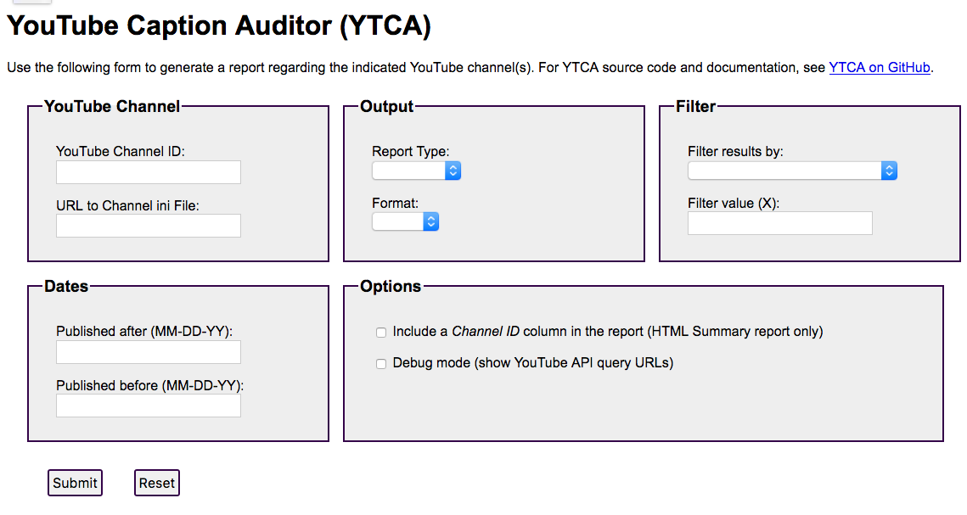
YTCA can help with prioritizing.
https://github.com/terrill/ytca
Notes:
Show Demo 4

Slide 5
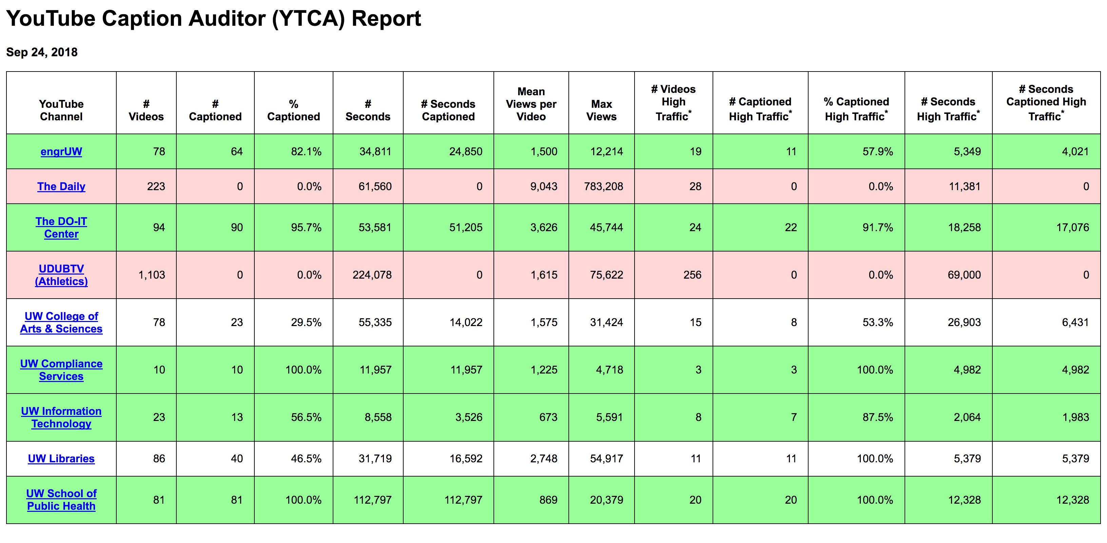
Sample YTCA “Summary” Report
Notes:
Show Demo 4

Slide 6
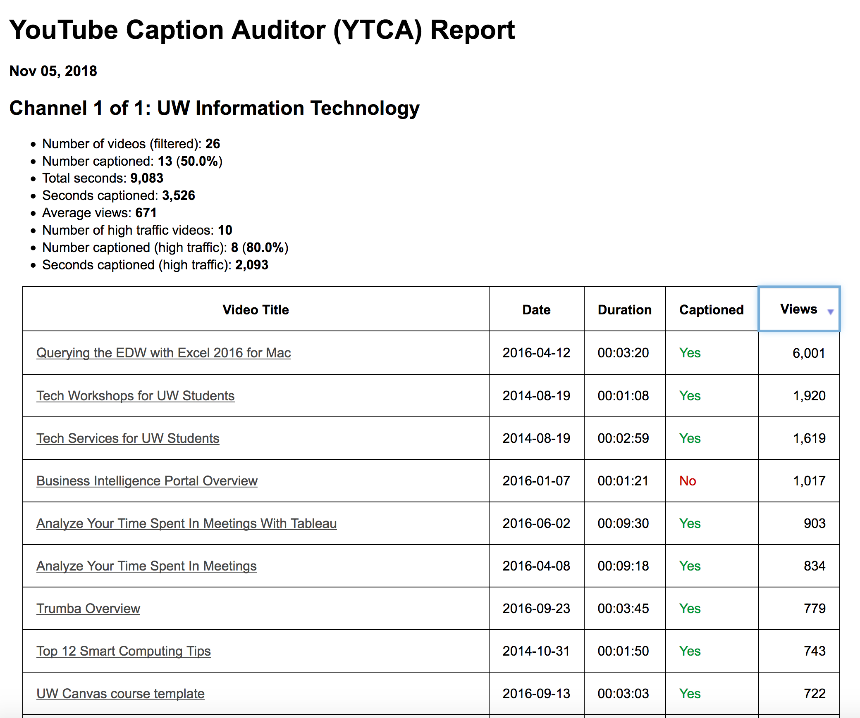
Sample YTCA “Details” Report
Notes:
Show Demo 4

Slide 7
Why Making Accessible Video Isn't an Undue Burden
Cost of Producing a 10-minute documentary-style video: $10,000
Cost to caption (@ $2/min) = $20 (0.2%)
Cost to describe (@ $10/min) = $100 (1%)
Cost to DIY (captions or description) = practically FREE

Slide 8
For More Information…
UW Accessible Technology http://uw.edu/accessibility
Creating Accessible Video http://uw.edu/accessibility/videos
DO-IT Videos http://uw.edu/doit/videos

