Slide 1

Systems librarian roles & responsibilities

Slide 2
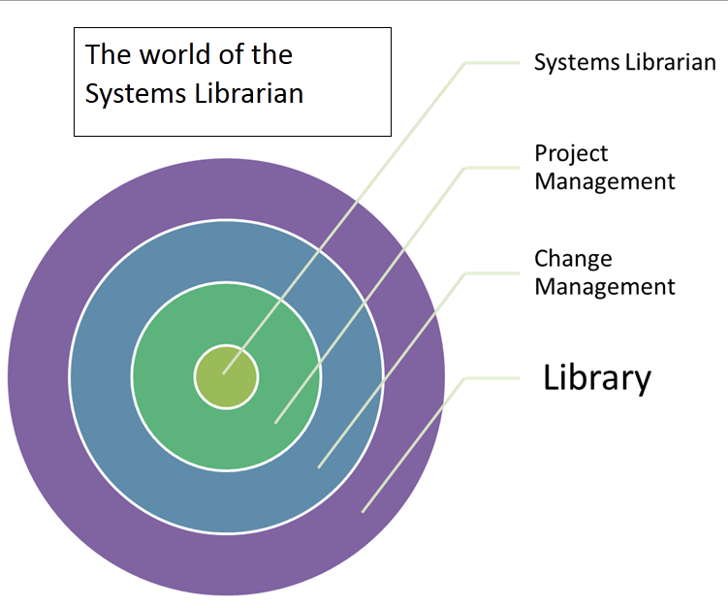

Slide 3
Definition
“Systems Librarians specifically concentrate on supporting library operations through the application of technologies…They seek to manage the organizational technological resources in a manner that best serves all departments within a library”
Thomas C. Wilson
The Systems Librarian: Designing Roles, Defining Skills

Slide 4
Systems
Librarian
Public services
Technical Services
Library
patrons
Software vendors
IT
Departments
Library
Management

Slide 5
Organizational place in library
Reference/Public Services Dept.
  Automation of circulation functions
Technical Services Dept.
  Automation of “back-room” functions (serials, acquisitions) and catalog
Computer Services/System Depts.
  Automation of all library functions as specialization

Slide 6
System Librarian duties, part one
Managing integrated library system
  Implementing system
  Hardware & software upgrades
  Data migration
Training staff and patrons
Planning and budgeting
New technology exploration & evaluation
Interface of system with other vendor systems (OCLC, Oracle, etc.)

Slide 7
System Librarian duties, part two
Desktop computing
  May be responsible for all software running on staff computers
Writing software programs to enhance system features
Performance monitoring and troubleshooting
Design and planning for new system migration

Slide 8
Roles of System Librarians, part one
DESIGNER: Provide input into the design of software and automated systems
PLANNER: Provide planning support for budget, personnel, etc., as part of the library management team
IMPLEMENTOR: Provide for the implementation of software packages or large scale automation projects

Slide 9
Roles of System Librarians, part two
CONSULTANT: Provide consultation on library projects that may have technology component
TECHNOLOGY REPRESENTATIVE: Serve as the library’s technology representative to senior management or outside organizations

Slide 10
Roles of System Librarians, part three
FACILITATOR: Serve as the facilitator between various groups seeking to use technology to address library problems
Thomas C. Wilson
The Systems Librarian: Designing Roles, Defining Skills

Slide 11
System Librarian Qualities
Flexibility and Balance
Sound Judgment
Curiosity and Risk Taking
Follow-through & Persistence
Time management
Resource management
Firmness & Cooperativeness
Nonjudgmental approach
Skepticism
Technical realism
Perspective switching
Resiliency
Technical aptitude
Thomas C. Wilson
The Systems Librarian: Designing Roles, Defining Skills

Slide 12
work issues
Should systems librarians actually do the technical work themselves?
How should libraries divide up duties between “managing” the work and “doing” the technical work?
Is it easier to train a computer specialist to do library work or a librarian to do computer work?

