Slide 1
Project Management

Slide 2
Project Management Diagram
DEFINE
PLAN
IMPLEMENT
MONITOR
ADJUST
EVALUATE
CELEBRATE
Making Project Management
Work for You--Liz MacLachlan, 1996

Slide 3
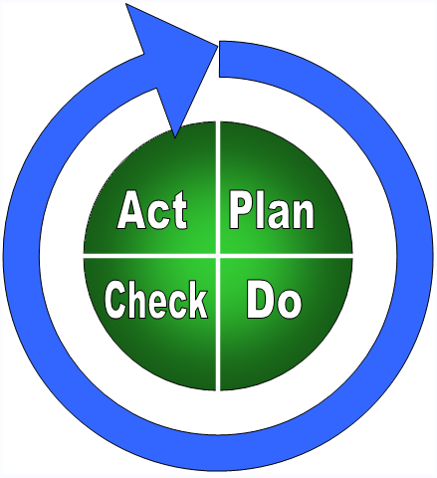
Project Management Plan

Slide 4
Step One: Set project goals
Determine what is the ultimate goal of project
Describe relationship to other projects underway or anticipated in the future

Slide 5
Step Two: Project description
Develop complete description of the project.
Avoid jargon
Translate technical terms as necessary

Slide 6
Step Three: Review technology
Decide which new technologies will be used
What are the benefits?
Decide which standards are being adopted
What are the benefits?
Document which (if any) standards specifically being ignored
What are the drawbacks & benefits?

Slide 7
Step Four: Identify team/resources
State assumptions about resources allocated to this project
People
Equipment
Facilities
Support & outside services
Develop communication plan for other staff or departments impacted by project
Develop budget

Slide 8
Step Five: Write procedures
Document procedures that will be used for project work
Highlight any procedural differences from regular projects of this type
Discuss requirements, benefits, and issues of using new procedures

Slide 9
Step Six: Develop schedule
Develop schedule milestones and deadlines
Phase 1
Phase 2
Phase 3
Jan
Feb
Mar
Apr
May
Jun
July
Sep
Oct
Nov
Dec

Slide 10
Step Seven: Develop plan to monitor current status
Develop plan to measure progress against schedule
On-track in what areas
Behind in what areas
Ahead in what areas
Anticipate and track unexpected delays or issues

