Slide 1
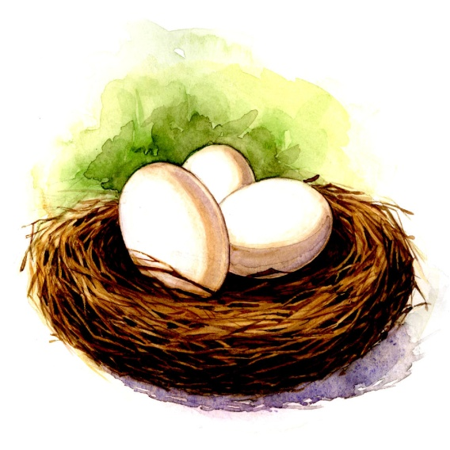
Project Management exercise
Project Goal: To design and construct a container that will allow an egg to be dropped from a height of 8 feet to the floor without breaking.

Slide 2
Instructions
Step One: Divide into 3 equal groups
Step Two: Sub-divide each group into two separate sub-groups: designers & builders

Slide 3
Instructions
Step Three: Choosing from the available supplies, the designers will design a container and develop instructions on how it should be constructed.
Step Four: Based on the design plan, the builders will construct the container per the instructions.

Slide 4
Instructions
Step Five: Upon completion of the container, each team will drop the container and egg from a height of 8 feet.
If the egg survives the fall without breaking, that team has successfully met the project goals.

Slide 5
Rules
The designers may NOT solicit input when designing the container.
The builders may NOT communicate questions to the designers when constructing the container.
The builder must build the container EXACTLY as designed.

