Slide 1
V2G
Vehicle to Grid

Slide 2
V2G
Electric Grid → Vehicle battery: Charging your car
Electric Grid ← Vehicle battery: V2G
Most important purpose: stabilizing the electric grid when most of our
electricity comes from solar/wind which are highly variable
EV batteries often store 50 to 100 kWh of energy.
Millions of these can absorb energy when it is abundant and send it to
the grid when it is scarce, thus largely solving the biggest problem of
solar and wind, which are highly variable
Potentially low cost as the batteries are already bought as part of a car

Slide 3
V2G
Main problem with V2G: battery cycles sent to the grid age the battery
and reduce the cycles for driving
It is not clear how much this ages the battery, or even if it does age it
One factor that ages batteries is depth of discharge. When driving an
EV uphill or accelerating, you can easily discharge at the rate of 50 to
100 kW. In contrast, discharge rates with V2G would be less than 1/10
of that rate
Most studies indicate some aging, but one study said that the gentle cycling
with V2G would actually improve the battery life

Slide 4
V2G
For our purposes we will assume that battery cycles sent through
V2G have the same aging effect as driving
The average American family owns two cars which are driven a
combined 20,000 miles per year
We will assume that each car is driven about 10,000 miles/year, and
that one of them is usually at home during the day, so it is there to
participate in V2G

Slide 5
V2G
Tesla batteries appear to retain 80% of their capacity even after 500,000
miles
But at 10,000 miles/year, it would take 50 years to travel 500,000 miles!,
but it is unlikely that the calendar life of a battery would last that long.
So there is absolutely no reason not to use the car battery for other
purposes, such as V2G
Since many EVs, such as Tesla Model 3, get about 4 miles/kWh, and if we
assume that the V2G cycles use the same energy as driving 10,000
miles/year, then each year we send (10,000/4) = 2,500 kWh back to the
grid using V2G, which should earn us at least $250/year

Slide 6
V2G
If we drive 10,000 miles/year, and use the equivalent of 10,000
miles/year in using V2G, then after 25 years we have “driven” the
equivalent of 500,000 miles
So if our battery capacity is down 20% we might want to get a new battery
But we have earned over $6000 ($250/year for 25 years: actually more
due to inflation) over those 25 years
And if we sell our used battery (with 80% capacity) to a battery farm, the
combination of our sale and the V2G money we have earned should get us
new battery for free

Slide 7
V2G
So we have benefited ourselves, as well as the world, as we have solved
the biggest problem facing renewable energy (e.g., solar/wind),
which in turn addresses the most important problem of all, climate change.

Slide 8
V2H: Vehicle to Home
Closely related to V2G is V2H: Vehicle to Home, in which the battery in
the car provides energy to your home
The average family not only owns two cars that are driven a combined
20,000 miles/year, but those two cars consume a total of about 28,000
kWh/year, when you convert the energy in the gasoline/ethanol mixture
to kWh
But EVs, such as the Model 3, get 4 miles/kWh, so two such EVs
driving a combined 20,000 miles/year, would only consume 5,000
kWh/year if they get their energy from clean sources, such as hydro,
solar, or wind, less than 1/5 (18%) of the energy consumed by gas cars

Slide 9
V2H: Vehicle to Home
The average American home consumes 11,000 to 12,000 kWh of
electricity, plus 12,000 to 14,000 kWh of heat (usually natural gas)
for a total of about 25,000 kWh/year
If you build a house to the European Passive House standards, which
increases the initial cost of the house itself by 6% (3% cost of house +
land), you cut the energy needed by a factor of 4.
If you also include the most energy efficient appliances, especially
a heat-pump water heater, you increase it to a total of a factor of 5,
or 5,000 kWh/year

Slide 10
V2H
The energy used at present for our current house + gas cars combination
is 25,000 + 28,000 = 53,000 kWh/year
The energy for the new passive house + electric cars combination
(when the electricity comes from clean sources such as hydro, solar, or
wind) comes to 5,000 + 5,000 = 10,000 kWh/year or 1/5 (19%) of the
53,000 kWh previous total
In those parts of the U.S. which get an average amount of sunlight,
a 10 kW solar panel will start producing electricity at 12,500 kWh/year,
declining to about 10,000 kWh/year after 30 or 40 years

Slide 11
V2H
The 10 kW solar panel provides all the energy we need, but since solar
is variable and not available at night, we need two other things: a
connection to the grid and the large battery in the one car that stays at
home during most of the day
During the day, energy from the solar panel first goes to run the house,
any left over fills the car’s battery, and if the battery is nearly full, the
rest is sent to the grid via V2G
As the sunlight fades, the large battery in the car takes over and
powers the house though the next morning, and so on

Slide 12
V2H
In most areas of the country, the PV + car battery combination makes
the family almost independent of the grid for 6+ months per year, except
for brief times when the one stay-at-home car is not at home, and also
the energy sent back to the grid
I analyzed the month-by-month energy available in Minneapolis, which
gets an average amount of solar radiation, and found that during the
colder, darker, months we would need at most 350 kWh from the grid.
We double this to 700 kWh to be conservative. See the table on the
next page.

Slide 13
Energy Efficiency for Buildings
Table shows solar PV energy in Minneapolis for 30 years for 12.5 to 10.14 kW array over 30 years
Month | E-needed | E-avail at 1st year | E-Diff at 1st year | E-avail at 30 years | E-diff at 30 year
Jan | 833 | 976 | 143 | 793 | -40
Feb | 833 | 1151 | 318 | 936 | 103
Mar | 833 | 1626 | 793 | 1321 | 488
Apr | 833 | 1640 | 807 | 1332 | 499
May | 833 | 1758 | 925 | 1428 | 595
Jun | 833 | 1759 | 926 | 1429 | 596
Jul | 833 | 1884 | 1051 | 1531 | 698
Aug | 833 | 1751 | 918 | 1423 | 590
Sep | 833 | 1453 | 620 | 1181 | 348
Oct | 833 | 1118 | 285 | 909 | 76
Nov | 833 | 903 | 70 | 732 | -101
Dec | 833 | 773 | -60 | 628 | -205

Slide 14
V2H
So, we need 700 kWh from an external source, but we also have to
account for the energy needed to manufacture and install the solar panels
The most recent estimate I have is that it takes 4,000 kWh of energy to
manufacture a 1 kW solar panel. I increase this to 5,000 kWh, to cover
installation as well and to be conservative
For a 10 kW solar panel that comes to 50,000 kWh, but since it covers at
least 30 years, that comes to about 1,700 kWh/year.
So the total amount of energy we need not operate the new passive
House + EV + solar combination is 700 + 1,700 = 2,400 kWh which is just
1/22 or less than 5% of the energy we now use

Slide 15
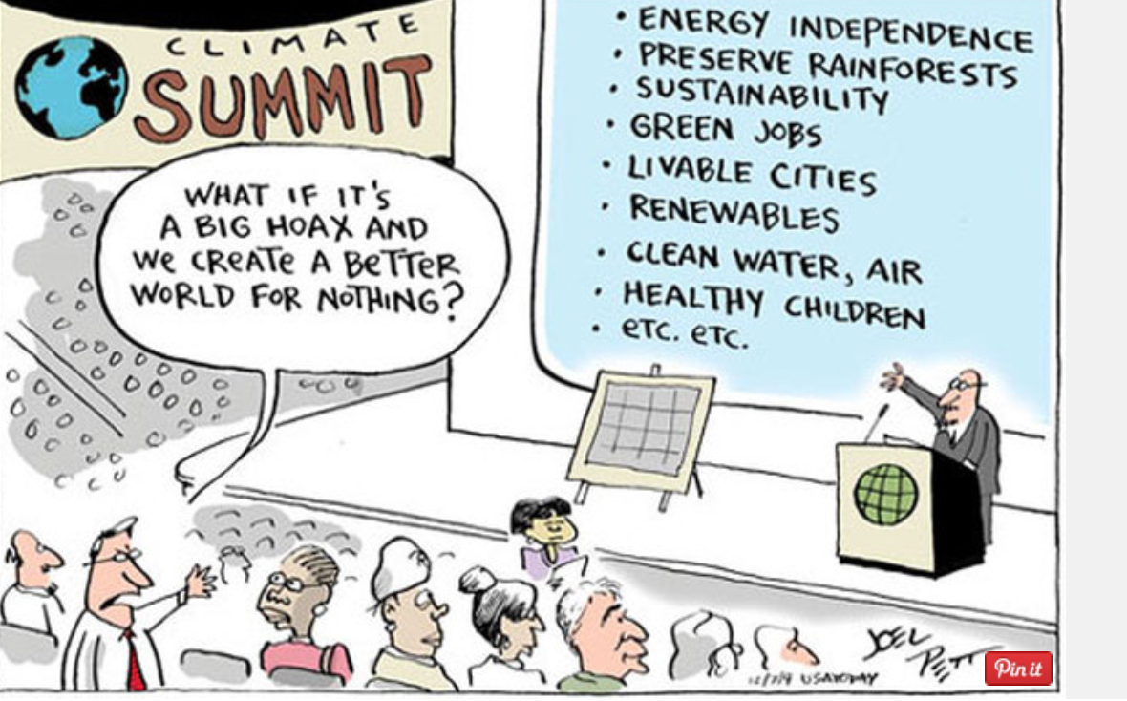
Climate Change (Cartoons)
http://politicalhumor.about.com/od/globalwarming/ig/Global-Warming-Cartoons/

