Slide 1
Cosegregation Analysis Using Custom Penetrance: AnalyzeMyVariant.org
ASHG 2019 Workshop
Interactive Introduction to Tools for
Estimating Age-based Penetrance and Pathogenicity
Brian H. Shirts, MD, PhD
Associate Professor of Laboratory Medicine
University of Washington

Slide 2
Cosegregation Analysis
Q: Does a trait tend to appear with a specific allele in a family?
One way to answer this question is with meiosis counting (Jarvik & Browning. PMID: 27236918)
N = (1/2)^{m}; m=number of meioses that are informative for co-segregation of disease with VUS
Smaller values → higher probability of pathogenicity
Major Limitations
Ignores age of onset and known penetrance for the gene
Unable to generate quantitative evidence against pathogenicity
Breast Cancer
+
+
+
+
$$N={\left(1/2\right)}^{2}=1/4$$

Slide 3
Cosegregation Analysis
More sophisticated analyses can use penetrance models to generate likelihood ratios
Thompson, Easton, & Goldgar, 2003. PMID:12900794
Mohamaddi et al. 2009 PMID:19563646
Overcome Limitations of Meiosis Counting
Incorporate age of onset and known penetrance for the gene
Able to generate quantitative evidence against pathogenicity

Slide 4
+
+
+
BrCa 65
LR = 3.2
LR = 22
LR = 275
LR = 51
+
+
+
+
+
BrCa 40
BrCa 38
BrCa 51
BrCa 50
BrCa 35

Slide 5
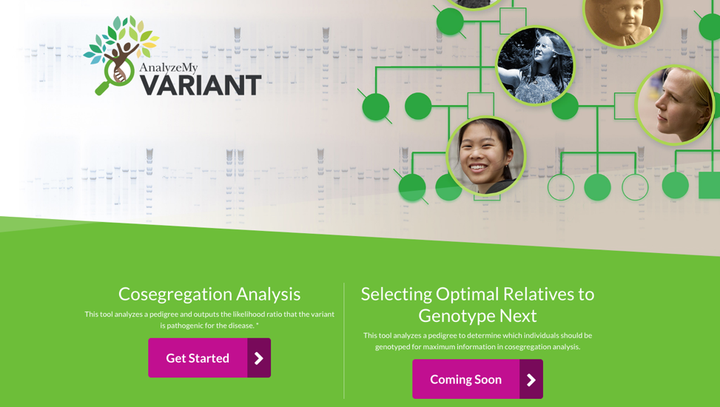
Getting Started
Get into groups of 4 or 5
Go to analyze.myvariant.org
Click on “Get Started” for Cosegregation Analysis
Notes:
You have now performed co-segregation analysis for a variant in BRCA1 - The results (LR 14.24) suggest evidence that the variant is pathogenic. These are likelihood ratios or Bayes Factors (both can be treated mathematically the same in Bayesian analysis). Results > 1 indicate evidence of pathogenicity, and results < 1 indicate evidence against pathogenicity.

Slide 6
Upload the example file - “example pedigree.xls”

Slide 7
Everyone listed in column 1 needs a mother and father.
”0” indicates no parent information
Age of disease onset, current age, or age of death, which ever is earlier
Only 1 proband allowed and 1 proband required

Slide 8
Upload the example file “example pedigree.xls”
Choose a gene type: “BRCA1”

Slide 9
Homozygous Normal | Heterozygous | Homozygous Pathogenic | Comments
8.85E-07 | 0.003451 | 0.003451 | << Class 1 female age < 20
4.0997E-05 | 0.015985 | 0.015985 | << Class 2 female 20 <= age < 30
0.00189916 | 0.12691 | 0.12691 | << Class 3 female 30 <= age < 40
0.00878848 | 0.2608 | 0.2608 | << Class 4 female 40 <= age < 50
0.0275136 | 0.4571 | 0.4571 | << Class 5 female 50 <= age < 60
0.05646 | 0.5554 | 0.5554 | << Class 6 female 60 <= age < 70
0.0793 | 0.6449 | 0.6449 | << Class 7 female 70 <= age
7.58E-08 | 0.000114 | 0.000114 | << Class 8 male age < 20
0.0000012 | 0.0018 | 0.0018 | << Class 9 male 20 <= age < 30
0.000019 | 0.012 | 0.012 | << Class 10 male 30 <= age < 40
0.000085 | 0.027 | 0.027 | << Class 11 male 40 <= age < 50
0.00027 | 0.047 | 0.047 | << Class 12 male 50 <= age < 60
0.00067 | 0.068 | 0.068 | << Class 13 male 60 <= age < 70
0.0012 | 0.083 | 0.083 | << Class 14 male 70 <= age
We will discuss these columns in more detail later

Slide 10
Upload the example file (BRCA1 excel file)
Choose a gene type “BRCA1”
Click start analysis

Slide 12
Changing the pedigree file
Open the example file: example-pedigree.xls
Have one person in your group change the status of individual 3 from affected “2” to unaffected “1”
Save the file under a new name (i.e., example-pedigree-version2.xls)
Have one person in your group change the genotype of individual 3 from unknown to homozygous for the common allele.
You will need to change both allele 1 and allele 2 from “0” to “1”.
Save the file under a new name (i.e., example-pedigree-version3.xls)
Have others in your group try different changes the genotype or phenotype of individuals to see how that alters the pedigree.
NOTE: If you add or remove people from the pedigree file in a way that that creates an individual with an incomplete set of parents or that creates two separate pedigrees, the LINKAGE analysis used to create likelihood ratios will not work.
Save the file under a new name (i.e., example-pedigree-versionXX.xls)
Notes:
We are first going to try a few things to see how changing the pedigree changes the likelihood ratio each individual in your group can try a different example to see how change in pedigree structure or affection status influences the co-segregation likelihood ratio results.

Slide 13
1
1
Notes:
Co-segregation analysis creates a ratio of the likelihood that the variant is associated with increased risk of a phenotype in the family relatives to the baseline population level risk over the likelihood that the increased risk in the family is due to a different, unlinked genetic variant. This generates a likelihood ratio. If individual 3 does not have this variant, then it is assumed that her siblings do not have it either, and their phenotype is caused by a different variant.

Slide 14
Creating Custom Penetrance Matrixes

Slide 15
Heterozygous Risk
This is the cumulative incidence (penetrance) of the disease at this age for people with the variant(s) in question
Homozygous normal
This is the cumulative incidence (penetrance) of the disease at this age in the general population
Homozygous Risk
For dominant traits this is extremely rare, but LINKAGE software needs the column
Comments
This is not used by the software. It is just to remind you what age categories are used in the AnalyzeMyVaraint calculator.
Notes:
The penetrance matrix has columns for the cumulative penetrance of the disease or trait in given age categories for men and women. Women are the first 7 rows, men are the next 7 rows. For a rare disease or trait, the first column (homozygous normal) is close to the cumulative disease incidence in the general population. The second column is the cumulative incidence in those heterozygous for an associated variant. The third column is the cumulative incidence in those homozygous for an associated variant. If good values for cumulative incidence are not known, you sometimes have to make assumptions and enter your educated guess. Note that the penetrance for the homozygous alternative is identical to the penetrance in the heterozygotes in this model. This is because we are assuming that the variant is so rare, that homozygotes do not exist for the variant. However, it can be positive in the case when a trait is autosomal recessive. Although it may give reasonable results, with a correct penetrance matrix, this online tool is not designed for use with recessive disease.

Slide 16
Now You Try
Open the example penetrance matrix: ExamplePenBRCA1.xls or “example penetrance.xls”
Have one person in your group change the penetrance so that the penetrance is the same regardless of age.
Keep the population values in column 1 the same, but change the cumulative incidence in column 2 so that it is 0.3 for women of all ages and 0.01 for men of all ages. This would accurately represent an early childhood onset disease that effects 30% of women and 1% of men with the genetic risk. It is sometime used as an assumption with software that is unable to incorporate age-based penetrance. Use the same pedigree that you initially used. What happens to the LR?
Have another person in your group change the cumulative incidence to reflect nearly complete penetrance for both sexes.
0.95 for women regardless of age, and the same for men. What happens to the LR?
Have a third person in your group change the population level cumulative incidence to a very low value.
Give the hetrozygotes (2nd column) values that are 1.5 times the population risk (1st column) values across all ages and sexes.
If there is any extra time or more people in your group, try modifying the pedigree and/or penetrance matrix to test your own hypothesis about what making changes will do.
You can find other penetrance matrices for different cancer predisposition genes under the ‘Penetrance Classes’ tab on the left-hand side of the web page.
Notes:
Discuss the changes you made and how then changed co-segregation likelihood ratio results with others in your group.

Slide 17
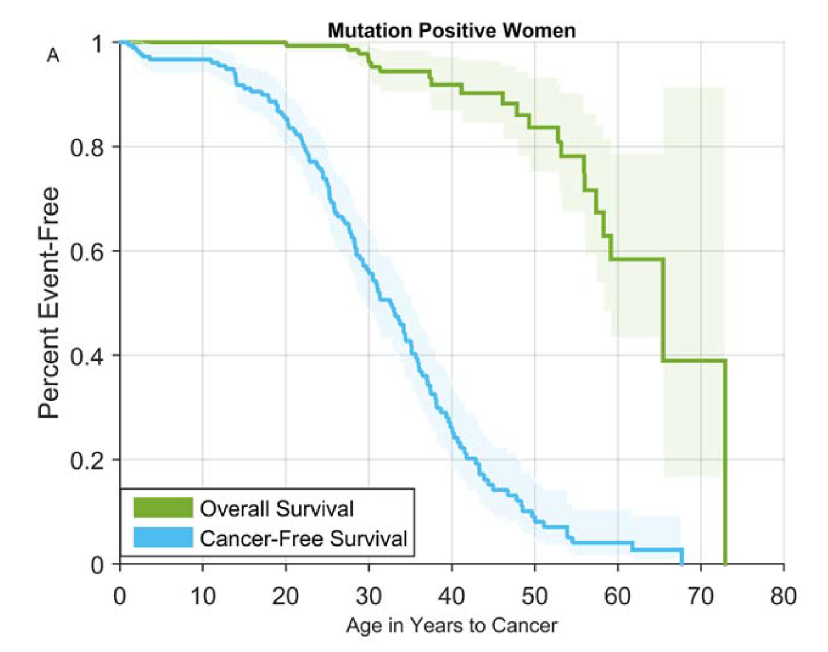
Modified from Mai et al. 2016
Risks of first and subsequent cancers among TP53 mutation carriers in the National Cancer Institute Li-Fraumeni syndrome cohort.
Cancer. 2016 Dec 1;122(23):3673-3681

Slide 18
AnalyzeMyVariant Acknowledgements
Elisabeth Rosenthal
John Michael O. Ranola
Ginger Tsai
Laura Amendola
Many users who have provided feedback

Slide 19
Questions and Comments

