Slide 1
UW Windows Infrastructure: What’s in it for me?
Brian Arkills
Software Engineer, LDAP geek, AD bum, and Associate Troublemaking Officer ☺
Nathan Dors
Manager of UW Technology: Identity and Access Management team

Slide 2
Who we are & how UWWI relates: Identity and Access Management

Slide 3
Agenda
Use cases
UWWI services and architectural review
Group Service overview
UWWI roadmap
Time permitting:
What do you want out of delegated OUs?

Slide 4
UWWI Core Services
Name resolution: WINS
Authentication services: Active Directory
Authorization services: Active Directory
Directory services: Active Directory
Windows domain services: Active Directory
License activation: Key Management Server

Slide 5
Who is using UWWI?
http://www.netid.washington.edu/dirinfo/trusts/
eplt.washington.edu | classrooms.washington.edu | sphcm.washington.edu
hslib.washington.edu | cfr.washington.edu | artsci.washington.edu
uwmcacct.washington.edu | caup.washington.edu | nebula2.washington.edu
cslt.cac.washington.edu | gifts.washington.edu | cseduct.cs.washington.edu
huskylabs.ica.washington.edu | windows.washington.edu | careers.washington.edu
sonnet.washington.edu | bschool.washington.edu | ad.engr.washington.edu
gw1.reg.washington.edu | jsisgrad.washington.edu | ctds.washington.edu
law.washington.edu | lib.washington.edu | somis.washington.edu
cs.law.washington.edu | evans.washington.edu | sphsc2.washington.edu
eplt2.washington.edu | pedom.peds.washington.edu | chem.washington.edu
uwb.edu | oris.washington.edu | math.washington.edu
admin.bioeng.washington.edu | grad.washington.edu | anthropology.washington.edu
aslab.washington.edu | phys.washington.edu

Slide 6
High level benefits
WINS
Don’t have to run your own
Wider set of computers than just your own
KMS
Don’t have to run your own, contending for limited number of KMS keys
No awkward key to enter at build
Key revocation protection
Domain Services
Simplifies domain/forest trust management
Future: Delegated OUs

Slide 7
High level benefits-AD
Authentication and Authorization
All UW NetIDs *with* the password, and other NetID integration benefits (e.g. disable events)
Provide a service to more than just your org, w/o costly one-off account provisioning
Groups used across non-Windows services
Groups formed from institutional data, course groups, affiliation groups, some department groups being piloted
Directory Services
Current person and group data together
Connectors from wide variety of applications

Slide 8
Expected Uses
Provide Windows service to entire UW audience (or just your neighborhood of it)
File service
IIS
Sharepoint
Exchange
Others …
Interactive login to existing domain workstations
NOTE: Members of the UW community don’t need a computer in a domain that trusts UWWI to access a Windows service that is ACL’d with UWWI principals.

Slide 9
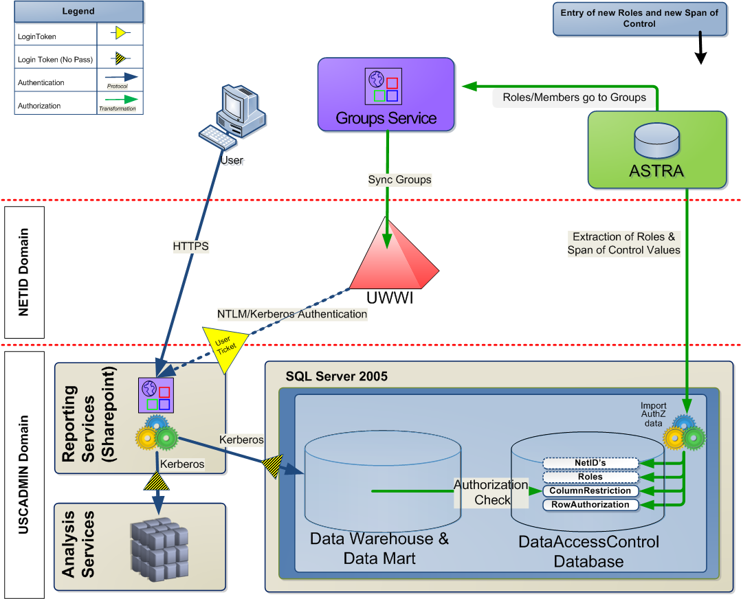
A highly-integrated example: EDW

Slide 10
Other known uses
Catalyst has automated access provisioning based on business data (via subscriptions)
SoN, iSchool, CFR all have department groups used to restrict access to various resources including Exchange public folders
Law School is using UWWI authN for public workstation access, also using “nested law course groups” to simulate student major groups
Catalyst and iSchool making use of uid for Macs and maybe other unix stuff
Educational outreach uses UWWI as source of directory information for Moodle; SoN had same use, but changed

Slide 11
Uses I can infer
Libraries is using affiliation groups to limit access to certain resources like login to public workstations
Physics, SPHCM, and Libraries may be using selective authentication
Language Learning Lab considered use of Catalyst Labs Authorized group to permit access to tech-fee students
R25 service provides access to non-Nebula users via UWWI
Support all student logins to labs, course groups for class-specific activities like file drops
CTDS querying group membership ala unix to permit web access

Slide 12
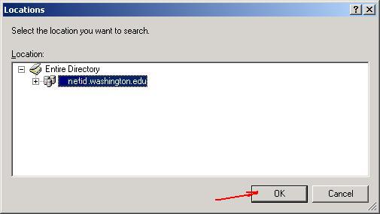
Sharing time: What do you use UWWI for?

Slide 13
Positive outcomes for Windows community
Need for separate account for Windows administration escalated into Admin NetIDs
Need for service account which generally doesn’t have a person behind it escalated into Application NetIDs
Need for Groups service enhancements exposed, e.g. need for a GUI, student major groups, department groups
Subscription service, NetID service, and other Identity and Access Management services get wider exposure
Central Exchange/Sharepoint services

Slide 14
Key Limitations
No delegated user management, i.e.
No home directory
No profile
Course groups are private, memberOf on *all* users is restricted*
No real use for computers. Needs Delegated OU project.
Cost recovery model shaky. Licensing compliance needs work.

Slide 15
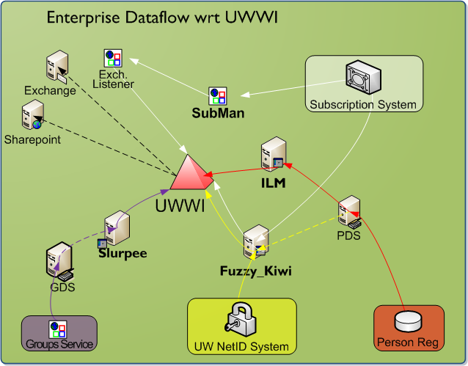
UWWI Architecture Diagram

Slide 16
Core Architectural Components
Active Directory (netid.washington.edu)
LDAP directory AND KDC realm
Dogfood forest for development
“Fuzzy Kiwi”, a UW NetID password change agent. Provisions UW NetIDs.
Slurpee, a Group Service connector. Synchronizes group directory information.
ILM, a Person Directory synchronization agent.
SubMan, a Subscriptions event handler. Provides service lifecycle event handling.

Slide 17
UW NetID Background
Multiple independent types: personal, shared (aka supplemental), admin, application, temporary, reserved
Each type has different naming, policy, and password restrictions
Test—any UW NetID type can be these.
Sponsored—personal only
Have state: current, former
Currently only netids w/ passwords are in UWWI

Slide 18
Stats (1/20/09)
Total users: 370730
Catalyst-enabled: 114341
Mail-enabled: 63808
Staff: 36893
Faculty: 15411
Student: 62276
Alum: 131723
Affiliate: 51730
Total groups: 152203
Course groups: 142207
GS groups: 9838
Private groups: 38
Mail-enabled: 60
Total trusts: 38
Domain trusts: 14
Forest trusts: 24
Total computers: 407
UW Tech Servers: 51
Catalyst Labs: 237
iSchool: 117

Slide 19
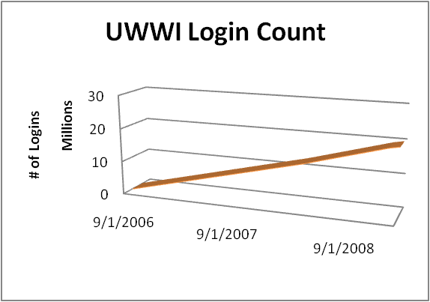
Stats-Logins
Total logins: 20,315,908 which is ~25K logins/day
Employee logins: 16,071,743 or ~80%
Student logins: 3,948,289 or ~19%
Non-Member logins: 16,401
Non-Person logins: 6,144

Slide 20
Groups Service
Defines a structure UW Group ID namespace
Provides fine-grained access control
Working on auto-provisioned groups
REST API for programmatic CRUD operations
Hourly sync to UWWI
Let’s see a demo:
https://iam-ws.u.washington.edu/group_ws/

Slide 21
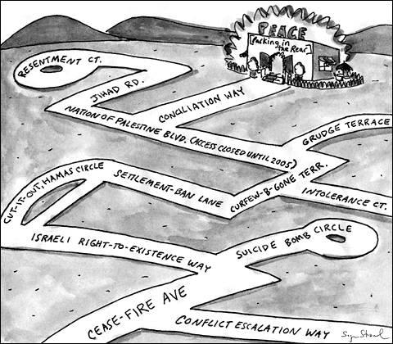
UWWI Roadmap Goal
Transparency; enable customer discussions and internal planning.

Slide 22
UWWI Roadmap Guidelines
All desired features are listed, with priority and dependencies.
Features are ideally scoped as small increments of work.
Items that might not involve UWWI engineering, but which UWWI would benefit from are included.
Approach is similar to scrum ‘work items’ list where higher priority items get better definition and attention.
No timeline in general. Instead timelines are set when there is active customer involvement.
I believe UWWI is the only UW Technology service which fully publishes its roadmap/feature/to do list today, but I expect this to become more common.

Slide 23
Roadmap work done
24 items completed. Notable among them are:
Group Service interface
Person Directory info sync’d on regular basis
NTLMv1 support added
KMS service deployed
Support for Groups for Exchange
Group Synchronization enhancements, including support for membership privacy
Admin NetIDs

Slide 24
Roadmap List
High Priority Features:
DCs to p172
Licensing compliance
WS2008 domain/forest functional level
Name improvements
Sidhistory migration tool
UWWI user attribute workaround documentation
Exchange LEDN fix-up

Slide 25
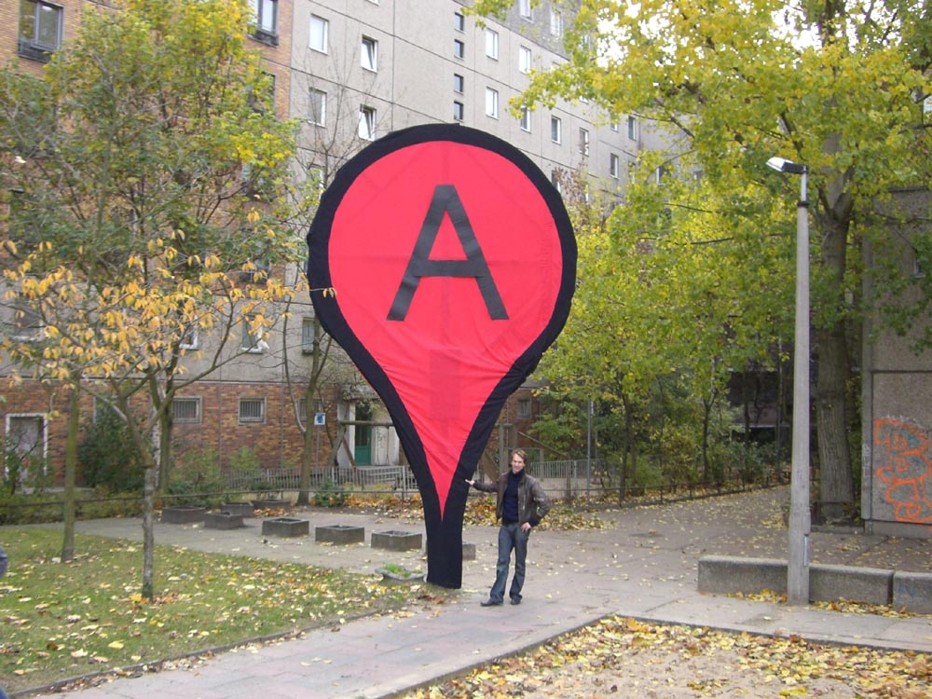
Is your point B on the list?
See https://sharepoint.washington.edu/windows/Lists/UWWI%20Roadmap%20Features/byPriorityUndone.aspx

Slide 26
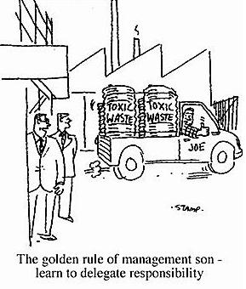
Delegated OUs

Slide 27
Delegated OUs—Last Year
iSchool, SoN, and others helped us to reconsider whether all identified problems needed to be solved.
In early fall, we entered into a pilot with the iSchool to have them help us determine what is needed.

Slide 28
Delegated OUs—This Year
5-6 policy documents are kicking around internally. These will be vetted after some refinement.
Licensing approach needs work.
Cost recovery needs thought.
Support implications needs planning.
Further documentation is needed.
Line of where 1st release of features needs to be drawn, e.g. is sidHistory migration needed?
Some of these items may need customers to partner with us to champion them.

Slide 29
Delegated OUs—Potential Wins
Remove need to run your own DCs
Remove need to buy a Windows Server external connector licenses for students (and other non-employees) to login to (your) domain controllers. (~$1500 per DC)
Fewer accounts/passwords for clients to use
Plagiarize other org’s group policy settings
i.e. Remove silos, share our costs and our successes

Slide 30
Potential Blockers: UW Technology
UW Tech: Support implications/cost is too high
UW Tech: Execution on implementation gets bogged down

Slide 31
Potential Blockers: Customers
Customer: Perceived cost of moving is higher than perceived benefit
Customer: Failure to have access to user object attributes is significant (potentially solvable in future)
Customer: Don’t want to lose independence
Customer: Monetary cost is too high

Slide 32
Delegated OUs--Questions
How many people would want to move their computers into the NETID domain? (at some point)
Would you pay—assuming the cost was nominal?
Would you migrate without sidHistory assistance?
Would you migrate if you didn’t have the ability to set user attributes to a department-specific value?
Do we need group policy management tools?
What kinds of support activities would you imagine UW Tech would need to provide for you? At what level of support?

Slide 33
The End
Brian Arkills
barkills@washington.edu
http://www.netid.washington.edu
http://sharepoint.washington.edu/windows
Author of LDAP Directories Explained

Slide 34
Delegated OUs—Possible Increased Support Requests for UW Tech
OU and OU Admin setup requests
‘How do I work in this environment’ questions/orientation
Increased admin/application NetID usage
Need for greater use of security restrictions around service accounts, e.g. logon restrictions
Increased requests for read access to all users
Group policy support
Computer lockout recovery
Security Compromise Involvement
Bitlocker/EFS key management recovery
Engineering engagement to provide delegation for domain-based applications such as SCCM (SMS).

