Slide 1
UW Windows Infrastructure: Delegated OUs
Brian Arkills
Software Engineer, LDAP geek, AD bum, and Associate Troublemaking Officer ☺
Identity and Access Management, UW-IT

Slide 2
Agenda
IAM background
UWWI services and architecture
Delegated OUs
Open discussion, Q&A, UWWI backlog

Slide 3
Who IAM is & where UWWI fits in

Slide 4
UW NetID Background
Funded by Technology Recharge Fee
Available to anyone that needs one
Multiple independent types: personal, shared, admin, application*, reserved
Each type has different naming, policy, and password restrictions
Test—any UW NetID type can be these
Sponsored—personal only
Only UW NetIDs w/ passwords are in UWWI

Slide 5
Groups Service
Defines a structure UW Group ID namespace
Provides fine-grained access control
Working on auto-provisioned groups
REST API for programmatic CRUD operations
Hourly sync to UWWI
https://iam-ws.u.washington.edu/group_ws/

Slide 6
UWWI Service Line
Delegated OUs, including DDNS service
Active Directory based LDAP services, including white pages info & LDAP authentication
Domain Services via Trust, including UW NetID and Groups service integration
Campus WINS service
Campus KMS service, aka Microsoft product activation services
UW Forest

Slide 7
Brief history
2000 UW Forest launched
2003 UW Forest stops accepting new domains
2006 UWWI Domain Services via Trust launched
LABS domain retired
WINS service launched
2007 UWWI supports LDAP authN
2008 KMS service launched, Ischool OU pilot
2009 P172 adoption
2010 Delegated OUs service launched
???? UW Forest end of life?

Slide 8
High level benefits
Authentication and Authorization
All UW NetIDs *with* the password, and other integration benefits (e.g. disable events)
Enables service access to more than just your org, w/o costly one-off account provisioning
Groups formed from institutional data
Directory Services
Person and group data together
Connectors from wide variety of applications
Delegated OUs
Reduce overhead of domain controllers
Less user administration, user simplification
Reduce friction to collaborate

Slide 9
Key Limitations
Limited user management via Support Tool
Writable: home directory, profile, logon script, unix shell, unix home directory
Readable: many key attributes, except memberOf
Non-UWWI features are also available
Some groups are private, memberOf on *all* users is restricted
Some attributes on users, groups, computers are not readable by domain users
DCs on P172
We can workaround these limitations in some cases, and some may change over time.

Slide 10
UWWI Stats and Use
Trusts
49 trusts today
OUs
26 OUs today
Basic Stats
UWWI logons/day:
2008: 25k 2010: 137k 2011: 154k
505k UWWI users, approximately half have logged in
92k UWWI groups (fluctuates with course groups)
2k UWWI computers (700 added in last 3 months)

Slide 11
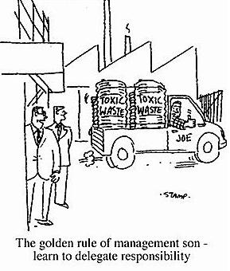
Delegated OUs

Slide 12
OUs: Basics
Funded by Technology Recharge Fee
UW-IT maintains AD, integrates with key infrastructure
You get a delegated slice of a shared domain
Can’t directly create users, groups, or contacts; can indirectly create via other mechanisms
Users, groups and contacts do not live in your slice of shared domain
Computers and GPOs have naming guidelines
Management tools: mostly MS default tools; only some custom tools required

Slide 13
OUs: Solutions (and demos?)
UW NetID Support Tool for delegated user management
Groups Service for delegated group management
Domain migration: Cost-recovery assistance or DIY
GroupSync tool for bulk group import
DDNS service for workstations
Automated delegated OU computer groups to replace domain computers

Slide 14
OUs: Weighing benefits/potential downsides
Benefits
Remove need to run your own DCs
Fewer accounts/passwords for clients to use
Remove silos, share our costs and successes
Potential downsides
Cost of migration of users, groups, and computers
Access to user object attributes is significant
Some external dependence
Some desired features are missing, e.g. SCCM, Likewise Enterprise, delegated bulk user writes
We are willing to partner with customers on any of these potential downsides

Slide 15
The End
Brian Arkills
barkills@washington.edu
http://www.netid.washington.edu
http://sharepoint.washington.edu/windows
Author of LDAP Directories Explained

Slide 16
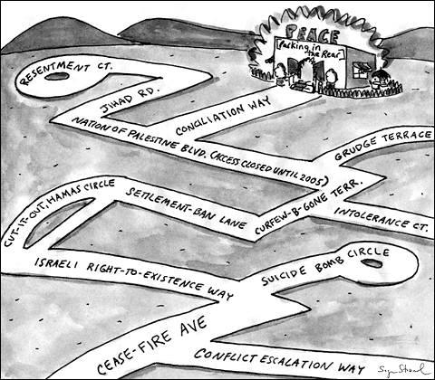
UWWI Backlog
Provide transparency; enable customer discussions and internal planning
Identify customers who will partner in development of tricky features
https://jira.cac.washington.edu/browse/UWWI

