Slide 1
Turning Off NTLMv1 or How to Approach Turning Off Legacy Technology
Brian Arkills
Software Engineer, UW Windows Infrastructure Svc Mgr, and Associate Troublemaking Officer ☺
UW-IT, Identity and Access Management
Microsoft Directory Services MVP 2012-2014

Slide 2
Goals
Notes:
How you go about turning off NTLMv1
How you might generally approach turning off an old technology

Slide 3
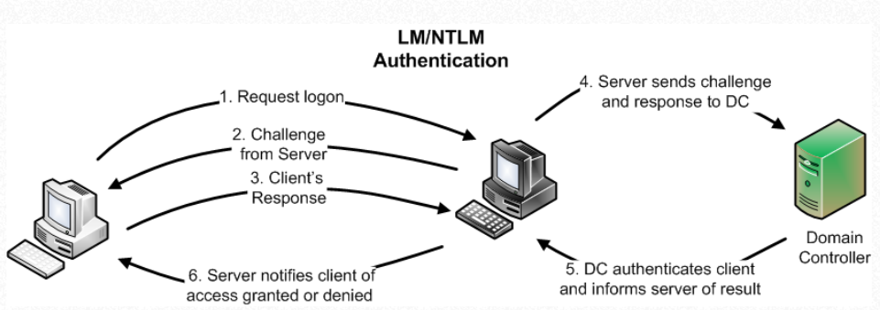
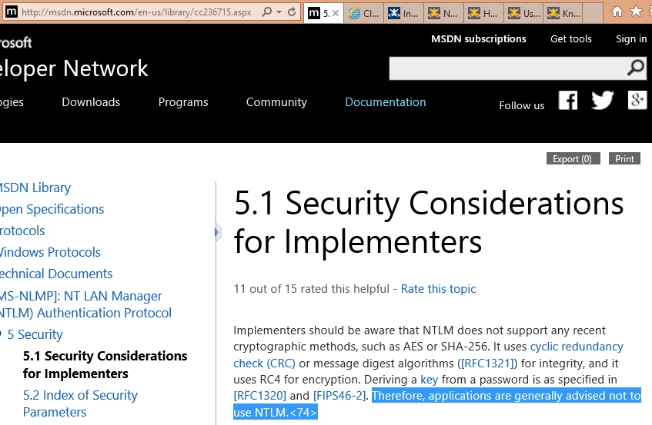
Why Turn Off NTLMv1?
Notes:
NTLMv1 is basically LM + a slightly stronger hashed response. For short passwords, anyone that gets the client response has an extremely easily crackable LM response. For longer passwords, the slightly stronger hash is still the password and is fairly easily broken.
http://msdn.microsoft.com/en-us/library/cc236715(v=PROT.10).aspx: “applications are generally advised not to use NTLM.”
Project Mars, www.cloudcracker.com, NTLMv1 rainbow tables
InCommon Assurance: AD Silver Cookbook: https://spaces.internet2.edu/display/InCAssurance/InCommon+Silver+with+Active+Directory+Domain+Services+Cookbook+-+201404

Slide 4
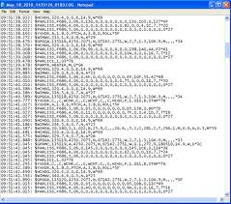
Keys to Success Retiring Old Tech
Notes:
Partners. Need folks who will help and champion. You can then leverage peer pressure to help speed up movement. ☺
Log data. Need to know what the current use is so you can target it. You might need to rely on your partners for this. Automate this as much as possible.
Workarounds. Customers often still have a business need, and you need to help route them on a permanent detour. Go the extra mile to inform customers of the alternatives.
Persistent Pestering. A large percent of customers will ignore you the first time you tell them they need to do something different. You become a pest, but ultimately this is better than breaking them later—and they have no excuse for missing many notices.
Imagined Impact. Having a good idea of how big the impact will be (both to the organization and to individuals) is invaluable in your communications. You might preliminarily try turning off the technology for an hour to gain this picture.

Slide 5
NTLMv1 Resources We Developed
NTLMv1 Removal - Known Problems and Workarounds
Customer Mitigation Walkthrough
PowerShell NTLMv1 Log Parser
PowerShell and Registry file for LMCompatibilityLevel
Log parsing -> Customer notification process
IIS web app that only allows NTLMv2

Slide 6
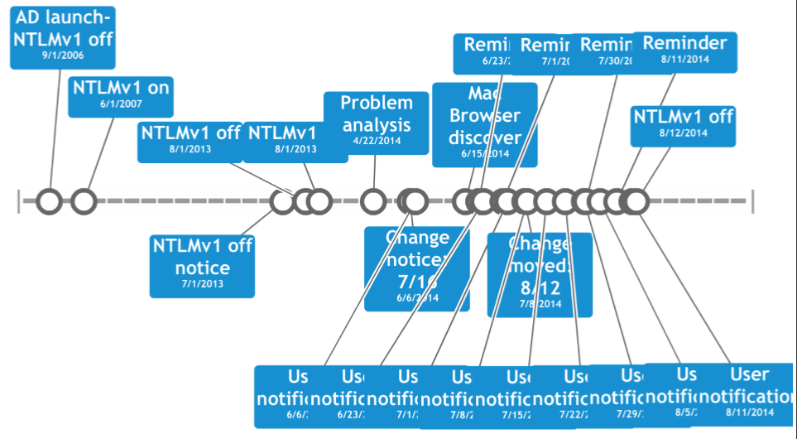
Timeline and Visualizations
Notes:
Lots of user notification. Lots of change reminders. Had to move the date back 4 weeks to accommodate a significant new problem discovery.
Note that right up until the end we still had users using NTLMv1. This is interesting in juxtaposition with the single digit number of folks who have contacted our help desk since the change.

Slide 7
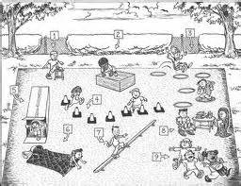
Stumbling Points

Slide 8
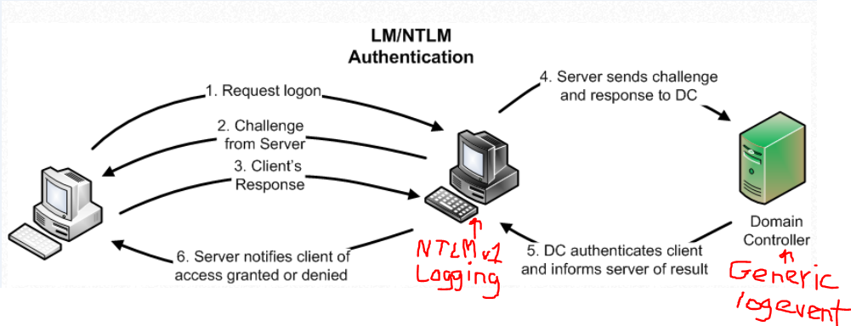
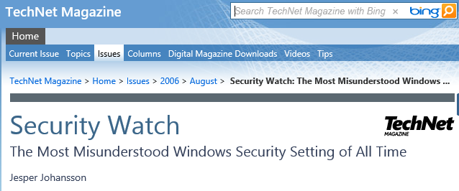
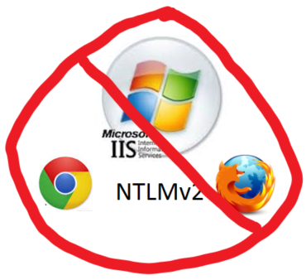
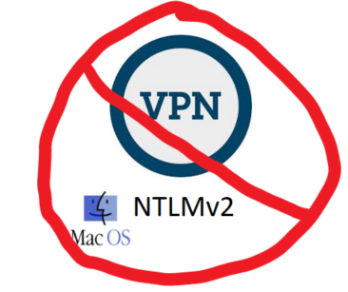
Tech - Stumbling Points
Notes:
You gotta understand how NTLM works, and especially the LMCompatibilityLevel setting. See http://technet.microsoft.com/en-us/magazine/2006.08.securitywatch.aspx. http://technet.microsoft.com/en-us/library/cc773178(v=WS.10).aspx (section NTLM Referral Processing) is good for cross-trusts. And http://digital-forensics.sans.org/blog/2012/09/18/protecting-privileged-domain-accounts-network-authentication-in-depth is good too.
You need to understand where NTLMv1 is logged. It’s logged at the server the client connects to. Not *ANYWHERE* else. That means looking at your DC logs won’t tell you who is using NTLMv1. You must get logs from other servers.
The MacOS doesn’t natively provide a NTLMv2 VPN client. 3rd party VPN client or VPN server are needed.
Non-Windows browsers don’t support NTLMv2. Chrome doesn’t. Firefox doesn’t. Safari on MacOs with an obscure setting does, but it’s the lone exception. For me, Windows Integrated AuthN is dead. You can either replace it with HTTPS & Basic. Or you can add a second site with the same content for non-Windows users that has HTTPS & Basic. Or move to federated AuthN.

Slide 9
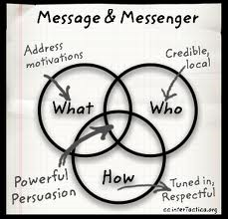
Svc Mgmt – Stumbling Points
Notes:
Identify stakeholder partners and persuade them of need to proceed
Communicate clearly and often.
Provide ample workaround solutions.
Have a thick skin about not rolling back the Svc. Design change. Have clear sense of what conditions would trigger rollback.
Be willing to bend a little to accommodate partners or discovery of new known problems
Get your service desk staff on board with the known problems and workarounds

Slide 10
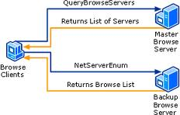
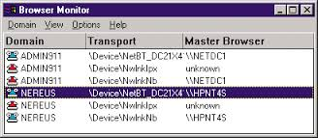
Loose Ends
Notes:
Obviously, there will be customers late to the party. They’ll need to get to something they infrequently access, and suddenly run into NTLMv2 problems. That’s where your service desk training helps.
We still see NTLMv1 events logged on our DCs *after* having explicitly turned off NTLMv1! These events are always computers—null sessions. We’ve successfully tracked some number of these oddities to the computers which are NetBios master browsers for their subnet, and stopped those events by turning off NetBios over TCP/IP on those computers. Still tracking down the rest of the oddities, but I suspect there’s a NetBios bug here that explains all of them.

Slide 11
What about NTLMv2? (Pass the Hash)
Notes:
Excellent summary of the Windows authentication vulnerability and hardening landscape: https://t.co/rH0NNqT4Gb.
High likelihood that the pass the hash technique is a crucial part of the many credit card breaches we have been seeing over the last year (e.g. see http://www.aorato.com/blog/untold-story-target-attack-step-step/), and it’s obvious these techniques will move to mainstream sooner than we’d like. In other words, assume breach will happen and plan accordingly.
Intrigued by recommendation #2 of the hardening NTLM section: use group policy to disable NTLM authentication on clients/servers within the domain that are compatible with Kerberos. IOW, don’t wait to turn off NTLMv2 when every possible computer is ready.
Also investigating Authentication Policy Silos to harden service accounts and admin accounts by turning off credential caching, disabling logon types not needed, and restricting where a given account can logon from (especially “gateway” servers)

Slide 12
The End
Brian Arkills
barkills@uw.edu
@barkills
http://blogs.uw.edu/barkills
http://www.netid.washington.edu
Author of LDAP Directories Explained
Microsoft Directory Services MVP 2012-2014

