Slide 1
State of Windows Services at the UW
Brian Arkills
Software Engineer, LDAP geek, AD bum, Senior Heckler, and Associate Troublemaking Officer ☺
Notes:
Change is in the air; UW change from president & provost levels; C&C changing; I’ve been re-org’ed twice in the past couple months. Many of these changes are VERY good; in fact, I now work in a Windows Engineering team of a dozen previously silo’ed engineers.

Slide 2
The Windows platform, circa 2000
Lots of Windows platform distrust; is it enterprise ready?
Windows client base had a heavy mix of “home” OS flavor (Win98, Windows Me)
New fangled domain-based features like Kerberos, LDAP, and DNS-integration
IIS 4 proved to have many security vulnerabilities
Notes:
-”insecure” or “unstable”.
-Lots of questions and issues

Slide 3
Where we’ve come from, circa 2000
C&C Windows services included:
the UW forest, to facilitate resource sharing across units
Nebula, to facilitate managed workstations
UW Pubcookie ISAPI module for IIS
Over 450 Windows domains & more than 1,200 Windows domain controllers across campus
Notes:
Lots of NT4 domains

Slide 4
Key Pain Points Between Then and 2006
Remember Nimda, CodeRed, Blaster, Slammer?
High rate of domain compromises
MS02-001 made UW forest service problematic
C&C chose to not run Dynamic DNS, nor Exchange. No central IIS web platform offering either
Nebula cost was high until 2006
Departmental silos of Windows services: multiple user provisioning processes and multiple passwords
No good IIS authorization mechanism

Slide 5
2006: UW Windows Infrastructure
Enabling infrastructure; Provides ability to offer Windows services to entire UW audience
Automated UW NetID provisioning with password
Trusts permitted for campus domains
Some automated group provisioning, including affiliation (faculty, staff, student, etc.) and courses
Does not solve managed user scenario … more to come
aka the NETID domain or netid.washington.edu
Notes:
The UW Windows Infrastructure (UWWI) is born out of departmental outcry.
20 trusts today

Slide 6
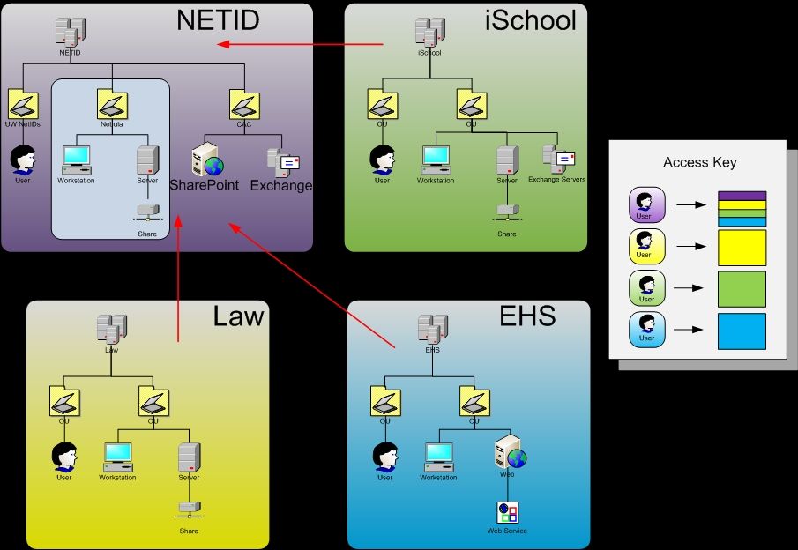
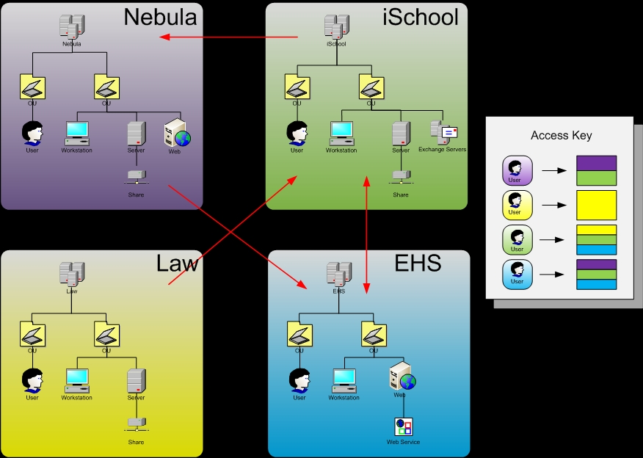
Notes:
The 4 large boxes represent some slightly fictitious campus domains, red arrows show trust relationships, the access key shows which domain resources any particular domain user might be able to access. Note that trust relationships needed for any particular unit to have complete collaboration are many. Note the possibly redundant user accounts and provisioning. Note that there really is no way for EHS to offer their web service campus-wide with Windows user accounts and authorization, without first self-provisioning all netids or getting a domain trust to every campus domain.
Trust relationships become much simpler for complete collaboration; each domain needs only one. Domains can continue to provide their existing domain-specific services via their own domain accounts, but now have the option to provide campus-wide services and sharing via NETID accounts. So EHS can offer their web service campus-wide. Note this also sets the stage for C&C to offer campus-wide services like sharepoint, exchange, and nebula.
Redundant user accounts and provisioning processes go away. Redundant domain controllers go away. Every unit still has the autonomy it needs to manage its Windows resources. This process could take a long time, and might never be attained, with some units keeping their Windows domain and trust to NETID.

Slide 7
The Near Future
Share vision that most campus Windows domains should consolidate into the NETID domain
Microsoft roadmap drafted to enable partnership with campus
C&C will work with campus partners to provide central service offerings for Exchange and SharePoint on an expedited schedule
Nebula will move into the NETID domain and pilot these services

Slide 8
Microsoft Numbers, since 1/2007
Based on campus security scans¹:
223 campus domain controllers²
263 campus IIS web servers
74 campus Microsoft Dynamic DNS servers
Based on C&C survey:
Email: 38% use “Pine” vs. 32% use “Outlook”
Calendar: 19% use Outlook vs. 12% use Oracle
Relative use of OS: 75% of campus uses Windows more than 80% of time
Notes:
Step back and look at numbers …
Which are limited by firewalls
Only includes DCs with an OS > Windows 2000, i.e. listening on port 389
DC numbers justify vision
IIS numbers argue for central web service based on IIS
DDNS numbers argue for central DDNS service
C&C survey numbers validate what most of us guessed: Windows use is rampant, and Outlook use is not insignificant

Slide 9
Future Possibilities
Provide Windows user and group management mechanisms
Office Communication Server / Exchange Unified Messaging
AD integrated certificate authority
Unix and Mac interoperability
Dynamic DNS
VPN Services
2-way password sync? Collapse Kerberos realms?
Active Directory Federated Services
Phase out UW forest?
Central IIS web service offering? (other than SharePoint)
<Your favorite Windows thing here>
Notes:
OCS=IM and video conferencing, presence services
Unified Messaging=Exchange linked to your phone system – voice mail in your Inbox, inbound faxes in your Inbox

Slide 10
Nebula in a Nutshell
0 domain or server compromises over 10-year history
Many “models” of computers with differing support levels:
Gold workstations = we manage, $52/month
Bronze workstation = you manage, $26/month
Kiosks = we manage
Strongly managed servers = we manage
Loosely managed servers = we manage OS, you manage app
Locally managed servers = you manage
Services provided include:
Help desk support
Networked home directory and group file space
Group management services
Automated software deployment
Security management and reporting
Discounts for other C&C services (Oracle Calendar, BES, and others)
More Info at: http://staff.washington.edu/barkills/Nebula-HiEd.ppt
Notes:
Laptops cost more. Doesn’t include hardware, add ~$30/month for hardware

Slide 11
Want to Know More?
UW Windows Infrastructure http://www.netid.washington.edu/
MS Collaborative Applications Roadmap http://go.cac.washington.edu/go/?linkID=10
MS Collaborative Applications Engineering Blog http://go.cac.washington.edu/go/?linkID=9
UW Windows Infrastructure Engineering Blog http://go.cac.washington.edu/go/?linkID=11
Windows Domains at the UW http://go.cac.washington.edu/go/?linkID=12

Slide 12
The End
Brian Arkills
barkills@cac.washington.edu
Author of “LDAP Directories Explained”

