Slide 1
Can my university switch its preferred Identity Provider to Azure AD? October 2021
Slide deck : https://staff.washington.edu/barkills/preferredIdpAad.pptx
Brian Arkills
Microsoft Solutions Architect
Svc Owner: MS Infrastructure, Managed Workstation
UW-IT IAM tech lead
Microsoft Directory Services Enterprise Mobility MVP 2012-2019

Slide 2
Goals
Share IdP comparative analysis
Share constructive patterns of change for infrastructure change in higher education
NOTE: Phil Swanzy will share Penn State’s IdP transition to Azure AD in a later session. UW has not made a transition yet

Slide 3
Overview
What prompted this
Brief Orientation to IdPs at UW
Consensus building: the real way decisions are made at universities
Comparative analysis: Shibboleth vs Azure AD
Problems & solutions
What’s next for UW
Questions & discussions on any of this

Slide 4
Mean Time to Irrelevance
This is an important conceptual term especially for technology.
How long before Shibboleth (or CAS) is irrelevant?
Determining a good guess requires:
perspective,
an understanding of the key value provided, and
why alternatives might make it irrelevant
The HiEd community has extremely high usage of Shibboleth, but other sectors do not. Have we lost perspective? Or is there some unique value?
My thanks to former UW-IT CTO Terry Gray for introducing this term to me

Slide 5
Shibboleth value proposition
Very focused on SAML protocol; when SAML is dead, so is Shibboleth. Have OIDC/OAuth2 ushered in the death of SAML?
Strong privacy foundation which HiEd values; future emergence of better privacy solutions (e.g. Verifiable Credentials) will erode this
SAML Federations (InCommon, EduGain, etc) as a way to simplify external user trust & build common use profiles for applications (e.g. Research & Scholarship); there are other ways to attain this, arguably better
Summary: looking just at Shibboleth’s strengths, the MTTI forecast is not good

Slide 6
What others have said & why
Craig Burton, Cloud Identity Summit 2012:
“SAML is the Windows XP of Identity. No funding. No innovation. People still use it. But it has no future.”
“There is no future for SAML. No one is putting money into SAML development. NO ONE is writing new SAML code. SAML is dead.”
“SAML is dead does not mean SAML is bad. SAML is dead does not mean SAML isn’t useful. SAML is dead means SAML is not the future.”
Ian Glazer, Identiverse 2020:
“SAML Will Still Be Dead: The reason why SAML is “dead” is because it works and it is a legacy technology. It is mature. It is popular. And that will not change in the next 5 years. Now, I do not expect a resurgence of SAML federations but I also do not expect rapid migration from SAML to OIDC (unless prompted by a shift in platform or provider.) Consider that it took years to stamp out WS-Federation; SAML will take a similar path. In 10 year’s time, the SAML zombie herd will be quite thin but still shuffling onwards and very much considered a legacy protocol.“
Synthesis of why:
API interactions needed to handle scale of authorizations—SAML products don’t deal with this
Developers don’t want to deal with XML and JSON, i.e. SAML+OAuth2 to solve the combined problem of authN+authZ. Easier to just use JSON, i.e. OIDC+OAuth2
For some reason, SAML products are averse to adopting SCIM, leaving app user provisioning options as rudimentary
SAML=SOAP, OIDC+OAuth2=RESTful
SAML=XML format, OIDC+OAuth2=JSON format

Slide 7
Some related UW IAM history
1998-2019: Pubcookie at UW
2005-today: Shibboleth at UW
2011-today: Google IdP at UW, federated to Shibboleth
2013-2022: ADFS at UW
2013-today: Azure AD at UW
5/2021: UW Shibboleth primary engineer retires
6/2021: Azure AD unfederates, goes to PHS
6/2021: UW Authentication tech lead retires
7/2021: At monthly UW IAM team meeting, Brian Arkills asks: “How do we have a constructive dialogue about our existing IdP technologies and the lifecycle support level for each so that we might as a team come to a recommendation?” Answer: seek consensus via analysis paper which we collectively contribute toward
8/2021: UW IAM team invited to collaborate on draft analysis paper
9/2021: Several break out discussions
9/2021: UW Enterprise Architecture invited to contribute
9/2021: Security team invited to contribute
Future: analysis sent to senior UW-IT leadership

Slide 8
Brief UW Web IdP orientation
Shibboleth is our preferred IdP. This means if you have an app to integrate, we recommend Shib, unless there is a compelling unmet need
Azure AD has been considered a tactical solution, not a baseline solution
Google IdP is federated to Shibboleth
ADFS is federated to Shibboleth & is a tactical solution we plan to retire in early 2022
UW Web Authentication (Support) Brick

Slide 9
2FA at UW
Preferred 2FA solutions:
1996-2011: RSA SecurId
2009-2017: Entrust
2017-today: Duo
Tactical 2FA solutions:
2018-today: Azure MFA

Slide 10
The road to consensus begins …

Slide 11
How Higher Education IT works
Central IT + Distributed IT + Academic freedom + Multiple roles -> Chaotic Neutral Environment
For example, in higher ed, consider printnightmare.
Many departments which need to each turn off spooler and/or make risk management & mitigation decisions
Central IT has advising role
Not all universities are the same. Mix and match for added complexity: multiple campuses, research, hospital system, DoD/Energy research
Major IT decisions require Consensus Building
https://itconnect.uw.edu/wares/msinf/other-help/the-hied-it-environment/ has a longer summary

Slide 12
How does this consensus building work?
There’s no Google Map directions. ☹
Advice:
Expect this is how it works
Get it in written form in collaborative software
easy to find & engage as the consensus circle grows
captures comments & history
have a document facilitator for organization and resolution
Need a champion within IT; may also need customer champion(s)
Cover all the angles
Document assumptions
Analyze Capabilities (what you get)
Analyze Costs (include full costs & be mindful of what you lose)
Align with your organizational strategies & principles

Slide 13
The road may get ugly ☺

Slide 14
Navigating gridlock
If you get stuck, there are several options:
Sit down with those who aren’t in agreement & try to understand their point of view.
Listen first and often. Successful consensus building requires that everyone feels like their point of view is valued.
Fear of change is #1 blocker.
Lack of understanding what will change is #1 reason for fear of change.
With additional insight, explanations or changes to the proposal may result in consensus
Wait for a better time or a better idea.
The people involved may need time to accept change
You may have to wait for who is in the consensus team to change
You may need time to find a better idea (your idea wasn’t brilliant enough ☺)
Depending on the circumstances, it might be time to take it to central IT authority figure.
If there is a clear cost/benefit story, but entrenched objectors, it may be that consensus can’t be reached.
Even if that central IT figure doesn’t feel comfortable moving forward, they now know more which may be key in the future

Slide 15
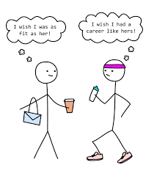
Comparative analysis
Background & Assumptions
Capabilities
Costs
Ability to customize/control
Note: transition topics are covered separately

Slide 16
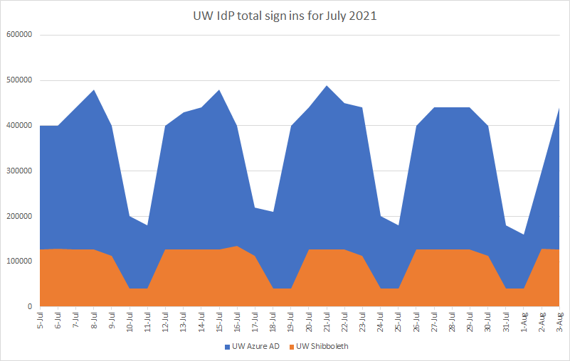
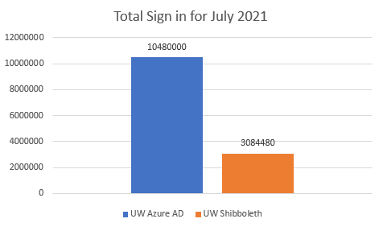
Background & assumptions
Gartner papers with modern market expectations:
Continuous adaptive risk and trust assessment (CARTA)
Online fraud detection (OFD)
IAM Leaders Guide to User Authentication (Dec 2020)
Market Guide for User Authentication (Jun 2020)
Magic Quadrant for Access Management (Nov 2020)
Research on:
What other products provide
What others are doing
Existing sign in volume

Slide 17
Market analyst comparisons
IDC Marketscape: Worldwide Advance Authentication for Identity Security 2021: Microsoft (Azure AD) is Leader
Gartner 2020 Magic Quadrant for Access Control: Microsoft (Azure AD) is Leader

Slide 18
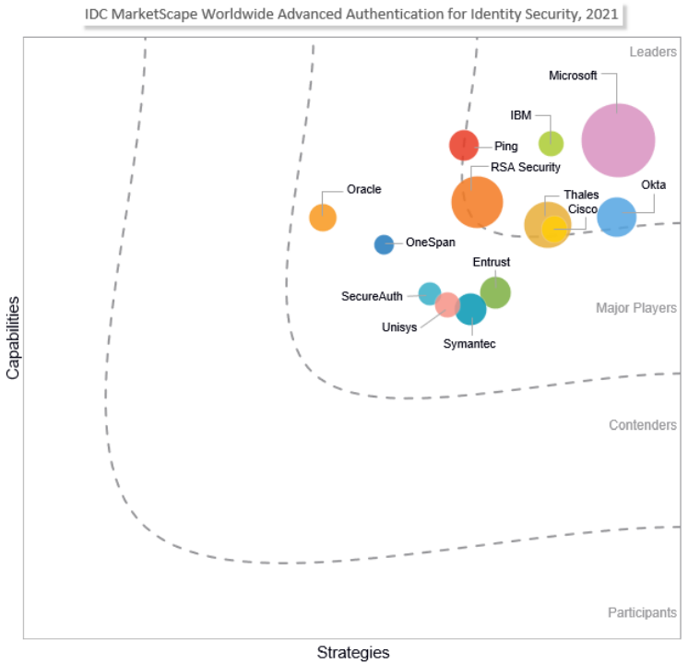
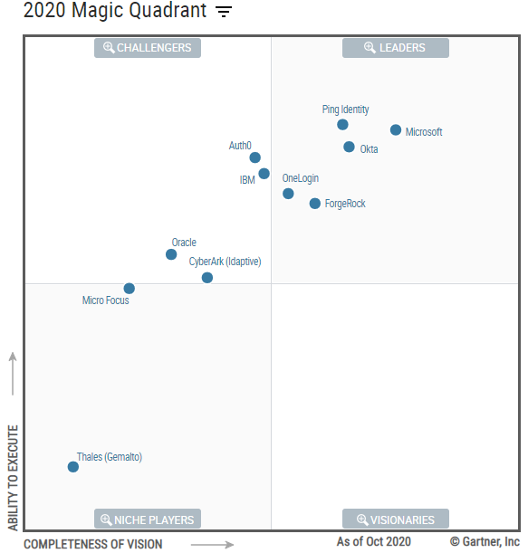
Analyst comparisons

Slide 19
Background: Shibboleth is less capable than *every* commercial IdP

Slide 20
Background: commercial IdP use in HiEd
 | Azure AD | Okta | Cirrus Identity Bridge
Large R1 universities or equivalent | Penn State, Oxford, John Hopkins, U of Birmingham, UC-San Diego | Iowa State, WSU | Iowa State, Yale, UC-Berkeley, Michigan, MIT, CMU, Indiana, Arizona, Oregon
Other universities | DePaul, UNCG, Univ of Dundee, U of Rhode Island, U of Glasgow, UNCP, State Univ of NY New Paltz, U of South Florida, Millersville University, Mansfield University, SUNY Geneseo In progress: Cedarville University, Campbell University, U of Louisville | U of Puget Sound, Notre Dame, CalState-Monterey Bay, Union College, U of Tampa | CalState-Monterey Bay, Union College, Pomona College, Carleton, Millersville University, UNLV, Oregon Institution of Technology, American University at Sharjah, U of Tampa, Icahn School of Medicine at Mount Sinai, U of Rhode Island, Chapman University, Lock Haven University, Mansfield University, U of Puget Sound
Other Higher Ed entities | Educause |  | Educause, NIH, Internet2

Slide 21
Protocol support
 | Shibboleth | Azure AD
SAML | Yes | Yes
OIDC | Yes | Yes
OAuth 2.0 | No | Yes
SCIM | No | Yes
WS-Fed | No | Yes
WebAuthN | 3rd party | Yes
Verifiable Credentials | No | Yes
Shib | AAD

Slide 22
Reliability
 | UW Shibboleth | UW Azure AD
Major INCs in past 3y | 3 | 3
Cell-based architecture | No | Yes
Redundant Backup authN infrastructure | Yes | Yes
Staggered change deployment with automated verification testing | No | Yes
Shib | AAD

Slide 23
Application support
 | UW Shibboleth | UW Azure AD
Basic application creation self-fulfillment | DNS contacts | Any UW AAD user
Federation enablement | Via UW-IT | Yes
Basic claims | Yes | Yes
Additional claims | Via UW-IT | Yes
2FA required configuration | Yes | Via UW-IT
Restrict access based on device health, geo-location, sign-in or user risk, IP address, etc. | Limited to IP and group | Yes
Installation templates | No | 1000+
Access to sign in logs | No | Yes
Provisioning setup | No | Via UW-IT
Provisioning maintenance | N/A | Yes
Shib | AAD

Slide 24
External identity support
 | Shibboleth | Azure AD
Multi-lateral federation & MDQ protocol | Yes | No
External users instantiated enabling central access control policies | No | Yes
# of organization IdPs federated via approach | 5K via EduGain | 200K within AAD
Social IdP support | No, requires 3rd party gateway | Yes
Shib | AAD

Slide 25
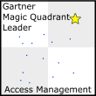
Security protections (CARTA & OFD)
 | Shibboleth | Azure AD
App does not handle credentials, credentials encrypted on wire | Yes | Yes
CARTA: Group membership | Yes | Yes
CARTA: Location | IP address only | IP, GeoRegion, or GPS
CARTA: Device platform | No | Yes
CARTA: Client application | No | Yes
CARTA: Client device state | No | Yes
CARTA: Application specific restrictions | No | Yes
CARTA: Sign in risk | No | Yes
Fraud detection: daily signal volume | N/A | 8+ trillion
Fraud detection: automated mitigation | N/A | Yes
Fraud detection: application reputation | No | Yes
Fraud detection: publisher verification | No | Yes
Fraud detection: device fingerprinting | No | Yes
Fraud detection: behavior analytics, e.g. Anonymous IP, atypical travel, unfamiliar location | No | Yes
Fraud detection: bot/malware source detection | No | Yes
Fraud detection: anonymous velocity | No | Yes
Fraud detection: leaked credentials | No | Yes
Shib | AAD

Slide 26
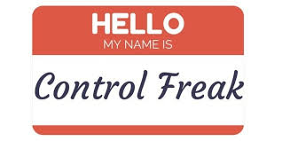
Ability to customize/control
Aren’t you losing the ability to customize?
Customization isn’t necessarily what you want
The need to customize is only an issue if the product doesn’t meet your needs
Customization -> increased risks due to security & reliability + increased costs
Azure AD B2C provides ton of customization for apps that have special needs
What if the vendor kills the product or raises the costs?
This is true for open-source too. All enterprise infrastructure should have an exit strategy--does your IdP have an exit strategy today?
Gartner: “banks are becoming increasingly comfortable with using vendor-hosted” for “OFD capability that has traditionally been deployed on-premises”
We are in good company with 200K other orgs using Azure AD
There are other strong cloud-based IdPs. They would be more expensive than AAD, but would be an alternative.

Slide 27
Technology evolution & control

Slide 28
Existing Costs
 | UW Shibboleth | UW Azure AD
IdP hosting non-labor costs | $10K | $0
Licensing costs (presumes EDU & separate needs paying for MS licensing) | $0 | $0
Code development & maintenance | $90K | $0
Assisted app integration | $70K (25/year) | $10K (8/year)
2FA (Duo/Azure MFA) | $170K | $0K
Notes:
Costs rounded to nearest 10K
Assisted app integrations today:
Shib: 25/year
AAD: 8/year
Average UW-IT time for app integration:
Shib: 19.5h
AAD: 10.5h
Shib | AAD

Slide 29
Potential problems with Azure AD as sole IdP
Support for Research and Scholarship category SPs
Claims bundle is easily supported by AAD
Requires multilateral SAML federation
Requires custom IdP metadata
Hosting or accessing InCommon/EduGain SPs
Requires multilateral SAML federation
UW Azure AD inactive user policy (1y->disable, 2y->delete) would become enterprise policy
This may be a boon, especially for spamming/phishing
However, there are impacts to several critical enterprise applications which may require alterations to the policy or different approaches for those applications
Identity data privacy
Azure AD has insufficient controls to prevent read access to sensitive identity data
For example, UW can not synchronize course groups to Azure AD
This means claims data with privacy concerns is not available

Slide 30
Potential solutions
Keep Shibboleth for use cases that require it, but use Shibboleth’s native SAML Proxy feature or auth_mod_OpenIDConnect module to point it at Azure AD
Note: this may be only solution for apps with claims data that has privacy concerns
Swap in Cirrus Identity Bridge for Shibboleth IdP. Cirrus IB is an Azure AD application that supports multi-lateral federation, custom IdP metadata, and many other features. Your Azure AD is joined to InCommon via Cirrus IB.
Outsource Shibboleth to Overt Software for limited use cases that require it

Slide 31
Transition

Slide 32
Transition options
Slow cutover
Azure AD=preferred IdP, Shib=tactical IdP for R&S category
Native Shib SAML Proxy pointed at AAD to unify user sign in experience & contain 2FA costs.
Existing Shib SPs migrated to AAD over period of time.
Eliminate Shib IdP, but not Shib SPs
Azure AD=preferred IdP, Cirrus Identity Bridge=tactical IdP for R&S category
Unifies user sign in, contains Shib labor costs
Existing Shib SPs are silently switched to Cirrus & migrated to AAD over period of time
AAD preferred, co-existence
Keep Shib IdP to minimize change
Worst option in terms of cost. No 2FA relief, no Shib labor cost relief, lost opportunity to improve overall security.
Existing Shib SPs don’t have to migrate

Slide 33
Option: Slow cutover
Orderly shift to unified IdP, spreading out transition costs. Impact to UW-IT and customers is manageable.
Can’t replace Duo 2FA with Azure MFA until Shib SPs are complete; immediate 2FA cost containment is price of slow cutover
Allows UW to consider retiring some other redundant authentication services
Minor immediate AAD benefits from OFD
Privacy claims can continue via Shib, with hope that AAD will provide future capability

Slide 34
Option: Eliminate Shib IdP
No immediate impact to Shib SP customers, with R&S category SPs staying with Cirrus long-term
Orderly shift to AAD for all other SPs, spreading out transition costs. Impact to UW-IT and customers is manageable.
Contains Shib labor costs. Cirrus annual costs range from $5K to $50K depending on modules and authentication traffic, so UW saves >$40K almost immediately
Allows UW to consider retiring some other redundant authentication services
Some AAD benefits immediately, more with future Cirrus features
Have to eliminate any privacy claims

Slide 35
Option: Coexistence
Not much of a change from today, but it is a change which opens the door to the first two options later
Makes no sense from capability or cost perspective
Reasons to pick this:
No Microsoft commitment to provide support for privacy claims
afraid of change
can’t tolerate more change at this time
you like to sign in a lot
yes, this is a joke but I need to talk about token lifetimes
holding onto open-source as a principle/value
???

Slide 36
What’s Next
IAM + Security forming consensus
Send along to CTO, deputy CIO & CISO
Publish analysis paper
Project?

Slide 37
Goals
Share IdP comparative analysis
Share constructive patterns of change for infrastructure change in higher education
NOTE: Phil Swanzy will share Penn State’s IdP transition to Azure AD in a later session. UW has not made a transition yet

Slide 38
Questions?
Key slides:
How Higher Education IT works
Navigating gridlock
Shib vs. *every* commercial IdP
Commercial IdP use in HiEd
Application Support
Security
Existing costs
Potential Solutions
Transition options

Slide 39
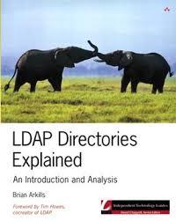
The End
Brian Arkills
barkills@uw.edu
@barkills
@brian-arkills
http://blogs.uw.edu/barkills
Author of LDAP Directories Explained

