Slide 1
Integration: Office 365
Brian Arkills
Software Engineer, LDAP geek, AD bum, and Associate Troublemaking Officer ☺
Identity and Access Management, UW-IT

Slide 2
High Level Background
Project charter has lots of wiggle room
Envisioned as way to replace UW Exchange
May also replace some parts of UW Sharepoint
May also fulfill ‘teleconference refresh’ project goals
Because of MS Cloud technology constraints, was assumed to replace UW Windows Live service
Computer Science impact
Alumni impact
Really long discovery phase

Slide 3
Application Constraints
Primarily Windows clients
Mix of browser and fat clients
Confusing array of directory synchronization, user provisioning, service provisioning, and authentication options. Each with different constraints and benefits, and some which only work in specific combinations.
The usual email constraints that Exchange has + a given email address may only be assigned once in any Microsoft cloud based service. Must prove ownership of email domain.

Slide 4
Data Types and Data Classification
UW NetIDs (public w/o any other data)
Passwords (confidential)
Directory data—users, groups and contacts (mix of public, restricted and confidential)
Medical related data—HIPPA (confidential)
Student related data—FERPA (confidential)
eDiscovery implications

Slide 5
User Population
Initial user population roughly equal to UW Exchange count + some MedCtr count = ~10k.
Entire UW NetID population will be represented in Office 365 directory.
Eligibility for employees or students. Unclear whether others can purchase. Unclear situation for alumni.
Permits data access for additional populations.

Slide 6
Authentication
UW NetID integration desired: NETID AD preferred
No consideration for 2 factor authN at this time.
Federated authentication is supported, but only via ADFS at this time—SAML based federation coming later this year.
Other sources of authentication are supported via Microsoft’s Federation Gateway.

Slide 7
Provisioning
Powershell based option (back door via Exchange Online). Can’t use federation with this. Only “real-time/event-based” option; others are state-based.
DirSync v2 option. Appliance which requires AD source, syncs all users, groups, contacts.
FIM connector option. Open-ended connector you plug into your FIM instance. You supply and support data source, code, business rules, etc. At this time, requires MS Consulting to deploy.
*ALSO* must provision licenses for variety of products and/or in a license suite. **VERY** messy.

Slide 8
Data Integration Needs
Need data currently in NETID AD.
Would love data that’s currently missing in NETID AD, e.g. manager, photo, others
Needs to integrate with on-premise UW Exchange (which will live on in some diminished form): Global Address List integration, calendar integration, etc.
Was originally thought it would also need to integration with UW Windows Live. Considered “migration”.
UW NetID Manage page integration for email forwarding (and perhaps other stuff)

Slide 9
Schedule, Sponsor & Visibility
Per original charter, we should be done. ☺
Multiple phases expected.
First phase is getting enough setup to be able to move UW Exchange mailboxes. Current projection is July/August.
Second phase to fix directory sync (if needed), try to tie ADFS to Shibboleth & weblogin, refactor NETID AD displayName provisioning. Unknown.
Sponsored by Tom & Kelli. High visibility—and expectation that folks can stop paying UW-IT $8/month for UW Exchange.

Slide 10
Integration Decisions Made
No migration from Live. “Green field” minimizes complications.
Authentication: ADFS. New service offering. Unclear when we’ll be ready for more than Office 365.
Directory sync & user provisioning: FIM connector to NETID AD. More control to address confidential data issues.

Slide 11
Integration Problems to Solve
License provisioning. Subscriptions integration expected here, possibly leveraging NETID AD & FIM.
Email forwarding/Exchange integration. Subscription/manage page integration expected here. May result in new subscription features.
May need NETID AD phone and email address fixes.
Lync? Sharepoint? Exchange GAL?
Some changes needed to UW Windows Live service & service lifecycle eval needed there.
In phase 2, we’ll need to address federation interop, weblogin integration, and displayName fix.

Slide 12
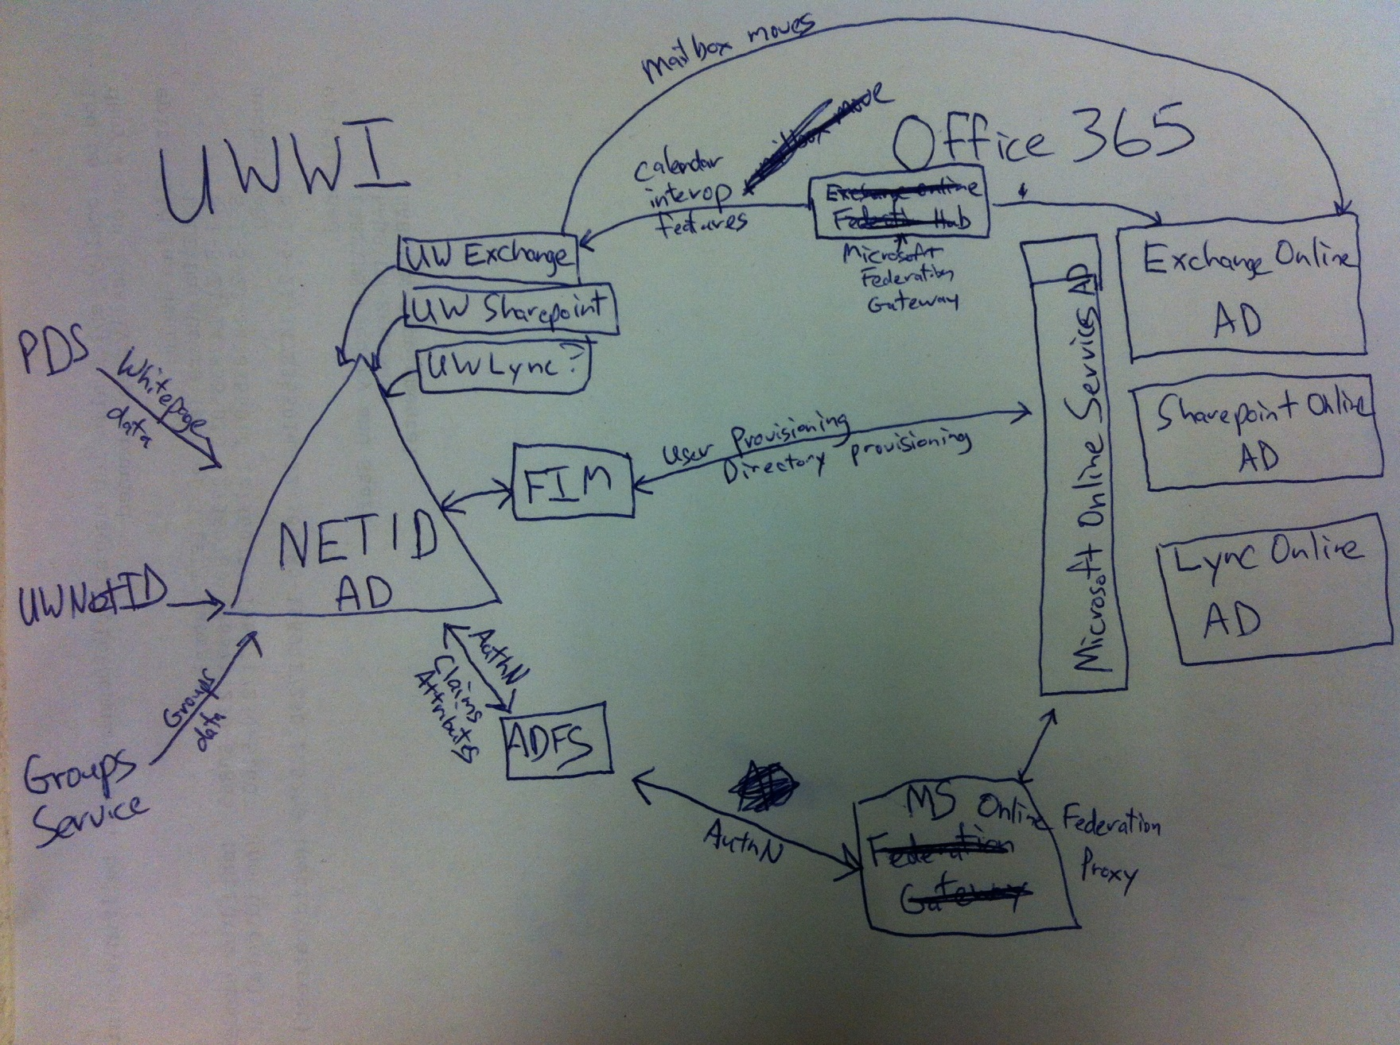

Slide 13
The End
Brian Arkills
barkills@washington.edu
http://www.netid.washington.edu
http://sharepoint.washington.edu/windows
Author of LDAP Directories Explained

