Slide 1
Identity in Education Customer Case Study: University of Washington
January 26th, 2023

Slide 2
Microsoft NDA Confidential This is a directional view of Microsoft Enterprise Mobility investments, suitable to share with others under NDA. Dates and capabilities are subject to change.
Important: This meeting is covered by your non-disclosure agreement with Microsoft and should not be discussed publicly

Slide 3
Customer Engagement Guidelines
Participation is HIGHLY encouraged.
Live chat and ask questions about the presentation in the chat window.
@mention the person you’re talking to whenever possible.
Thumbs-up questions or comments you would like answered or agree with. We’d like to address all of them, and this will help us prioritize if needed.
Provide examples and minimize acronyms if possible.
Stay on mute unless you are asking or answering questions.
Use the Raise Hand feature if you’d prefer to talk to the speaker. Often this is better than typing.

Slide 4
Microsoft Identity at the UW: 2021-2022 & what’s ahead January 2023
Slide deck : https://staff.washington.edu/barkills/msIdentityAtUw2022.pptx
Brian Arkills
Microsoft Solutions Architect
Svc Owner: MS Infrastructure, Windows Managed Server
UW-IT IAM tech lead
Microsoft Enterprise Mobility MVP 2012-2019

Slide 5
Overview
Tight timeline, lots to cover. Will skim lots of slides w/o much depth—you can read those
IAM at UW (2m)
My role at UW (1m)
UW MS IAM 2y timeline (0m)
AD modernization/Hybrid (3m)
VNet Hub + DNS bridge (8m)
Defederation of AAD (4m)
ADFS retirement (2m)
Legacy AuthN Block (5m)
AADC upgrade (1m)
2FA for the Web (5m)
Licensing (3m)
Azure AD as primary IdP (2m)
AAD app integration guide (1m)
What’s next for us (3m)
3-5 year predictions for HiEd (4m)
Q&A (8m)

Slide 6
IAM at the UW
Staff: 17 (15.7 FTE)
Specialists: 3 (1 opening)
Engineers/Developers: 9 (3 openings)
Leads: 3
Director & Service Managers: 2 (1 opening)
Services:
Access Management (2.7 FTE)
Authentication (1.6 FTE)
Certificate Services (.4 FTE)
Directory Services (.4 FTE)
Identity Registration (1 FTE)
UW NetID (1 FTE)
Microsoft Infrastructure (2.7 FTE)
Note: +3.9 FTE distributed across IAM business service
Technologies in use:
Custom identity management system
Custom password manager (syncs passwords to AD, MIT Kerberos, OpenRadius)
Shibboleth, Azure AD, AD, MIT Kerberos realm, & OpenRadius are central authN solutions
Custom group manager (some Grouper technology) with custom group sync to AD, Google, Canvas
OpenLDAP directories (in containment)
Web services and event queue technologies (Groups, UW NetIDs, Entitlement Provisioning)
Custom MIM connector
Unix platform & open-source dominates existing UW IAM technologies

Slide 7
My role at UW
+ Changed role
Shifted Managed Workstation service owner to James Morris
Took on Windows Managed Server service owner role
Less time for IAM & MS Identity, but stronger & coherent direction across our MS technologies

Slide 8
UW MS Identity: 2021-2022
1/2021
Defederation of Azure AD
12/2021
2/2022
5/2021
Azure based DCs deployed
2FA on the web: employees
8/2021
Shift all MI servers to Azure
12/2021
AAD as primary IdP discussion
1/2022
AAD application integration guide
Azure VNET Hub peering
2/2022
Azure based DNS bridge solution
3/2022
ADFS retirement.
5/2022
AADC upgrade/hybrid identity admin
6/2022
2FA on the web: faculty
8/2022
MS licensing
9/2022
Legacy authN block
11/2022
2FA on the web: students
12/2022
DC replacements

Slide 9
AD modernization & enabling hybrid Azure
Setup ExpressRoute to a VNet in MI subscription
2 Azure based DCs deployed in single region
New AD site for UW IPs assigned to Azure. Adjusted Intersite replication interval to 15m
Replaced ~40 MI servers in Azure (took ~1y)
Azure VNet Hub peering
Azure based DNS bridge solution
DC replacements & made Azure our business continuity site for DCs

Slide 10
Solutions: Vnet peering with Hub, Shared ExpressRoute & DNS bridge

Slide 11
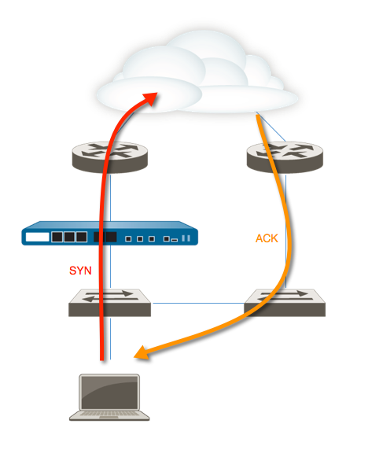
Gotcha: Asymmetric routing
Multiple network paths: client path1, server response via path2=failed connection
Advice:
Review ExpressRoute routing rules. Wrong: “Wildcard” routes sends *all* traffic from Azure to your network.
If you have an Azure service which needs a public IP: separate subnet + no gateway propagation on that subnet
Consider a load balancer in front of public IPs in Azure

Slide 12
Defederation of Azure AD
->
Why: Simplify, cut costs, align w/MS direction, avoid future Azure SQL annoyance
Customer messaging: The UW Microsoft sign in experience is changing
Azure AD Connect: Cloud authentication via Staged Rollout - Microsoft Entra | Microsoft Learn
Very little AADC:
1: setup PHS as optional in AADC before you stage
2: add users via staging groups which are specified via Azure Portal>AAD>AADC
3: cutover tenant via AADC config + PS. PS command is *quick* and uses the “deprecated” MSOnline PS module ;)
Staging group issues:
50K group member limit ☹
Only 10 staging groups ☹, i.e. max 500K staged
Minor oops: SynchronizeUpnForManagedUsers=false -> true
*Best AAD change we’ve made in 10 years*

Slide 13
ADFS Retirement
3 customers were simple transitions to Azure AD; required a little hand-holding. Minor issues:
Credential expiration
Dealing with metadata
Dynamics 365 on-premises was the tough one.
Dynamics product team: our documentation is accurate; can’t be done
Identity product team: here’s a solution paper -- worked but:
3rd party solution on top of Dyn365 had odd token use, so had to customize access token lifetime (1h -> 1d) to keep clients from going crazy
Mobile apps are hard-coded to Dynamics Online, so can’t be used. Not a show-stopper for us. We later heard the product team was working on this, and this was the reason this transition isn’t supported in documentation
Moved forward.
Now have issue with Dyn365->EO legacy authN integration, but that’s another story

Slide 14
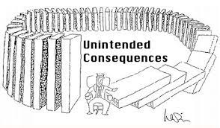
Legacy Authentication block
Performed sign in analysis, generating 3 groups of users with legacy authN use
Group 1: 3K, Group 2: 10K, Group 3: 10K
PowerBI page: IT legacy authN sign in query per user
Couldn’t handle sheer volume of data in our tenant, and silently failed to return results. ☹
Adopted last-minute iOS solution after internal debate
Phased approach:
Phase 1 blocked all via CA, with group2 & 3 as exceptions + an “authorized exceptions group”
Smaller initial phase helped refine our docs and approach since MS guidance was poor
Subsequent phases just dropped an exception group
Had to create extensive documentation of our own b/c MS’ was so poor
Had to create summary docs on all the programmatic ways to do modern authN with EO and SO b/c MS doesn’t provide overview docs, just individual ones for each different approach, scattered all over the place
Programmatic access to an Exchange Online mailbox – IT Connect (uw.edu)
Programmatic access to a SharePoint Online site – IT Connect (uw.edu)
Dyn365->EO legacy authN integration issue prompted us to extend through 1/1/2023. And get an exception for another 6 months.
Sign in logs have lots of failures ☹

Slide 15
AADC upgrade & Hybrid Identity admin
We did this for a number of reasons:
Avoid support deprecations (most of which were delayed, but at least we got ahead)
Delegate AADC support away from a global admin (me)
Get >50K group support
Gotcha: hybrid identity admin can’t deploy AADC health agent; global admin had to do this ☹
To my knowledge, MS still hasn’t fixed this

Slide 16
2FA for the web
Require users to consent on every device
Critical 2FA detail: *where* are policy enforcement points?
“for the web”=Shib IdP + Azure AD
Began as “opt in” offering for any personal UW NetID
Required:
8/31/2021: All employees (except UW Medicine)
6/15/2022: All faculty (except UW Medicine)
11/2/2022 11/21/2022: All students (except UW Medicine)
???: UW Medicine
Some help desk impact—added a couple temp FTE for each of these
Student round
Since very few students had Duo registered, we implemented “nudge/reminder” in authN flow for any student who hadn’t opted in
Stakeholder group challenges
Anxieties about impacts on course registration
Late emerging opt-in adoption percentages as a pre-req for initial requirement date

Slide 17
2FA for the web (continued)
Used Azure AD Terms of Use
MS documentation has a lot of missing gotchas for ToU
Do not create a ToU and immediately assign it to a CA policy as MS walkthrough suggests: leads to 5-25m denial of service for any user assigned while ToU is deployed to all AAD servers
Do: create the ToU assign it to a temp CA and test sign in until you actually get the ToU instead of an error
Do not use ‘Require users to consent on every device’ unless all of your devices are AAD registered; will lead to a massive incident that almost no one understands except you
Do not expect to be able to edit the frequency/duration on a ToU; you must create a new ToU each time you want to change that
You can use edit to replace the PDF in your ToU, but because of the issues noted above about deployment timing, I recommend a new version for each change to your ToU, and replacing the ToU referenced in the CA policy after verifying all look good
This effort plus other AAD authN challenges led me to write: Azure AD Authentication Troubleshooting Guide – IT Connect (uw.edu)
Unexpected 2FA, “2FA is ruining my life” (because it prompts so often), the mythical 2FA “loop”, and more were all scenarios we heard from many AAD customers
Most common fixes to AAD customer 2FA problem reports:
Device registration (aka you need a PRT to reduce interactive sign in)
You didn’t supply a correct password ☺
You have a corrupt AAD token stuck on your device. Manually delete it
You didn’t supply a correct username—you need to enter a UPN not a UW NetID
Some other tenant is requiring Azure MFA. You’ll need to register for it b/c MS hasn’t designed this very well.

Slide 18
Licensing
Historical background
Tech background: custom subscriptions system, categories, and special supersedence feature
This year's multi-month INC
Microsoft removed grace for group-based licensing, so our approach broke
Bought ~1K more A5s
Sign in activity AND opportunistic license savings
Identify users not using their paid license. Override their entitlement & downgrade them to A1 using supersedence feature in our custom subscription system. Customer just needs to sign in to remove the override
Inspecting data for licensing peaks; educated guess for next year
MS is missing a solution or two here

Slide 19
Azure AD as primary IdP discussion
Background: Oct 2021: Microsoft HiEd Conference - Can my university switch its preferred Identity Provider to Azure AD?
What happened:
Agreement among UW IAM tech leads that:
AAD should be considered one of two preferred IdPs
Until AAD supports data privacy, can’t consider removing Shib
Further analysis needed about viability & costs of migration
I recognized status quo will continue to work against AAD at the UW, so initiated a change catalyst: Azure AD application integration guide

Slide 20
Azure AD app integration guide
https://itconnect.uw.edu/tools-services-support/it-systems-infrastructure/msinf/aad/apps/integration/
Introduces the technical integrator to the terminology, concepts, and relevant config activities
Pulls together a disparate set of Microsoft documentation into a single resource
Still lacks portal navigation child pages/code blocks

Slide 21
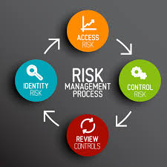
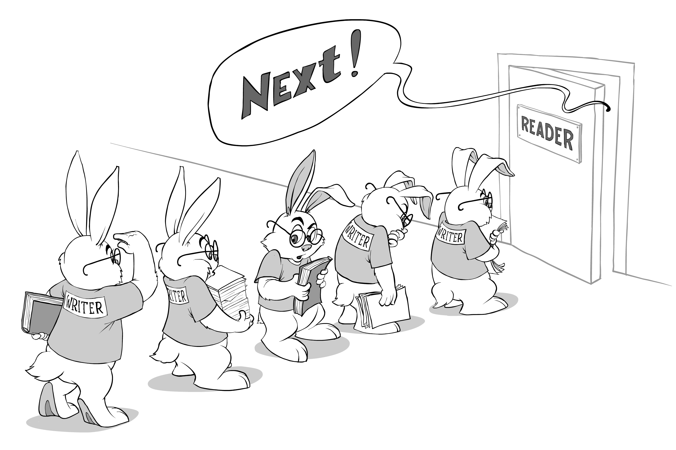
What’s next for us
WHfB: Need 2FA for Windows
Add more B2B protections. Start with lifecycle
More tightly integrate our MS Identity docs into our "enterprise" IAM documentation
MS IAM security risk analysis
Reimplement inactive users, using sign in activity as building block
Replace MIM with event queue

Slide 22
Hopeful futures
Incommon adds Sectigo’s AD-CS proxy feature to its Certificate Authority offering
MS adds missing group features & we make architecture shifts

Slide 23
3-5 year predictions for HiEd
Shib is clearly dying; AAD is the primary IdP
Requires: MS to deliver on claims data privacy & better delegation protections of application claim configuration, i.e. app owner *can’t* configure these.
Driver: Strong “pre-integration” vendor relationships, strong security + reliability foundation, & SCIM are major reasons this happens
There is a reckoning within various HiEd communities, where certain principles have been used in only one direction to justify not promoting certain vendor products.
Driver: Emergence of AAD as primary IdP forces certain individuals to face reality
Azure MFA (rebranded by that point) is the primary 2FA provider, not Duo
Driver: Emergence of AAD as primary IdP + cost savings
Requires: MS to cover some non-Azure AD use cases it doesn’t currently have solutions for
AD is more clearly dying, with 1/2 of universities in the process of reversing sync or dropping AD as part of integrated IAM stack
Driver: Lack of AD investment, shifting workloads due to features
Requires: MS delivers on missing Intune delegation features
Incommon’s recommended midPoint solution overtakes MIM market share as IAM data sync tool to AD
Driver: Poor MIM end of life planning from Microsoft ☹
Late breaking news: MS extended MIM end of life from 2026 to 2029

Slide 24
Questions?

Slide 25
The End
Brian Arkills
barkills@uw.edu
@barkills
@brian-arkills
http://blogs.uw.edu/barkills
Author of LDAP Directories Explained

