Slide 1
Leadership and Me
Brian Arkills
Software Engineer, LDAP geek, AD bum, and Associate Troublemaking Officer ☺
Identity and Access Management, UW-IT

Slide 3
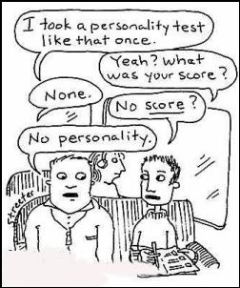
College: Self-Discovery
Notes:
First Myers-Briggs test result: XXXX. X means half way between the two options. This was my first indication that one of my defining traits is flexibility. Also taught me that temperaments aren't black or white labels, but instead are a spectrum.

Slide 4
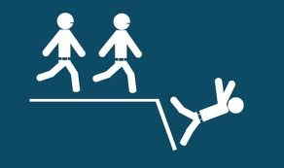
First Leadership Experience

Slide 5
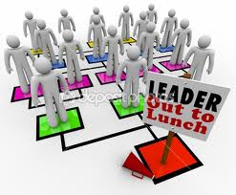
While at Stanford

Slide 6
Selective leadership led to …

Slide 7
Back at the UW

Slide 8
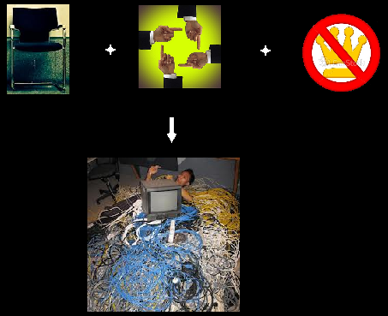
Cross Service Engineering Team

Slide 9
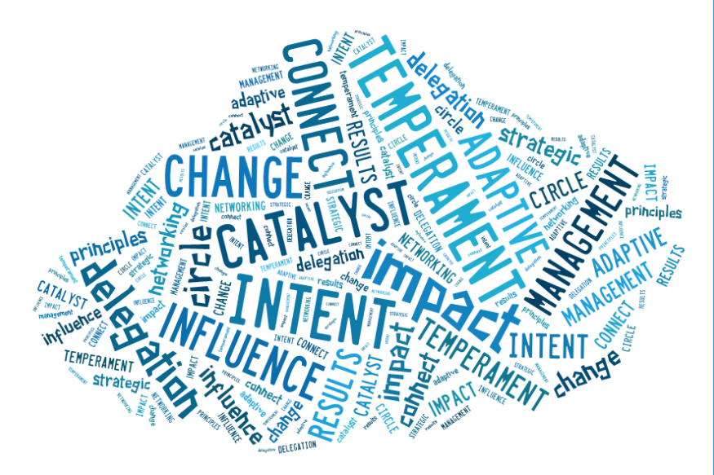
LDP

Slide 10
The End
Brian Arkills
barkills@uw.edu
http://blogs.uw.edu/barkills
http://www.netid.washington.edu
Author of LDAP Directories Explained

