Slide 1
Re-inventing Middleware in UW-IT With a Focus on Identity and Access Management
Brian Arkills
Software Engineer, LDAP geek, AD bum, and Associate Troublemaking Officer ☺
Identity and Access Management, UW-IT

Slide 2
A different talk for this conference
Most talks here:
Are Microsoft product based
Are system administrator focused
This talk is:
Not product based
Architect or software engineer focused
So an experiment. ☺

Slide 3
Points to Take Away
Extending delegation of management enables central services to be more accessible/adoptable
Improving access control capabilities greatly improves what’s possible in all services
Web services are an elegant way to aggregate and distribute data
Event messaging bus simplifies and extends capabilities

Slide 4
Agenda
UW IAM Background & Trends:
Delegated Management
Groups
Some AD user management
Improved Access Control
Group Data Ownership and Classification
Institutional Data Driven Groups: Department employees, student majors, student curriculum, Shared UW NetIDs
Technology Trends From EA Work
Messaging Bus to Enable Loosely Coupled Interaction
Web Services to Aggregate and Distribute Data
EXTRA: A Modern Enterprise Architecture for UW

Slide 5
UW IAM

Slide 6
UW IAM Background
Accounts and Passwords
UW NetIDs, Kerberos realm, 2 factor authN, CA, Weblogin, Shibboleth
Directory Services
Person & Whitepage Directories
Various Registries—clearinghouses for data sources
Access Control
Groups Service
ASTRA, role based authZ
Windows Infrastructure
Windows based AuthN/AuthZ via trust
Delegated OU service
LDAP authN/authZ for application integration
Assorted other services to enable Windows

Slide 7
UW IAM Customer Perceptions circa 2006
High quality services
Perfection preferred over timeliness
Difficult to adopt IAM services
Hard to engage IAM
Missing capabilities

Slide 8
UW IAM Customer Perceptions circa 2011
Services have functionality I need
Delivers missing capabilities in a timely fashion
Easy to adopt
Easy to engage
Considered a critical resource in any high priority UW-IT project, b/c integration with IAM services is seen as critical to success

Slide 9
What’s behind the transformation?
Focus on lean & agile methodologies
Service backlogs
Used to capture missing functionality
Used to capture important operational work
Used to capture bugs
Used to prioritize work
Used to be transparent with customers
Use of our services means success so … goals:
Release 3 delegated management features *every* quarter (was 2 last year)
Improve access control capabilities
Improve communication, making sure existing IAM capabilities are understood
Notes:
Lean = cut out unnecessary work, wasteful processes, aka “The Toyota Way”
See agilemanifesto.org for more on agile

Slide 10
Delegated Management

Slide 11
Why Delegated Management Features?
Moves responsibility into customer’s hands
Enables functionality not previously possible
Because it didn’t scale
Because there wasn’t a model for it
Because previously we had to be involved
Because there wasn’t a single steward of data element
Decreases IAM resource consumption & saves time
More attractive services b/c more capability

Slide 12
Delegated Management – Accounts & Directories
Accounts and Passwords
Self-service UW NetID sponsorship with low-assurance identity vetting
Federation based UW NetID sign-up processing for undergrad applicants (CollegeNET)
Self-service Admin/Temp UW NetID sponsorship
Directory Services
Person Registry Source Web Service enables capability to create/modify people
Self-service management of Display Name*
Notes:
The new CollegeNet process puts UW Admissions and the applicants in the driver seat.
*More capabilities coming here

Slide 13
Delegated Management – Access Control and Windows
Access Control
Group self-management
Web service client based apps like groupsync.exe
Self-service management for UW-IT provided services
Delegated management to IT staff for UW-IT provided services*
Windows Infrastructure
Delegated OUs
1 way forest trust creation
User management*
Delegated migration capabilities
Notes:
* This capability is limited today
See slide # 49 for demos if time allows

Slide 14
Improved Access Control

Slide 15
Improved Access Control
Central groups service seen as critical driver
Data classification for institutional groups
Institutional data driven groups
Shared UW NetID admin groups
Curriculum groups
Student major groups
Departmental employee appointment groups
Institutional group = Group formed by data in core UW business domains, where changes are automatically reflected in corresponding group

Slide 16
Groups Service
Defines a structured UW Group ID namespace
Provides fine-grained access control
Have some institutional groups:
Course groups
Affiliation groups (uw_employee, uw_student, etc.)
Student major groups
REST API for programmatic CRUD operations
Browser based UI for interactive management
Hourly sync to AD, selective event-based sync to GAE cloud
Notes:
Invested a lot of time in building up Groups Service

Slide 17
Data Classification for Institutional Groups
Primary goals:
Identify data trustee/custodian for institutional groups, come to common agreement on:
Acceptable use
Data classification
Access control risks that are acceptable
Protect data assets appropriately
Develop good guidelines so anyone at UW can re-use
Secondary goals:
Adjust institutional group names where needed
Through exercise, make it easier to add future institutional groups

Slide 18
Critical Element: Data Custodian Map
Notes:
University-wide Data Management Committee plays a key role in terms of forming data policy and strategic direction
Also key to enterprise architecture

Slide 19
Classification Points of Interest
Classify each institutional group as {Public, Restricted, Confidential}
Examine additional “impact factors” (see NIST SP 800-122), e.g. this data plus that data adds up to trouble or in only this use case it’s OK
Use classification plus impact factors to decide on technical control
Recognize that not all risks can be controlled via technical enforcement
This is all about Risk Management

Slide 20
Decision Points for Group Custodians
Membership Viewer control
UW Exchange and/or Cloud integration
Authorized Senders control
Release of attributes approval (SAML based AuthZ)
Application integration approval process (app Z needs membership access to perform AuthZ)

Slide 21
Shared UW NetIDs
Uses are:
Departmental uses such as public Web sites and role-based email accounts
Course web sites and shared management of courseware
Mailing lists and other email forwarding

Slide 22
Shared UW NetIDs as Institutional Groups
Problem: Who is behind the curtain? Shared passwords and lack of lifecycle should be reduced.
Solution: Create/publish a group for each Shared UW NetID indicating the recognized administrators for it.
Enables: Access control (via the personal UW NetID of the admins) to various services which integrate with Shared UW NetIDs. In the future, this will allow us to remove passwords from many Shared UW NetIDs reducing shared password risk.

Slide 23
Student Major Groups
uw_major_art OR uw_major_2011spr
uw_major_art_pathway-70 or uw_major_art_pathway-70_2011spr = Ceramics major, a subdiscipline of Art, in current quarter
Retain last 3 quarters
uw_employee can view membership
Group description: registrar URL about FERPA
We may need additional subdivisions in future, including: branch, degree level, degree type, class standing. Existing naming allows for this possibility.
Notes:
Shortest name is same as current quarter

Slide 24
Curriculum Groups
Not here yet, but on our radar
Similar to course groups
Include all students registered for a class in a specific curriculum, e.g. Art
Would be used to provide access control to academic department provided resources
Currently, folks manually find and nest all the course groups for a given curriculum in their own curriculum groups

Slide 25
Department Employee Groups
No exact data set that provides easy win
Leverage Enterprise Data Warehouse, HR data, and Reporting Services capabilities
Departments use a “My People” report to refine a set of characteristics that define their departmental employees
This report displays Employees by selected Appointing Department, Home Department or Distribution OrgCodes
Department passes TSQL query output of report to Groups Service to define a new institutional group

Slide 26
Department Employee Groups
This capability has been in pilot for 2+ years, and is just now being released
http://decisionsupport.washington.edu HR reports, My People
https://iam-ws.u.washington.edu/group_ws/v1/group/uw_org_208_distbdgt_2009_043550_staff Current UW staff with UW NetIDs, whose appointments have a Distribution Budget Number 04-3550 (UW FINANCE&FACILITIES: CAMPUS OPERATIONS: POWER PLANT) during the 2009 biennium

Slide 27
Where’d Event Messaging and ROA Web Services Come From?
Re-examining our enterprise architecture came out of plans to replace the core administrative business systems at the UW
Business Architecture – capability requirements
Information Architecture – structured data
Application Architecture – connect the dots, provide topical capabilities
Technology Architecture – how the data and capabilities are delivered
Notes:
EA is an active topic within HiEd with lots of discussion on ITANA, IT Architects in Academia
Lots of frameworks out there, some conflicting. Lots of complexity and evolution.
See slides 42-53 at end of deck for lots more material on this.

Slide 28
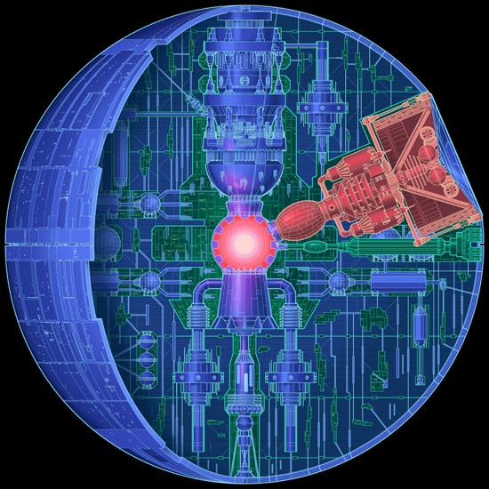
From Spaghetti Mess to Wow

Slide 29
Application Architecture Wins
Enterprise Data Warehouse build out (with Web Service front-end)
Student Web Service
Network monitoring (Meerkat)
Web Services has become preferred way to aggregate & distribute data
RESTful web service templates and ROA consulting available to departments
Notes:
Note that most of these are enablers, either via making data more accessible or allowing delegation of control.
ROA = Resource Oriented Architecture

Slide 30
Application Architecture Wins--IAM
Person Web Service
Added XML and JSON representations
Person Registry Source Web Service
Role based Authorization Web Service (ASTRA)
Integrates with Groups and Data Warehouse
Groups Web Service
Groups integration with Google Apps and UW Courseware

Slide 31
Developing Application Architecture
Workflow Web Service - integrating disparate workflow functionality
Enterprise Message Queue service
More sophisticated data flow from Mainframe -event messaging form, leveraging SQL Data bridge, triggers, and message queue
Real-time AD Group Sync Agent
Re-design of Network/DNS contact database

Slide 32
Why Web Services?
Can aggregate disparate data sets into useful resources
Consumable from almost any platform or language
Scalable, high-performing, re-usable
Modularity because of ROA allows easy replacement

Slide 33
Web Service Details
ROA -- Resource Oriented Architecture
One characteristic beyond REST (i.e. stateful web services): Nouns, not verbs
Models real-world closely, enabling business capabilities
Consistent definitions for data, enabling re-use and promoting cross-university coordination
Supports decentralized decision-making (sound like a university?)
Low barrier to adoption
Allows business process improvement/agility*
Notes:
An example: Student Web Services adopted a ROA approach and was able to quickly respond to a UW President mandate that there be an iPhone app developed by external vendors

Slide 34
ROA Example
Resources
Their names (URIs); addressability
Your employment status at the UW
http://webservices.uw.edu/identity/person/rberk/employee/employmentstatus
Uniform Interface (GET, PUT, POST, DELETE)
GET /identity/person/rberk/employee/employmentstatus <EmploymentStatus>ACTIVE</EmploymentStatus>
PUT /identity/person/rberk/employee/employmentstatus <EmploymentStatus>SEPARATED</EmploymentStatus>
Notes:
Addressability: All information can be exposed via URIs. URIs allow applications to connect to useful data and to reference useful data on other servers around the world.
Uniform Interface: only HTTP CRUD methods. Very simple interface that is understood by all HTTP clients There isn’t variation in the verbs ONLY in the nouns. Nouns, not verbs. Resources, not actions. Vs. an interface such as GetEmployee or GetEmploymentStatus or RetrieveEmploymentStatus or SeparateEmployee or ActivateEmployee

Slide 35
Why Event Messaging?
Allows loose coupling, i.e. 3rd party mediator
Better capacity & availability (commodity service)
Flexibility to add/drop components b/c:
modular components
events queue up
Can separate data integ. & monitoring from app
Enable time-based processes and pattern correlation
Delta processing vs. intensive state-based processing
Translates into Robust and Scalable Transport

Slide 36
Event Messaging Details
1 producer : many listeners to many producers : 1 listener
One MQ can directly feed one or more other MQs, with mirroring and virtual queues
Messages can persist beyond listener ack.
MQs can span servers with automatic client failover
Listeners can listen to many MQs at the same time
C, C++, Java, C#/.Net, Perl, Ruby, Python, Javascript
ActiveMQ is what UW (and Amazon) uses

Slide 37
Simple Example: AD Group Sync
Today: pulls data from OpenLDAP to AD
Periodic query w/ 1 hour latency
Can’t process large groups often – once/day
Impacts production directories
Future: push-based event MQ
Near real-time latency
Only processes deltas, so changes to large groups are no problem
Loose coupling means no direct dependency/impact on other prod dirs

Slide 38
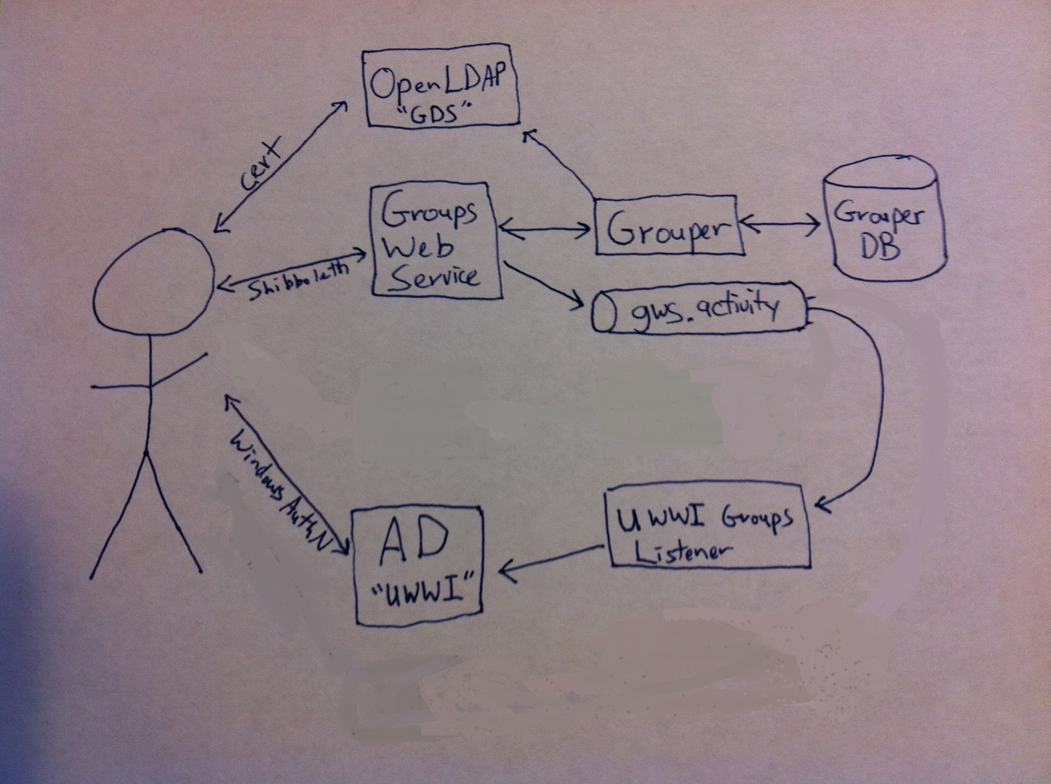
Groups to AD Event Queue

Slide 39
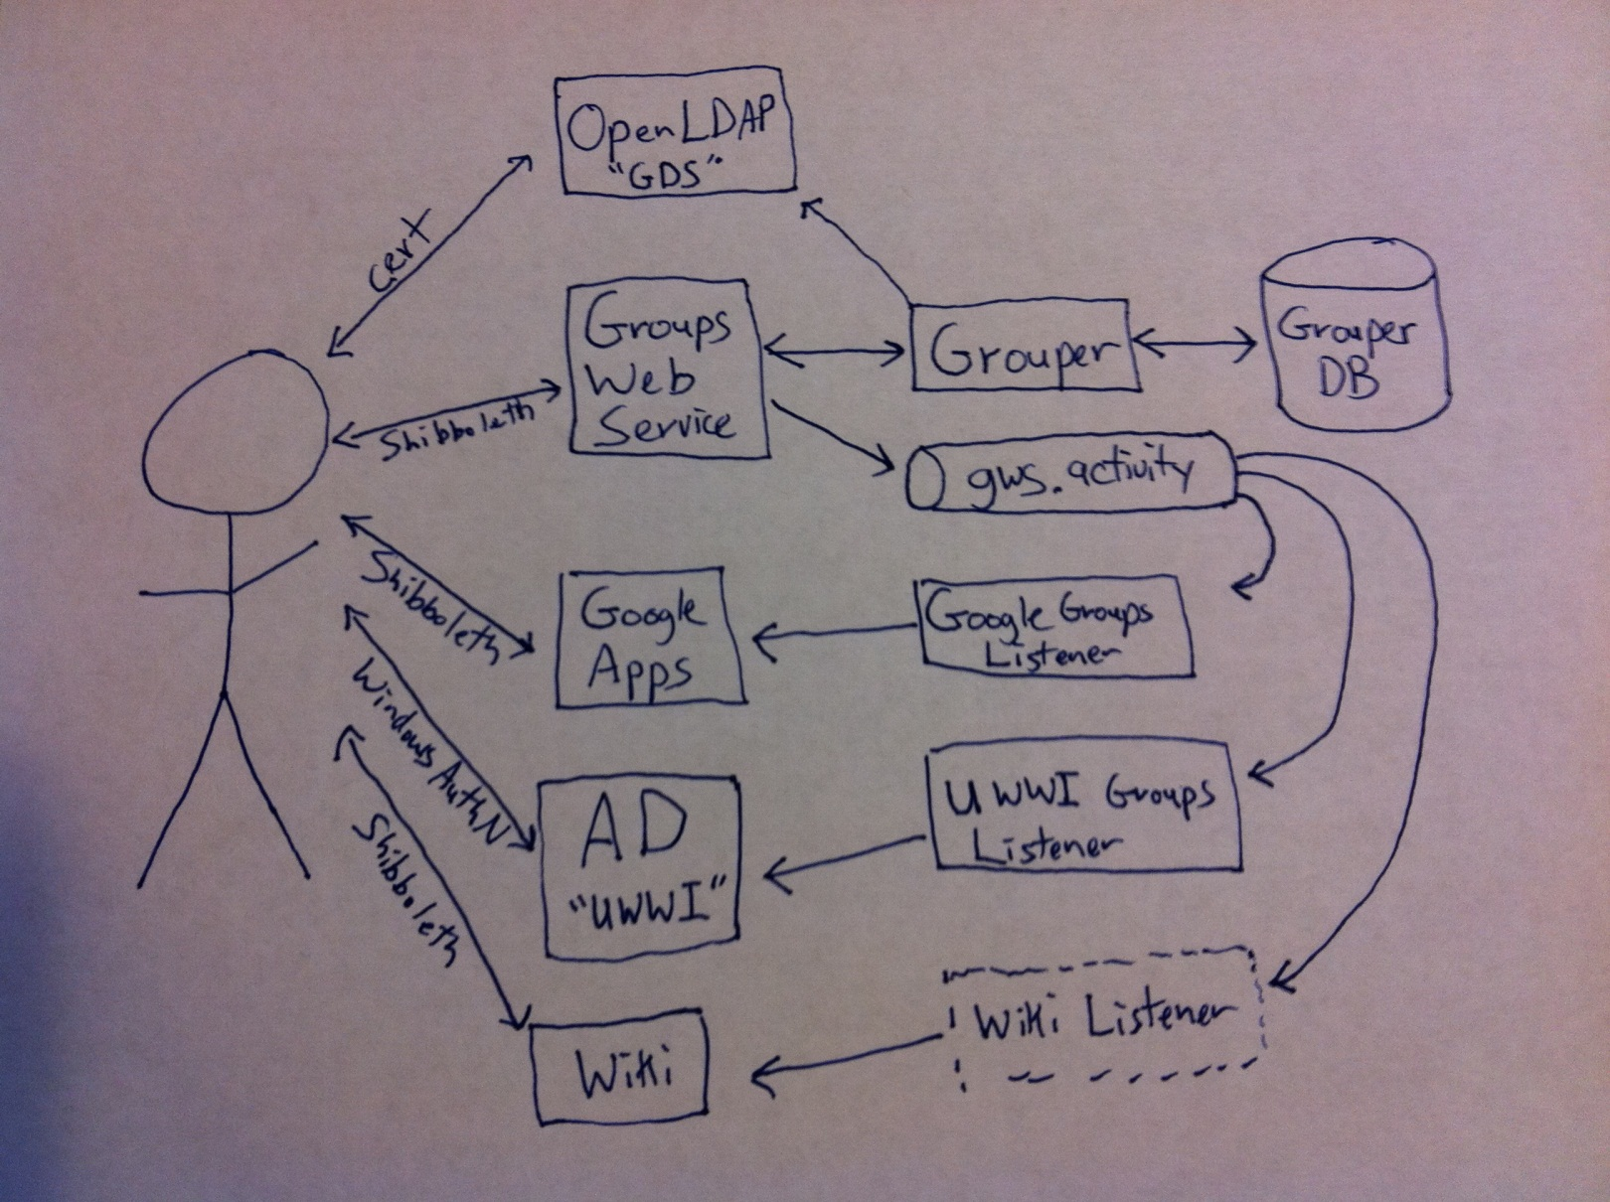
Groups Event Queue

Slide 40
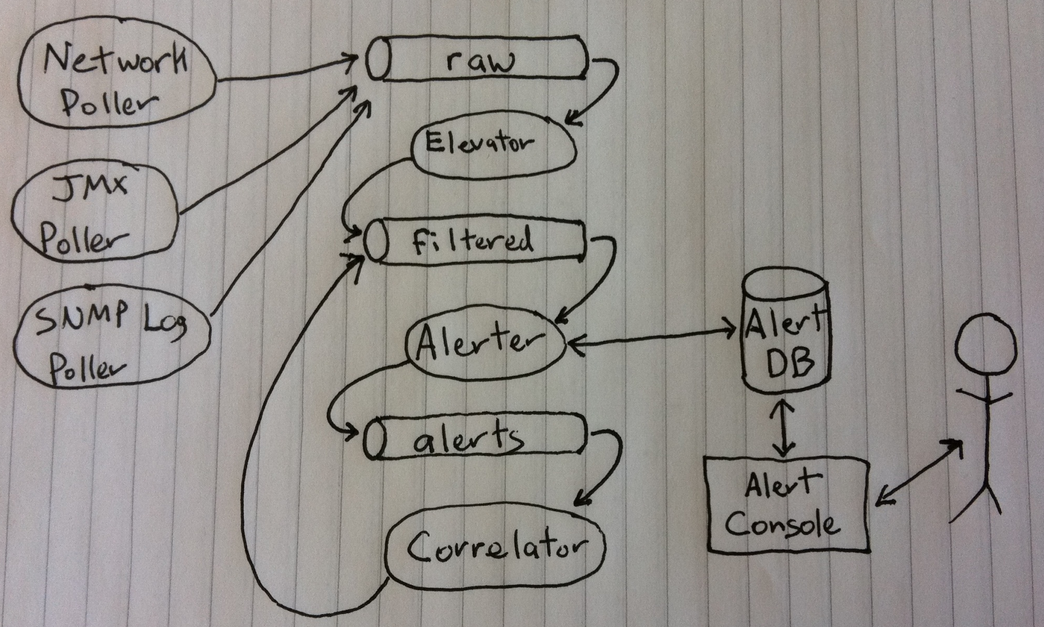
A Complex Example: Network Monitoring
Notes:
See slide # 54:
-Network Sources: Network poller, JMX poller, SNMP Log poller
-These sources dump all events onto event message queue “raw”
-A listener “elevator” identifies important events on “raw” and puts them onto event queue “filtered”
-An listener on “filtered” feeds all events into a DB which feeds to a UI, an Alert Console for operators, & also feeds all events to event queue “alerts”
-A listener on “alerts” watches for combinations of events which together have meaning, putting new events back on event queue “filtered”
-Additional listeners (not pictured) on “filtered” feed our ticket tracking system, and result in pages. Also KPI is fed from DB.
-Note how easy it is to add additional sources, consumers

Slide 41
Got All That?

Slide 42
Points to Take Away
Extending delegation of management enables central services to be more accessible/adoptable
Improving access control capabilities greatly improves what’s possible in all services
Web services are an elegant way to aggregate and distribute data
Event messaging bus simplifies and extends capabilities

Slide 43
The End
Brian Arkills
barkills@washington.edu
Identity and Access Management
http://www.netid.washington.edu
Blog: http://sharepoint.washington.edu/windows
Author of LDAP Directories Explained

Slide 44
Extra Demos If Time Allows
Support Tool https://uwnetid.washington.edu/support/
Groups Service https://iam-ws.u.washington.edu/group_ws/v1/
Membership viewer
Membership details page
Search capability, respecting membership viewer controls
Applications feature, exchange & google
History page, respecting membership viewer controls
Move/rename capability
Manage Tool https://uwnetid.washington.edu/manage/
Sponsored UW NetID process https://uwnetid.washington.edu/sponsor/

Slide 45
Enterprise Architecture @ UW
Re-examining our enterprise architecture came out of plans to replace the core administrative business systems at the UW. Still in development.
Business Architecture – capability requirements
Information Architecture – structured data
Application Architecture – connect the dots, provide topical capabilities
Technology Architecture – how the data and capabilities are delivered
Notes:
EA is an active topic within HiEd with lots of discussion on ITANA, IT Architects in Academia
Lots of frameworks out there, some conflicting. Lots of complexity and evolution

Slide 46
How?

Slide 47
Ingredients for Success
To evolve your application architecture, you will need:
Guiding Principles to Steer Decisions
Business Capabilities Analysis (i.e. partnerships)
Data Governance (i.e. partnerships)
Technology Expertise

Slide 48
Business Capabilities: HiEd
Strategic Capabilities
Knowledge Creation
Knowledge Transfer
Innovation
Global Citizenship
Discovery
Prospect Management
Learning
Relationship Management
Service Capabilities
Healthcare
Revenues & Funds Management
Community-Facing Capabilities
Community Enrichment
Marketing & External Affairs
Finance
HR/Payroll
Asset Management
IT
Contract Management
Supporting Capabilities
Strategic Capabilities – what outcomes we want our services to result in
Service Capabilities – what we deliver
Community-Facing Capabilities – what we do to connect people to our services
Supporting Capabilities – what we do to support delivery of our services
Notes:
Start broadly, then drill down.
Each capability will yield more details, e.g. under payroll, you have the capability of paying people, which relies on a bunch of other capabilities, etc. Each of these capabilities has processes, supporting technology, supporting information, even metrics.

Slide 49
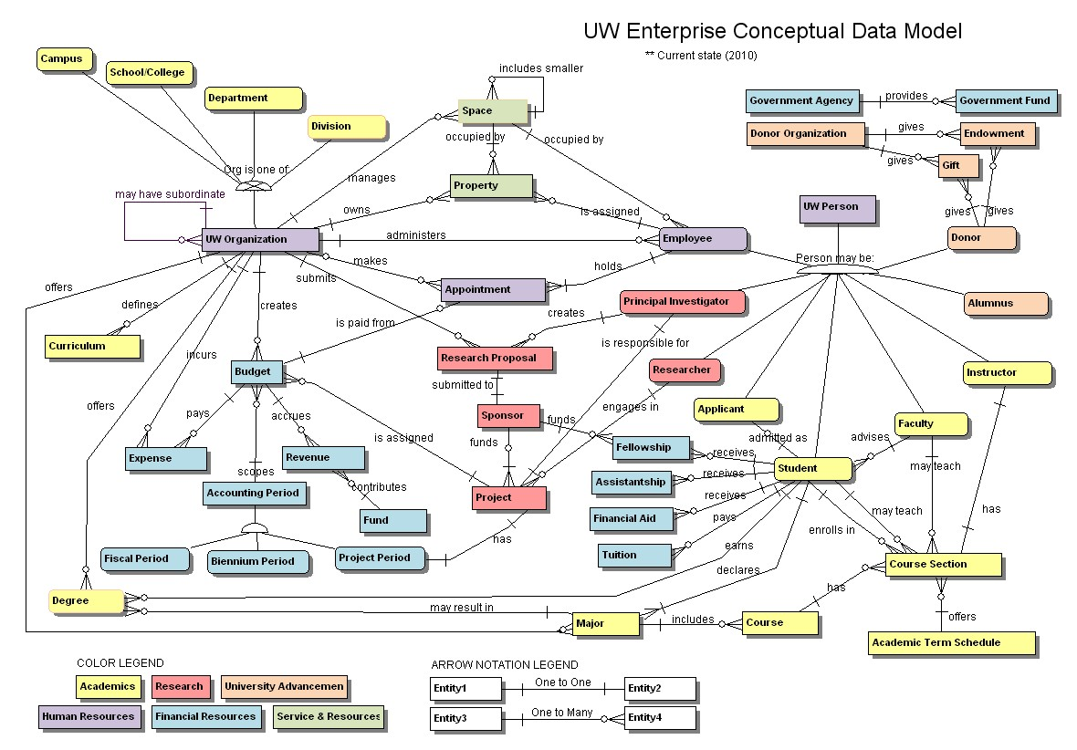
Conceptual Data Model
Notes:
Captures relationships between conceptual data. Enables data integration across the University. One step closer to being able to transform data into structured information.

Slide 50
Envisioning Apps
UI: Users have single point of access for related functionality. UI separation from application layer promotes re-usability and consistency.
App layer: provides application specific logic, consumes services via mashups.
Service integration layer: consistent exposure of services, may support integration from multiple technologies
Service layer: provides business logic (separate from app logic), has clearly defined contracts
Data integration layer: consistent exposure of data, may support integration from multiple technologies, consolidation of data by data domain
Data layer: Raw data, definitions
Notes:
These layers help you to envision possibilities; they aren’t rules. Many apps will combine some of these layers as appropriate. But often an app should separate some of these layers because there is an increased value over the cost to do it that way.
Where does the increased value come from? Clearer dependencies (via loose coupling), increased availability, better performance, more scalability, more security, re-use across multiple applications.
Apps which separate these layers are more flexible and more often succeed—e.g. think of the apps which leverage AD for authN, authZ.

Slide 51
UW Application Architecture: Current State
1000s of point-to-point integrations
Lots of integration patterns that don’t scale:
File transfers
Shared databases
Database extracts
Many languages and platforms
Redundant applications and functionalities
Little coordination of app development = silos
Tactical, not strategic decision making
Aging legacy systems
Notes:
Look more closely at App Arch

Slide 52
Current state: A picture

Slide 53
Current State: A Game of Data Telephone

Slide 54
Future State Vision
Characteristics:
Loose coupling
High availability
High performance
Scalable
Secure
Re-usable
Keys to Transition:
ROA Web Services aggregating/re-delivering structured data
Event messaging bus simplifying data exchange, allowing easy scale out

Slide 55
A Complex Example: Network Monitoring
Notes:
See slide # 54:
-Network Sources: Network poller, JMX poller, SNMP Log poller
-These sources dump all events onto event message queue “raw”
-A listener “elevator” identifies important events on “raw” and puts them onto event queue “filtered”
-An listener on “filtered” feeds all events into a DB which feeds to a UI, an Alert Console for operators, & also feeds all events to event queue “alerts”
-A listener on “alerts” watches for combinations of events which together have meaning, putting new events back on event queue “filtered”
-Additional listeners (not pictured) on “filtered” feed our ticket tracking system, and result in pages. Also KPI is fed from DB.
-Note how easy it is to add additional sources, consumers

Slide 56
Network monitoring
Network Sources: Network poller, JMX poller, SNMP Log poller
These sources dump all events onto event message queue “raw”
A listener “elevator” identifies important events on “raw” and puts them onto event queue “filtered”
A listener on “filtered” feeds all events into a DB which feeds to a UI, an Alert Console for operators, & also feeds all events to event queue “alerts”
A listener on “alerts” watches for combinations of events which together have meaning, putting new events back on event queue “filtered”
Additional listeners (not pictured) on “filtered” feed our ticket tracking system, and result in pages. Also KPI is fed from DB.
Note how easy it is to add additional sources, consumers

