Slide 1
MS Tech: What’s changing at UW? October 2019
Managed Workstation is hiring—ask me for details! ☺
Brian Arkills
Microsoft Solutions Architect
UW-IT

Slide 2
Status quo vs engagement & change
There’s been a lot of status quo for the past 5 years
But change is in the air!
What drivers have changed?
Email Modernization project
UW Medicine ITS leadership change + strong interest in Microsoft stack
Microsoft maturing/refining some of its cloud solutions
Our comfort levels around cloud solutions
Renewed interest & engagement

Slide 3
Adapting to change
People are at heart of change: the hardest part of change is changing culture
This means people-friendly messaging is one of the most important things we can invest in
Also means adaptability is important
Transparency helps you level-up = trust multiplier
“The plan” will work better if everyone knows it
Those who need to know should have access to info
Clear responsibility expectations
Even being clear about failure helps multiply trust
You felt better hearing directly from responsible parties that the IdP and Groups Svc had problems on first day of school, right?

Slide 4
What has changed?
Kerberos, SMB & RDP port blocking at border (4/2019 & 4/2018)
UW-IT Windows File Service replacing many departmental file services
Microsoft 365 licensing assignment mechanisms in place
Clearer approval process for provisioning Office 365
Azure AD PHS enabled
UW ExpressRoute queueing up interested customers
Log Analytics has emerged as highly useful log/search capability—all 4 UW-IT MS services using it
Other cloud analytics also emerging as highly useful, e.g. Windows Analytics

Slide 5
More has changed
Defender ATP pilot – MWS team (~10) using this for their computers
MWS ditches WSUS; now uses Windows Update for Business. Working well so far. ☺
MWS ditching MDT for imaging; now using SCCM OSD
Working well
Push imaging (e.g. for compromised computers) & ‘reimage now’ OSD features coming soon

Slide 6
Attempted but failed change
Azure Files + WFS as SMBv3 mounted disk cache on sync servers.
Can’t reshare SMBv3 mounted disk ☹
Next attempt: Azure Files + Hosted server with slightly more expensive disk

Slide 7
Microsoft-initiated change
Too many new things to list … and what do you count? Private preview, public preview, or GA? New products or new features?
Disable Exchange Online basic authN: 10/13/2020
End of life:
Windows 7 January 14, 2020
Windows Server 2008 January 14, 2020
Windows Server 2008 R2 January 14, 2020
SQL Server 2008 July 9, 2019
SQL Server 2008 R2 July 9, 2019
Windows 10 1607 April 9, 2019
Windows 10 1703 October 8, 2019
Windows 10 1709 April 14, 2020
Windows 10 1803 November 10, 2020
Office 2010 October 13, 2020
Office ProPlus 1708 (SA) March 12, 2019
Office ProPlus 1803 (SA) September 10, 2019
Office ProPlus 1808 (SAT) March 12, 2019
Office ProPlus 1808 (SA) March 10, 2020

Slide 8
What is coming soon? (6 months?)
MFA for Azure AD/Office 365
Azure AD Application Proxy emerging, likely an offering soon
UW Sharepoint 2010 shutdown (3/31/2020)
Hybrid AAD join enabled for NETID
Office ProPlus device based licensing (v1909+)

Slide 9
What is coming (1 year?)
Hub-spoke Azure VNET architecture, with NETID DC in hub VNET (only DC communication permitted)
Domain/Global Admin risk mitigations?
just-in-time roles
privileged-admin-workstations & trust tiers
risk mapping, &
other pass-the-hash help and risk practices
Azure AD Domain Services?

Slide 10
Unclear when, but high interest
InTune shared service offering
UW Medicine AMC domain shift?
Clear UW-IT strategy for MS
M365 A5 capabilities
Defender ATP, Cloud App Security, Azure Info Protection, Exchange ATP, PowerBI, To-Do (plan 3), Premium Encryption in O365
Direct group sync integration for Azure AD/O365
Office groups, Teams, DLs, etc
Modernize existing AD user provisioning integrations
Build economies of scale around Managed Workstation infrastructure?

Slide 11
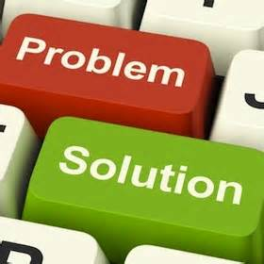
Your Questions? Unmet Business Needs?
Yes, I have a bunch more slides if you don’t have questions, but I’ve dominated the direction so far, so your turn. ☺

Slide 12
Goal: Informal interaction
Lacking audience-provided topics, here are seed topics:
When should new tenant be created?: 1 slide
MFA with UW Microsoft technologies: 3 slides
UW’s MS Campus Agreement : 1 slide
AAD tokens: different types, lifetime, revocation : 4 slides
AAD Apps: OAuth & user consent : 6 slides (pair with tokens topic)
AAD App Proxy (Hybrid AuthN) : 2 slides
AAD Device Registration Service
AAD Conditional Access: control token issuance : 3 slides
InTune service? : 1 slide
Azure Info Protection: control data access : 1 slide
AAD Roles: PIM, RBAC, AUs : 1 slide
Inactive users update : 1 slide
Pass the Hash mitigations: ATA, PAM, PAWs : 3 slides
Hybrid Cloud, DCs, & AAD-DS : 5 slides
Architecture pictures: 2 slides

Slide 13
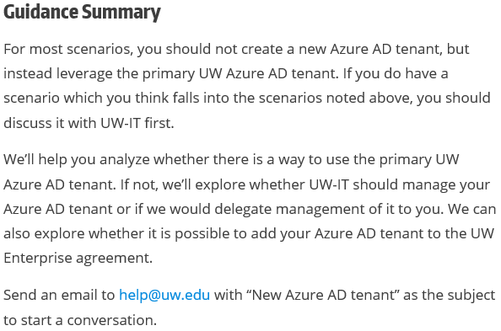
When should a new AAD tenant be Created?
https://itconnect.uw.edu/wares/msinf/aad/new-aad-tenant/
Visit this page! Good background & subscription links
Return

Slide 14
MFA for Azure AD & O365
Project launched
Duo is primary solution; other design in progress
Possible outcomes:
Simplify greatly: stop doing federated authentication & move to Password Hash Sync, with different UI
Continue existing double federation arch
“Remember me” to save Duo costs
Certainties:
Default result of enable: MFA required for all AAD apps
Legacy clients compatibility = possible user impact
Opt-in to enable?
Conditional Access policies

Slide 15
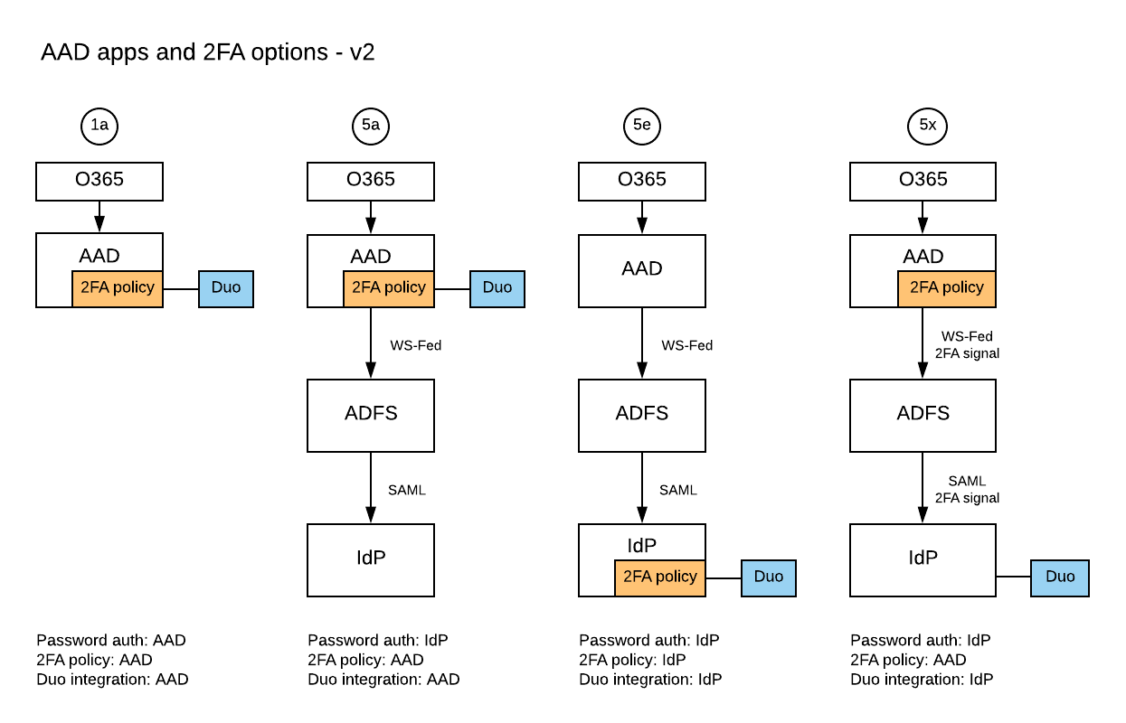
MFA: architectural decision points
Where do I trigger the need for MFA?
Where do I enforce MFA?
Block legacy authentication?

Slide 16
MFA: Windows host-based
Aside from Hello for Business, no good way to require 2FA at AD level
HfB not considered strategic -> no investment planned
Duo integration for Windows (RDP): https://wiki.cac.washington.edu/x/5wVNBQ

Slide 17
UW’s MS Campus Agreement
Includes Microsoft 365 A3 licenses in quantities equivalent to (Workday count of employees) + (IPEDS count of students)
UW-IT has entitled/assigned A3 to:
Employees (including UW Medicine workforce)
Students
PRT enabled other UW NetIDs
Lost entitlement -> loss of license (includes mailbox)
Note: Lots of possible things which require shared service design & central commitment to facilitate
Return

Slide 18
AAD tokens – 1
Token type | What | Restrictions
Access tokens | Get access to resource | User+client+resource bound; can’t be reused if any of those change Can’t be revoked; can only be deleted by user or expire
Refresh token | Get a fresh access token; think of it as a cached authorization code | User+client bound Can be revoked¹
ID token | Proof of authentication. Includes some user profile info | User+client
SSO token | Browser cookie KMSI=yes: persistent KMSI=no: session Special version of the refresh token (I think) | User+session bound Can be revoked¹
Primary refresh token (PRT) | Uber Refresh/SSO token | User+device bound Windows 10 only Must be AAD joined (or hybrid) Can only be stopped via: Deleting AAD device Disable AAD user
^{References:}
https://docs.microsoft.com/en-us/azure/active-directory/active-directory-configurable-token-lifetimes
https://jairocadena.com/2016/11/08/how-sso-works-in-windows-10-devices/
https://blogs.technet.microsoft.com/educloud/2017/06/14/how-to-kill-an-active-user-session-in-office-365/
¹ Revocation is a complex topic; don’t rely on this too much w/o a deeper understanding.

Slide 19
AAD tokens - 2
KMSI dialog only governs browser cookie; no=browser session bound, yes=persists across browser sessions
Many of the AAD tokens have long lifetimes
Browsers are not only SW managing Azure AD token, e.g.
iOS: the app, unless MS Authenticator
Windows: depends on OS & Office version
Federation: upstream tokens: UW ADFS & UW Shibboleth
Getting rid of a cached AAD token is problem: need to know the specific client details & the recipe for that specific scenario.
Recent “Outlook” incident, some corrupt cached AAD tokens had to be manually deleted.
Apps have to actually enforce token lifetime; many do not ☹
There’s a lot more to this

Slide 20
Lifetime Policies
Property | Affects | Default | Minimum | Maximum
Access Token Lifetime | Access tokens, ID tokens, SAML2 tokens | 1 hour | 10 minutes | 1 day
Refresh Token Max Inactive Time | Refresh tokens | 90 days | 10 minutes | 90 days
Single-Factor Refresh Token Max Age | Refresh tokens (for any users) | Until-revoked | 10 minutes | Until-revoked¹
Multi-Factor Refresh Token Max Age | Refresh tokens (for any users) | Until-revoked | 10 minutes | Until-revoked¹
Single-Factor Session Token Max Age | Session tokens (persistent and nonpersistent) | Until-revoked | 10 minutes | Until-revoked¹
Multi-Factor Session Token Max Age | Session tokens (persistent and nonpersistent) | Until-revoked | 10 minutes | Until-revoked¹

Slide 21
Revocation – events instead of timeout
 | Password-based cookie | Password-based token | Non-password-based cookie | Non-password-based token | Confidential client token
Password expires | Stays alive | Stays alive | Stays alive | Stays alive | Stays alive
Password changed by user | Revoked | Revoked | Stays alive | Stays alive | Stays alive
User does SSPR | Revoked | Revoked | Stays alive | Stays alive | Stays alive
Admin resets password | Revoked | Revoked | Stays alive | Stays alive | Stays alive
User revokes their refresh tokens via PowerShell | Revoked | Revoked | Revoked | Revoked | Revoked
Admin revokes all refresh tokens for the tenant via PowerShell | Revoked | Revoked | Revoked | Revoked | Revoked
Single sign-out on web | Revoked | Stays alive | Revoked | Stays alive | Stays alive
Return

Slide 22
AAD Apps: Why - 1
SaaS apps: Azure AD Application Gallery or 1st party
UW AuthN integration, links AAD user to SaaS app user
With proper licensing, could do conditional access
If app supports, automate (de)provision SaaS app user
Can get data from other AAD apps like O365 (note: some Office add-ons are this, e.g. FindTime)
Unless you need b, c, or d, we recommend you integrate via Shibboleth
UW Developer
1a, 1b, 1c, 1d, and 1e continue to be true here
You may not actually be writing code … you may just want to enable some Azure service to use @uw.edu identities. This is a special case of 1d. ☺
Gotcha: application identity credential expiration

Slide 23
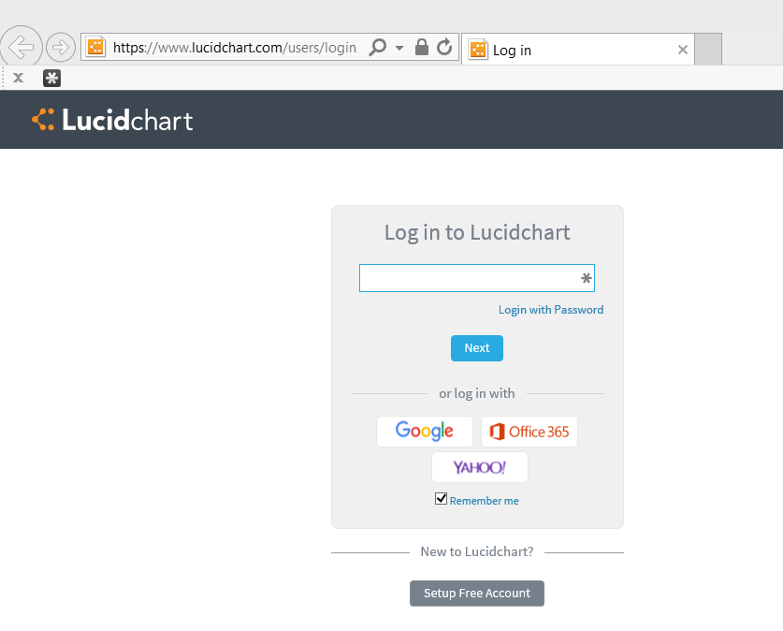
An AAD app example: step 1

Slide 24
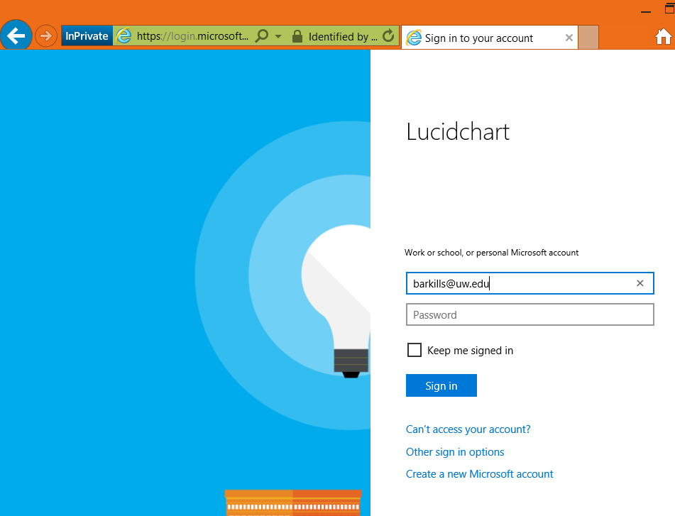
AAD app example: step 2

Slide 25
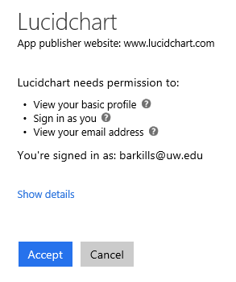
AAD app example: step 3

Slide 26
AAD Apps: What (basics) - 2
This is an identity.
“Azure AD Application” = 1 Azure AD application object + many Azure AD service principal objects
App object: definition template. Includes needed permissions, endpoint, name, etc. Needs a credential, which expires.
SP object: Can assign users, tracks user consent
https://itconnect.uw.edu/wares/msinf/aad/apps/basics/

Slide 27
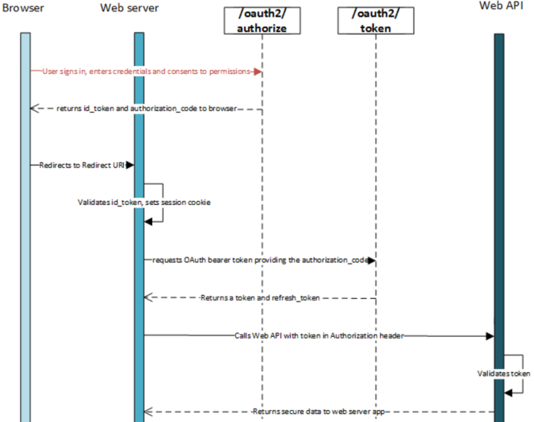
AAD Apps: Oauth & consent - 3
Return

Slide 28
AAD App Proxy (Hybrid AuthN)
Cloud based endpoint that MS secures
Can add Conditional Access & Azure MFA goodness in front of existing apps
Can easily re-invigorate existing IWA apps w/o touching their code
Cloud Hybrid Print
Only requires AAD basic ☺

Slide 29
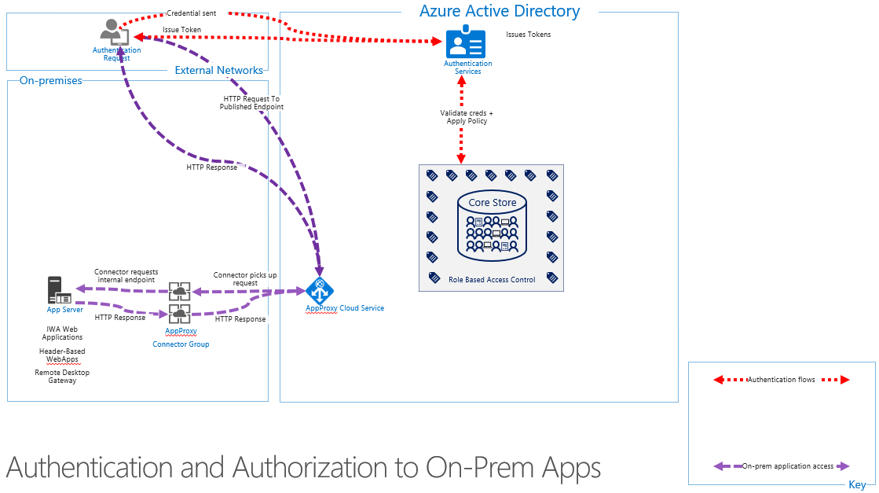
App Proxy Diagram
Return

Slide 30
AAD Device Registration Service
This is an under-emphasized AAD system; does what its name suggests
Responsible for:
AAD device join
AAD workplace join
Some MDM capabilities
Certificate issuance related to the above for the purposes of Enterprise Data Protection, Hello for Business, + more
NOTE: only one MDM provider per tenant; must contact MS to change it.
Return

Slide 31
AAD Conditional Access
Policy governs whether a given user can get an AAD access token (to a given AAD app) based on conditions.
Most common CA policies (all in use at UW):
For users in group A, require MFA for all AAD apps
For users in group B, require MFA for all AAD apps except from known locations
For users in group C, block access to apps X,Y, & Z

Slide 32
AAD CA: conditions
Which AAD app?: All or selected
User conditions: identity, group membership, session risk, more coming …
Device conditions: OS/platform, location (IP range/ country/region), client app, “compliant”, lost/stolen
More coming …

Slide 33
AAD CA: controls
Access controls: allow sign-in, block sign-in, enforce MFA, “is compliant” (domain-joined), require approved client app, terms of use, 3rd party custom controls, more coming …
Session controls: depends on app support (e.g. can’t download data, prevent print)
Return

Slide 34
InTune service?
Why?
Can manage non-traditional platforms: iOS, Android
Easier to deploy than SCCM; light-weight
Remote partial wipe, AutoPilot
Barriers?
Needs to be shared service b/c only one per tenant
Shared service design needed for delegation & “rules”
Device lifecycle mgmt. from MS is poor but getting better
Funding for resourcing: MWS, UW Medicine, and you?
Incremental approach?:
Release with 2-4 use cases, with no/limited delegation
Build experience & partner to expand
Return

Slide 35
Azure Info Protection (RMS)
Think ‘containers for files’: you enable protection and don’t have to care where the file goes
Rights management (via encryption) per-file
Restrictions for some apps (e.g. block email forward)
Short-lived access token issued by AAD
immediately revoke access
Central audit of who has accessed what from where
Ways to enable protection
Users add a label via UI (via client add-in). Each label is connected to protection policy.
Admin creates automated rule
Depending on features requires AADp1 or AADp2
Return

Slide 36
AAD RBAC & Roles
RBAC model:
Role = Scope + permissions
Scope of affected objects: AAD Administrative Units
Incremental permissions defined for AAD objects, AAD applications, or even Azure resources
Assign users or service principals to Roles
Today there are a variety of canned AAD roles, Azure roles, O365 roles, InTune roles, and more … all based on the same underlying AAD RBAC platform
Administrative Units = under developed
Future: expect more … custom roles!
Return

Slide 37
Inactive Users
Success! Hundreds of thousands disabled, most to be deleted in ~6 months
UW Medicine missed that this change was happening ☹
We made a minor change to allow returning users (with an entitlement which makes them “active”) to not have to reset their password
Change only helps users disabled after July
Return

Slide 38
Pass the Hash mitigations - 1
Existing mitigations:
Azure ATP in place for NETID domain
Best practices:
Personal, Wadm, Sadm, & Eadm UW NetIDs separate permissions already. If we do not mix these accounts on same computer, we are in great shape. But I’d bet money we aren’t very successful at this.
Do not allow the same account to have permanent admin permissions across many computers, especially if that account is used by someone without good security hygiene
Throw away workstation model, i.e. when computers are compromised, proceed immediately to a rebuild

Slide 39
Pass the Hash mitigations - 2
Future plans
Privileged Access Mgmt (PAM) for on-premises role activation, paired with a “red/bastion” forest to further isolate domain admins & elevation control
Privileged Access Workstations (PAWS)
Multi tier or silo model.
Tier 0 = any system/account which can control a domain admin or domain controller. There’s a lot more here than you’d imagine.
Tier 0 accounts can only be used from tier 0 systems.
IOW, can’t log in with a DA account on a system where anything *other than* other members of tier 0 can log in.
Other tiers are defined as you like, e.g.
Tier 1 = server admins
Tier 2 = workstation admins
Tier 3 = personal accounts
Centrally, we’d tackle tier 0 initially, with a model that could scale to tier 1

Slide 40
Pass the Hash mitigations - 3
PAWS implies dedicated additional computers for each type of account.
Windows 10 has a VM solution which we’ll likely look at to limit costs. This leverages shielded VMs + a host guardian watcher service (like bitlocker’s anti-tampering protections, but for the hypervisor)
Return

Slide 41
NETID DCs for cloud-based VMs
Why existing design has NETID DCs on private network:
Do you want an off-campus user logon experience of ~6 minutes or 20s?
Cloud IaaS servers can join NETID AD like any other computer.
Like any other computer off-campus, they will need VPN connectivity
Future possibility: maybe Azure based DCs in a “hub” VNET that your Azure subscription & VNET can peer

Slide 42
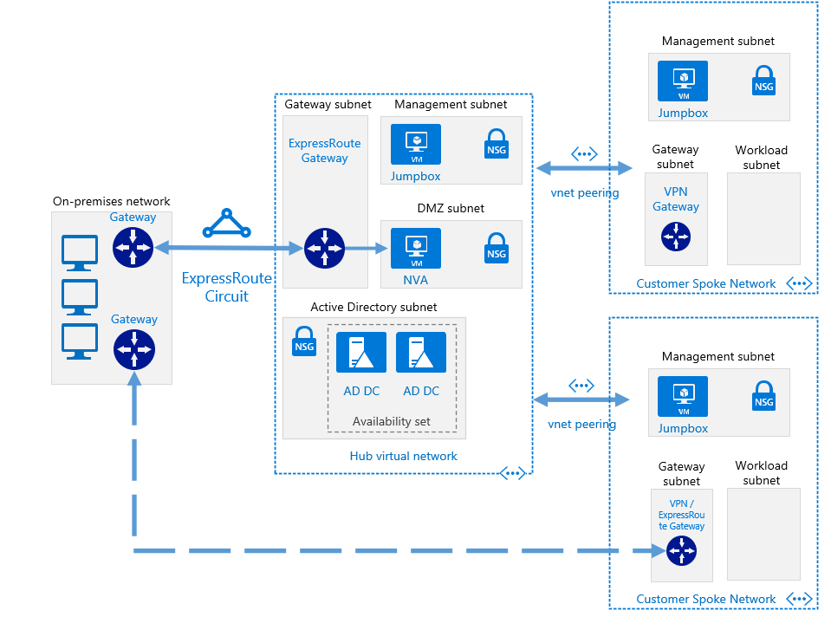
VNET Hub

Slide 43
Pic & docs here
https://docs.microsoft.com/en-us/azure/architecture/reference-architectures/hybrid-networking/shared-services

Slide 44
AAD-DS: AAD Domain Services
You end up with something like AD-DS, but in the cloud. Has LDAP and Kerberos endpoints.
It is automatically provisioned based on AAD data (so no member private groups)
You can’t administrate this like AD-DS
No ACLs,
No ability to directly create users/groups,
Only 1 GPO!! ☹
The endpoints are on a single Azure VNET
Pricing is based on number of objects (we’re off the published scale, probably $40K/year)
Makes sense for specific limited scenarios

Slide 45
AAD-DS: GA 10/12/2016
Significant features added:
LDAPS support, including option to open up this endpoint to internet
Custom OUs possible
AD-integrated DNS management
Non-Windows domain join
Automated sidHistory in provisioning sync
Azure virtual network peering support
MS “lift and shift” pitch
Still lacks flexibility and control; likely cheaper to stick DCs in Azure & you remain in control
Return

Slide 46
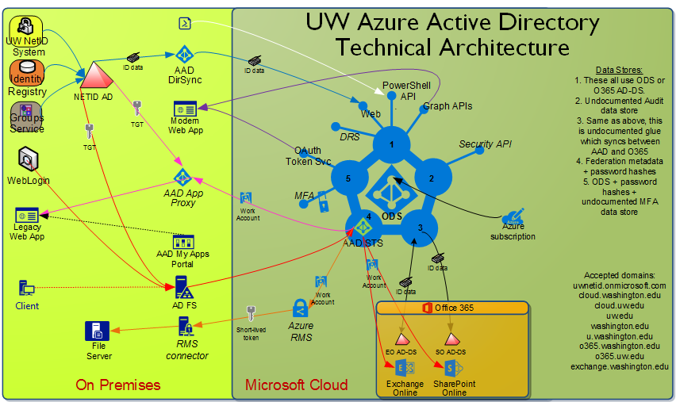
Return

Slide 47
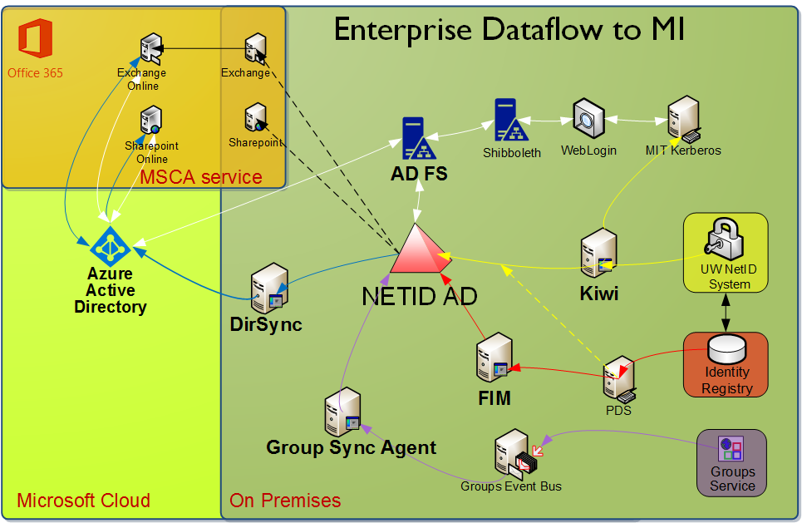
Return

