Slide 1
Interactive Overview of Emerging MS Tech April 2018
Brian Arkills
Microsoft Solutions Architect

Slide 2
Goal: Informal interaction
Lacking audience-provided topics, here are seed topics:
MFA with UW Microsoft technologies: 3 slides
UW’s MS Campus Agreement : 1 slide
AAD tokens: different types, lifetime, revocation : 1 slide
AAD Apps: OAuth & user consent : 6 slides (pair with tokens topic)
AAD Conditional Access: control token issuance : 3 slides
AAD Join & Hybrid: move beyond on-premises : 1 slide (pair with InTune)
InTune service? : 1 slide
MS Teams & Planner : 2 slides or demo?
Defender ATP : Demo?
Azure Info Protection: control data access : 1 slide
AAD Roles: PIM, RBAC, AUs : 2 slides
Inactive users update : 1 slide
Pass the Hash mitigations: ATA, PAM, PAWs : 3 slides
NETID DCs on public internet? : 1 slide
Architecture pictures: 3 slides

Slide 3
MFA for Azure AD & O365 - 1
Business stakeholder interest
Options analysis during April; enable decisions
Our architecture & enviro mean this is not simple
Possible outcomes:
Simplify greatly: requires more expensive MS licenses + stop doing federated authentication
Simplify federation, but lose some capabilities
Continue existing arch
Certainties:
Legacy clients not compatible = user impact
Someone will need to make a decision about the cost of control & user experience

Slide 4
MFA for AAD/O365 - Options
Auth1: Pwd Hash Sync + Auth2: AAD initiated Duo
Trigger: AAD Conditional Access: per-app, groups, etc
Why: Massively simplifies architecture & same 2FA solution
Impacts:
Requires AADp2 per user
MS controls our MFA options
No legacy auth for MFA clients; Legacy auth still allowed for non-MFA clients ☺
Variant- Auth2: Azure MFA, which drops 1c1 & alters 1b
Auth1: ADFS/Shib + Auth2: Shib initiated Duo
Trigger: AAD Conditional Access
Why: no arch. Changes + user experience
Impacts:
No legacy auth for MFA clients
Note: all of these options rely on Conditional Access as the trigger. See Conditional Access slides.

Slide 5
MFA for Windows: Hello for Business
Provides Windows 10 MFA for AD or AAD integrated resources. Best thing: no per user cost. ☺
2FA or 3FA: something you know/have/are. HfB by design includes *have* factor.
Reqs:
Windows 10 1511 (1709 & 1803 add features)
TPM 2.0 optional, but recommended
If biometric, then additional hardware
AD at right levels (UW is)
ADFS w/3rd party MFA adapter
Might this work in combo with Duo?
Return

Slide 6
UW’s MS Campus Agreement
2018/04/1 thru 2019/06/30:
includes all licenses in last agreement
Also includes Microsoft 365 A3 licenses in quantities equivalent to (Workday count of employees) + (IPEDS count of students)
Agreement beginning in 2019/07/01 will not have "old" licenses
UW-IT needs time to determine:
New boundaries/issues via answers from MS & CDWG
which user accounts get M365 A3 licenses covered by TRF
how other accounts, like shared & sponsored, can get M365 A3 & other licenses (probably need per-user cost-recovery mechanism)
how to communicate & assist customers in transitioning from the old licensing to the new licensing, with Office VL -> ProPlus as one notable highlight
How to improve license lifecycle provisioning processes
Relevant to Azure AD, this means we now have tens of thousands of Azure AD P1 & InTune licenses.
This means (pending above) that a variety of features may become available for more mainstream use, but will require attention to licensing status
Return

Slide 7
AAD tokens – 1
Token type | What | Restrictions
Access tokens | Get access to resource | User+client+resource bound; can’t be reused if any of those change Can’t be revoked; can only be deleted by user or expire
Refresh token | Get a fresh access token; think of it as a cached authorization code | User+client bound Can be revoked¹
ID token | Proof of authentication. Includes some user profile info | User+client
SSO token | Browser cookie KMSI=yes: persistent KMSI=no: session Special version of the refresh token (I think) | User+session bound Can be revoked¹
Primary refresh token (PRT) | Uber Refresh/SSO token | User+device bound Windows 10 only Must be AAD joined (or hybrid) Can only be stopped via: Deleting AAD device Disable AAD user
^{References:}
https://docs.microsoft.com/en-us/azure/active-directory/active-directory-configurable-token-lifetimes
https://jairocadena.com/2016/11/08/how-sso-works-in-windows-10-devices/
https://blogs.technet.microsoft.com/educloud/2017/06/14/how-to-kill-an-active-user-session-in-office-365/
¹ Revocation is a complex topic; don’t rely on this too much w/o a deeper understanding.

Slide 8
AAD tokens - 2
KMSI dialog only governs browser cookie; no=browser session bound, yes=persists across browser sessions
Many of the AAD tokens have long lifetimes
Browsers are not only SW managing Azure AD token, e.g.
iOS: the app, unless MS Authenticator
Windows: depends on OS & Office version
Federation: upstream tokens: UW ADFS & UW Shibboleth
Getting rid of a cached AAD token is problem: need to know the specific client details & the recipe for that specific scenario.
Recent “Outlook” incident, some corrupt cached AAD tokens had to be manually deleted.
Apps have to actually enforce token lifetime; many do not ☹
There’s a lot more to this
Return

Slide 9
AAD Apps: Why - 1
SaaS apps: Azure AD Application Gallery or 1st party
UW AuthN integration, links AAD user to SaaS app user
With proper licensing, could do conditional access
If app supports, automate (de)provision SaaS app user
Can get data from other AAD apps like O365 (note: some Office add-ons are this, e.g. FindTime)
Unless you need b, c, or d, we recommend you integrate via Shibboleth
UW Developer
1a, 1b, 1c, 1d, and 1e continue to be true here
You may not actually be writing code … you may just want to enable some Azure service to use @uw.edu identities. This is a special case of 1d. ☺
Gotcha: application identity credential expiration

Slide 10
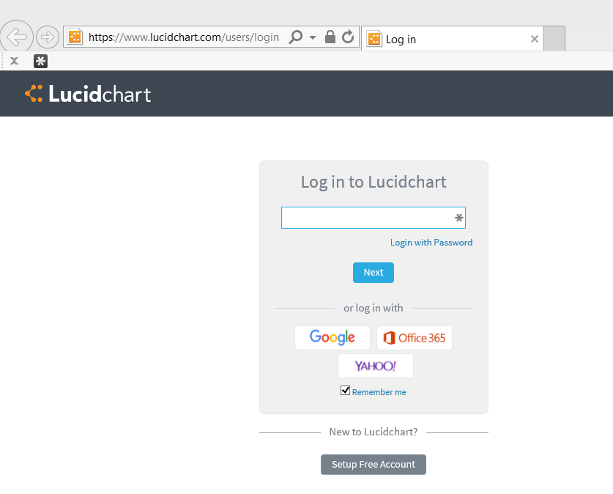
An AAD app example: step 1

Slide 11
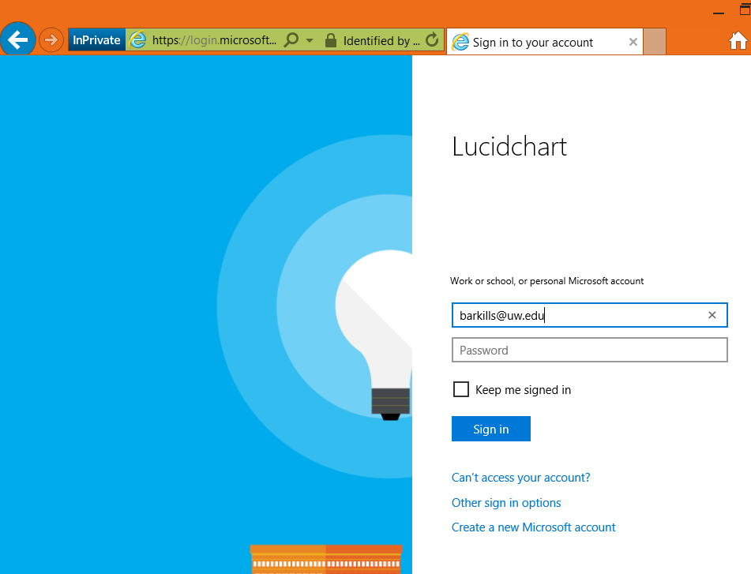
AAD app example: step 2

Slide 12
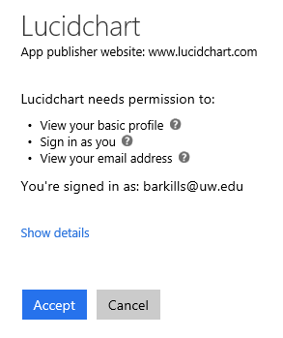
AAD app example: step 3

Slide 13
AAD Apps: What (basics) - 2
This is an identity.
“Azure AD Application” = 1 Azure AD application object + many Azure AD service principal objects
App object: definition template. Includes needed permissions, endpoint, name, etc. Needs a credential, which expires.
SP object: Can assign users, tracks user consent
https://itconnect.uw.edu/wares/msinf/aad/apps/basics/

Slide 14
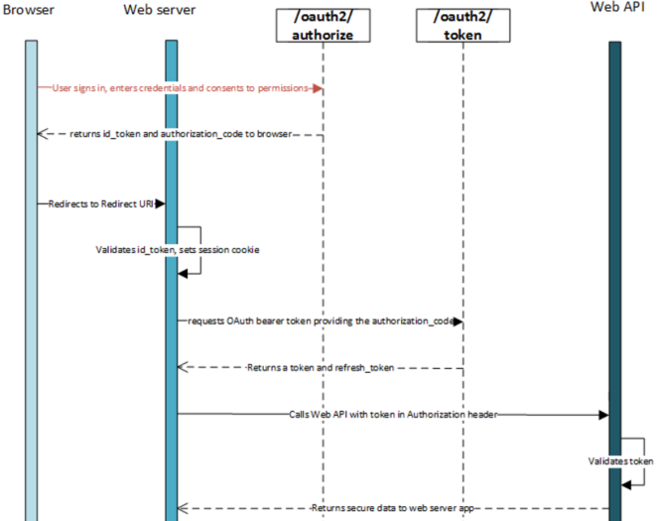
AAD Apps: Oauth & consent - 3
Return

Slide 15
AAD Conditional Access
Per AAD application policy that governs whether a given user can get an AAD access token based on conditions
Requires AADp1 license per user covered by policy

Slide 16
AAD CA: conditions
Which AAD app?: All or selected
User conditions: identity, group membership, session risk, more coming …
Device conditions: OS/platform, location (IP range/ country/region), client app, “compliant”, lost/stolen
More coming …

Slide 17
AAD CA: controls
Access controls: allow sign-in, block sign-in, enforce MFA, “is compliant” (domain-joined), require approved client app, terms of use, 3rd party custom controls (AAD P2), more coming …
Session controls: in preview now, depends on app support (e.g. can’t download data, prevent print)
Return

Slide 18
AADJ & DJ++
AADJ: Azure AD Domain Join
DJ++: AD domain join with hybrid AAD registration
Initial availability: no value to UW, so block AAD DJ
Now:
Can integrate non-traditional platforms: iOS, Android
Hybrid authentication features, including improved SSO
MDM (InTune) features approaching SCCM parity
Some InTune features surpass SCCM (e.g. remote partial device wipe, AutoPilot)
Bad Still: AAD Device lifecycle mgmt. & name change
At some point we need to re-allow AAD DJ
Likely sooner: enable hybrid device registration
Return

Slide 19
InTune service?
What has changed?
MS Campus Agreement, i.e. our licensing
Delegation capabilities exist … unclear how good they are
MS investment pattern suggests SCCM has limited life
UW Medicine interest for phone risk mitigation
“Co-manage” adds features we don’t have with SCCM only
Remote partial wipe, Autopilot, off-campus changes
How?
MI svc owns need, but MI resourcing is notably low
Funding for resourcing: MWS, UW Medicine, and you?
Incremental:
Release with 2-4 use cases, with no/limited delegation
Build experience & partner to expand
Return

Slide 20
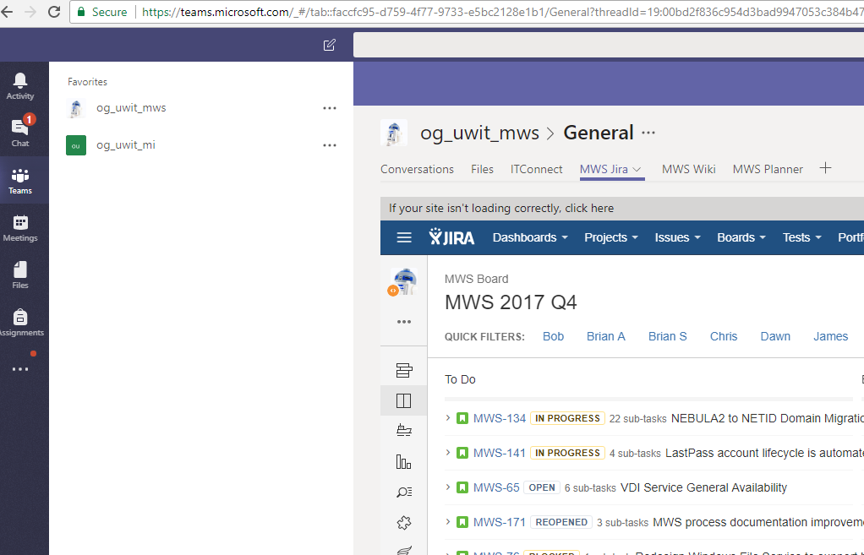
Microsoft Teams

Slide 21
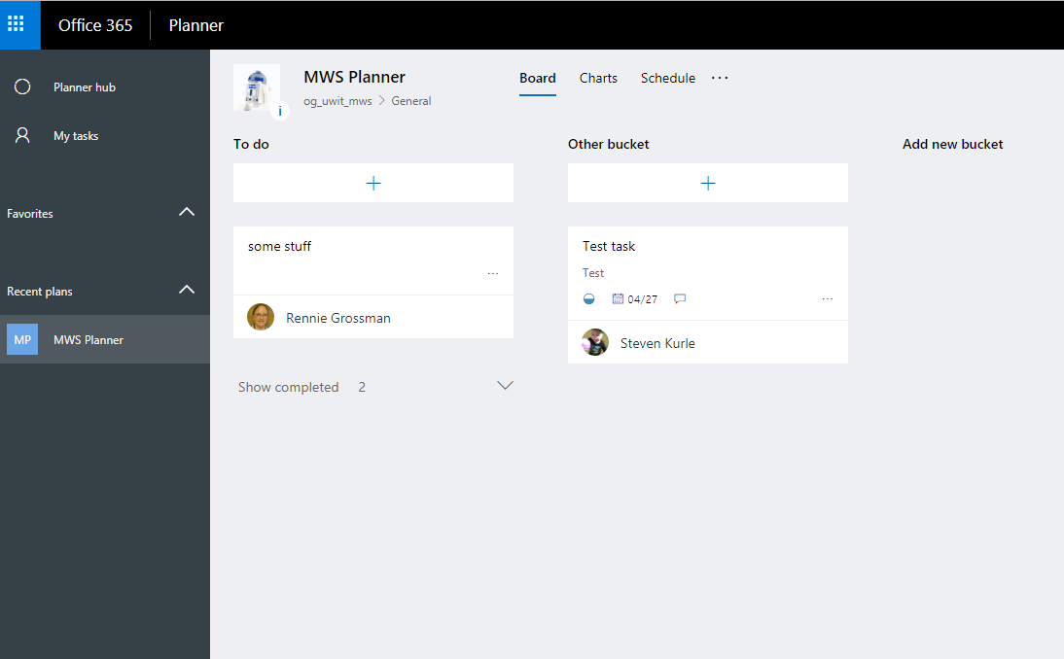
Microsoft Planner
Return

Slide 22
Azure Info Protection (RMS)
Think ‘containers for files’: you enable protection and don’t have to care where the file goes
Rights management (via encryption) per-file
Restrictions for some apps (e.g. block email forward)
Short-lived access token issued by AAD
immediately revoke access
Central audit of who has accessed what from where
Ways to enable protection
Users add a label via UI (via client add-in). Each label is connected to protection policy.
Admin creates automated rule
Depending on features requires AADp1 or AADp2
Return

Slide 23
AAD RBAC & Roles - 1
RBAC model:
Role = Scope + permissions
Scope of affected objects: AAD Administrative Units (not available yet)
Incremental permissions defined for AAD objects, AAD applications, or even Azure resources
Assign users or service principals to Roles (groups not supported yet)
Today there are a variety of canned AAD roles, Azure roles, O365 roles, InTune roles, and more … all based on the same underlying AAD RBAC platform
Future: expect lots here. I can’t say more … ☹

Slide 24
AAD RBAC & Roles – 2
Privileged Identity Management (PIM) provides just in time “activation” of roles, i.e. accounts do not permanently have roles
Time limited role activation, e.g. 1 hour
Can have workflow approval for activation or not
Can require MFA to initiate activation
Requires AADp1 for accounts that need to activate
Bad: Exchange & Sharepoint admin role activations currently have ~45m latency. MS aware of issue.
Return

Slide 25
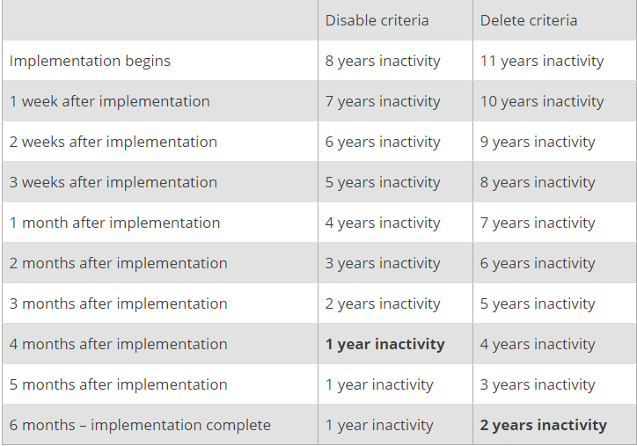
Inactive Users initiative update
Staging prep before getting change approval
Confident the cost benefits mean this will be approved
UW NetID svc interest: may expand
Adjusted timeframe for phased implementation:
Return

Slide 26
Pass the Hash mitigations - 1
Existing mitigations:
Advanced Threat Analytics (ATA) in place for NETID domain
Best practices:
Personal, Wadm, Sadm, & Eadm UW NetIDs separate permissions already. If folks do not mix these accounts on same computer, we are in great shape. But I’d bet money we aren’t very successful at this.
Do not allow the same account to have permanent admin permissions across many computers, especially if that account is used by someone without good security hygiene
Throw away workstation model, i.e. when computers are compromised, proceed immediately to a rebuild

Slide 27
Pass the Hash mitigations - 2
Future plans
Privileged Access Mgmt (PAM) for on-premises role activation, paired with a “red/bastion” forest to further isolate domain admins & elevation control
Privileged Access Workstations (PAWS)
Multi tier or silo model.
Tier 0 = any system/account which can control a domain admin or domain controller. There’s a lot more here than you’d imagine.
Tier 0 accounts can only be used from tier 0 systems.
IOW, can’t log in with a DA account on a system where anything *other than* other members of tier 0 can log in.
Other tiers are defined as you like, e.g.
Tier 1 = server admins
Tier 2 = workstation admins
Tier 3 = personal accounts
Centrally, we’d tackle tier 0 initially, with a model that could scale to tier 1

Slide 28
Pass the Hash mitigations - 3
PAWS implies dedicated additional computers for each type of account.
Windows 10 has a VM solution which we’ll likely look at to limit costs. This leverages shielded VMs + a host guardian watcher service (like bitlocker’s anti-tampering protections, but for the hypervisor)
Return

Slide 29
NETID DCs on internet
Cloud IaaS & SaaS hosting sometimes raises architectural questions about existing network design for NETID AD
Why existing design has NETID DCs on private network:
Do you want an off-campus user logon experience of ~6 minutes or 20s?
Cloud IaaS servers can join NETID AD like any other computer.
Like any other computer off-campus, they will need VPN connectivity
Alternative: Azure AD Domain Services.
SaaS apps whose integration technology is LDAP
These are poorly designed, should be avoided
VPN or Azure AD Domain Services are only options
AAD DS
Pricing: $1.60/h for up to 500K objects, “contact us” for more objects. We have ~3x that. If scales, ~$42K/year.
AAD DS has many limitations.
Return

Slide 30
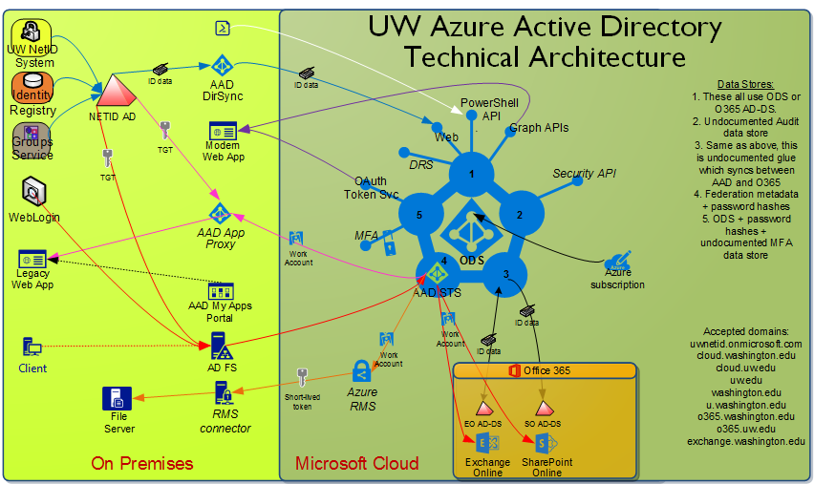
Return

Slide 31
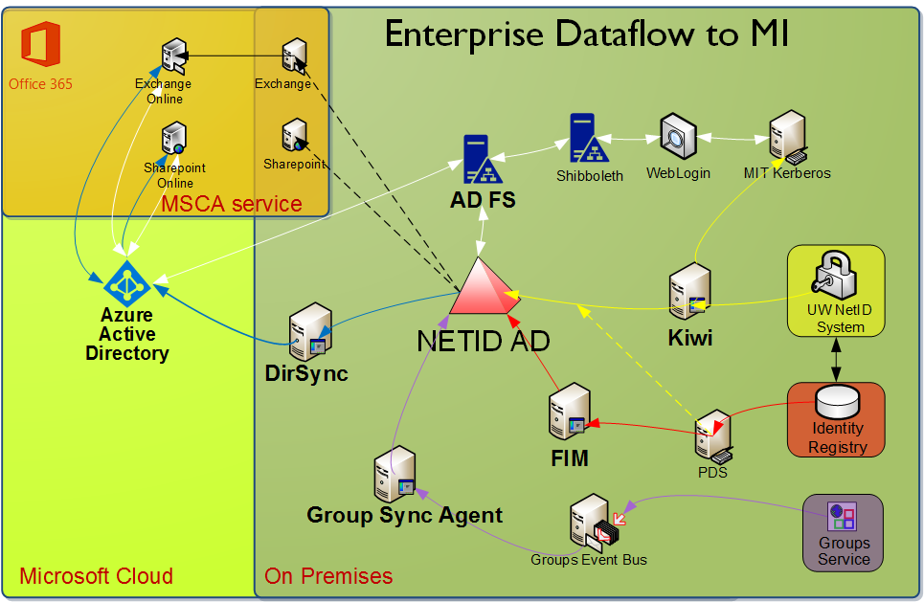
Return

Slide 32
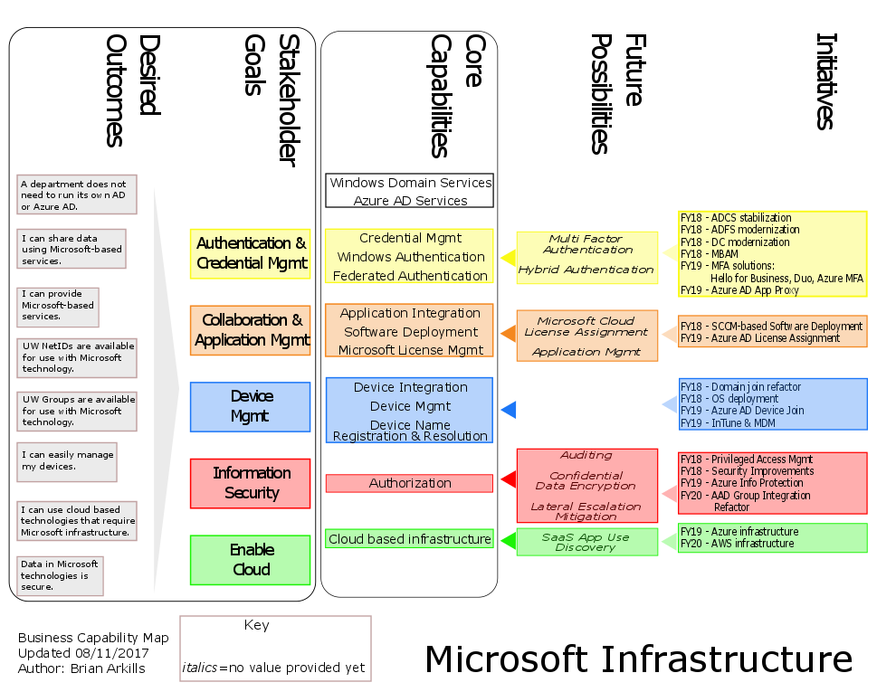
Return

