Slide 1
HiEd Panel: Azure AD/AD/Hybrid October 2019
We’re hiring!! Ask for more info … ☺
Brian Arkills
Microsoft Solutions Architect
UW-IT

Slide 2
Goal: Informal interaction
Lacking audience-provided topics, here are seed topics:
When should new tenant be created?: 1 slide
MFA with AAD: 2 slides
AAD Connect: Hybrid Identity
AAD B2B: External users
AAD tokens: different types, lifetime, revocation : 4 slides
AAD Apps: OAuth & user consent : 6 slides (pair with tokens topic)
AAD App Proxy (Hybrid AuthN)
AAD Device Registration Service
AAD Conditional Access: control token issuance : 3 slides
AAD Roles: PIM, RBAC, AUs : 1 slide
Hybrid Cloud, DCs, & AAD-DS : 5 slides
UW Architecture pictures: 2 slides
Other MS deck with lots of architectural pics …

Slide 3
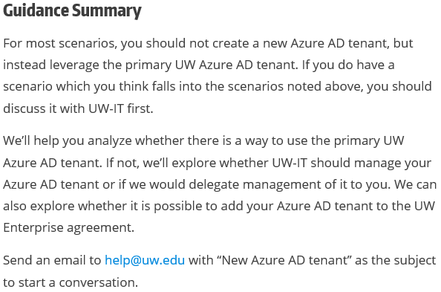
When should a new AAD tenant be Created?
https://itconnect.uw.edu/wares/msinf/aad/new-aad-tenant/
Visit this page! Good background & subscription links
Return

Slide 4
MFA for Azure AD & O365
Depends a lot on authentication architecture
Depends on what MFA solution you can use: Azure MFA & Duo are common patterns in HiEd
Three architectural decision points:
Where do I trigger the need for MFA?
Conditional Access
External federated IdP
Where do I enforce MFA?
Conditional Access
External federated IdP
Do I block legacy authentication?
Note: If federated:
Can trigger need with Conditional Access, but enforce MFA external to AAD via tenant configurations switch

Slide 5
MFA for Azure AD & O365 @ UW
Project launched
Duo is primary solution; other design in progress
Possible outcomes:
Simplify greatly: stop doing federated authentication & move to Password Hash Sync, with different UI
Continue existing double federation arch
“Remember me” to save Duo costs
Might break out legacy auth into separate project
Certainties:
Default result of enable: MFA required for all AAD apps
Legacy clients not compatible = user impact
Some kind of opt-in to enable
Conditional Access policies
Return

Slide 6
AAD Connect (Hybrid Identity)
Syncs users, groups, contacts from AD to AAD
Can filter, mostly easily by OU
Can do pwd hash sync as fallback option
Also where you enable AAD Hybrid Join
Bi-directional sync of a few things:
Exchange user attributes for hybrid Exch.
AAD registered devices
Office groups -> AD contacts
Failover supported via pre-sync’d AADC server
Return

Slide 7
AAD B2B (Provisioning external users )
Ability to invite users from another AAD tenant or Microsoft Accounts to have a “SID” in your tenant. Enables sharing resources that require an AAD logon token from your tenant
Email-based invitation to hook up home identity with guest identity in your tenant. Note: “They” don’t need to have an AAD tenant already.
This is not-mature
But it also is the only way to share without owning identity credentialing for those outside your university

Slide 8
AAD tokens – 1
Token type | What | Restrictions
Access tokens | Get access to resource | User+client+resource bound; can’t be reused if any of those change Can’t be revoked; can only be deleted by user or expire
Refresh token | Get a fresh access token; think of it as a cached authorization code | User+client bound Can be revoked¹
ID token | Proof of authentication. Includes some user profile info | User+client
SSO token | Browser cookie KMSI=yes: persistent KMSI=no: session Special version of the refresh token (I think) | User+session bound Can be revoked¹
Primary refresh token (PRT) | Uber Refresh/SSO token | User+device bound Windows 10 only Must be AAD joined (or hybrid) Can only be stopped via: Deleting AAD device Disable AAD user
^{References:}
https://docs.microsoft.com/en-us/azure/active-directory/active-directory-configurable-token-lifetimes
https://jairocadena.com/2016/11/08/how-sso-works-in-windows-10-devices/
https://blogs.technet.microsoft.com/educloud/2017/06/14/how-to-kill-an-active-user-session-in-office-365/
¹ Revocation is a complex topic; don’t rely on this too much w/o a deeper understanding.

Slide 9
AAD tokens - 2
KMSI dialog only governs browser cookie; no=browser session bound, yes=persists across browser sessions
Many of the AAD tokens have long lifetimes
Browsers are not only SW managing Azure AD token, e.g.
iOS: the app, unless MS Authenticator
Windows: depends on OS & Office version
Federation: upstream tokens: UW ADFS & UW Shibboleth
Getting rid of a cached AAD token is problem: need to know the specific client details & the recipe for that specific scenario.
Recent “Outlook” incident, some corrupt cached AAD tokens had to be manually deleted.
Apps have to actually enforce token lifetime; many do not ☹
There’s a lot more to this
Return

Slide 10
Lifetime Policies
Property | Affects | Default | Minimum | Maximum
Access Token Lifetime | Access tokens, ID tokens, SAML2 tokens | 1 hour | 10 minutes | 1 day
Refresh Token Max Inactive Time | Refresh tokens | 90 days | 10 minutes | 90 days
Single-Factor Refresh Token Max Age | Refresh tokens (for any users) | Until-revoked | 10 minutes | Until-revoked¹
Multi-Factor Refresh Token Max Age | Refresh tokens (for any users) | Until-revoked | 10 minutes | Until-revoked¹
Single-Factor Session Token Max Age | Session tokens (persistent and nonpersistent) | Until-revoked | 10 minutes | Until-revoked¹
Multi-Factor Session Token Max Age | Session tokens (persistent and nonpersistent) | Until-revoked | 10 minutes | Until-revoked¹

Slide 11
Revocation – events instead of timeout
 | Password-based cookie | Password-based token | Non-password-based cookie | Non-password-based token | Confidential client token
Password expires | Stays alive | Stays alive | Stays alive | Stays alive | Stays alive
Password changed by user | Revoked | Revoked | Stays alive | Stays alive | Stays alive
User does SSPR | Revoked | Revoked | Stays alive | Stays alive | Stays alive
Admin resets password | Revoked | Revoked | Stays alive | Stays alive | Stays alive
User revokes their refresh tokens via PowerShell | Revoked | Revoked | Revoked | Revoked | Revoked
Admin revokes all refresh tokens for the tenant via PowerShell | Revoked | Revoked | Revoked | Revoked | Revoked
Single sign-out on web | Revoked | Stays alive | Revoked | Stays alive | Stays alive
Return

Slide 12
AAD Apps: Why - 1
SaaS apps: Azure AD Application Gallery or 1st party
UW AuthN integration, links AAD user to SaaS app user
With proper licensing, could do conditional access
If app supports, automate (de)provision SaaS app user
Can get data from other AAD apps like O365 (note: some Office add-ons are this, e.g. FindTime)
Unless you need b, c, or d, we recommend you integrate via Shibboleth
UW Developer
1a, 1b, 1c, 1d, and 1e continue to be true here
You may not actually be writing code … you may just want to enable some Azure service to use @uw.edu identities. This is a special case of 1d. ☺
Gotcha: application identity credential expiration

Slide 13
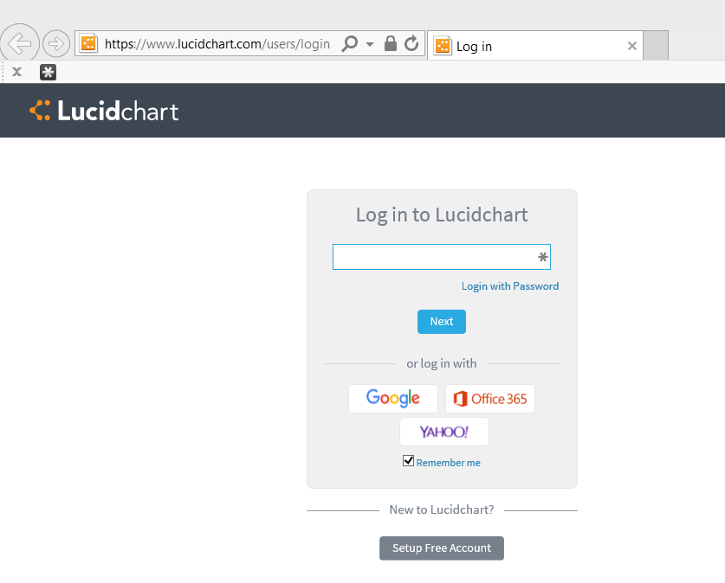
An AAD app example: step 1

Slide 14
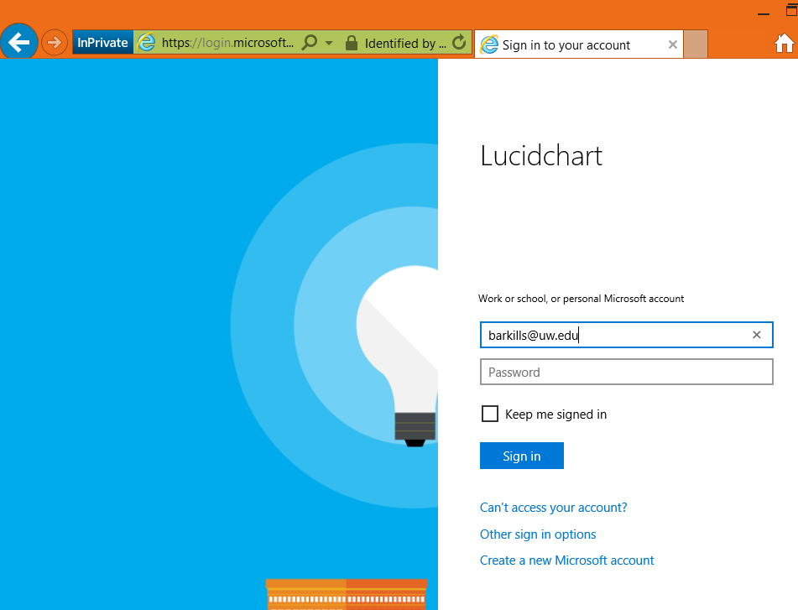
AAD app example: step 2

Slide 15
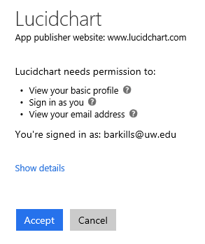
AAD app example: step 3

Slide 16
AAD Apps: What (basics) - 2
This is an identity.
“Azure AD Application” = 1 Azure AD application object + many Azure AD service principal objects
App object: definition template. Includes needed permissions, endpoint, name, etc. Needs a credential, which expires.
SP object: Can assign users, tracks user consent
https://itconnect.uw.edu/wares/msinf/aad/apps/basics/

Slide 17
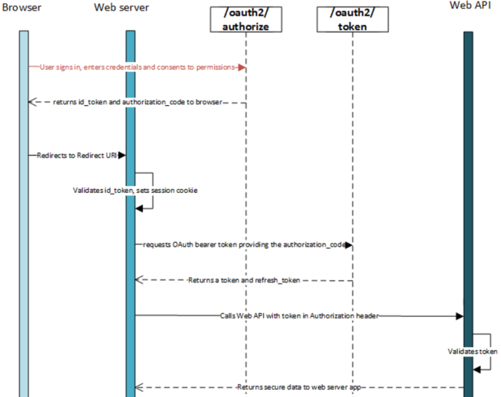
AAD Apps: Oauth & consent - 3
Return

Slide 18
AAD App Proxy (Hybrid AuthN)
Cloud based endpoint that MS secures
Can add Conditional Access & Azure MFA goodness in front of existing apps
Can easily re-invigorate existing IWA apps w/o touching their code
Cloud Hybrid Print
Only requires AAD basic ☺
Downsides: doesn’t yet support RD Gateway
Piloting this, but: solution looking for customers
Return

Slide 19
AAD Device Registration Service
This is an under-emphasized AAD system; does what its name suggests
Responsible for:
AAD device join
AAD workplace join
Some MDM capabilities
Certificate issuance related to the above for the purposes of Enterprise Data Protection, Hello for Business, + more
NOTE: only one MDM provider per tenant; must contact MS to change it.
Return

Slide 20
AAD Conditional Access
Policy governs whether a given user can get an AAD access token (to a given AAD app) based on conditions.
Requires AADp1 license per user covered by policy
Most common CA policies (all in use at UW):
For users in group A, require MFA for all AAD apps
For users in group B, require MFA for all AAD apps except from known locations
For users in group C, block access to apps X,Y, & Z

Slide 21
AAD CA: conditions
Which AAD app?: All or selected
User conditions: identity, group membership, session risk, more coming …
Device conditions: OS/platform, location (IP range/ country/region), client app, “compliant”, lost/stolen
More coming …

Slide 22
AAD CA: controls
Access controls: allow sign-in, block sign-in, enforce MFA, “is compliant” (domain-joined), require approved client app, terms of use, 3rd party custom controls, more coming …
Session controls: depends on app support (e.g. can’t download data, prevent print)
Return

Slide 23
AAD RBAC & Roles
RBAC model:
Role = Scope + permissions
Scope of affected objects: AAD Administrative Units
Incremental permissions defined for AAD objects, AAD applications, or even Azure resources
Assign users or service principals to Roles
Today there are a variety of canned AAD roles, Azure roles, O365 roles, InTune roles, and more … all based on the same underlying AAD RBAC platform
Administrative Units is major hole currently
Users only, poor ways to provision, limited role usage
Future: expect more … custom roles
Return

Slide 24
NETID DCs for cloud-based VMs
Why existing design has NETID DCs on private network:
Do you want an off-campus user logon experience of ~6 minutes or 20s?
Cloud IaaS servers can join NETID AD like any other computer.
Like any other computer off-campus, they will need VPN connectivity
Future possibility: maybe Azure based DCs in a “hub” VNET that your Azure subscription & VNET can peer

Slide 25
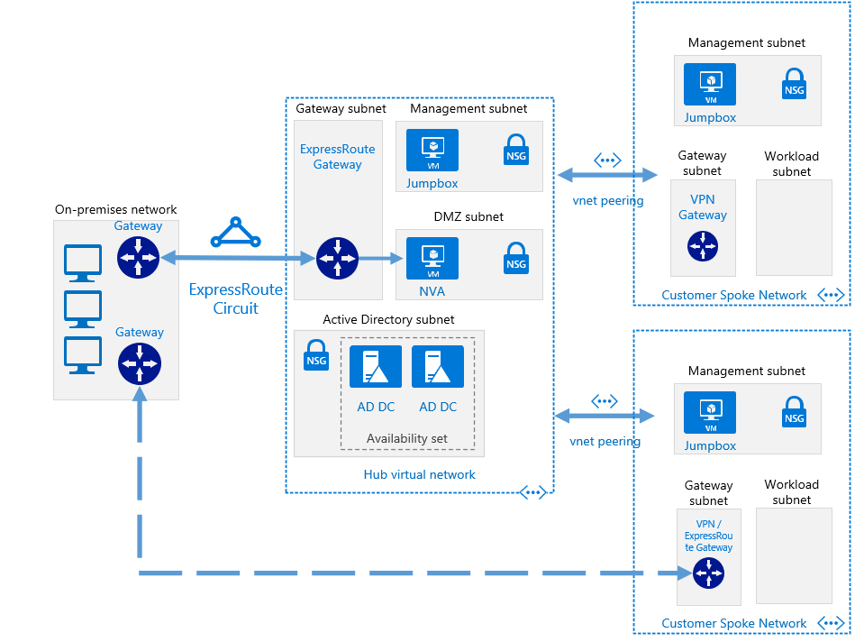
VNET Hub
Return

Slide 26
Pic & docs here
https://docs.microsoft.com/en-us/azure/architecture/reference-architectures/hybrid-networking/shared-services

Slide 27
Azure AD Domain Services
Pricing: $1.60/h for up to 500K objects, “contact us” for more objects. ~$42K/year.
AAD DS has many limitations, especially no delegation.
Best for SaaS apps whose integration technology is LDAP
LDAP should be avoided, if possible
VPN is another option, but not best for variety of reasons

Slide 28
AAD-DS: AAD Domain Services
You end up with something like AD-DS, but in the cloud. Has LDAP and Kerberos endpoints.
It is automatically provisioned based on AAD data (so no member private groups)
You can’t administrate this like AD-DS
No ACLs,
No ability to directly create users/groups,
Only 1 GPO!! ☹
The endpoints are on a single Azure VNET
Pricing is based on number of objects (we’re off the published scale)
Makes sense for specific limited scenarios
Bottom line: it’s likely cheaper to stick DCs in Azure & you remain in control

Slide 29
AAD-DS: GA 10/12/2016
Significant features added:
LDAPS support, including option to open up this endpoint to internet
Custom OUs possible
AD-integrated DNS management
Non-Windows domain join
Automated sidHistory in provisioning sync
Azure virtual network peering support
MS resumes “lift and shift” pitch
Still lacks flexibility and control, but looking more interesting
Return

Slide 30
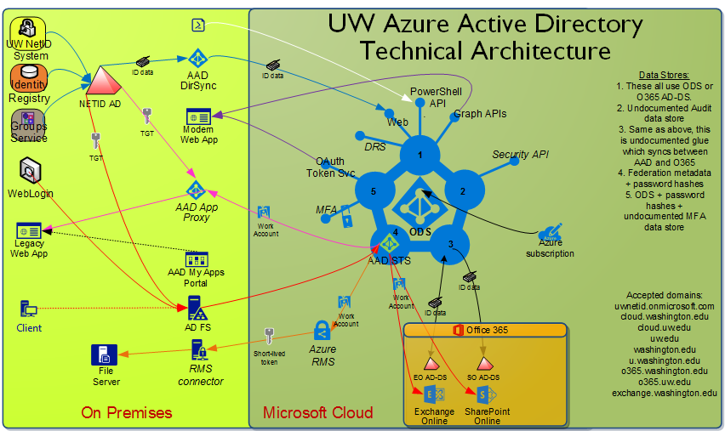
Return

Slide 31
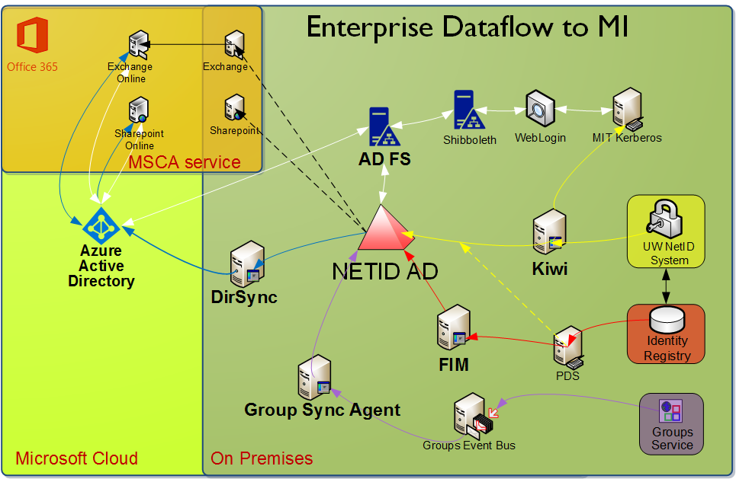
Return

