Slide 1
Azure AD Governance: In the middle of organizational friction May 2018
Brian Arkills
Microsoft Solutions Architect
Microsoft Infrastructure Svc Mgr
Managed Workstation Svc Owner
UW-IT, Identity and Access Management
Microsoft Directory Services Enterprise Mobility MVP 2012-2018

Slide 2
Goals
Tell our organizational story around AAD
Entertain & touchpoint for others
Share lessons learned

Slide 3
Agenda
UW context
Problems & resolutions
Governance work products
How & practices
Lessons learned

Slide 4
About the UW
Large research university with large medical center
52K students, 41K staff
Perennially ranked in top 20 of world universities
Husky Promise: tuition covered for those can’t afford; 31% of students qualified
86 startups based on UW research launched in 5 years; #1 public university for innovation
Top 5 biggest employer in WA

Slide 5
About MSFT at UW
On premises:
Central domain has trusts with 45 others, trending ↓
159 delegated OUs
>2K Windows Servers
>50K Windows workstations
134K groups
Cloud:
3 AAD tenants, moving to 2
73K groups
O365 active users:
25K Exchange Online, 5K OD4B, 2K Skype, <1K Teams
Some Azure IaaS & other Azure services
Both
980K user accounts

Slide 6
UW Identity and Access Management
15 staff; 1 FTE working on Microsoft technologies
Services:
Identity Registration
UW NetID
Authentication
MIT Kerberos, Shibboleth, ADFS, RADIUS, Duo, AD, AAD
Access Management
ASTRA, Groups Service, Subscriptions
Certificate Services
UW CA, InCommon CA
Directory Services
White pages
Microsoft Infrastructure
Active Directory, Azure Active Directory, KMS, AD-CS, others

Slide 7
Key IAM background for UW
Not just students, staff & faculty
> dozen sources of identity
many individuals in more than one identity source
identities are not defined by a single HR feed
identity registration is not simple
Access mgmt.
User accounts/email addresses do not go away over time
Access does need to go away
collaborate outside UW: need flexible access management
FERPA and confidentiality of group membership data
Diverse technology support
Microsoft is one among many; if you can think of something, the UW has it
Central IT + Department IT + Partner IT -> Diverse decisions

Slide 8
UW’s AAD Challenges
>50% of our groups can’t be in Azure AD
MS products that require *every* user have a given license = we won’t ever use them
How to handle hybrid cloud challenges (AD on private network, computers in cloud) without S2S VPN solutions
How to cost-effectively work around AAD group arch
Pre-provision federated AAD user for hybrid EO mailbox
Reduce MS licensing cost exposure; maximize chances re: #2
Too many tenant global admins
Efficient audit queries don’t require that download all events
AAD app credentials expiration
Jump

Slide 9
UW’s story

Slide 10
Problem 1: Shouldn’t Office 365 own AAD?

Slide 11
Resolution 1: Ownership
Enterprise Architecture brings IAM, O365 and AD teams together for 12 hours
Acknowledge overlapping capability interests
AD team continues to own
AAD governance team of 9-10 to resolve sticky issues
Governance team charter with specific goals: utility, capability, recommended uses, config decisions
Gov team meets biweekly for 3 months to get up to speed, then monthly.
9 months later, Change Advisory Board spun up.

Slide 12
Problem #2: OAuth2 & AAD Apps!!!
How could we possibly trust users?

Slide 13
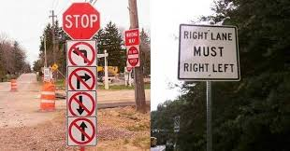
How do Azure AD apps work?

Slide 14
AAD Apps: the problem
Default tenant config allows any user to add Apps + any user to allow a given app access to their data in other AAD apps. So self svc creation + consent.
When several that required perms to EO & SO showed up, alarms were raised by our O365 folks who wanted to provide a HIPAA compliant solution for our giant hospital system. Possibility of HIPAA data flowing through non-BAA covered apps!!

Slide 15
Solution 2a: Disable it until we can make it conform …

Slide 16
Solution 2a: Gatekeeper approach
All AAD apps go through request, risk analysis, approval process.
Outcome: Only a few go through process, don’t like how long it takes. Many apps desired but not available. Business is not happy, but O365 team is happy.

Slide 17
AAD Apps: But wait …
SO/SM consistently advocate for ‘Monitor and Mitigate’ approach, matching our approach for *every* other type of application
Over time …

Slide 18
Solution 2b: A happy ending?
New O365 service owner prefers ‘monitor and mitigate’ approach
This still means AAD apps which require “elevated” app permissions need a tenant admin, and will go through our more extended risk analysis approval process. But that’s a 99.99/.01 thing.

Slide 19
Solution 2b: Monitor and Mitigate
Move back to AAD tenant app defaults, i.e. self-svc creation + consent=on
Build app that watches AAD for new apps and SPs with “risky” perms
Allow stakeholders to identify new risky perms
Disable new risky apps for full risk review
Build tool for stakeholders to audit consent permissions by individuals
“Risky” apps -> Prior approach used, unless stakeholder for “appB” accepts risk
AAD App Analysis/Recommendation

Slide 20
Solution 2b - metrics

Slide 21
Problem 3: AAD B2B/external users
Confusing
Sharepoint Online invitations
B2C differentiation
Extremely not mature
in a 2h session with MS PMs we identified ~23 issues
Golden tickets
Differentiation in UX
Lifecycle mgmt
UW users that are external elsewhere … how to control
But it also is the only way to share without owning identity credentialing for those outside

Slide 22
Solution 3: Allow but press MS
We felt we had no choice but to allow this, despite known problems.
This is technical debt, and we assume MS will help us pay that debt.
MS seems clued into “external user attestation” & “golden ticket”, but not the UX ☹
e.g. John Smith (external user) vs. John Smith (internal)

Slide 23
Problem 4: AAD Device Join
Microsoft releases Windows 10, with new AAD DJ capability paired with InTune
We observe: this looks really immature from a lifecycle management perspective + many folks will do this not really knowing what they are doing

Slide 24
Solution 4: AAD DJ blocked
After review, we agreed there is no value here—yet
Our BYOD users have other existing ways to integrate
MS later acknowledges that AAD device join isn’t yet appropriate for enterprise managed devices
No new significant capability offered
After quite a bit of research into the difference between AAD device join, AAD device registration, and AAD workplace join, we blocked AAD device join, but allow the others
Publish guidance on our config & why
Future changes are dependent on MDM futures
https://jairocadena.com/

Slide 25
AAD Governance Work Products
Technical architecture diagram (both the generic one you’ve already seen and a UW specific one)
Capability map – EA & stakeholders wanted this, but no standard approach. These are intended to facilitate conversations with customers. We are one of only two UW-IT services to publish ours.
AAD tenant utility guidance – What is it good for? When do you get one?
Customer orientation documentation – Terminology and FAQ
Many decisions about specific capabilities & settings
Jump

Slide 26
UW’s AAD Capability Map
https://itconnect.uw.edu/wares/msinf/design/azure-ad-capability-map/
Jump

Slide 27
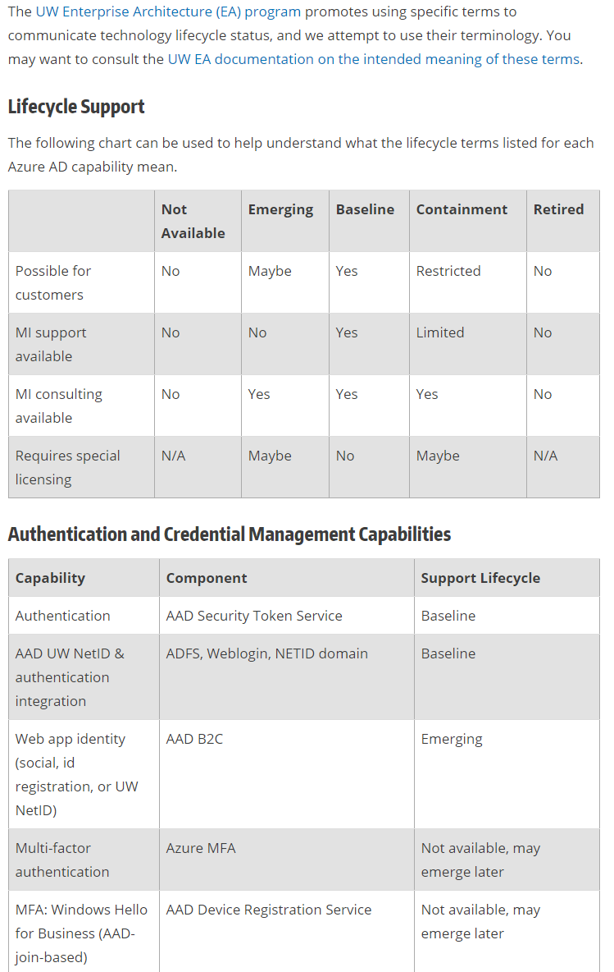
AAD Capability Lifecycle Support
https://itconnect.uw.edu/wares/msinf/design/aad-lifecycle/

Slide 28
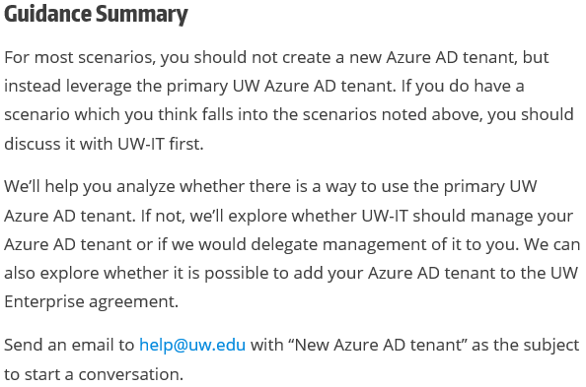
When should a new AAD tenant be Created?
https://itconnect.uw.edu/wares/msinf/aad/new-aad-tenant/
Visit this page—good discussion section
Jump

Slide 29
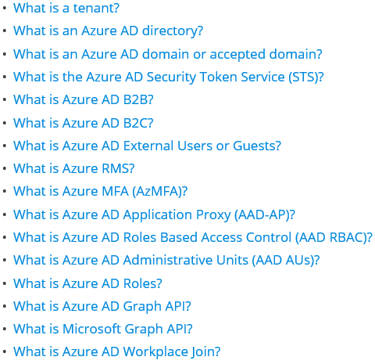
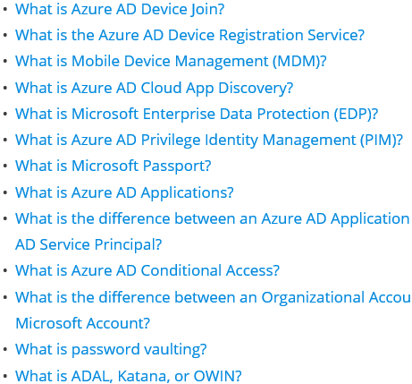
AAD Terminology & FAQ
https://itconnect.uw.edu/wares/msinf/other-help/faq/aad-terms/
Jump

Slide 30
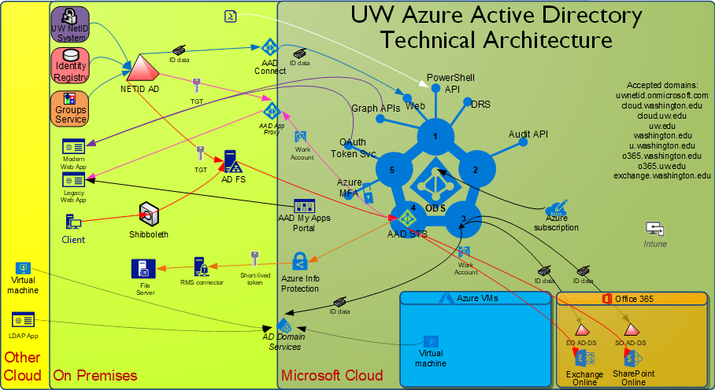
UW’s AAD Architecture Guide
https://itconnect.uw.edu/wares/msinf/design/arch/aad-arch/
Jump

Slide 31
How AAD governance works at UW
O365, IAM, and Enterprise Architecture were initial stakeholders
Agreement that any significant governance problems will be raised to Enterprise Architecture
Charter drafted among stakeholders with clear objectives before the group was convened, https://wiki.cac.washington.edu/x/coknB
After a few meetings, we collectively agreed on rules about decision making. Most of those rules were later superseded by Change Advisory Board rules

Slide 32
AAD Gov: Who
Governance team membership & roles:
~11 members: 2 from O365, 3 from IAM, 1 from EA, 2 from Security, 2 customer IT directors, 1 senior MS engineer
1 governance team leader: me. I set agenda, run meetings, grease the works, etc.
The members were picked with some input from initial sessions which formed the charter, but as the team leader I had final decision
Change Advisory Board membership & roles
Above 11 are CAB members: they advise the CAB managers
2 Change Advisory Board managers: service owner of Microsoft Infrastructure & service owner of O365. They are responsible for decisions

Slide 33
AAD Gov. meeting schedule
1st 3 months: we met weekly, 1h
Next 18 months: we met monthly, 1h
Now: we split CAB meetings from AAD discussions
CAB meetings: 30m, 2x month, 90% cancelled b/c no change to review
Governance meetings: 1h, 1x every 2 months

Slide 34
AAD CAB
Change proposed (anyone)
Change feasibility determined by AAD owner/manager
CAB reviews & comments on change
CAB meets briefly, managers make decision asking for any input comments didn’t address
If complications in implementation arise, CAB may meet or CAB managers may agree on resolution
Alternate for routine changes:
Approved automatically

Slide 35
AAD Gov. meeting agenda
Review (15m)
AAD related incidents, developments on past topics of interest, and AAD changes
I wrangle a list of this based on our operations, the AAD monthly release notes, AAD blog, Office blog, and various other sources. This takes me ~2 hours to put together
Discussion topics (40m)
When there isn’t something flaming, these are generally chosen to smooth future change proposals
Otherwise, these are to put out whatever is on fire ☺
Input (5m)
Future discussion topic suggestions
Needs raised for the service backlog
https://wiki.cac.washington.edu/x/PlU6B

Slide 36
Example agenda

Slide 37
Getting started …
We collected a “backlog” of issues that needed discussion
Started with issues heard by 3 initial stakeholder groups, but added to over time
Prioritized discussion on backlog
Discussions go more smoothly when you prep the group with MS documentation on the topic & call out key things the MS docs don’t cover
If discussion is design focused, these things help: a picture, context, definition of terms, & an overview of the options

Slide 38
AAD Gov: Unique challenge
Balancing protecting Identity Advisors NDA info with firehose of releases by MS—easy to get confused about what is “public” and what isn’t
I’ve personally had a hard time doing this, and this is magnified by the fact that all our meeting notes are public
Figure out a way to deal with this, talk with MS when you feel you need to share more broadly

Slide 39
Interaction: How do you approach AAD governance?
Who has an AAD governance mechanism?
Do you have multiple stakeholders with AAD caught in the middle? Separate teams for O365 & AAD?
Do your O365 & AAD teams consult each other before making changes? If not, how do you handle unexpected impacts?
Do you treat things like InTune as essentially part of AAD?
What AAD decisions/issues have needed more than simple levels of management?
Would you ever reconsider your AAD architecture? How would you go about that?

Slide 40
AAD Gov Round-up: Cost/Outcome
We’ve had these great outcomes:
Broader understanding of AAD technology & issues
↓ friction around which configuration is right for us
↓ friction around who makes the decisions
Common practices for tricky situations (e.g. immediately disable risky apps that MS pushes on us which meet our “risky” criteria)
Guidance for a broad shared enterprise
And paid these costs:
Lots of time to organize. Someone who can track all the details needs to be involved
Minor involvement by a few key folks
Involved executive sponsorship
Agreement to use a change management process, which in some cases slows down value (which can be positive too)

Slide 41
Early AD Lessons Re-learned
Ownership wars -> Leadership buy-in
Utility guidance needed
# of Admins … unfortunately MS needed to relearn this first ☹
Gov team: sustained invest -> momentum + insurance
Trust in configuration decision-making is earned over time
build governance with concerned parties until they trust
Constructive talks re: MS licensing=mythical pink unicorn – it may exist, but we haven’t seen it yet
Notes:
ITIL term – Utility: what is it good for?

Slide 42
New Lessons Learned
Develop and publish guidance
AAD app risks – be aware and make others aware
New cloud & hybrid models deserve careful/critical thought
“Presume breach”—Aggressive MS innovation means:
Active discovery or unprepared, e.g. nested groups
Lightly analyze shiny/new against your needs: share results
Turn things off that MS deploys enabled -> evaluate
Many design assumptions don’t fit HiEd; + voices needed
poor cross MS prod team practices mean must engage Office+
Flexibility
new arch approaches re: cloud-based IAM vs on-premises IAM

Slide 43
Governance-related requests for MS
Azure AD monthly change log
What is in scope? When is it updated? Why don’t all changes make it in?
Could the process be documented so we know what will/won’t be listed?
New=off by default
Can new things be deployed off by default? Especially Office stuff!?
Then we don’t have to do a fire drill when the next Planner is released
Reduce design assumptions that are MS-centric
Not all of us have a simple pure MS architecture
Groups, SSPR, MFA, AAD apps are examples
MS documenting design details is invaluable … recent example which could have gone much better:
Set-MsolDomainFederationSettings –DomainName <domainName> -PromptLoginBehavior Disabled
Jump

Slide 44
Gov request for MS - 2
Anticipate implementation issues & work to address them
Lack of delegated management, poor lifecycle management design, licensing and impacts to other MS products are all common reasons we don’t implement
Document issues related to these in implementation guides
For example, hard to figure out which products are 1 per tenant & have little to no delegation. These products are effectively part of AAD, even if you don’t see them that way. InTune is a good example, and Office Groups were an awkward example for awhile
Implement more stringent release practices to prevent inadequate lifecycle management capabilities. Or make it more clear that this is a known problem
Office Groups shouldn’t have been released given the lack of namespace controls it had
Likewise AAD DJ wasn’t ready …
Carefully consider your customers when deciding on licensing
There probably isn’t anyone in the room who can affect this, but …
HiEd’s use of valuable AAD features has been stuck behind a completely unrealistic licensing approach until ~4 months ago … that’s 6+ years of having your first adopters stuck. ☹
RBAC –AAD started behind, not learning the Domain Admin lesson. We need you to deliver fine-grain custom RBAC so we can clean up the mess

Slide 45
Goals
Tell our organizational story around AAD
Entertain & touchpoint for others
Share lessons learned

Slide 46
Questions?
AAD Gov Work Products:
Capability Map
Tenant Guidance
Terminology
Architecture Drawing
UW AAD Challenges
Requests for MS

Slide 47
The End
Brian Arkills
barkills@uw.edu
@barkills
@brian-arkills
http://blogs.uw.edu/barkills
https://itconnect.uw.edu/wares/msinf/
Author of LDAP Directories Explained

