Slide 1
2FA for UW Azure AD June 2020
Hiring: MS Identity developer & MS Device Mgmt Engineer
Brian Arkills
Microsoft Solutions Architect
UW-IT

Slide 2
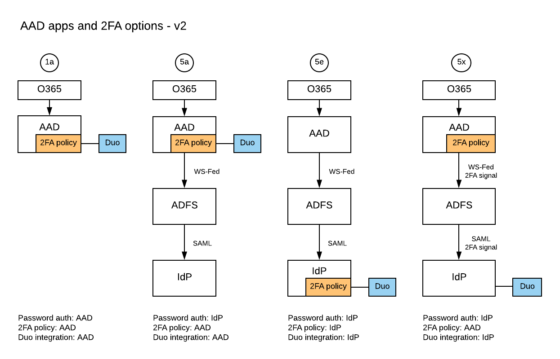
Slide from MS Tech October 2019
Where do I trigger and enforce the need for MFA?
Block legacy authentication?
Keep federated authN or move to cloud authN?

Slide 3
Unknowns circa October 2019
Unknowns at that point:
Mandatory 2FA initiative emerges
Clear thinking about how to on-board users
Desire to share opt-in mechanism across AAD and UW IdP

Slide 4
Project summary
Decisions:
Keep federated authN for now
Cloud-based authN is clearly the right strategic choice
We can switch you if you need it
Require & Trigger 2FA via AAD Conditional Access
Do not block legacy authN at this time
We can if you request it
Impacts of unknowns:
Per-user opt-in period, with mandatory at some point
Self-service via identity.uw.edu—where you enroll Duo
AAD and UW IdP share per-user mechanism; doesn’t make sense to share a per-app mechanism

Slide 5
TWO 2FA options with UW AAD
Per-user: “Enable UW Duo for the web” (coming real soon now)
Per-application: Require UW Duo
Unadvertised option: Azure MFA for Azure AD only accounts
https://itconnect.uw.edu/wares/msinf/aad/authn/2fa/

Slide 6
Per-user: Enable UW Duo for the web
How: opt-in via https://identity.uw.edu self-service
Who: personal UW NetIDs who are eligible for Duo
What: Duo 2FA required for all web (http/https) apps that rely on UW IdP or Azure AD
Constraints: Web only=not legacy authN=not a comprehensive security control
Other stuff to keep in mind:, remember me, AAD token lifetimes, mandatory 2FA coming for some populations
Soft release later this month; no customer doc URL for this yet

Slide 7
Per-app
How: Send a request to help@uw.edu
Who: Ideally AAD application owner, but we can work with shared AAD apps too
What: The defined set of users will have Duo 2FA required when accessing that AAD application
Constraints: delegated mgmt. possible but constrained
Other stuff: shared apps are tough + see the list for prior slide
https://itconnect.uw.edu/wares/msinf/aad/authn/2fa/per-application/

Slide 8
AAD authentication experience expectations
All UW Azure AD authN experiences are documented, except Azure MFA option, as it is limited to only a few.
AAD Federated: https://itconnect.uw.edu/wares/msinf/aad/authn/federated-experience/
AAD Federated with Duo: https://itconnect.uw.edu/wares/msinf/aad/authn/federated-with-duo-2fa-expected-experience/
AAD Cloud authN with Duo: https://itconnect.uw.edu/wares/msinf/aad/authn/cloud-only-with-duo-2fa-expected-experience/
Users can know what the experience should look like

Slide 9
Cloud Authentication?
Started syncing Password Hashes last year
Doesn’t require ADFS or UW IdP; much simpler to support
Send password to Microsoft sign in (IdP); it uses same hashing algorithm to check for match
More MS products/technologies work well with this
Quicker for cloud-native solutions
You can opt into this at any time
I’ve been running in this config for ~8 months now without any issue. It’s very good. ☺
https://itconnect.uw.edu/wares/msinf/aad/authn/#cloud-only

Slide 10
Legacy authentication
Microsoft term for basic authentication
Bad: password sent to the resource service
Resource does modern authentication on behalf of client
Client is incapable of “modern authentication”;
Modern auth: IdP handles all authentication + access token tells the resource to allow access
Microsoft plans to block some legacy authN in 2021
Fix: change or stop using the client
Identify: https://miportal.netid.washington.edu/legacyauth/
IT units need to work with users
https://itconnect.uw.edu/wares/msinf/aad/authn/legacy-authn/

Slide 11
UW Remember me ≠ MS AAD tokens
All AAD tokens bound to device (AAD device reg)
AAD tokens are long lived = AAD has perma-mega remember me, not mini UW remember me
Perma has some controls … ask for more info
MS studies show asking for authN too much -> bad behaviors for phishing
MS asks for re-auth when security risk present
Access tokens have 1h lifetime
Session controls via Conditional Access allow for organizational directed re-auth
UW detected misuse -> Token revocation + CA block until re-credential
https://itconnect.uw.edu/wares/msinf/aad/authn/#token

Slide 12
AAD Conditional Access
Policy governs whether a user can get an AAD access token to a given AAD app based on conditions.
Powerful, but dangerous.
Requires judicious management
Who is authoritative for you?
How do we protect both you and the UW?
Most common CA policies (all in use at UW):
For group A, require 2FA for all AAD apps
For group B, require 2FA except from known locations
For group C, block access to apps X,Y, & Z
For group D, require 2FA for app Q
https://itconnect.uw.edu/wares/msinf/aad/authn/#ca

Slide 13
AAD CA: conditions
All are include and/or exclude. Combinations are ☺
Which AAD app?: All or selected
User conditions
identity,
group membership,
session risk
Device conditions
OS/platform,
location (IP range/ country/region),
client app,
“compliant”
Variety of client app conditions that are complicated to easily summarize

Slide 14
AAD CA: controls
allow sign-in
block sign-in
enforce MFA
“is compliant” (domain-joined)
require approved client app
terms of use
3rd party custom controls
require app protection policy
Session controls:
App enforced restrictions: e.g. can’t download data, prevent print
Cloud App Security risk-based (requires M365 A5 license)
Sign-in frequency (aka turn off mega)
Persist browser session (aka turn off perma)

Slide 15
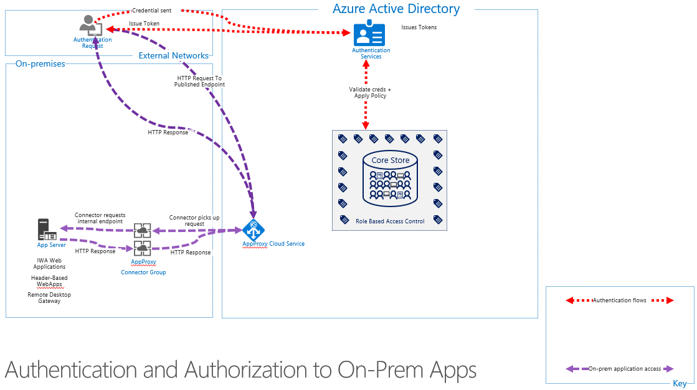
AAD App Proxy (Hybrid AuthN)

Slide 16
UW AAD App Proxy
Cloud based endpoint that MS secures
Can add Conditional Access & 2FA on existing apps
Can re-invigorate existing IWA apps w/o code change
Cost-recovery, but no rate yet
No published doc ☹

Slide 17
Lifetime Policies
Property | Affects | Default | Minimum | Maximum
Access Token Lifetime | Access tokens, ID tokens, SAML2 tokens | 1 hour | 10 minutes | 1 day
Refresh Token Max Inactive Time | Refresh tokens | 90 days | 10 minutes | 90 days
Single-Factor Refresh Token Max Age | Refresh tokens (for any users) | Until-revoked | 10 minutes | Until-revoked¹
Multi-Factor Refresh Token Max Age | Refresh tokens (for any users) | Until-revoked | 10 minutes | Until-revoked¹
Single-Factor Session Token Max Age | Session tokens (persistent and nonpersistent) | Until-revoked | 10 minutes | Until-revoked¹
Multi-Factor Session Token Max Age | Session tokens (persistent and nonpersistent) | Until-revoked | 10 minutes | Until-revoked¹
Notes:
https://docs.microsoft.com/en-us/azure/active-directory/develop/active-directory-configurable-token-lifetimes#configurable-token-lifetime-properties

Slide 18
Revocation – events instead of timeout
 | Password-based cookie | Password-based token | Non-password-based cookie | Non-password-based token | Confidential client token
Password expires | Stays alive | Stays alive | Stays alive | Stays alive | Stays alive
Password changed by user | Revoked | Revoked | Stays alive | Stays alive | Stays alive
User does SSPR | Revoked | Revoked | Stays alive | Stays alive | Stays alive
Admin resets password | Revoked | Revoked | Stays alive | Stays alive | Stays alive
User revokes their refresh tokens via PowerShell | Revoked | Revoked | Revoked | Revoked | Revoked
Admin revokes all refresh tokens for the tenant via PowerShell | Revoked | Revoked | Revoked | Revoked | Revoked
Single sign-out on web | Revoked | Stays alive | Revoked | Stays alive | Stays alive
Return
Notes:
https://docs.microsoft.com/en-us/azure/active-directory/develop/access-tokens#token-revocation

Slide 19
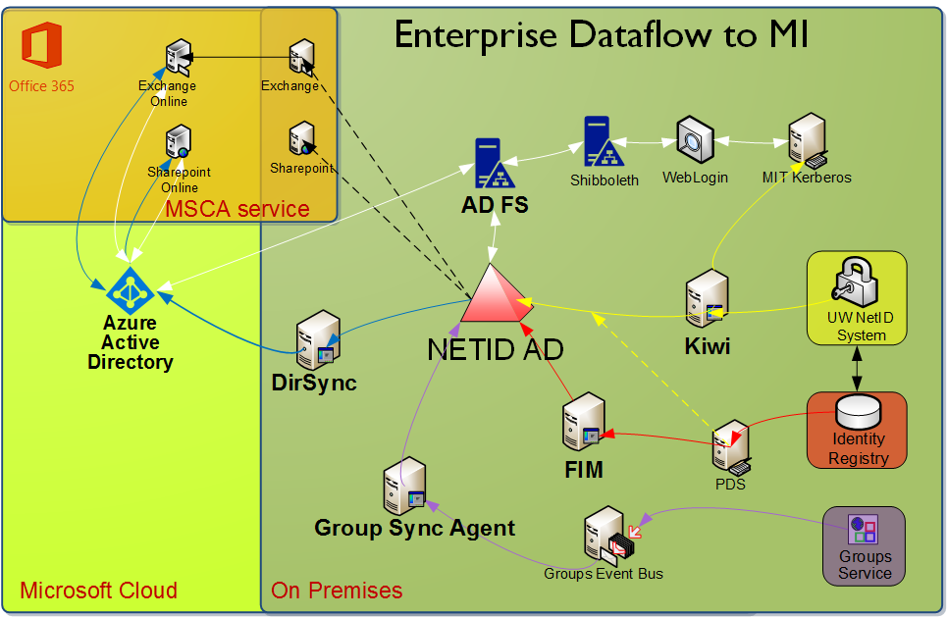
Return

