Slide 1
Office 365 Identity aka Azure Active Directory
Brian Arkills
Software Engineer, UW Windows Infrastructure Svc Mgr, and Associate Troublemaking Officer ☺
UW-IT, Identity and Access Management
Microsoft Directory Services MVP 2012-2014

Slide 2
Goals
Azure Active Directory Architecture
Authentication Options
Provisioning Options
Examine Complex Implementation
Review Pitfalls

Slide 3
Azure Active Directory
AD revised to Internet-scale multi-tenant identity service
Extends AD into cloud; cloud –based identity
Connect from any platform, and device
Connect hundreds of SaaS apps or your on-premise apps
Cloud App
SharePoint
Online
Exchange
Online
Cloud App
Azure
AD
Lync
Online
Your
Custom IT App
AD
Notes:
General diagram. Shows relationships between AAD, SO AD, EO AD, LO AD. Includes public interfaces to each.

Slide 4
AAD Architecture

Slide 5
Protocols to Connect with AAD
Protocol | Purpose | Details
REST/HTTP directory access | Create, Read, Update, Delete directory objects and relationships | Compatible with OData V3 Authenticate with OAuth 2.0
OAuth 2.0 | Service to service authentication Delegated access | JWT token format
Open ID Connect | Web application authentication Rich client authentication | JWT token format
SAML 2.0 | Web application authentication | SAML 2.0 token format
WS-Federation 1.3 | Web application authentication | SAML 1.1 token format SAML 2.0 token format JWT token format

Slide 6
AAD Provisioning Options
AAD Graph API (RESTful web service)
Remote PowerShell
Multiple Directory Synchronization variants
DirSync: original appliance
FIM Sync: MS provides FIM connector, you provide business logic/code
AAD Connect: appliance re-engineered to encompass scenarios FIM Sync covered
NOTE: the UPN and the object identifier are important. The UPN is a key parameter, the objID survives renames and is what federated authN keys on
Notes:
http://technet.microsoft.com/en-us/library/jj573653.aspx has an excellent set of info focused around sync scenarios.
http://technet.microsoft.com/en-us/library/jj151815.aspx is a good starter for PowerShell with AAD.
http://blogs.msdn.com/b/aadgraphteam/ & http://msdn.microsoft.com/library/azure/hh974476.aspx are good starter locations for AAD Graph.

Slide 7
AAD Authentication Options
Provision password in AAD
Federated authentication
More complex variations or mixes (e.g. UW)
Also there is MFA for Office 365 (powered by Azure MFA), no cost above existing O365 licenses
NOTE: MOSSIA is needed for older Windows OSes when using a native Office client (fat client)
Notes:
See http://msdn.microsoft.com/en-us/library/azure/dn383636.aspx & http://blogs.technet.com/b/ad/archive/2014/02/11/mfa-for-office-365-and-mfa-for-azure.aspx for more details and a comparison of MFA for O365 vs. Azure MFA
See http://www.microsoft.com/en-us/download/details.aspx?id=28971 for more on MOSSIA

Slide 8
AuthN flow (Passive/Web profile)
Customer
Microsoft Online Services
User
Source ID
Azure Active Directory
Logon (SAML 1.1) Token
UPN:user@contoso.com
Source User ID: ABC123
Auth Token
UPN:user@contoso.com
Unique ID: 254729

Slide 9
AuthN flow (MEX/Rich Client Profile)
Customer
Microsoft Online Services
User
Source ID
Azure Active Directory
Logon (SAML 1.1) Token
UPN:user@contoso.com
Source User ID: ABC123
Auth Token
UPN:user@contoso.com
Unique ID: 254729

Slide 10
AuthN Active flow(Outlook/Active Sync)
Customer
Microsoft Online Services
User
Source ID
Azure Active Directory
Logon (SAML 1.1) Token
UPN:user@contoso.com
Source User ID: ABC123
Auth Token
UPN:user@contoso.com
Unique ID: 254729
Basic Auth Credentilas
Username/Password

Slide 11
AuthN Regroup/Review
EO/SO/LO only trust logon tokens issued by AAD
In “bouncy slides” token issued b/c AAD trusts ADFS
AAD knew user@upn.com meant your ADFS server
Some clients/protocols can’t do federated authN, so service does them on behalf of client. Note: pwd sent over wire to service
Just as easily could not federate, with pwd in AAD (pwd would always go over wire then)
Multiple places to layer additional authN interactions (e.g. MFA or consent). Also multiple places to troubleshoot, if things go wrong

Slide 12
UW AuthN: ADFS + Shibboleth
Dueling Goals:
trusted, well-known web-based login experience of Shibboleth
Single sign-on experience for Windows domain joined clients via ADFS
So we did both! AAD trusts ADFS, ADFS trusts Shibboleth.
If client arrives at ADFS & has Windows token: done
If client doesn’t have Windows token -> Shibboleth

Slide 13
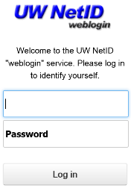
UW: Example AuthN flow
UW
Microsoft Online Services
User
Source ID
Logon (SAML 1.1) Token
UPN:user@uw.edu
Source User ID: XYZ987
Logon (SAML 1.1) Token
UPN:user@uw.edu
Source User ID: ABC123
Auth Token
UPN:user@contoso.com
Unique ID: 254729

Slide 14
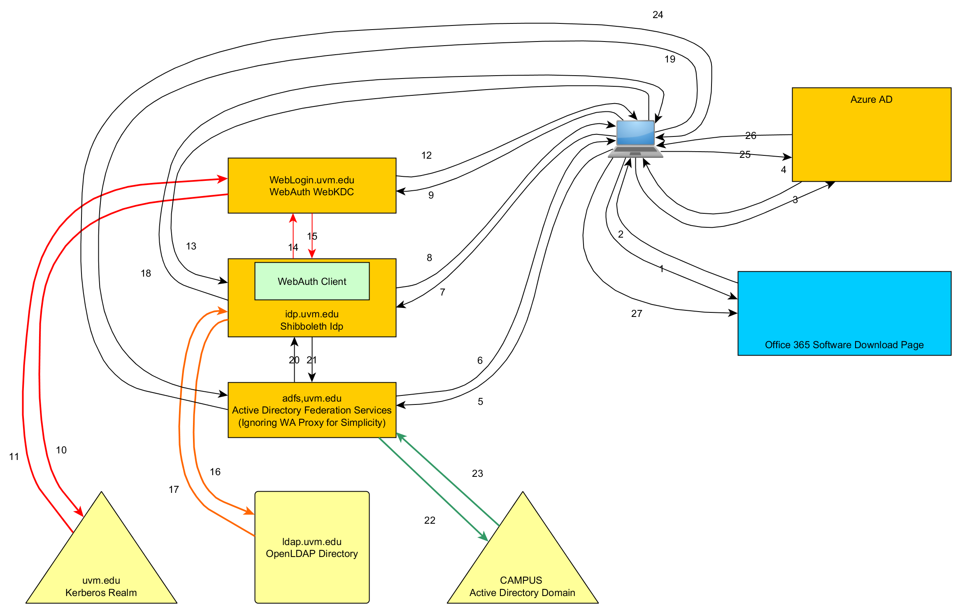
UVM AuthN Flow Diagram
Notes:
With thanks to Greg McKinnon at University of Vermont. This slide illustrates some of the greater detail behind even the detail I’ve shown in the previous slide.

Slide 15
Duplicate slide: AAD Provisioning Options
AAD Graph API (RESTful web service)
Remote PowerShell
Multiple Directory Synchronization variants
DirSync: original appliance
FIM Sync: MS provides FIM connector, you provide business logic/code
AAD Sync: appliance re-engineered to encompass scenarios FIM Sync covered
NOTE: the UPN and the object identifier are important. The UPN is a key parameter, the objID survives renames and is what federated authN keys on
Notes:
http://technet.microsoft.com/en-us/library/jj573653.aspx has an excellent set of info focused around sync scenarios.
http://technet.microsoft.com/en-us/library/jj151815.aspx is a good starter for PowerShell with AAD.
http://blogs.msdn.com/b/aadgraphteam/ & http://msdn.microsoft.com/library/azure/hh974476.aspx are good starter locations for AAD Graph.

Slide 16
UW Provisioning: DirSync
FERPA prevents us from exposing directory data. AAD has no read controls today.
Need to filter out directory data that goes to AAD, until AAD has more capabilities
Considered FIM Sync, but overkill. Considered Graph API, but can’t provision objectID. Considered PS, but know from Live@EDU that doesn’t scale well
Used DirSync to filter out groups with sensitive memberships. This means we have ~60k groups not provisioned in AAD. ☹
Lately, I’ve been rethinking whether sending pwd to AAD is such a bad thing …

Slide 17
Common Pitfalls
Accepted domains--DirSync drops any UPN, mail or proxyAddresses value that isn't an accepted domain -> AD cleanup mini-project
Notification emails only to initial global admin
Number of object sync limit
SQL vs. WID for ADFS
Full SQL vs. SQL Express for DirSync
Tenant user size limit for SO
User retraining: enter the UPN in username
ADFS certificate expiration

Slide 18
Advanced Pitfalls
Licensing (slightly outside O365 Identity, but you do need to assign users O365 licenses)
Azure MFA for O365—who? And when?
HA for ADFS (load balancer)
ADFS Claims Transformation Language
DirSync error troubleshooting & navigating Azure AD support
AAD Premium & Enterprise Mobility Suite
Myapps.Microsoft.com, SaaS password vaulting, legal implications …

Slide 19
The End
Brian Arkills
barkills@uw.edu
@barkills
http://blogs.uw.edu/barkills
http://www.netid.washington.edu
Author of LDAP Directories Explained

