Slide 1
Fill-in Topics for Windows HiEd Conference 2007
Brian Arkills
Software Engineer, LDAP geek, AD bum, Senior Heckler, and Associate Troublemaking Officer ☺

Slide 2
Topic Choices
Membership Privacy for AD Groups ala FERPA and Course Groups
Forest trusts vs. Domain trusts
Other interesting stuff for your personal browsing:
Netlogon Logging or Tracking Down Account Lockouts at https://viewpoint.cac.washington.edu/blogs/ms-collab/Lists/Posts/Post.aspx?ID=43 (uses UW CA, so you’ll get a cert error)

Slide 3
Forest Trusts vs. Domain Trusts
Forest trusts:
Require W2K3 Forest Functional Level
Allow Kerberos or NTLM authentication
Are transitive for every domain in the two forests involved
Domain trusts:
Permit NT4 or W2K DCs
But there’s a lot more …

Slide 4
Sidfiltering
Forest Trusts
netdom trust externalForestRootDomain /domain: internalForestRootDomain /enablesidhistory:YES
Domain Trusts
netdom trust externalForestRootDomain /domain: internalForestRootDomain /quarantine:YES
Forest sidfiltering is active for all domains in the other forest.

Slide 5
Name Suffix Routing
What is this?
For forest trusts, it provides the ability to distinguish which trust should be authoritative for any given DNS suffix in an authentication request.
Only one trust (domain or forest) can be authoritative for a given DNS suffix.
Wildcards are acceptable.
All domains in other forest are auto-populated at creation time, but you MUST manually add new domains to the other forest (no auto-discovery of new domains).

Slide 6
The User Experience
Forest Trust have several quirks which aren’t particularly well documented (KB816467):
Interactive Login Domain Drop-Down
Security Object Picker (only afflicts downlevel clients)
Requires user knowledge and use of fully qualified principal name, i.e. domain\user or user@domain.whatever.edu
Microsoft is requiring users have this knowledge. See Vista and Server 2008.
Notes:
Downlevel clients: W2K SP3 or earlier, XP SP1 or earlier
Domain drop-down works for forest root domains, but not any other domains in forest. This is because:
No dynamic polling of other forest’s GC for new domains
Would require a collision resolution algorithm for the netbios domain name between the two forests (and any other forest trusts!!)
Newer Windows OSes have done away with the domain drop-down, making the netbios domain name less visible
There is a objectclass=trustedDomain object created only in the forest root domain and this object is detected by one step of the algorithm to populate the domain drop-down list. For any given computer, it only checks it’s domain’s trustedDomain objects.
No … the registry key which populates the domain name for a cross-realm Kerberos trust will not enable you to populate the domain name in non-forest root domains with forest trusts. In fact, if you try this you will break all interactive logins on that computer.

Slide 7
The Admin Experience
‘Incoming Forest Trust Builders’ group makes creating 1 way forest trusts easy.
Must coordinate shared secret for a domain trust.
Forest root domain is *key* for forest trusts.
3 tier service models: Forest trusts enable Kerberos. Kerberos enables impersonation across forest boundaries. NTLM *can’t* do impersonation.
Selective Authentication available for forest trusts.
Regardless of domain or forest trust, you must use a domain local group to contain users or groups from the other forest.
Notes:
By choosing 'selective authentication', users from the trusted domain are not members of the dynamic 'Authenticated Users' group. Administrators must explicitly grant the 'allowed to authenticate' permission on the AD computer object to the users/groups in the trusted domain for each computer object you want to allow those users to login to. While this can be a great option to limit where users in the trusted forest can login, such as a scenario where a student lab should have access (but the rest of the domain shouldn't), it does comes with the cost of needing to explicitly allow their use on each individual computer.
The Windows Server TechCenter has a great description of how to do that: Grant the Allowed to Authenticate permission on computers in the trusting domain or forest.

Slide 8
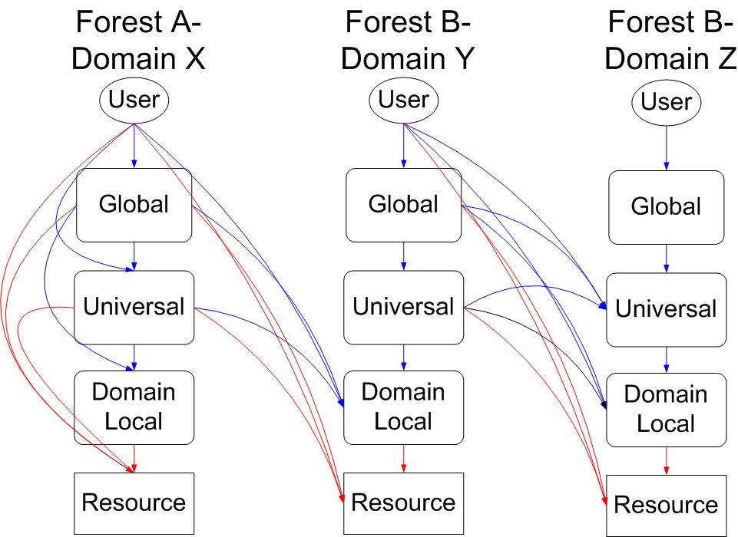
Security Nesting and ACLs
Notes:
Lines in blue indicate group membership possibilities. Lines in red indicate ACL possibilities.
Only the Forest A-Domain X (AX) column shows all intra-domain possibilities.
The interaction between AX and BY shows cross-domain plus cross-forest possibilities.
The interaction between BY and BZ shows cross-domain, intraforest possibilities.
Downloadable copy of this picture: http://www.netid.washington.edu/documentation/images/groups.jpg

Slide 9
Requirements to Setup Any Trust
Admin credentials or incremental permissions.
Working DNS configuration for domains involved.
Firewalls are correctly configured between DCs:
tcp 53, 88, 135, 389, 445, 636, *
udp 53, 88, 135, 389, 445, *
Firewalls are correctly configured between domain client computers and external DCs:
tcp 53, 88, 135, 137, 139, 389, 445, 636, 3268, 3269 udp 53, 88, 123, 135, 137, 138, 389, 445
Notes:
* Additionally a range of dynamic RPC ports for the RPC endpoint mapper needs access if you want to be able to do trust validation. By default, this is a large set of ports, but you can limit it to a much smaller set. See the Microsoft whitepaper http://download.microsoft.com/download/c/a/3/ca3647b8-9948-4f92-8637-fcb8fdfa3de0/ADSegment_IPSec_W2K.doc (in appendix E) for more on that.

Slide 10
Trust Summary
With a forest trust you must ensure you want a trust with every domain--and any possible future domains--in that forest.
Forest trusts enable client -> web service -> database scenarios where the database lives in a different forest than the web service/client. This can be significant.
Established applications with existing end users may not do well with a transition that removes their user domain from the domain drop down. Terminal servers are most visible example.

Slide 11
The End
Brian Arkills
barkills@cac.washington.edu
Author of “LDAP Directories Explained”

Slide 12
Group Membership Invisibility
Lots of reasons to want this, including various legal issues, with the most common use case being course groups.
Microsoft has no out of the box solution for this, and internally has no membership invisible groups.

Slide 13
Problems for Any Solution to Surmount
MemberOf attribute exposes group membership, so solution must address both groups and users
Default explicit ACL (as opposed to inherited ACL) on groups and users (i.e. what’s defined in the schema elements for each) gives read access to several principals that include widespread membership
Must accept the possibility for passive exposure of group membership via “audit log fishing*” or security token inspection#.
Notes:
*=Anyone with a computer that trusts your domain can setup a shared resource that permits access to a group with hidden membership, publish the resource via some mechanism, then watch the audit logs to see who successfully connects.
#=Similar to above; anyone with a shared resource can inspect the contents of security tokens passed to them via impersonation for domain-based group membership information.
Technically, in both scenarios the user has some control; they choose where they go, and therefore who they pass their credentials and membership onto, but this knowledge isn’t especially apparent to most users.

Slide 14
Mike Kanofsky @UofFlorida and MCS
Yank all members of the ‘Pre-Windows 2000 Compatible Access’ group
Set the following inherited ACEs on the OU containing the groups you want to protect: Deny Domain Users* : Read Membership for Group objects
Allow Domain Users* : Read for this object and all child objects
For each group you want to protect, remove two explicit ACEs:
Allow Authenticated Users : Read
Allow Self : Read
Notes:
* = Might need to replace Domain Users with Authenticated Users if you trust other domains

Slide 15
.Net Code to Add ACEs
Dim ferpaGroup As New System.Security.Principal.NTAccount("netid.washington.edu", "FERPA-Registrar Authorized")
Dim ferpaGroupAsSecurityIdentifier As System.Security.Principal.SecurityIdentifier = ferpaGroup.Translate(System.Type.GetType("System.Security.Principal.SecurityIdentifier"))
Dim domainSid As System.Security.Principal.SecurityIdentifier
domainSid = ferpaGroupAsSecurityIdentifier.AccountDomainSid
Dim authUsers As New System.Security.Principal.SecurityIdentifier(Security.Principal.WellKnownSidType.AuthenticatedUserSid, domainSid)
Dim self As New System.Security.Principal.SecurityIdentifier(Security.Principal.WellKnownSidType.SelfSid, domainSid)
Dim rule As New System.DirectoryServices.ActiveDirectoryAccessRule(authUsers, System.DirectoryServices.ActiveDirectoryRights.ReadProperty, System.Security.AccessControl.AccessControlType.Allow)
Dim rule2 As New System.DirectoryServices.ActiveDirectoryAccessRule(self, System.DirectoryServices.ActiveDirectoryRights.ReadProperty, System.Security.AccessControl.AccessControlType.Allow)
ADEntry.ObjectSecurity.RemoveAccessRule(rule)
ADEntry.ObjectSecurity.RemoveAccessRule(rule2)
ADEntry.CommitChanges()
Notes:
This is visual basic, but it’s very easy to convert to C# or pretty much any other .net language

Slide 16
Side Effects of This Solution
By default, after implementing this, no one except AD administrators can read the MemberOf attribute on user objects.
The ‘Pre-Windows 2000 Compatible Access’ group grants read access to users, computers, and groups, and has as membership either authenticated user or everyone depending on the decision you made at domain setup time, so there are other possible side effects, but we haven’t seen anything serious.

Slide 17
Other Solutions (I know about)
Stanford (Ross Wilper) has a solution:
Modify default schema for user objects to strip all default ACEs.
Configure OU(s) with users with inherited ACEs as you desire

Slide 18
Side Effects of Ross’s Solution
With every Microsoft schema change, must:
Turn off user provisioning and re-modify the schema to strip all ACEs from default user objects
Must consider whether any new ACEs added to user objects should be added to the inherited ACLs on OUs
Departmental administrators must be granted permissions in order to troubleshoot all group access issues.
By default, after implementing this, no one except AD administrators can read the MemberOf attribute (or any other attribute depending on what inherited ACL you added) on user objects.

Slide 19
The End
Brian Arkills
barkills@cac.washington.edu
Author of “LDAP Directories Explained”

