Slide 1
Intune for Education Customer Success Story
Welcome !
Host: Liz Cox and Andy Fu
Notes:
<Update Host (MC) names per region>

Slide 2
Everyone’s Welcome
All opinions count
Please be respectful
Adhere to the Microsoft Code of Conduct (next slide)

Slide 3
Microsoft Code of Conduct
Microsoft’s mission is to empower every person and every organization on the planet to achieve more. This includes all Microsoft events and gatherings, including on digital platforms, where we seek to create a respectful, friendly, fun and inclusive experience for all participants.
We expect all digital event participants to uphold the principles of this Code of Conduct, which covers the main digital event and all related activities. We do not tolerate disruptive or disrespectful behavior, messages, images, or interactions by any party participant, in any form, at any aspect of the program including business and social activities, regardless of location.
Microsoft will not tolerate harassment or discrimination based on age, ancestry, color, gender identity or expression, national origin, physical or mental disability, religion, sexual orientation, or any other characteristic protected by applicable local laws, regulations, and ordinances.
We encourage everyone to assist in creating a welcoming and safe environment. Please report any concerns, harassing behavior, suspicious, or disruptive activity to Business Conduct Hotline (1-877-320-MSFT or buscond@microsoft.com). Microsoft reserves the right to refuse admittance to or remove any person from this session at any time at its sole discretion.
Notes:
COPY/PASTE
Microsoft Code of Conduct
Microsoft’s mission is to empower every person and every organization on the planet to achieve more. This includes all Microsoft events and gatherings, including on digital platforms, where we seek to create a respectful, friendly, fun and inclusive experience for all participants.
We expect all digital event participants to uphold the principles of this Code of Conduct, which covers the main digital event and all related activities. We do not tolerate disruptive or disrespectful behavior, messages, images, or interactions by any party participant, in any form, at any aspect of the program including business and social activities, regardless of location.
Microsoft will not tolerate harassment or discrimination based on age, ancestry, color, gender identity or expression, national origin, physical or mental disability, religion, sexual orientation, or any other characteristic protected by applicable local laws, regulations, and ordinances.
We encourage everyone to assist in creating a welcoming and safe environment. Please report any concerns, harassing behavior, suspicious, or disruptive activity to Business Conduct Hotline (1-877-320-MSFT or buscond@microsoft.com). Microsoft reserves the right to refuse admittance to or remove any person from Microsoft Build at any time at its sole discretion.

Slide 4
Let's Get Started
Notes:
MC to introduce first Speaker. First speaker shares their screen, and we get started

Slide 5
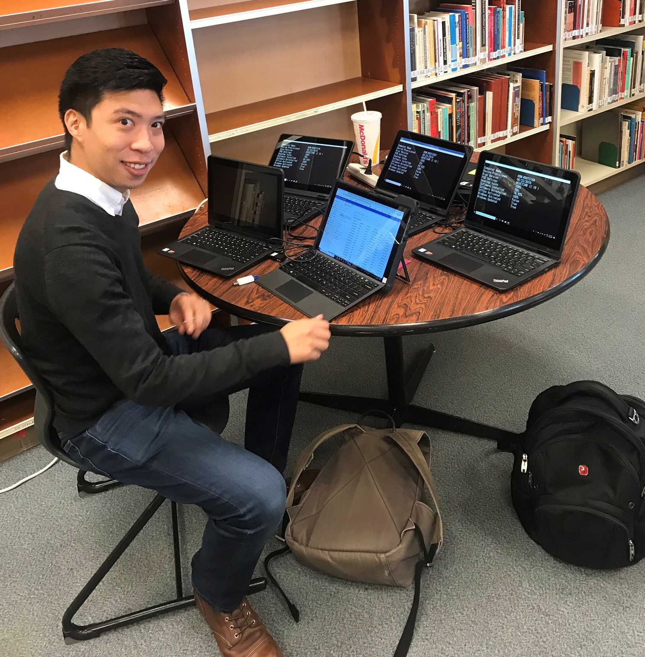
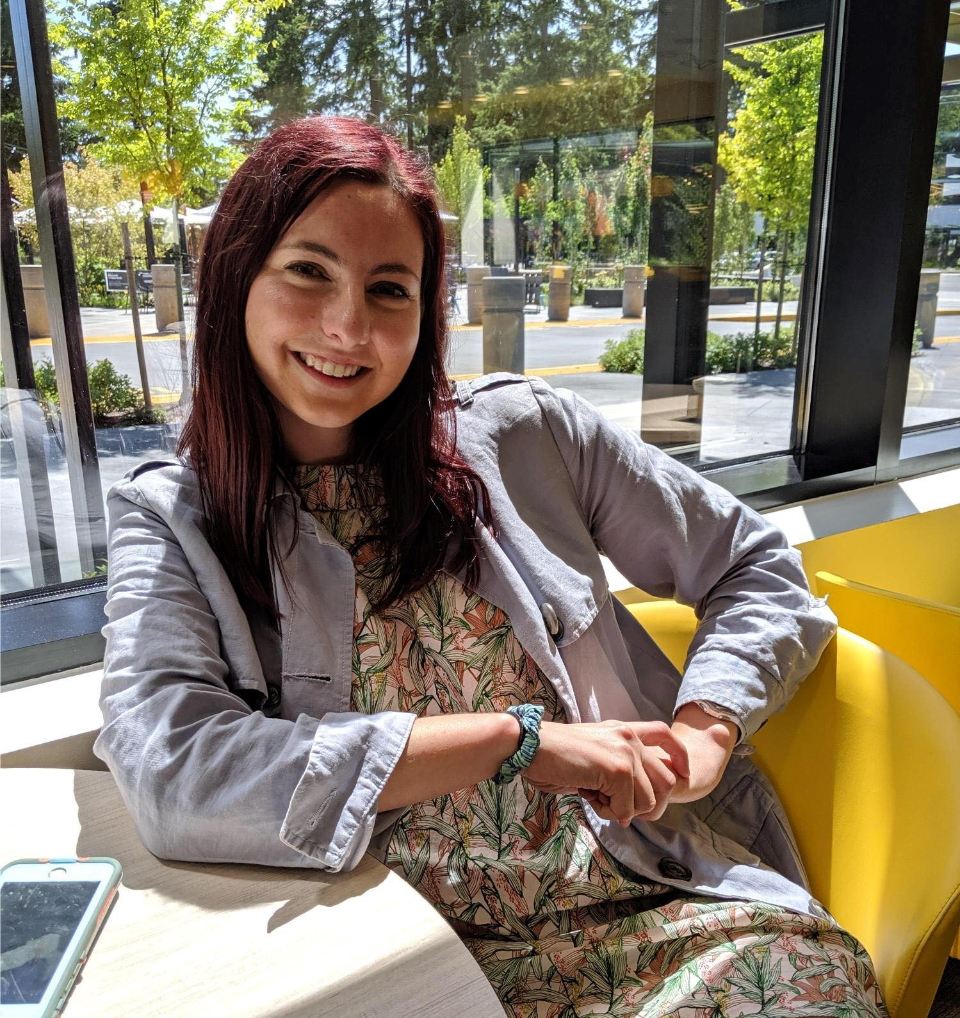
Andy Fu
Program Manager
Education customer experience
Liz Cox
Program Manager
Education device management

Slide 6
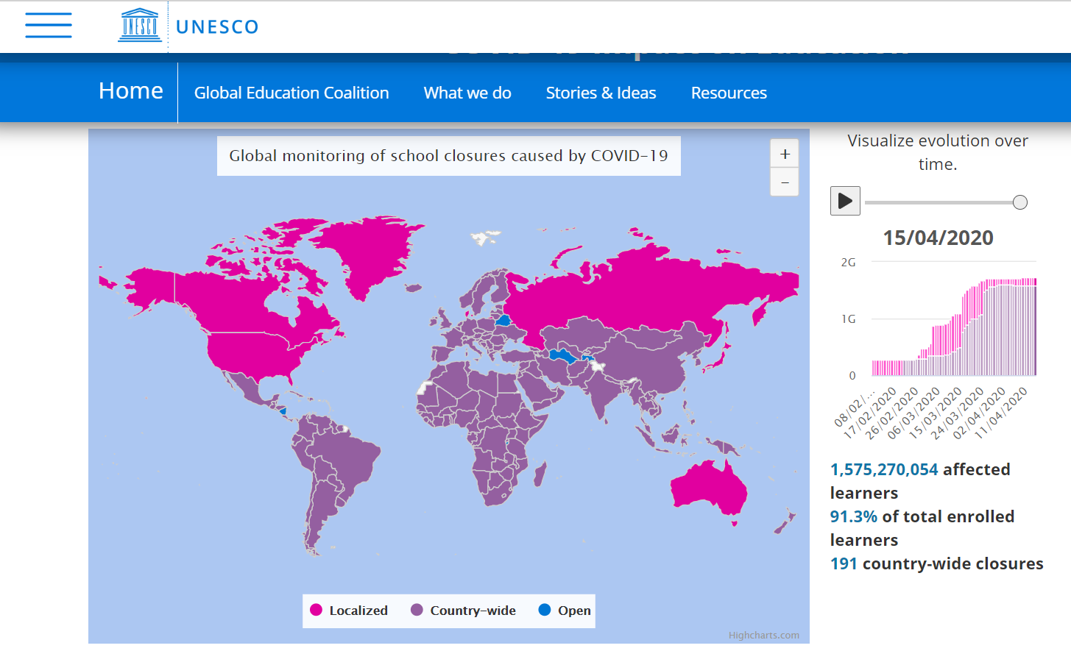
91% of learners were affected by COVID-19
1.4 billion
Students shifted to remote learning during the COVID-19 pandemic¹
Rapid growth
Intune for EDU has grown rapidly in the last year
1/2
Top Autopilot customers are EDU
Notes:
When we look at the COVID world that we are in today, one of the most staggering statistics is that 91% of learners are affected by COVID-19 and that 1.4 billion students have shifted to remote learning during the pandemic. Close to 200,000 tenants worldwide have turned to using Teams for Education. The biggest challenge IT faces today is supporting remote learning which became a giant force in pushing these institutions to look at adopting modern management.
One of the customers that I’m working with, University of Washington, fell right into the traditional IT model where everything was managed on premise. They’ve heard the value prop of moving over to a M365 powered device and was interested in adopting it, but there was never really a big motivator for them. But when COVID hit, they found that they really needed to embrace the value of modern management to respond to the pandemic and started adopting Intune for new devices for faculty and staff. This isn’t just UW, but it is happening across the entire world as we’re seeing entire countries like Japan, India, Romania, and many more where they are responding to COVID and providing managed devices to students.

Slide 7
Autopilot and Intune Growth
EDU MDM
EDU MDM
EDU
Intune for EDU is 3X where it started in FY21
1/3 of top Autopilot customers are EDU

Slide 8
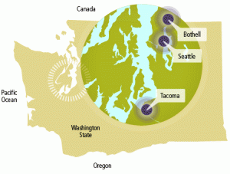
Introducing University of Washington
54k students -> 1800 courses/quarter -> 12k degrees/annually
~500K active users at UW, so everything done at scale
Jake Nastasiak, James Morris, Kim Frye, and Brian Arkills work in the central IT organization, which encompasses about half of all IT at UW. Other half are large medical system plus departmental IT.

Slide 9
Device management before COVID
Device management responsibility distributed across units
Cost-recovery device mgmt service provided centrally for about 3k
~20k devices joined to central AD … there are other ADs
Some units leverage SCCM + GP, most others only group policy
Most units use MDT or OSD for Windows device builds
Both of which require line-of-sight network access ...

Slide 10
Goals & Solution Summary
Establish a safe and seamless process of provisioning useful UW appropriate Windows computers to end users. Eliminate IT physical touch for each device prior to provisioning to the end user.
Address requirements to decrease or eliminate campus presence during the Covid-19 Stay-At-Home mandate while meeting the computing needs of staff.
Intune provides cloud-based device management including quick, self-service Windows imaging via Autopilot. Autopilot allows new computers shipped from a vendor to be setup with a UW image from the first boot without requiring a physical presence from IT staff at the UW. This results in a domain-joined, UW configured computer. Because the entire solution is cloud-based, there is no need for the device to be physically on the UW network at any point in time to get setup or configured.

Slide 11
Scope
In Scope
Enable cloud-based Windows setup for UW employees, such that the device does not need to be physically present on the UW network.
Minimally provide cloud-based management capabilities, limited to what Autopilot requires or would result in significant future problems
As needed to provide Autopilot, minimally provide limited delegation to other IT units at UW
Design Intune infrastructure to allow for additional capabilities to be realized in the future
The project beneficiary community will ultimately be all UW employees.
Out of Scope
Custom Images
Intune Based Workstation Management
Direct join to Delegated Organizational Units (OUs)

Slide 12
Implementation
A single Autopilot provisioning package for all employees which:
Performs a hybrid join over VPN (AAD join and NETID AD join)
See https://docs.microsoft.com/en-us/mem/autopilot/user-driven#user-driven-mode-for-hybrid-azure-active-directory-join-with-vpn-support
VPN based sign in after the initial reboot to complete the AD join
Basic applications installed
Office ProPlus
Husky OnNet (F5 VPN client)
Windows Defender
Windows Update for Business
Computer is joined to Autopilot OU with a basic GPO applied
OU administrators can move computers from the Autopilot OU to their delegated OUs

Slide 13
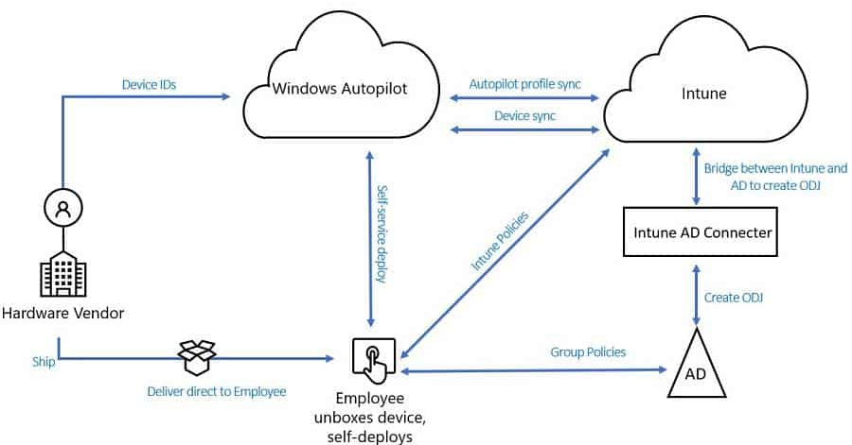
Autopilot Hybrid Join

Slide 14
Obstacles
RBAC/delegation
Scope tag assignment
Union of perms across scope tags
Groups of devices
Support model
Glossary
Central IT absorbs only Autopilot support
Support after Autopilot is distributed except lock out interventions
Biggest issue: OS entry point Win10 1903+ Pro or Ent w/ Dec 2019 cumulative update
Autopilot vendors
Consent model is different for resellers vs OEMs – still not sure what perms we gave away
Different offerings from each vendor, e.g. Scope tag limit, cost vs free, self-service

Slide 15
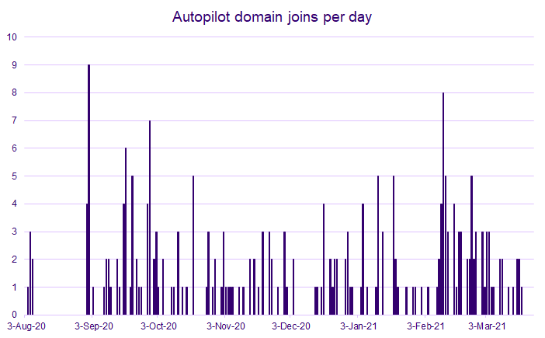
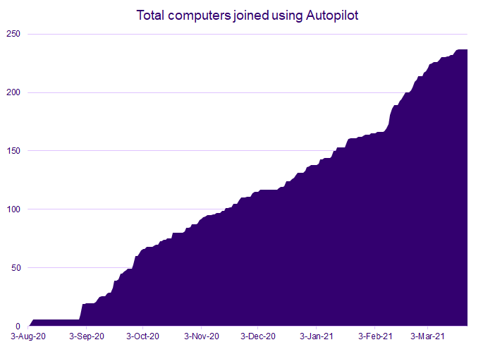
Results and moving forward
Moving forward:

Slide 16
Questions?

Slide 17
Notes:
Poll Title: Intune for Education Customer Success Story https://www.polleverywhere.com/surveys/tnmTorfM5eWbkKmGRXO2d?display_state=chart&activity_state=opened&state=opened&flow=Engagement&onscreen=persist

Slide 18
Notes:
Poll Title: How helpful was this session? https://www.polleverywhere.com/clickable_images/3HBf2PULp7lp5yis9hPuo?display_state=chart&activity_state=opened&state=opened&flow=Engagement&onscreen=persist&hide=instructions

Slide 19
Thank you! We appreciate your time with us!
#MonthOfMEM
Look for other opportunities to connect with us here: aka.ms/MEMafterIgnite

Slide 20
Notes:
Poll Title: What is your job title? https://www.polleverywhere.com/free_text_polls/WCaFbYnucIBBLJqJV0rHL?display_state=chart&activity_state=opened&state=opened&flow=Engagement&onscreen=persist&hide=instructions

Slide 21
Notes:
Poll Title: Is there any other feedback you'd like to give us? Any other sessions you'd like to see in the fall? https://www.polleverywhere.com/free_text_polls/SvS0z3WcrDMXkWlyUP3ga?display_state=chart&activity_state=opened&state=opened&flow=Engagement&onscreen=persist&hide=instructions

Slide 22
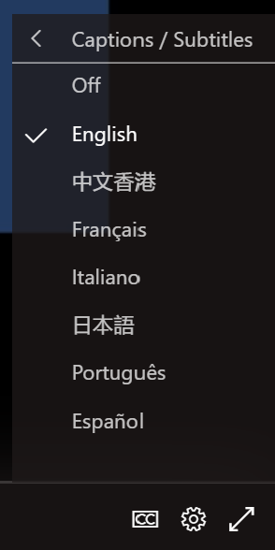
Captions

