Slide 1
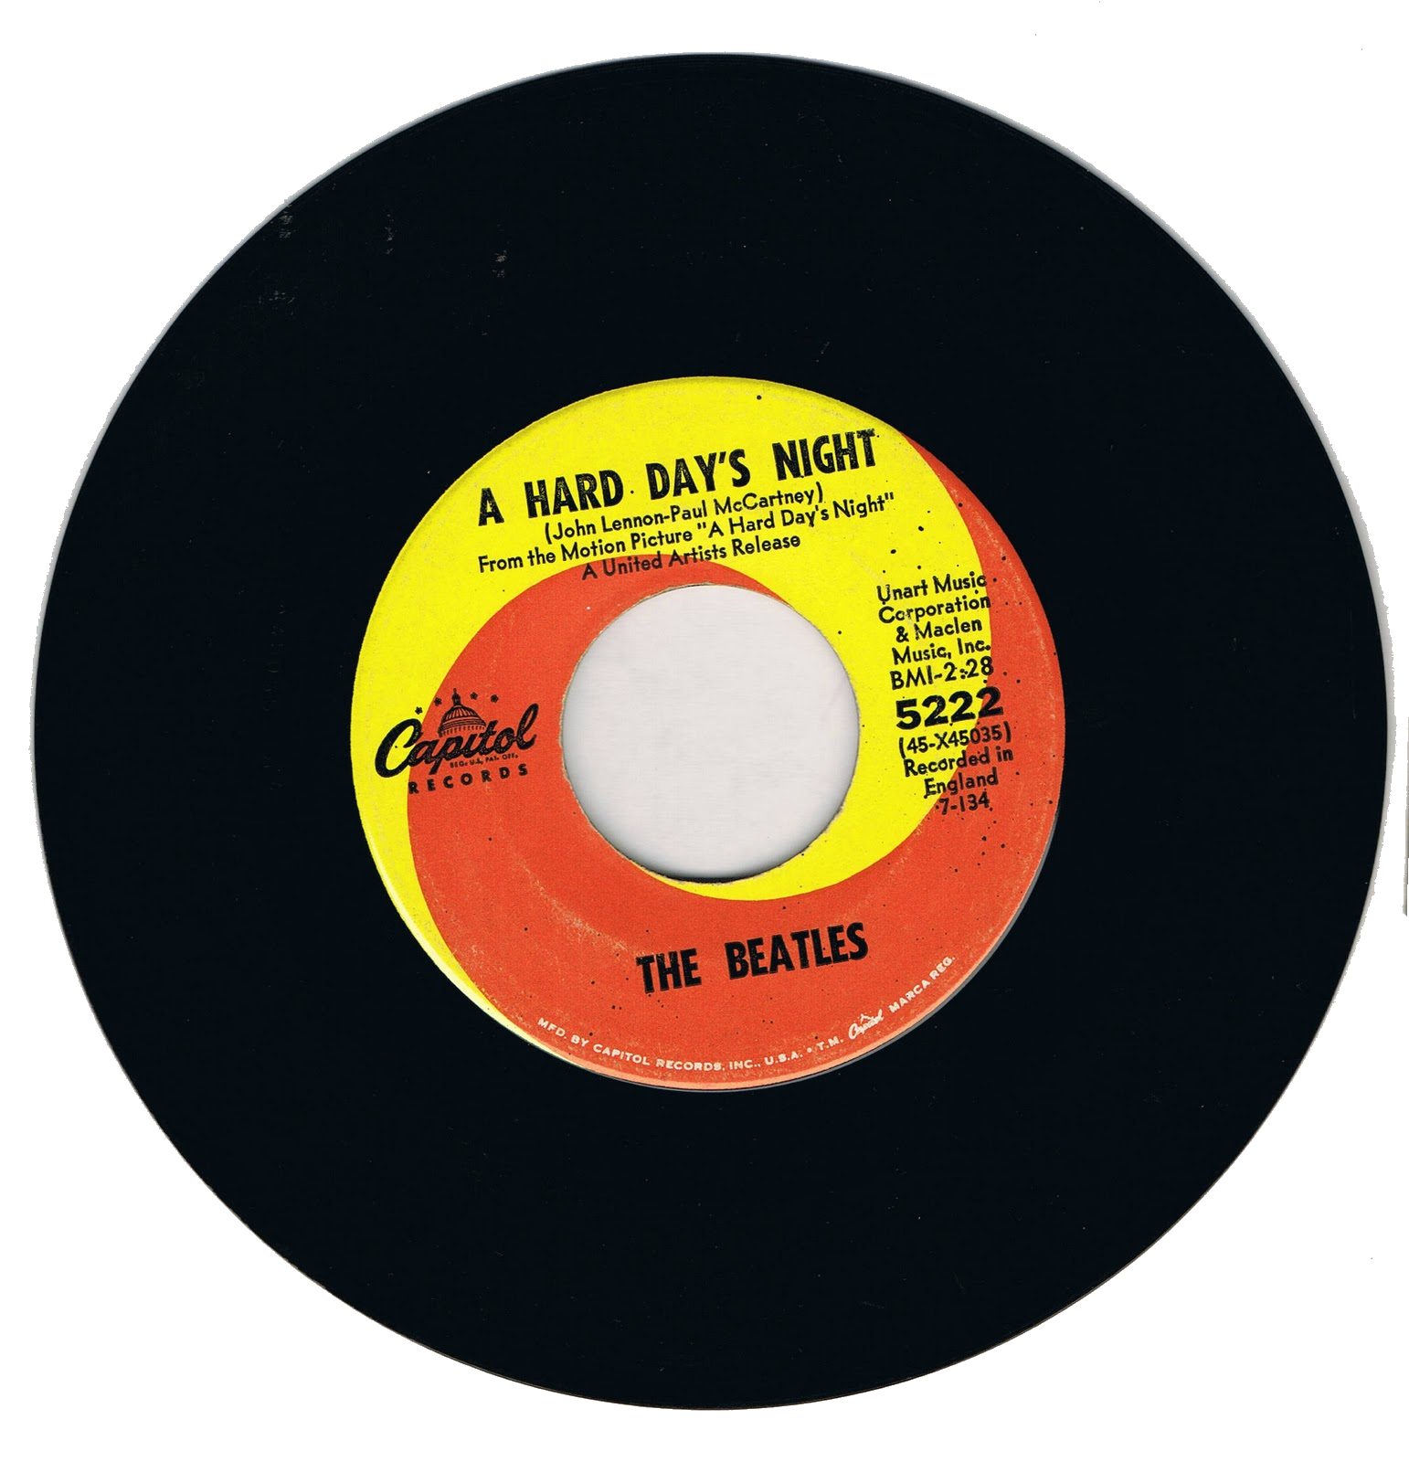
⇧
Notes:
Doing the impossible: Fitting 33 fit into 45!

Slide 2
33 ⅓ Web Accessibility Tips
in 45 Minutes
Terrill Thompson
University of Washington
tft@uw.edu
@terrillthompson
http://terrillthompson.com
http://uw.edu/accesscomputing/tips

Slide 3
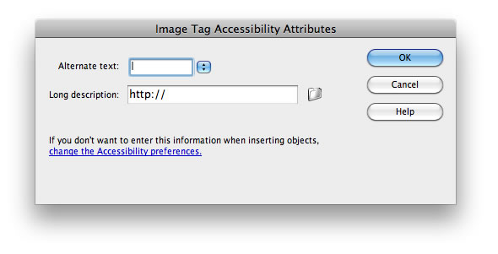
1. Add proper alt text to images
<img src="altdialog.png" alt="screen shot of Dreamweaver Image Tag Accessibility Attributes dialog, including prompts for Alternate Text and Long Description">

Slide 4
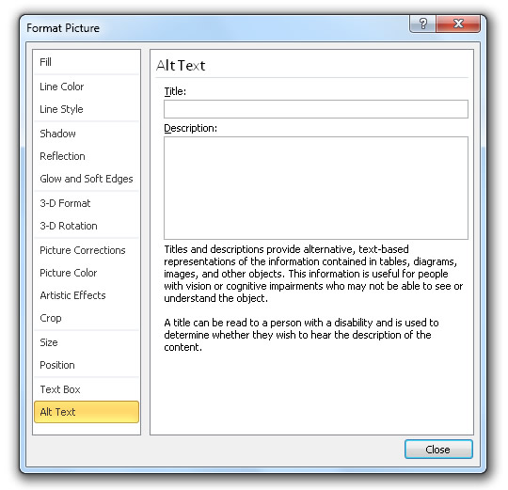
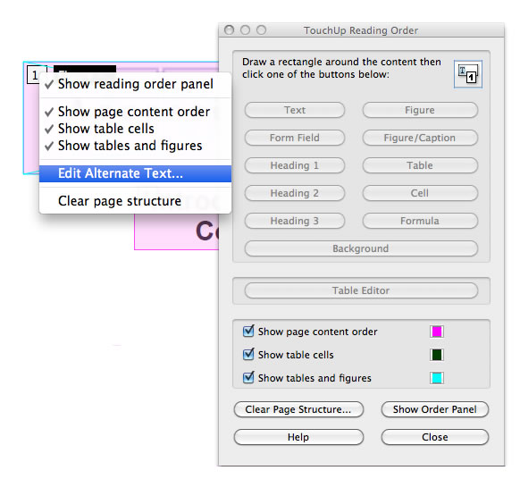
Add alt text in all documents, not just web pages!
Alt text in PDF (using Adobe Acrobat Pro)
Alt text in Word 2011 & 2012

Slide 5
A Couple of Great Alt Text Resources
W3C Techniques for providing useful text alternatives http://www.w3.org/TR/html-alt-techniques/
NCAM Effective practices for describing science content http://ncam.wgbh.org/experience_learn/educational_media/stemdx

Slide 6
2. Use headings properly
<h1>Main heading/title of the page</h1>
<h2>Secondary heading</h2>
<h3>First subheading in this section</h3>
<h3>Second subheading in this section</h3>
<h2>Another secondary heading</h2>

Slide 7
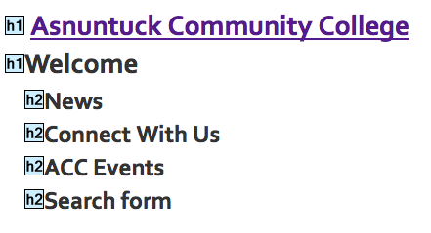
Example of Good Heading Structure

Slide 8
Add headings in all documents, not just web pages!

Slide 9
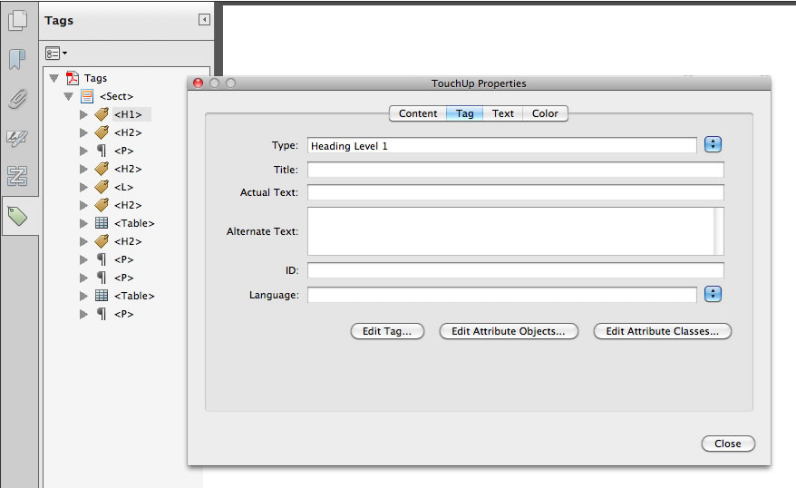
Yes, even (especially) in PDF!

Slide 10
Speaking of PDF…

Slide 11
3. Create accessible PDFs
Not all PDFs are equal:
Image PDFs
PDFs with text, but no structure
Tagged PDF (the only accessible type)
Can create an accessible PDF from scratch
Using a tool that supports tagged PDF (e.g., Word)
Save as tagged PDF
Can fix an inaccessible PDF using Adobe Acrobat Pro

Slide 12
Fixing a PDF in Acrobat Pro
Convert to text (if needed)
Add tags to document (if needed)
Touch up reading order, add alt text to images
Check/correct headings and other tags
Create links from URLs (if needed)
Define document language
Run an accessibility check

Slide 13
More on PDF Accessibility
http://uw.edu/accessibility/pdf.html
Includes workflows for:
Making a PDF accessible from scratch
Exporting from Word to tagged PDF
Repairing an inaccessible PDF using Acrobat Pro
Repairing inaccessible PDF forms using Acrobat Pro
Creating accessible PDF forms using Acrobat Pro
Creating accessible PDF forms using LiveCycle Designer
Also includes additional resources

Slide 14
4. Know when to use PDF
PDF is great for documents where:
Appearance is critical. Document must be the same across all platforms.
Security is critical. Document requires encryption, digital signatures, watermarks, etc.
For many documents, HTML may be a better choice

Slide 15
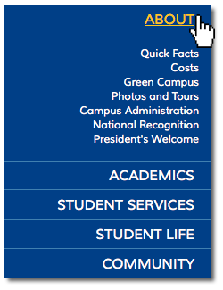
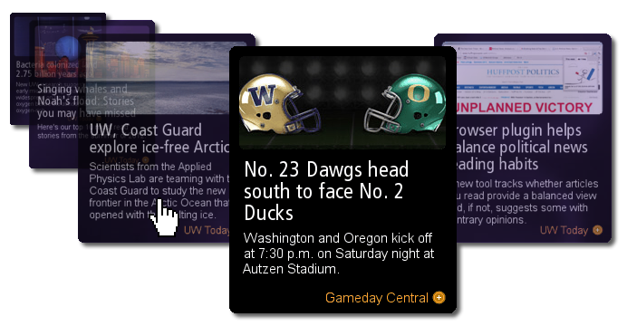
5. Use ARIA
ARIA = Accessible Rich Internet Applications
Notes:
Dynamic apps like this accordion menu, slideshow controller, and carousel widget involve content that changes based on user behavior (typically hovering or clicking with a mouse). ARIA is needed in order to make these sorts of features accessible.

Slide 16
What ARIA Does
Communicates roles, states, and properties of interface elements to assistive technologies. Answers questions like:
What is this?
How do I use it?
Is it on/selected?
What just happened?
<div class="error" role="alert"> The email you entered is not valid. Please try again. </div>

Slide 17
ARIA at its simplest: Landmark Roles
Already well supported by screen readers http://www.html5accessibility.com/tests/landmarks.html
role=“banner”
role=“navigation”
role=“main”
role=“search”
role=“form”
role=“complementary” (e.g., sidebar)
role=“contentinfo” (e.g., footer)
role=“application” (use with discretion)

Slide 18
ARIA Resources
Draft W3C spec http://w3.org/TR/wai-aria
WebAIM slides on ARIA and HTML5 http://weba.im/ahg2011
MDN ARIA site https://developer.mozilla.org/en/aria
HTML5 Accessibility http://html5accessibility.com
Open Ajax Alliance: Accessibility Examples http://oaa-accessibility.org/examples

Slide 19
6. Add labels to form fields
Explicitly associate labels/prompts with the fields they represent
<label for="firstname">First Name:</label>
<input type="text" name="fname" id="firstname">

Slide 20
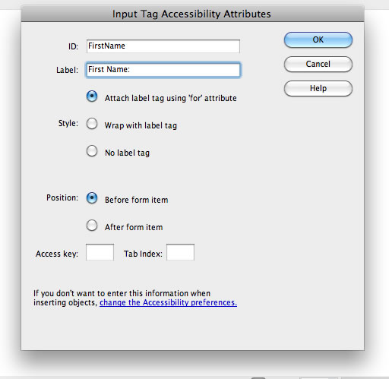
Adding labels in Dreamweaver

Slide 21
In PDF, use tooltips for labels

Slide 22
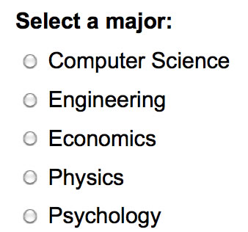
7. Group related form fields together
When form fields are logically grouped together (especially radio buttons and checkboxes) non-visual users need access to both prompts

Slide 23
In HTML, use fieldset and legend
<fieldset>
<legend>Select a major:</legend>
<input type="radio" name="major" id="maj1">
<label for="maj1">Computer Science</label>
<!-- etc. -->
</fieldset>

Slide 24
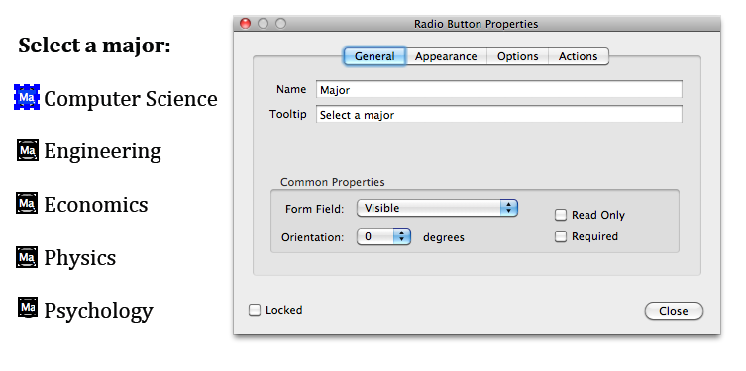
In PDF, use tooltip like <legend>

Slide 25
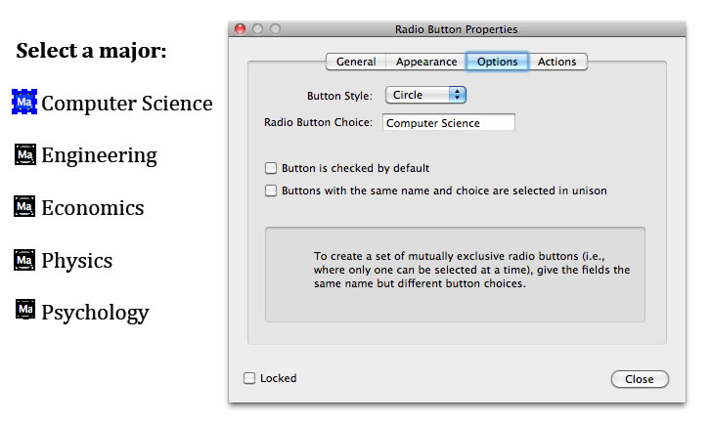
And “Radio Button Choice” like <label>

Slide 26
8. Markup tables appropriately
Include markup that clearly communicates the relationship between table headers and the cells within their scope

Slide 27
Example Simple Table

Slide 28
Example Simple Table in HTML
<table>
<thead>
<tr>
<th scope=“col”>Week</th>
<th scope=“col”>Topic</th>
<th scope=“col”>Reading Assignment</th>
</tr>
</thead>
<tbody>
<tr>
<th scope=“row”>1</th>
<td>Course Introduction</td>
<td>Chapter 1</td>
</tr>
<!-- etc. -->
</tbody>
</table>

Slide 29
Example complex table

Slide 30
Accessible complex table in HTML (just the highlights)
<th id="ay0708" colspan="6">2007-08</th>
<th id="eco1"> <abbr title="Ecological Sciences">Eco</abbr> </th>
<th id="female">% Female</th>
<td headers="ay0708 eco1 female"> 27</td>

Slide 31
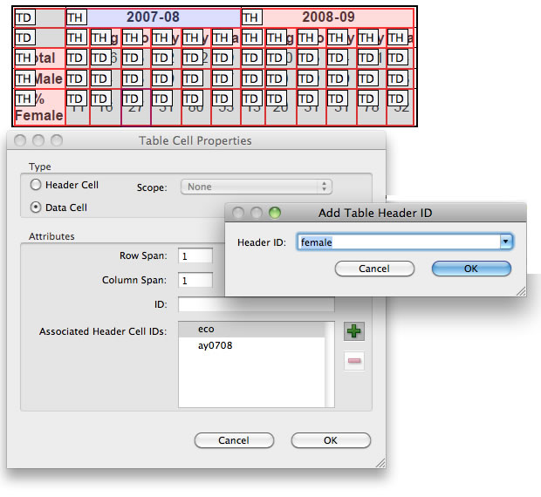
Accessible PDF tables in Acrobat

Slide 32
9. Identify language of text
Identify default language of document <html lang="en">
Identify changes in language <p lang="fr">Après la pluie le beau temps.</p>
Experiments with Language and Accessibility http://terrillthompson.com/blog/30

Slide 33
10. Use a color contrast checker
WCAG 2.0 Level AA:
Contrast ratio of 4.5:1 for normal text
or 3:1 for large text (18 pt or 14 pt bold)
WCAG 2.0 Level AAA:
Contrast ratio of 7:1 for normal text
Or 4.5:1 for large text

Slide 34
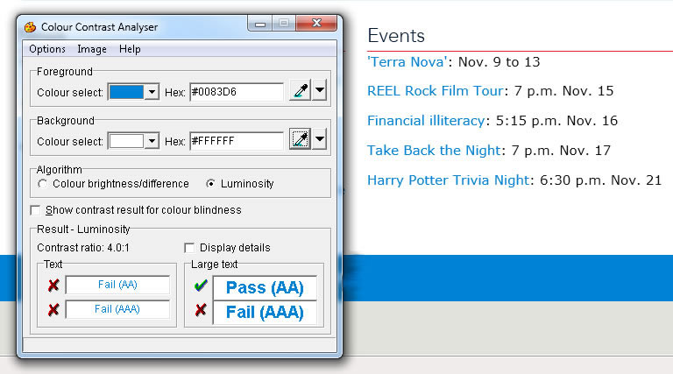
Example Contrast Checker
http://www.paciellogroup.com/resources/contrast-analyser.html

Slide 35
11. Avoid using tiny fonts
Paragraph with font-size:8px
Paragraph with font-size:1em
= my default size as defined in my browser preferences

Slide 36
12. Respect white space
Space between lines
Space between paragraphs
Can help users who have difficulty tracking text horizontally.
Contributes to a cleaner, more aesthetically pleasing interface for everyone.

Slide 37
Sample CSS with white space
p, li, blockquote {
line-height: 1.5em;
margin-bottom: 1.5em;
}

Slide 38
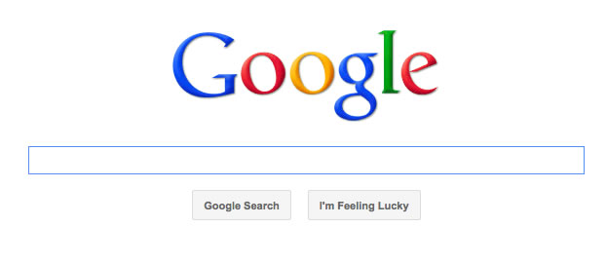
Clean and simple is good.

Slide 39
13. Provide visible indication of focus
a {
color: black;
background-color: white;
}
a:hover {
color: white;
background-color: black;
}

Slide 40
Focus is especially important for keyboard users
a {
color: black;
background-color: white;
}
a:hover, a:focus {
color: white;
background-color: black;
}

Slide 41
14. Use text, not pictures of text
Pictures become blurry when enlarged
Pictures take longer to download
Pictures are more difficult for you (the website author) to edit.
You can attain very good visual effects using text and CSS.

Slide 42
15. Think twice about the words you choose
Word length and sentence complexity have an effect on the ability of certain individuals to decode the words on a page.
Juicy Studio Readability Test: http://juicystudio.com/services/readability.php
Struggling with Understandability: http://terrillthompson.com/blog/10

Slide 43
Example choices to make text easier to read
Understandable → “easier to read”
Manipulated → Changed
Subsequently → Later
“Testimonials from individuals with disabilities…” → “People with disabilities talk about…”

Slide 44
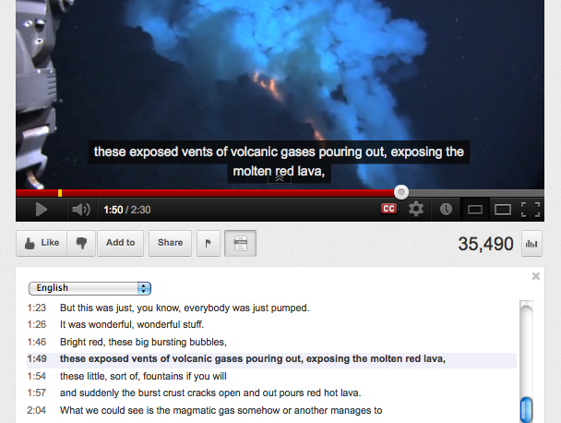
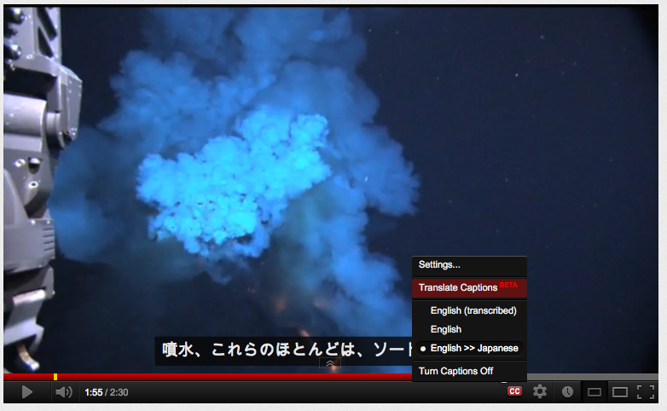
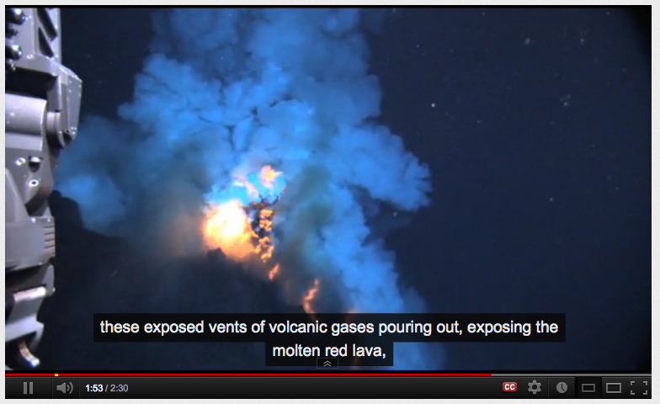
16. Caption video

Slide 45
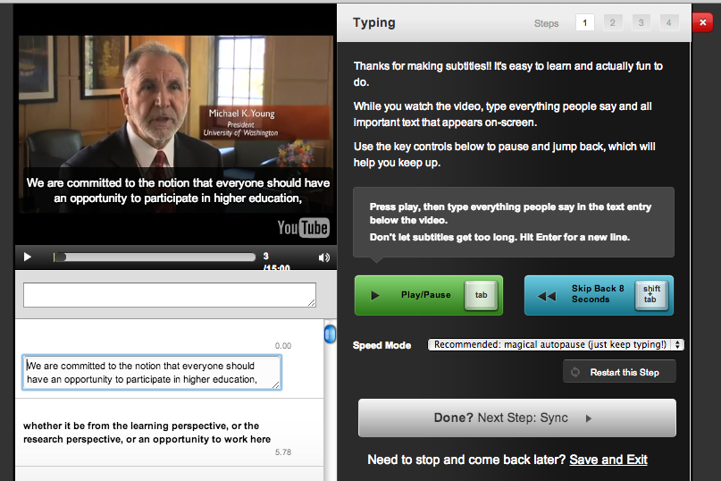
Free Captioning Tools (e.g., Amara)

Slide 46
A Few Tools & Services for Captioning
Amara (Universal Subtitles) http://universalsubtitles.org
3PlayMedia http://www.3playmedia.com/
CaptionSync http://www.automaticsync.com/captionsync/
DocSoft http://www.docsoft.com/

Slide 47
17. Describe video
Describe content that is otherwise only accessible to people who can see it. Examples:
Words on the screen
Critical actions
Other critical details about the setting, etc.

Slide 48
Description in 2 (or 3) Simple Steps
Script the description
What needs to be described?
When?
(optional) Record the narration.
Sync description with the video.
Many examples of vendors’ work at: http://listeningislearning.org/background_what-is-description.html

Slide 49
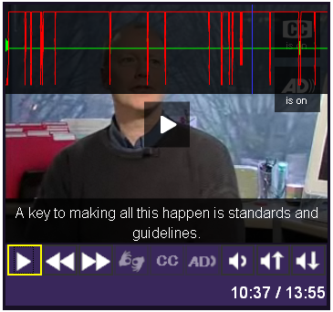
Description as Audio File
JW Player supports description as MP3 file

Slide 50
Description as Text
<video controls tabindex="0">
<source src="myvideo.mp4" type="video/mp4">
<source src="myvideo.ogv" type="video/ogg">
<track kind="captions" src="mycaptions.vtt">
<track kind="descriptions" src="mydesc.vtt">
<!-- fallback content goes here -->
</video>

Slide 51
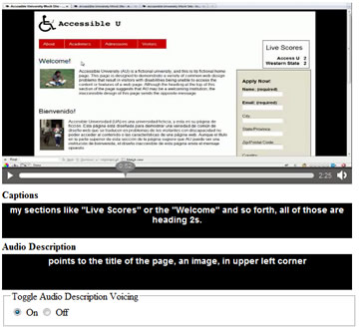
Text Description Proof of Concept
From Greg Kraus, NCSU: http://bit.ly/ncsudesc

Slide 52
18. Provide a transcript
Who benefits?
People who are deaf-blind (easier to read than captions with a Braille device)
People with low Internet bandwidth
People who want the information but don't have time to watch the video

Slide 53
19. Choose media players that support accessibility
Does this player support closed captions?
Does it support description?
Can it be operated without a mouse?
Are buttons and controls accessible to screen reader users?

Slide 54
A Few Media Players To Check Out
JW Player http://www.longtailvideo.com/players
Ohio State JW Player Controls http://wac.osu.edu/examples/jwpc/
NCAM ccPlayer http://ncam.wgbh.org/invent_build/web_multimedia/tools-guidelines/ccplayer
See also my blog on HTML5 video and JW Player http://terrillthompson.com/blog/40

Slide 55
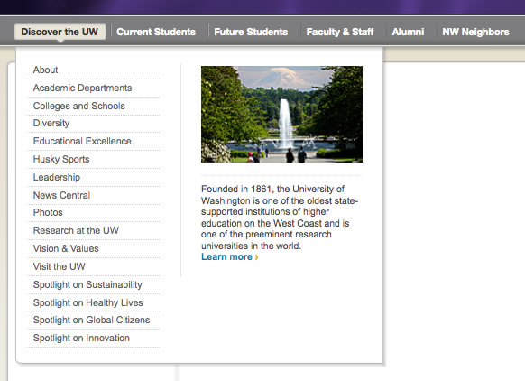
20. Choose a menu system that works for all users

Slide 56
How a Modern Menu Should Work
Full support for keyboard navigation
Tab enters and exits the menu
Navigate with arrow keys
Open sub-menu with enter, space bar, or up/down arrows
Exit sub-menu with escape
Keyboard models defined by DHTML Style Guide http://dev.aol.com/dhtml_style_guide
Use ARIA to communicate roles (e.g., menubar, menuitem), states, & properties (! (see Tip #5)
More details, plus examples on my blog: http://terrillthompson.com/blog/202

Slide 57
21. Choose Accessible Widgets, Plug-ins and Modules
Can you use it with a keyboard?
Does it include ARIA markup?
Has it been tested with assistive technology?

Slide 58
22. Test Widgets, Plug-ins, & Modules – don’t assume they work for everyone
ARIA is a work in progress
ARIA is not fully supported by AT
ARIA requires relatively new AT
Test! Test! Test! (see tips 24-27)
Ask users with disabilities to help with testing
Practice progressive enhancement
If you must, practice graceful degradation

Slide 59
23. Chose LMS and CMS that support accessibility
Learning management systems (e.g., Blackboard, Desire2Learn, Moodle, Sakai) will have a huge impact on students’ educational experience.
Content management systems (e.g., Drupal, Plone, Joomla, WordPress) will have a huge impact on a institution’s Web.
Accessible LMS or CMS = Accessible everywhere
Inaccessible LMS or CMS = Inaccessible everywhere

Slide 60
24. Test with a keyboard
Use the tab key (and other keys where doing so makes sense)
Don’t touch the mouse!
Can you access all features?
Can you operate all controls?

Slide 61
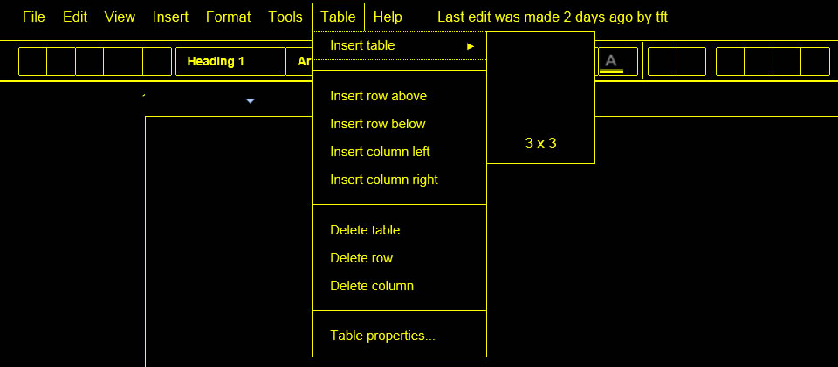
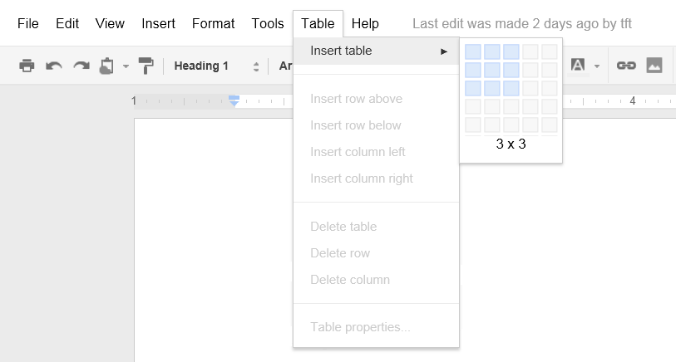
25. Test with high contrast color schemes
Is all important content still visible?

Slide 62
26. Test pages with screen readers
JAWS http://freedomscientific.com/products/fs/jaws-product-page.asp
Window-Eyes http://www.gwmicro.com/Window-Eyes/
NVDA (Free!) http://www.nvda-project.org
VoiceOver (built in to Mac OS X and iOS) http://www.apple.com/accessibility/voiceover/

Slide 63
27. Test pages on mobile devices
71.8% of screen reader users now use a screen reader on a mobile device Source: WebAIM Screen Reader User Survey #4: http://weba.im/survey4
Test on iPhone using VoiceOver. Some tips: http://webaim.org/articles/voiceover/

Slide 64
28. Ask vendors specific questions about accessibility of their products
Is your product accessible?
Do you have a Voluntary Product Accessibility Template (VPAT)?
Can you demonstrate how to operate your product without a mouse?
What sort of testing have you done with users with disabilities? (probe for details)
Fact check their answers with other users

Slide 65
More Questions
Are third party plug-ins accessible?
Example: “The Drupal Accessibility Pledge” http://groups.drupal.org/node/66383
Can content authors use the tool to create accessible content?
Does the tool prompt authors to include accessibility, and provide relevant help?

Slide 66
29. Demand accessibility!
Not accessible? Don’t buy it. Don’t use it. Don’t support it.
If no comparable product is accessible, buy it only with the understanding that the vendor must address its accessibility shortcomings.
Work to implement policies on your campus that require IT purchases to be accessible.

Slide 67
Hold vendors accountable
Representations and Warranties. Vendor represents and warrants that [the product] is fully accessible to persons with disabilities in accordance with Title II of the Americans with Disabilities Act [or Title III for private institutions] and Section 504 of the Rehabilitation Act [or delete the “and” and add your state statute after the Rehab Act] and further hereby indemnifies University from all claims, liability and damages for any violation of those statutes traceable to Vendor’s [product].

Slide 68
30. Get involved!
Contribute accessibility to open source
Follow #a11y on Twitter
EDUCAUSE IT Accessibility Constituent Group
Working to get accessibility on the radar of EDUCAUSE, CIO’s, and other IT Leaders
http://educause.edu/groups/itaccess
Access Technology Higher Education Network (ATHEN)
Activities include active collaborations with vendors
Home page: http://athenpro.org

Slide 69
31.
?
Notes:
Audience-contributed bonus tip!

Slide 70
32.
Notes:
Another audience-contributed bonus tip!

Slide 71
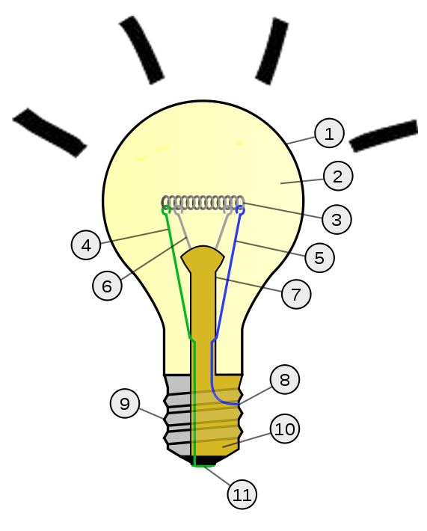
33.
Notes:
Wow! Yet another audience-contributed bonus tip!

Slide 72
33⅓. Get Your Accessibility Sticker!

