Slide 1
The Past, Present and Future of Digital Accessibility
Terrill Thompson
Director of Accessibility Consulting & Engagement
UWIT Accessible Technology Services

Slide 2

Barrier #1
Notes:
Mountains are huge, vast and impossible barriers.
How can we possibly get to the other side?
Some people (e.g., Erik Weihenmayer) might go over the top, but few people have this ability.
Others must find another way…

Slide 3
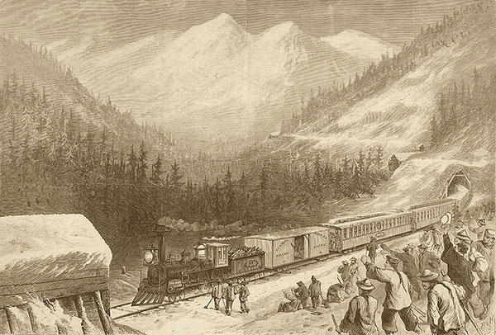
Overcoming barriers requires:
Hard work
Time
Money
Huge teams of people working together, collaborating
Leaders who recognize that getting to the other side is worth the investment

Slide 4

Barrier #2
Notes:
The ocean presents a similar barrier.

Slide 5
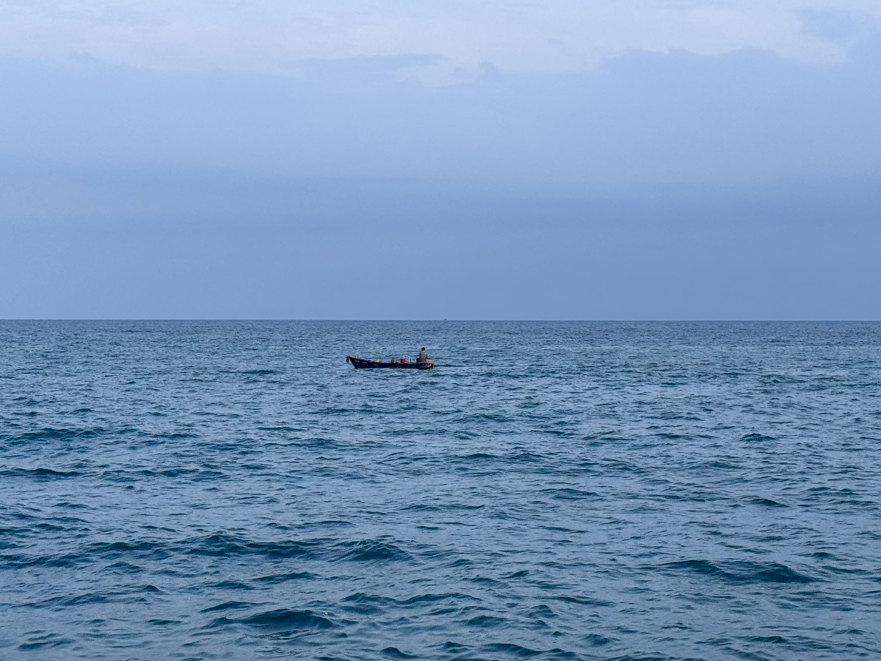
Small boat on the water
Notes:
Conquering barriers starts in small steps. Progress over Perfection.

Slide 6
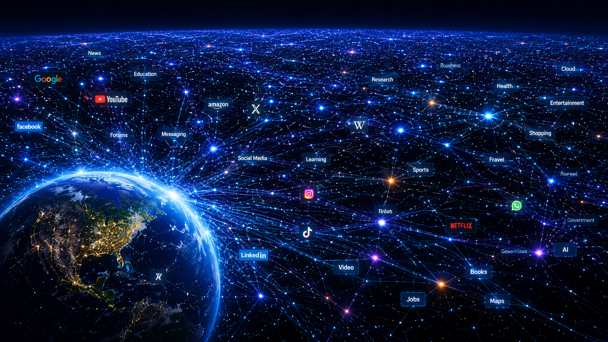
Map of the World Wide Web (Slide 1 of 2)
Notes:
An even bigger barrier: The World Wide Web

Slide 7
Map of the World Wide Web (Slide 2 of 2)
Artist: ChatGPT
Prompt: Draw a graphic rendering of the World Wide Web that captures the Web’s vastness and immensity. Also provide alt text for screen reader users.
"A vast visualization of the World Wide Web stretching across space, with Earth glowing in the lower left corner and billions of interconnected points, lines, and data nodes extending endlessly into the distance like a cosmic neural network."

Slide 8
The Past
How did we get here?

Slide 9
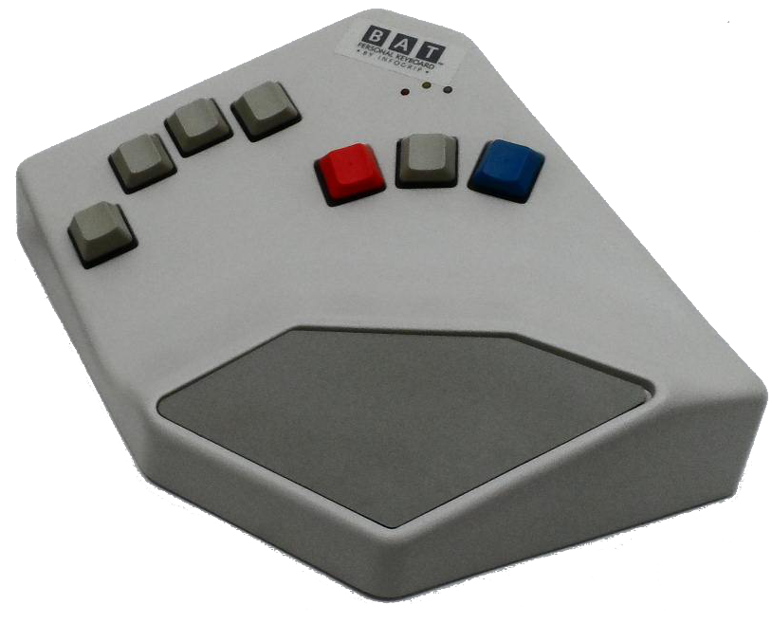
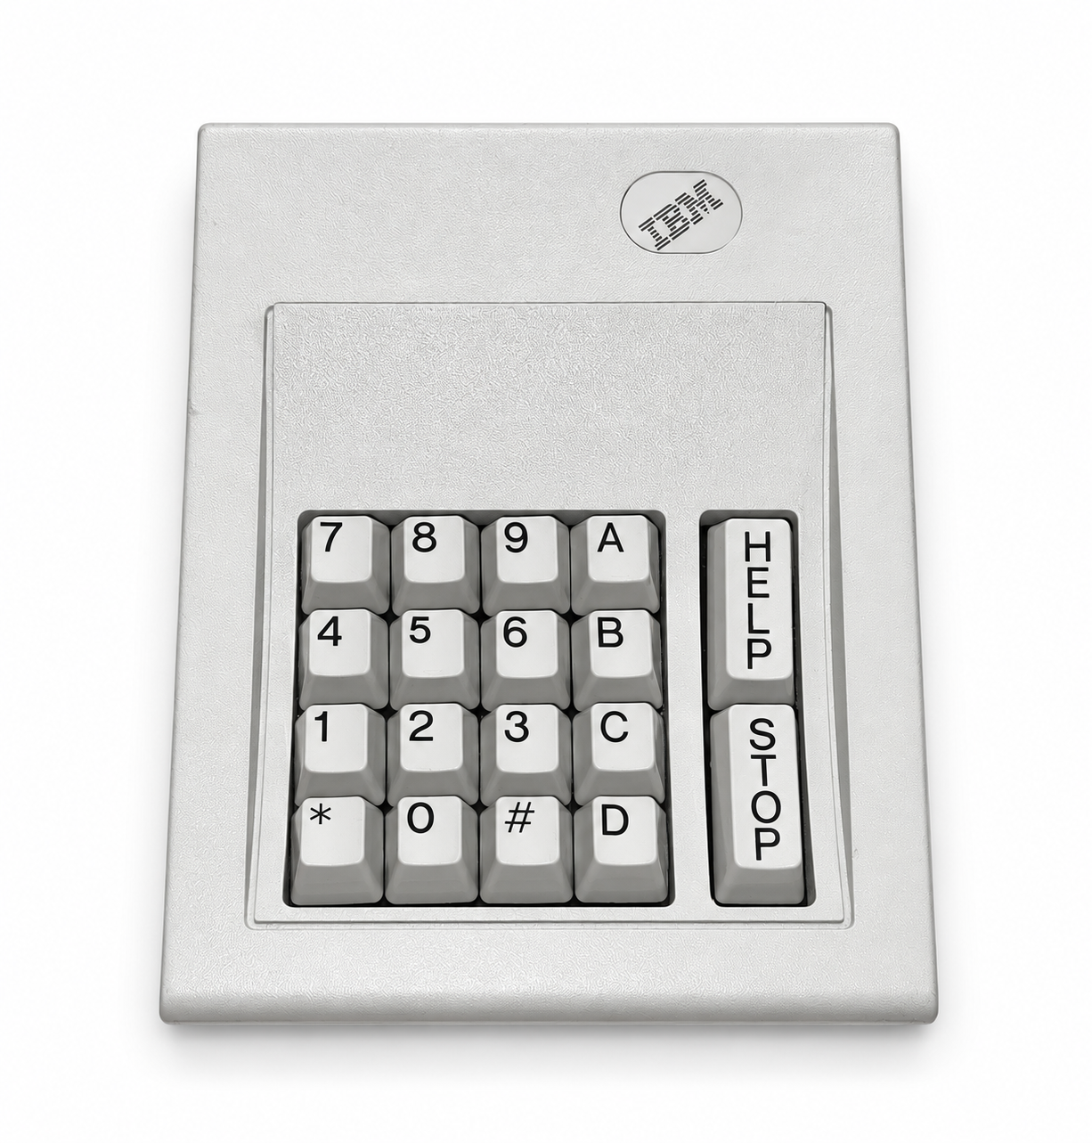
Making Computers Accessible
Early focus was on assistive technology, adapting technology to make it possible for people with disabilities to use devices that were otherwise inaccessible.
1971 – Trace Research and Development Center founded at University of Wisconsin – Madison
1976 – Kurzweil Reading Machine
1985 – First CSUN Assistive Technology Conference
1986 – IBM Screen Reader

Slide 10

Accessibility within Association for Computing Machinery (ACM)
1964 – started a Committee on Professional Activities for the Blind
1969 – The committee held their first conference
1971 – Expanded scope and renamed to Special Interest Group on Computers and the Physically Handicapped (SIGCAPH)
2003 – Renamed to SIGACCESS, which continues to serve as a hub for accessibility-related research and innovation

Slide 11

U.S. Accessibility Laws
1973 – Rehabilitation Act, Section 504
  Prohibits disability discrimination in federally funded programs.
  The regulations, published in 1977, explicitly defined the accommodations required for qualified students with disabilities.
1990 – Americans with Disabilities Act (ADA)
  Prohibits disability discrimination across major areas of public life
1998 – Rehabilitation Act, Section 508
  Required federal agencies to make covered electronic and information technology accessible.
2024 – ADA Title II web and mobile app rule
  Establishes WCAG 2.1 Level AA as the technical standard for covered state and local government web content and mobile apps.
April 26, 2027 – the current deadline for meeting the ADA Title II rule
  Extended from an earlier deadline, April 2026

Slide 12
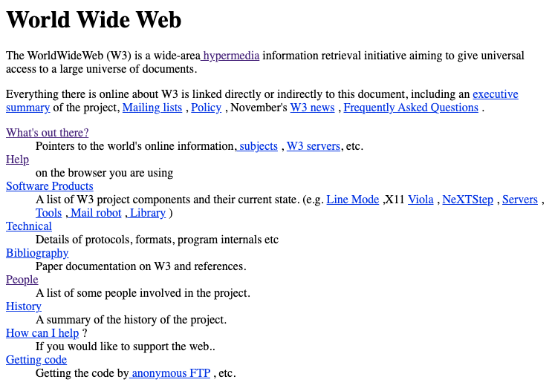
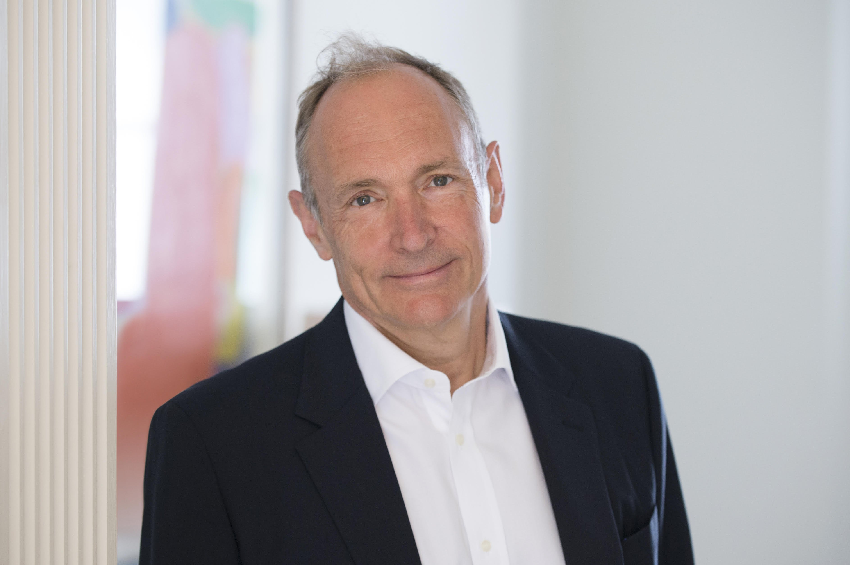
1991 - The First Website
Tim Berners Lee, inventor of the Web

Slide 13
1993 - HTML 1.1: Headings
H1 is the highest level of heading, and is recommened for the start of a hypertext node. It is suggested that the text of the first heading be suitable for a reader who is already browsing in related information, in contrast to the title tag which should identify the node in a wider context.
The heading elements are
<H1>, <H2>, <H3>, <H4>, <H5>, <H6>
It is not normal practice to jump from one header to a header level more than one below, for example for follow an H1 with an H3. Although this is legal, it is discouraged, as it may prodcue strange results for example when generating other representations from the HTML.

Slide 14
1993 - HTML 1.1 & 1.2: Images
The <IMG> element is introduced in HTML 1.1, but its only attributes are SRC and ALIGN.
In HTML 1.2 (published in the same month as 1.1), the ALT attribute was added.
“Optional alternative text as an alternative to the graphics for display in text-only environments.”

Slide 15
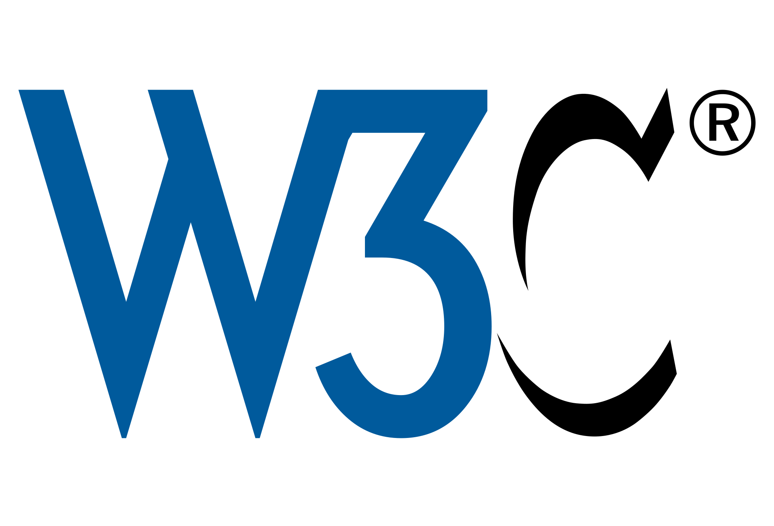
1997 – HTML 4.0
Separation of structure (HTML) from presentation (CSS)
Better table accessibility (e.g.. column and row headers)
Titles on frames
Labels on form fields
Language specification

Slide 16
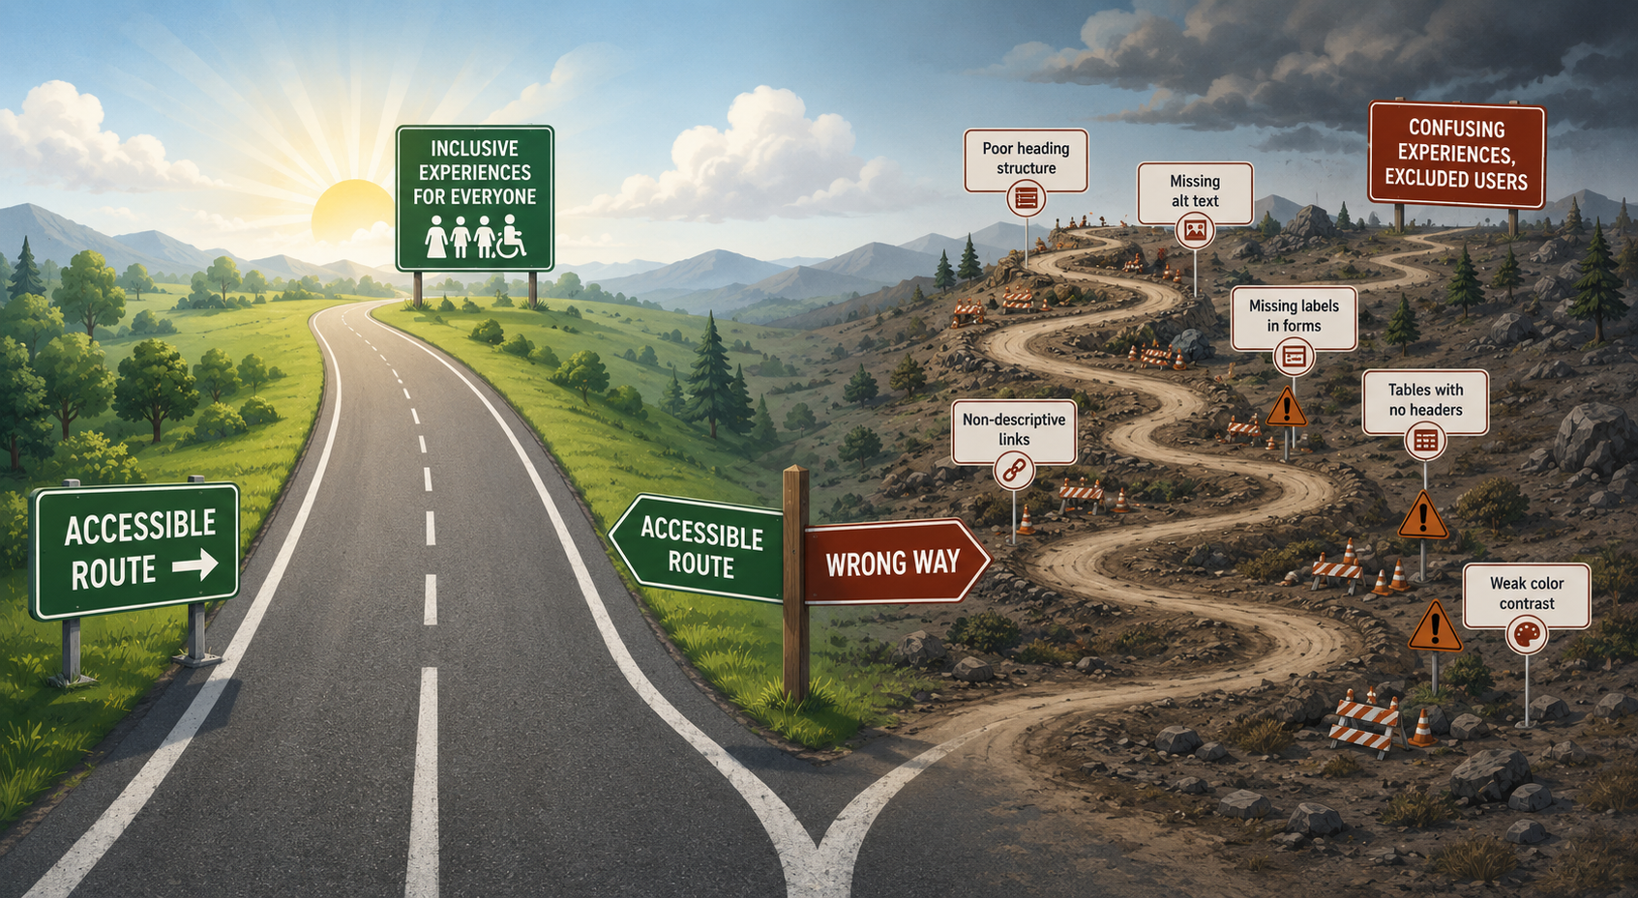
The wrong path (Slide 1 of 2)

Slide 17
The wrong path (Slide 2 of 2)
AI-generated alt text:
Illustration of a fork in the road symbolizing two approaches to digital accessibility. The left path, labeled “Accessible Route,” is smooth, straight, and leads through a bright landscape toward a large sign reading “Inclusive Experiences for Everyone,” with icons representing diverse users. The right path, labeled “Wrong Way,” is rough and winding through a barren landscape, with warning signs along the route labeled “Poor heading structure,” “Missing alt text,” “Missing labels in forms,” “Tables with no headers,” “Non-descriptive links,” and “Weak color contrast.” At the end of the winding road is a sign reading “Confusing Experiences, Excluded Users.”

Slide 18
1997 - Launch of the W3C Web Accessibility Initiative
"Worldwide, there are more than 750 million people with disabilities. As we move towards a highly connected world, it is critical that the Web be usable by anyone, regardless of individual capabilities and disabilities.”
- Tim Berners-Lee

Slide 19
Web Content Accessibility Guidelines (WCAG)
1999 – WCAG 1.0
2008 - WCAG 2.0
  Perceivable, Operable, Understandable, Robust
  Three Levels (A, AA, AAA)
2018 – WCAG 2.1
  Level AA required by the ADA Title II rule
2023 – WCAG 2.2
  Level AA required by WA State Policy User-01 and UW APS 9.0

Slide 20
Other milestones in digital accessibility
1993 – PDF 1.0
  2001 – PDF 1.4 (introduced tagged PDF; required for accessibility)
  2026 – PDF 2.0 (added support for accessible math – finally!)
2005 – YouTube launched
  2008 – Added support for captions
  2009 – Added support for automatic captioning
  April 2025 – Automatic captions improved (e.g., introduced punctuation)

Slide 21

Meanwhile, at the UW…
1992 – The DO-IT Center (Disabilities, Opportunities, Internetworking, & Technology) was founded by Sheryl Burgstahler.
2002 – AccessibleWeb CoP was founded
  Mailman list + monthly meetups
2017 – IT Accessibility Liaisons network

Slide 22
The Present
Where are we now?

Slide 23
University of Washington: Digital Accessibility Initiative
Website: ADA Digital Accessibility Initiative
Established in 2024 in response to the ADA Title II rule
University-wide partnership with executive sponsors from:
  UWIT
  Compliance Services
  The Provost’s Office
  UW Medicine
In Year 3 of 3, work is underway to operationalize our work.

Slide 24
Strategies used by the UW Digital Accessibility Initiative (1 of 3)
Policies, standards, and procedures
  APS 9.0 and associated documents
  Roles and responsibilities clearly defined in all procedures
Provide tools and services
  accessibility checkers, PDF remediation solutions, captioning services
Provide training opportunities
  Asynchronous and synchronous; define role-based learning pathways

Slide 25
Strategies used by the UW Digital Accessibility Initiative (2 of 3)
Build accessibility into procurement process
  Scope and risk analysis (result: low, medium, or high risk)
  Score Accessibility Conformance Reports (ACRs, aka VPATs)
  Test products (if needed)
  Exemption process / provisional approvals for products that fail
  Digital Accessibility Rider for contracts

Slide 26
Strategies used by the UW Digital Accessibility Initiative (3 of 3)
Communication Plan
  Toolkits for faculty and supervisors, Digital Accessibility News blog
  A series of emails to suppliers (procurement)
Building community
  Digital Accessibility Liaisons – Founded in 2017, now has 342 members
  Meetups, Communities of Practice, and Events
  More on our Get Involved and Events pages

Slide 27
Digital accessibility, beyond the UW
Growing interest in the digital accessibility field (IAAP, Slack)
Success in educating students (who will be designing and building our future world) on digital accessibility (Teach Access)
Mixed results in web accessibility (WebAIM, UW)

Slide 28
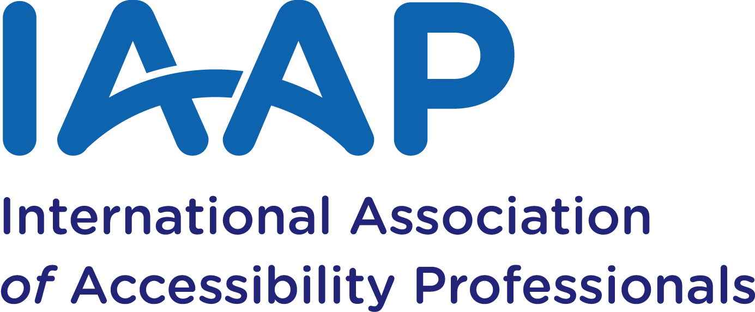
IAAP
10,984 members
110 countries engaged
12,011 professional certifications issued
  Certified Professional in Accessibility Core Competencies (CPACC)
  Web Accessibility Specialist (WAS)
  Certified Professional in Web Accessibility (CPWA)
  Accessible Document Specialist (ADS)
  Certified Professional in Accessible Built Environments (CPABE)

Slide 29
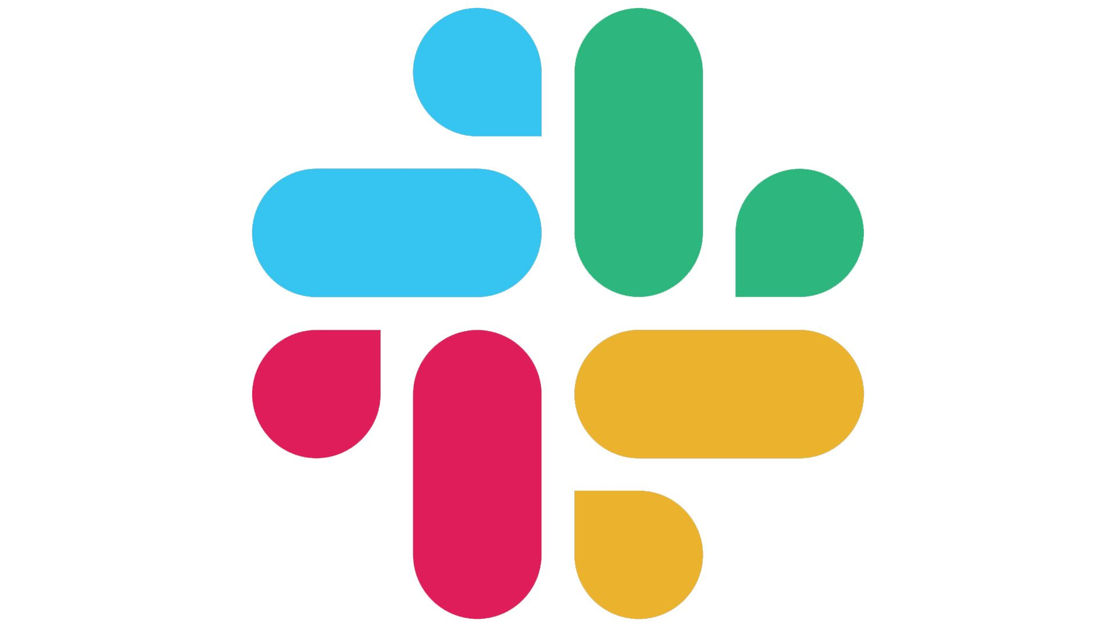
Slack A11y Workspace
16,253 members
1,137 monthly active
172 channels
(e.g., a11y-patterns, a11y-ux, wcag, job-opportunities)
More info: Slack A11y page on GitHub

Slide 30

TeachAccess
Founded in 2016
2 million students reached
1,350+ engaged educators
400+ schools
400+ free programs and resources
66+ countries
Source: Teach Access 2026 Stories of Impact & Growth

Slide 31
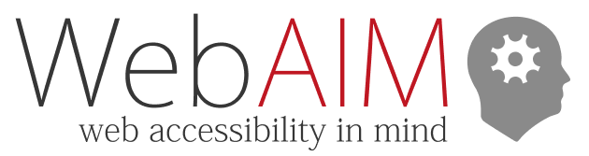
The Current State of Web Accessibility
Source: The WebAIM Million
  2026 report on the top 1 million home pages
An average of 56.1 accessibility errors per home page
Up 10.1% since 2025 (51 errors per page)
Home page complexity has also increased
  Average of 1,437 elements per page (up 14.3% from 2025)
  Average of 133 ARIA attributes per page (up 27% from 2025)

Slide 32
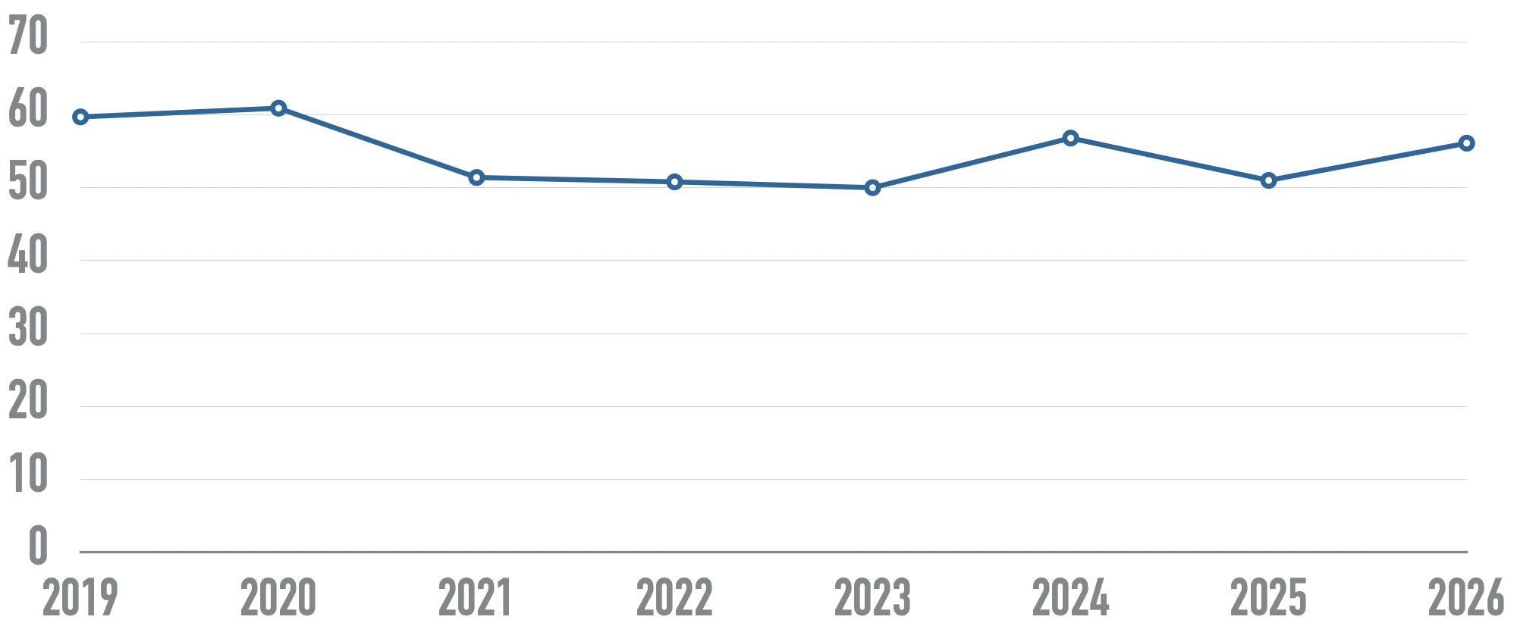
WebAIM Million: Detected Errors
Average number of detectable errors per home page over time

Slide 33
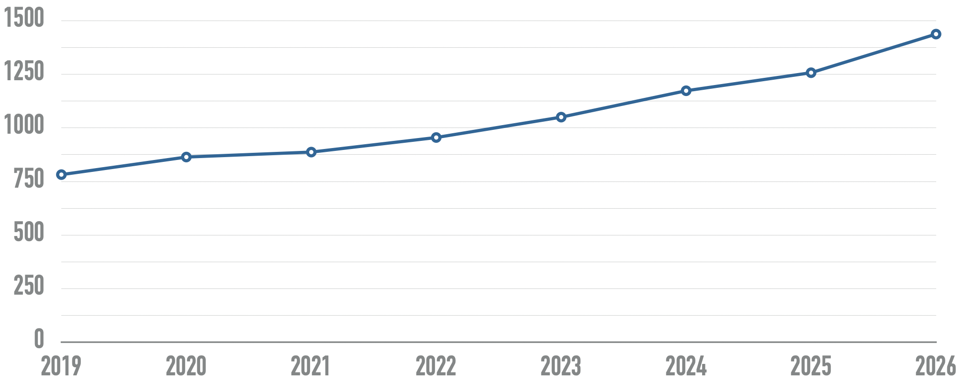
WebAIM Million: Home Page Complexity
Average number of elements per home page over time

Slide 34
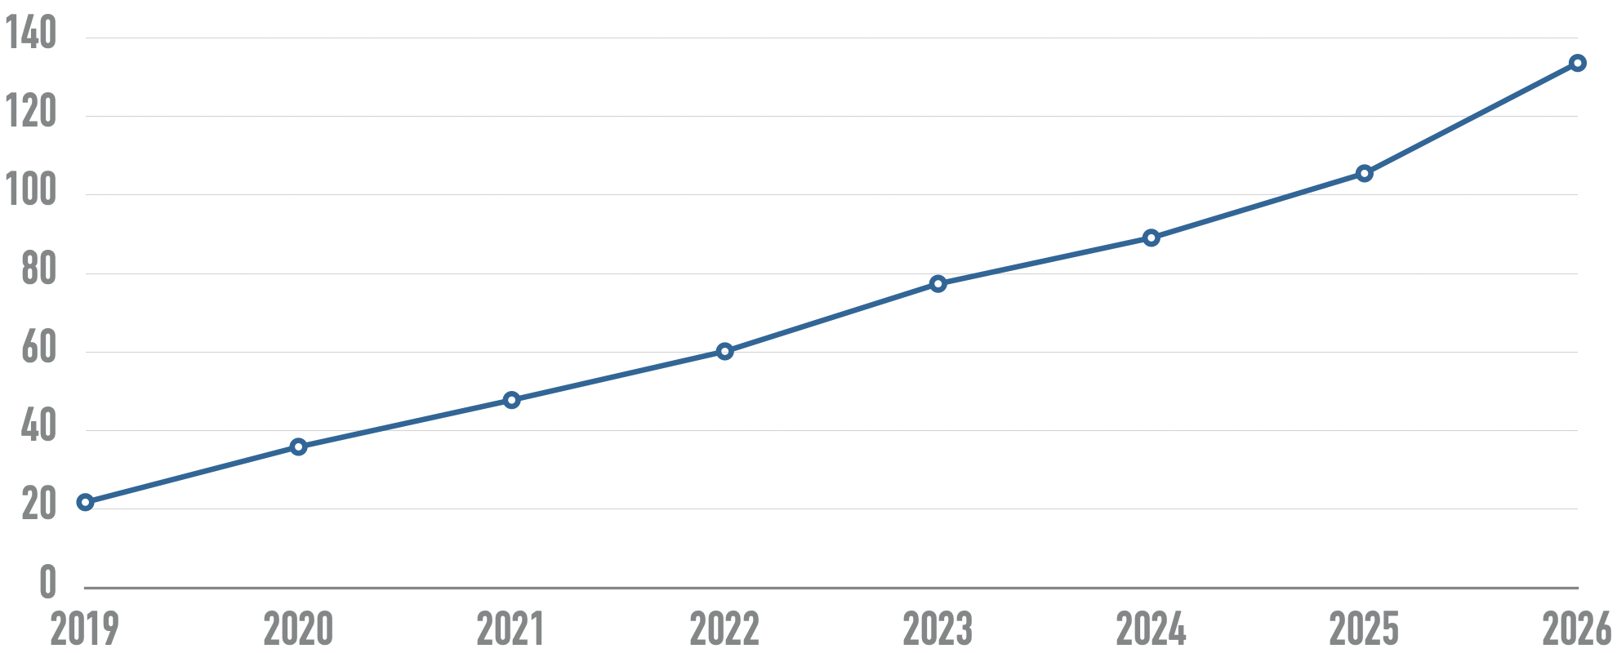
WebAIM Million: ARIA Attributes
Average number of ARIA attributes per home page over time

Slide 35
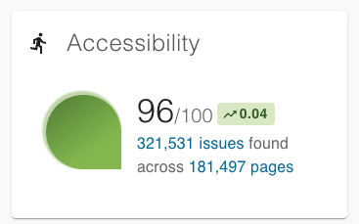
Better Web Accessibility Scores at the UW
Measured by DubBot, our enterprise web accessibility checker
Across ~1500 sites, Accessibility Score is 96/100
249 sites have perfect scores
Notes:
Maybe evidence that all our efforts are having a positive effect?

Slide 36
Accessibility of web and mobile applications at the UW
So far, 877 products submitted
  194 (22.1%) are medium or high risk
82 Accessibility Conformance Reports (ACRs) reviewed
  ACRs (aka Voluntary Product Accessibility Template, or VPAT) have historically been of dubious value. But they’re getting better…
  35 (42.7%) “meet expectations” (scored for credibility)
52 products manually tested for WCAG 2.1 Level AA compliance
  47 (90.4%) failed

Slide 37
The Future
Where do we go from here?

Slide 38
An impossible scaling problem. A typical university has:
Tens of thousands of websites
Hundreds of third-party applications
Millions of documents
Thousands of people creating content
Despite all our efforts at the UW, we’re still only scraping the surface. Will adding more resources help?

Slide 39
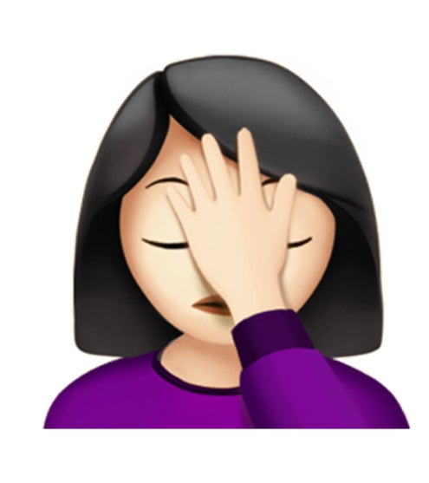
Compliance does not equal accessibility
A technically conformant interface can still be confusing, inefficient, or unnecessarily difficult for someone using assistive technology

Slide 40
Imagining a different future
Accessibility is a default property of digital products.
Accessibility is a standard measure of software quality.
People with disabilities have more influence over product design.
AI dramatically reduces the labor required for accessibility.
Assistive technologies are more capable of overcoming barriers.
The interface itself is more adaptable.

Slide 41
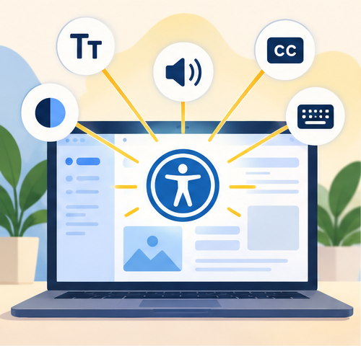
Accessibility is a default property of digital products.
Rather than addressing accessible one website or one PDF at a time, focus our efforts on ensuring components, design systems, and authoring tools are accessible and are producing accessible output.

Slide 42
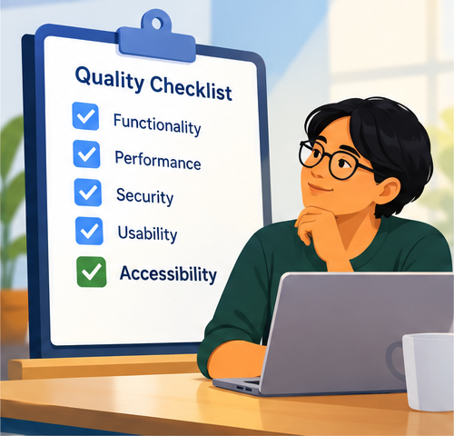
Accessibility is a standard measure of software quality (1 of 2)
ACRs/VPATs are getting better. Can we trust them?
HECVAT offers a potentially trustworthy measure of a vendor’s commitment to accessibility (plus security, privacy).
Internet2 NET+ UpGuard looks promising.
Notes:
HECVAT = Higher Education Community Vendor Accessibility Toolkit. Created by leaders in higher education in collaboration with EDUCAUSE, Internet2, and REN-ISAC.

Slide 43
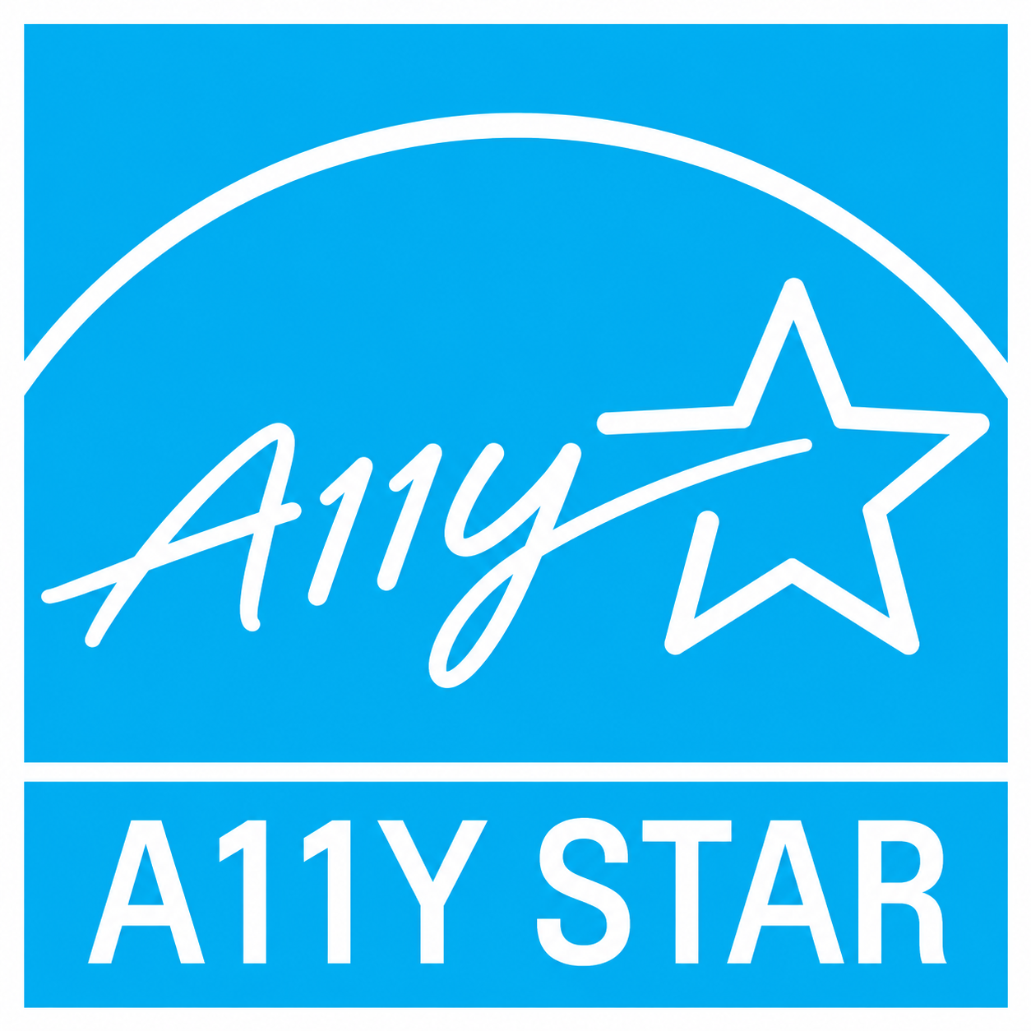
Accessibility is a standard measure of software quality (2 of 2)
Might A11Y STAR Compliance be possible (modeled after ENERGY STAR)?
Independent third-party testing by certified labs
Ongoing verification, enforcement
Even if not mandatory, could be quasi-mandatory if customers (e.g., governments, universities) require it
Has marketing advantages for vendors

Slide 44
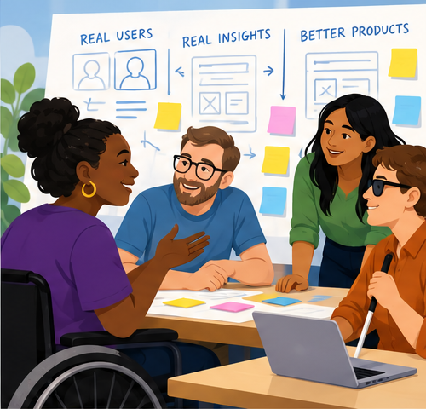
People with disabilities have more influence over product design
People with disabilities as design partners, not merely testers.
This is something the UW offers to our highest priority vendors (shared goals, collaboration)
Big companies are on board (Microsoft, Workday, Zoom) but what about all the others?
Notes:
Participatory design

Slide 45
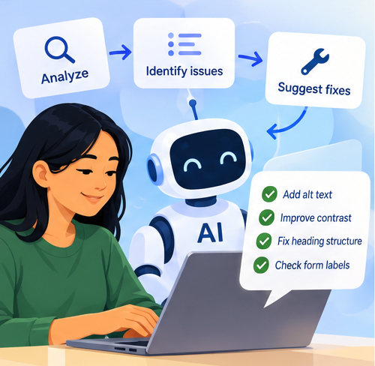
AI dramatically reduces the labor required for accessibility.
AI is capable of:
Writing code that complies with accessibility standards (if prompted)
Generating alt text with consideration for an image’s context
Conducting accessibility checks
WebAIM’s data on complexity might suggest the opposite trend.
Notes:
Imagine a future in which a developer asks an AI coding assistant to create a registration form, and the generated form automatically includes appropriate labels, validation messages, focus management, keyboard interaction, and accessible error handling.

Slide 46
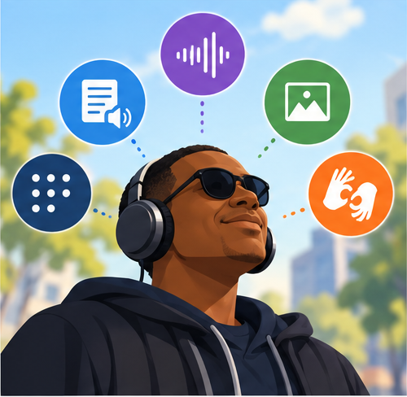
Assistive technologies are more capable of overcoming barriers.
If a mouse user with eyesight can understand and interact with the content on the screen, AT should be able to handle that same content.
See CREATE at UW’s AI and Machine Learning Research for a variety of projects focused on AI and disability.

Slide 47
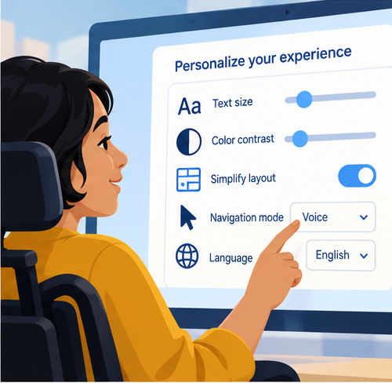
The interface itself is more adaptable.
Shift focus away from aesthetic-driven design to functionalism (i.e., “form follows function”). Users perform functions using their preferred mode.
“Technology should adapt to people, not the other way around.” – Raising the Floor, Access for All

Slide 48
Accessibility is a journey.
There is much more work to do.
Let’s do it together.

