Slide 1

Integrating Universal Design Into the University Curriculum
Accessing Higher Ground 2013
Westminster, Colorado USA
David
Sloan
The Paciello Group
Jonathan Lazar
Towson University
E.A. Draffan
University of Southampton
Terrill Thompson
University of Washington

Slide 2
Sharing Good Ideas with the World
On Twitter: #ahg13
On the Web:
http://staff.washington.edu/tft/talks/ahg13/ud

Slide 3
Agenda
9:00 – 10:00
Introductions
10:00 – Noon
Four Perspectives on Universal Design in Curriculum
Noon – 1:30
Lunch Break
1:30 – 4:30
AHG13 UD in Curriculum Un-preconference
Crowdsourcing your UD-related challenges

Slide 4

Integrating Universal Design for Technology into YOUR Curriculum
Dr. Jonathan Lazar
Dept. of Computer and Information Sciences
and
Universal Usability Laboratory
Towson University

Slide 5
First, let’s clarify…
Universal Design for Learning
  1. Present information and content in different ways
  2. Differentiate the ways that students can express what they know
  3. Stimulate interest and motivation for learning
  (from http://www.cast.org/udl/)
That’s awesome, but not really what we are discussing here
WE are talking about getting universal design concepts, related to technology, into the curriculum

Slide 6
Second, let’s clarify again…
Accessible course content ≠
teaching about accessibility
US law requires accessible course content
  It’s a civil rights issue
  Professors cannot choose to have an inaccessible course or inaccessible materials
But professors CAN choose to not cover accessibility as a teaching topic (of course, we want to encourage coverage of the topic)

Slide 7
Diversity of user needs
We are talking about diversity of user needs, in terms of interface and design requirements
There is one unique aspect to teaching about user diversity in our context:
  LEGAL REQUIREMENTS
While we should be broad in our discussions about universal design, we should remain true to that core point: legal requirements
Be specific: WHICH laws?
It’s not just an issue of design and creativity

Slide 8
Who needs to be involved
Disability Student Services Office
CIO and the Office of Information Technology Services
Division of Academic Affairs, and the Depts of CS/IS/IT

Slide 9
Which classes to start with:
Human-Computer Interaction
Web Design
Systems Analysis and Design
Software Engineering
You can naturally discuss user diversity in terms of interface and design requirements
Don’t forget, reach out to: Instructional Technology, Special Education, Design, Engineering, Speech Pathology, and Occupational Therapy (SIG on Disability)

Slide 10
Human-Computer Interaction Course
Assistive technology (alternate forms of input/output)
Standards (such as WCAG)
Usability testing (how to involve PWD)
Inclusive design/UCD methods
Out of the box vs. add-on
E-reader devices

Slide 11
Web Design Course
Cover WCAG 2.0
National and local laws
Start by evaluating your own department, college, and university for web accessibility
Discuss diversity of devices: not only people who are Blind or Deaf, but people using smartphones to access web content
In Web Design OR Intro to HCI courses, you could do community-based policy projects (come to my talk on Wed. to hear more!)

Slide 12
Systems Analysis and Design & Software Engineering Courses
You could focus on requirements gathering, user profiles, personas…
Focus on understanding what users need
Include examples in your class discussions about users with diverse needs
Bring in on-campus staff (from DSS or CIO) to discuss the types of diverse users on the campus, how do THEY include UD in the procurement/development process for IT?

Slide 13
A course on universal design?
A Towson University special topics course, started 2007 on the topic of universal usability
Students thought it was too broad
Narrowed the focus to just blind users
Now includes 4 field trips:
  National Federation of the Blind IBTC
  Maryland Library for the Blind and Physically Handicapped
  Maryland Technology Assistance Program (TAP)
  Blind Industries and Services of Maryland

Slide 14

Inaccessible design matters…
Don’t just talk about technology
So if technology isn’t accessible, so what? Why should students care?
  Pricing discrimination
  Limited access to educational materials
  Employment discrimination
Talk about the societal impacts!
Talk about the connection with public policy
  e.g. how policies influence how AT is adopted

Slide 15
Class Project ideas
Does your university have an accessible web page template?
Does your university have guidelines for accessible PDFs?
Does your university have accessible procurement processes?
Has there been an IT Accessibility audit yet?
Is there an IT accessibility plan in place?
  If not, these are perfect class activities!

Slide 16
Students may not, conceptually, “get it”
Partner with local organizations:
  Talk to local advocacy groups
  State department of rehabilitation services
  Library for the blind and physically handicapped
  Schools for the blind, deaf, special needs
Go out to community sites, bring in speakers
Make sure if students are going out in the community: understand that time is valuable for ALL people

Slide 17
Don’t forget to emphasize
Accessibility helps other people who were not originally the intended users
Example: captioning on videos, helps people who are deaf and hard of hearing
  And people in noisy environments (gyms, bars, airports)
  And people who are learning English
  And search engines that are cataloging content
Google and other search engines are, in effect, “blind users”, relying on structure and semantics (verbatim from UC-Boulder course materials)

Slide 18


Could we do this better?
Better than fitting it into one or two courses, would be injecting it into the entire curriculum
Accessibility is a fundamental issue to all topics within computing curricula
Short modules on accessibility should be “injected” throughout the curriculum
Allows accessibility to be seen in CONTEXT, rather than as a separate topic
It doesn’t add to the over-scheduled courseload
It’s a requirement, not an elective

Slide 19
Information and Diverse Populations-U. of Maryland
A specialization in the Maryland MLS program
“…to provide information and technology services to diverse populations in libraries, archives, school media centers, government agencies, and numerous other information settings.”
Courses in:
  Diverse Populations, Inclusion, and Information
  Universal Usability
  Information and Human Rights

Slide 20



Let’s talk more broadly: Curriculum Models
Three core undergraduate computing curriculum models
  CS 2008
  IS 2010
  IT 2008
  Coordinated by:

Slide 21
CS 2008 Model
In the Human-Computer Interaction course
Under course topics:
  Accommodating human diversity, including universal design and accessibility and designing for multiple cultural and linguistic contexts.
But NOT listed under learning objectives
No laws or regulations (ADA, 508, etc.) are mentioned
Most of the HCI course material was classified as “elective”
8 classroom hours considered core, on ALL HCI topics, for the entire curriculum
Source: http://www.acm.org/education/curricula-recommendations

Slide 22
IS 2010 Model
Elective Course: Intro to HCI
  “Societal impacts of HCI such as accessibility will also be discussed”
Special HCI Issues related to users
  Children
  Elderly
  Accessibility
  Gender
NO REQUIREMENT FOR TEACHING ABOUT HCI OR ACCESSIBILITY!
Source: http://www.acm.org/education/curricula-recommendations

Slide 23
IT 2008 Model
Course in Human-Computer Interaction
2 hours to cover:
Biometrics
Repetitive stress syndrome
Accessibility guidelines and regulations
  ADA 508
  NIMAS
  UDL
  WCAG
Advanced learning outcome- “Design a new interface to accommodate users with a particular disability”

Slide 24
Also mentioned in IT 2008…
Legal Issues in Computing class:
“Describe the basic elements of compliance laws – such as ADA508, FERPA, HIPPA, and Sarbanes-Oxley”
Web Development class:
“Design and implement a web site that meets the standards set by such bodies as the Web Accessibility Initiative and/or is compliant with various government mandated regulations, such as Section 508 of the US Rehabilitation Act.

Slide 25
Yes---some attention for the topic!
Source: http://www.acm.org//education/curricula/IT2008%20Curriculum.pdf

Slide 26

That’s the key problem
Many software developers, web designers, systems analysts, programmers, never LEARNED about accessibility concepts in their professional training
They don’t PERSONALLY know people with disabilities
CS and IS curricula don’t require accessibility
They don’t understand WHY people with disabilities need to use a web site
We need accessibility and UD integrated from the beginning of computing education, throughout!

Slide 27
Together, we can make a difference!!
But it will take time!
Start pushing now!
Any questions?

Slide 28
Strategies for Promoting the Integration of Universal Design into University Curriculum
Howard Kramer
hkramer@Colorado.edu

Slide 29
Howard Kramer
  Teach a class in UD – Universal Design for Digital Media
    How UD class came about
    Benefits of class –
    Took concept to campus – UD committee
  Work on a NEA grant for Promoting the Integration of Universal Design in University Curriculum (UDUC)
    Funded about a little over a year ago
    Again – focus is not accessibility in classroom or UDL – focus is increasing the amount of UD related or accessibility rated content in courses

Slide 30
Activities of grant
  Develop a network of faculty and others and promote collaboration on the development of UD curricula
  Develop & encourage the sharing of resources
  What we’ve done
    Developed an ongoing online course on UD for digital media
    (course will be taught on the ground next semester)(self-paced)
    Writing & Rhetoric class – using Digital Story Telling to tell the stories of electronic access issues of persons with disabilities
    develop a course on Universal Design for Content Management Systems
    (waiting for approval from A&S)
    Advanced class on UD for digital media – 4000/5000 level class
    Graduate Certificate on UD (for digital media) – (few years away?)

Slide 31
  Relationship with ATLAS
    Confer with other ATLAS staff
Activities of grant - Resources
  Developed beta version of a website which will be up soon at uduc.org
    Clearinghouse of syllabi and syllabi components that address UD
    Been talking to faculty such as David and Jonathan and about sharing resources
    I’ll make the material from my class and any classes to be developed available
    No real resource for this on ICT (stuff on architecture)

Slide 32
Videos - Conferences
  Confer with other ATLAS staff
What audience can do
Looking for collaborators
  Thursday meeting – Westin Boardroom
  Send me your email

Slide 33
Practical Inclusive Design Teaching – a Dundee case Study
David Sloan
The Paciello Group
AHG 2013
2013-11-04

Slide 34
David Sloan
Formerly with the University of Dundee (1998-2013)
Completed a Masters in Applied Computing and a PhD (subject – web accessibility audits)
Researcher, teacher and consultant specializing in Universal Design and User Experience
  Teaching covered modules on degree programs; staff development; workshops for external clients
Now an Accessible User Experience Consultant with The Paciello Group (May 2013- )

Slide 35
Dundee Case Study
A brief overview of the Dundee approach
A case study on a unit on Practical Inclusive Design
  Aims
  Students
  Curriculum
  Learning Activities
  Assessment

Slide 36
Universal Design in the Curriculum
Bachelors and Masters courses
UD/Accessibility generally not taught in isolation, but integrated into appropriate points of relevant courses
  With one exception…
Web Design, Physical Computing, Team Project, HCI, Software Engineering, Graphics
Staff development courses on IT accessibility
  Web authoring, e-assessment,…

Slide 37
Practical Inclusive Design
A unit taught to under- and post-grad students

Slide 38
Context and constraints
A unit forming part of a module titled “Research Frontiers”
Squeezing into a gap between existing units: Human-centred Computing research and Augmented and Alternative Communication (AAC)
5 weeks, 10 credits (for most)
A real mix of students – from UX Masters students to visiting students from China with little specialist knowledge in UD/HCI
Team teaching – David Sloan and Prof Alan Newell (good cop/bad cop)

Slide 39
“If user-centred, inclusive design is so wonderful, why are so many systems still so difficult to use by so many people?
And how can we improve the situation?”

Slide 40
Curriculum
Week 1 - Exploring the problem space; the Dundee story; other contributors to inclusive design thinking
Week 2 – Exploring real world constraints; inclusive design in practice in industry
Week 3 – Evaluation methods for inclusive design; methodologies and measures; conformance and compliance
Week 4 – Engaging with diverse users: when, how, who?
Week 5 – Inclusive design as a skill or a specialism; Education and motivation

Slide 41
Learning activities
Research and presentation on output of selected centres of excellence in Universal Design research & development
Produce and present a dramatic performance showing impact of UD

Slide 42
Assessment
4 individual written reports
A critical assessment of adoption of Universal Design in industry (Apple or Google)
Planning an accessibility assessment project for a large University web site
Designing a training curriculum for staff at a medium-sized tech company
Critical reflection on knowledge gained during the unit

Slide 43
Success?
We had great fun teaching it!
Feedback indicates the students had fun learning
Marks improved over the course of the unit
Value – exploring the practical challenges of defining and implementing Universal Design

Slide 44

Web Technology MSc
Assistive Technologies and Universal Design
E.A. Draffan

Slide 45

Web Technology MSc - Assistive Technologies and Universal Design
Course Overview
To understand the role of accessibility and assistive technologies in achieving universal design
To explore the relationship between accessibility and usability
To prepare students to engage in research and development in assistive technologies and universal design
Notes:
Course Overview
To understand the role of Assistive technologies in achieving universal design
To explore the relationship between accessibility and usability
To prepare students to engage in research and development in assistive technologies and universal design

Slide 46
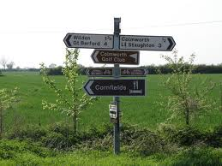
How the course covers issues
Models of disability
Definitions of Assistive Technology and Universal Design
Relevant Legislation and Accessibility and Usability Standards
The interdisciplinary approach to design, research, evaluation
Assessment for assistive technology and universal design
Sources of information about current research in assistive technology and universal design

Slide 47

Main issues arising for course leaders
Up to 50 students each year with a very high percentage of non-English speaking graduates
Need for flexible approach as understanding of disability varies so enormously between cultures
What is Assistive Technology when mainstreaming is moving at such a pace
Tend to make assumptions about accessibility and student’s skills
Explanations about what we mean by guidelines, standards and the law
Ethics
Thinking about projects for their final assignment.

Slide 48







Successes
Students ideas and projects leading to actual products and services
Funded projects supported by Interns and now employed researchers
Increased number of PhDs researching accessibility and universal design
University hosts products & policies – Web4All
Increased grant funding

Slide 49

Examples from the
University of Washington
Terrill Thompson

Slide 50
How We’re Organized
UW-IT Academic Services
  Associate Vice Provost Phil Reid
  Academic & Collaborative Applications
  Classroom Technology & Events
  Learning Technologies
  Student Program (Kuali Student)
  Accessible Technology Services

Slide 51
Accessible Technology Services
Provides consulting and support to campus community on accessible technology
Delivers trainings
Develops resources:
http://uw.edu/accessibility
Manages the Access Technology Lab
Works on several grant projects through DO-IT
http://uw.edu/doit

Slide 52
Oh, and we’re hiring!
http://tinyurl.com/uw-a11y-job

Slide 53
How can we help spread the word about Universal Design?
Collaborate with Learning Technologies
  Inject accessibility into training materials for faculty and staff
Collaborate with all of UW-IT Academic Services
  Inject accessibility into online help docs (part of a larger standardization effort)
Through our grant funding: Develop our own web design and development curriculum

Slide 54

Inject accessibility into training materials for faculty and staff
UW-IT Learning Technologies
  Computing workshops
    Canvas LMS
    Catalyst Web Tools
    Tegrity Lecture Capture
    Google Apps
  Faculty Fellows Program
    New faculty orientation
    One-week intensive program including teaching strategies and education technologies

Slide 55

Inject accessibility into online tutorials and help docs
Academic Services External Document Review Task Force
  Learning Technologies, Instructional Technology Support and Training
  Academic and Collaborative Applications
  Classroom Support Services
  Student Program (Kuali Student)
  Communications
  Accessible Technology Services

Slide 56
Goal Statement
All groups within Academic Services (AS) have web content. The goal of this project is to inventory, review, and support improvements to external-facing documentation of Academic Services, including website content. The activities of the task force should result in improvements to the collection of materials as a whole, making help easier to find for our users and more useful once they find it and the collection of teaching and learning materials more complete, cohesive, and consistent. The task force will also make recommendations to the project sponsor [Associate Vice Provost for Academic Technologies] regarding ongoing work in these areas.

Slide 57

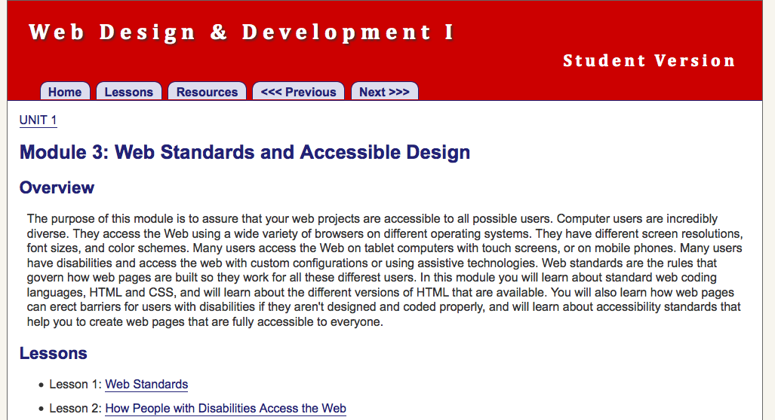
Web Design & Development I Course Curriculum
http://uw.edu/accesscomputing/webd2

Slide 58
Teaching Respect for Diversity while Teaching Coding
Technology diversity provides technology teachers with a great opportunity!
There is no technology without users
Each user is different
When learning to code, students should actively consider their users, including user differences

Slide 59
Curriculum Features
Teaches standards-based and accessible web design
Is platform and vendor-neutral (teaches concepts, not specific tools)
Standards-based, accessible design is taught early as a core design principle, and reinforced throughout the course
For assignments students must use valid code & conform to accessibility standards

Slide 60
Course Outline
Designing and Planning Web Pages
Creating Content and Structure with HTML
Formatting Web Pages with Style Sheets
Graphics
Scripting
Quality Control
Website Management and Authoring Tools
Client Website

Slide 61
Not Just a Curriculum,
A Community
Over 4000 registered teachers worldwide
Discussion list with 400+ subscribers
Students and teachers are learning about standards-based, accessible web design and development

Slide 62
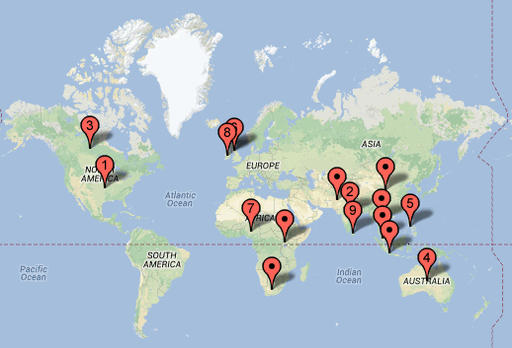
Countries with 10 or more teachers
Notes:
US = nearly 3000; India=76; Canada=73; Australia=52; Phillipines=51;Nigeria=35; also Uganda, South Africa, Sri Lanka, Pakistan

Slide 63
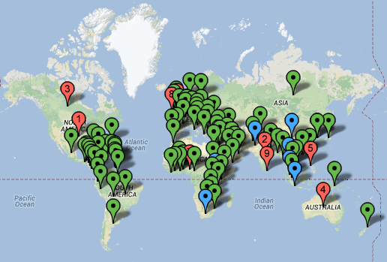
Teaching the World
(Countries with one or more teachers)
Notes:
Teaching the World!

Slide 64
For More Information…
How (Not) To Teach Web Design & Development
  Wednesday 9:15-10:15
  Meadowbrook II

Slide 65
The AHG13 UD in Curriculum Un-preconference

Slide 66
Recurring Challenges
Universal design vs. innovation and exploration. Many faculty view them as mutually exclusive.
“Why should I invest my scarce time and resources into UD on the slim possibility I might have a student who would benefit?”

Slide 67
More Recurring Challenges
How to apply UD in courses constrained by means of delivery, e.g., LMS
Learning activities vs learning outcomes
Publicizing and replicating promising practices
How to stay connected, bridge efforts, collaborate… where do we go from here?

