Slide 1
Growth, Progress, Energy, and the Role of Electric Vehicles

Slide 2
How Much Energy American Drivers Use
The average American family owns two cars that are driven a combined 20,000 miles per year
The MPG fleet average for NEW cars is 24.4 MPG
One gallon of the gasoline- ethanol mixture that we currently use converts to 33.7 kWh of energy
Putting these facts together, we find that the average American family consumes more than 27,000 kWh per year in the DIRECT operation of their automobiles (this does not include the (considerable amount of) energy needed to drill, refine, etc., to provide your car with gas)

Slide 3
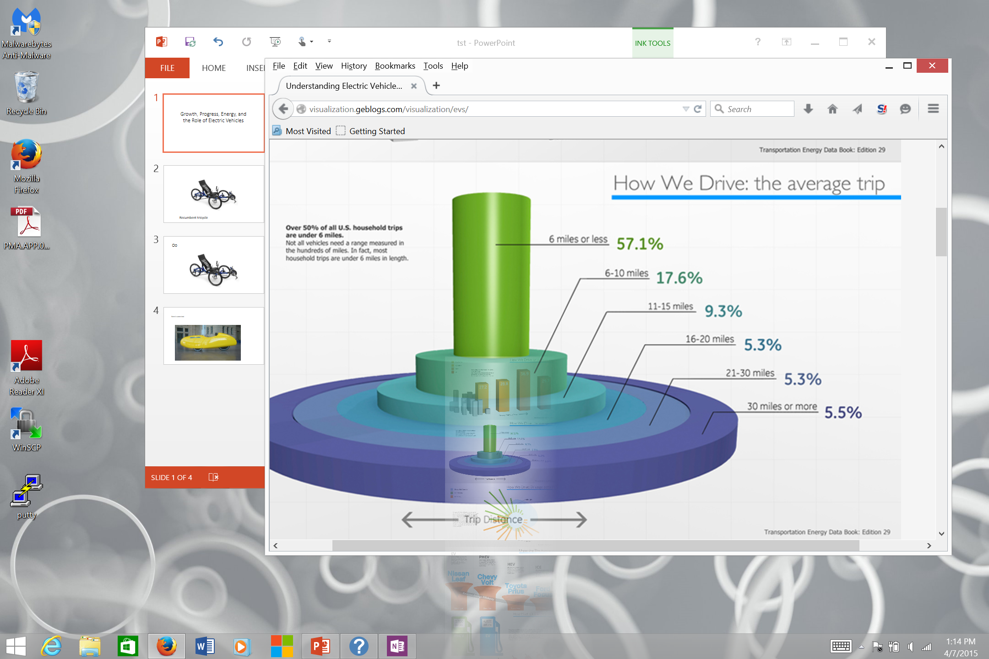

Slide 4
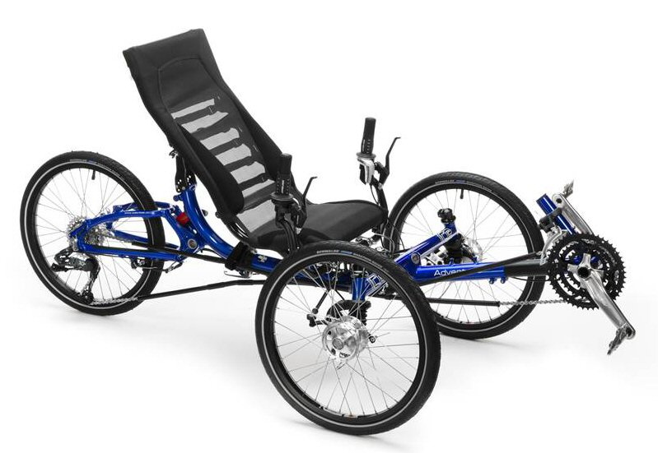
Recumbent Tricycle

Slide 5
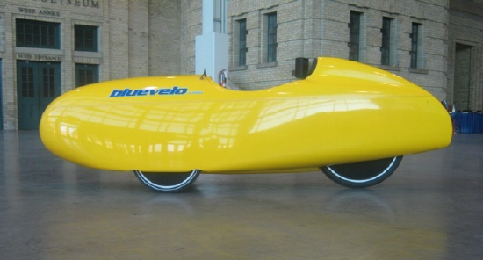
Velomobile

Slide 6
Electric Modifications to Basic Velomobile
Basic velomobile with headlights, taillights, turn signals, small battery weighs 70 lb.
Strip out all elements of human propulsion
Replace rear wheel with a two kWh geared hub motor which weighs about 11 lb.
Add a one kWh Lithium battery which weighs about 16 lb.
Add electric resistance heating wires in seat and a small electric blanket for your lap/legs
So, you end up with a weather proof vehicle that weighs under 100 lbs.

Slide 7
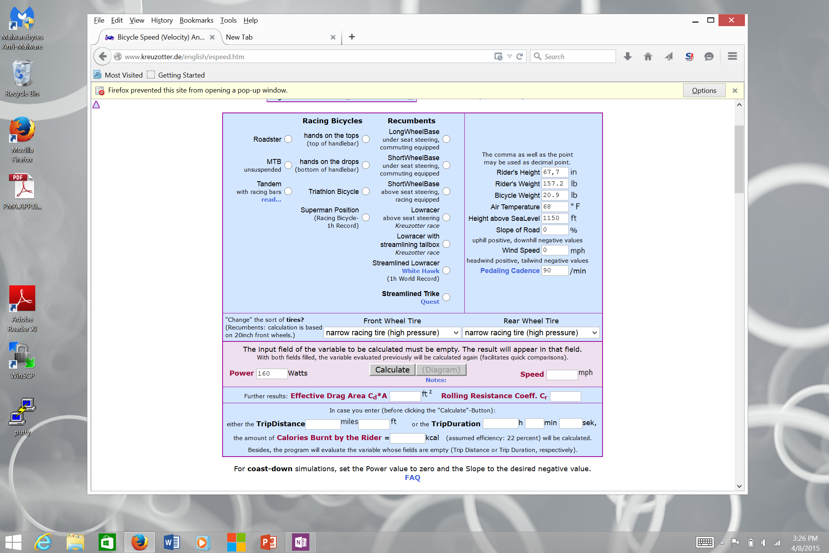
Calculate Energy Needed for Velomobile

Slide 8
Energy Efficiency of Velomobiles
Type: velomobile
Person + cargo weight = 200 lb.
Vehicle weight = 100 lbs.
Road slope = 0 degrees
Tire type = wide robust touring tires
Speed = 25 mph
Calculated energy consumption = 205 watts
Energy consumption for realistic conditions (+ 40%) = 287 watts
Distance traveled using a one kWh battery = 87 miles rounded to 85
Miles per kWh = 85
Energy to travel 6000 miles Per year = 70 kWh
Assume 2 person velomobile gets 40 miles/kWh, = 250 kWh for 10,000 miles
Assume about 3.7 miles/kWh for next gen electric car, = 1080 kWh for 4000 miles

Slide 9
Recalculate Energy Efficiency Based on Solar PV Energy Source
We need about 1400 kWh per year to travel 20,000 miles with these three vehicles
In those parts of the US that get an average amount of sunlight (about 30% more than Seattle),
a 1.4 KW PV array will start out producing over 1750 kWh/year
The average degradation rate of a PV array is 0.5%/year,
At that rate, after 50 years, it will produce 78% of its original power, or about 1360 kWh/year
So that 1.4 KW array will drive our three vehicles for about 50 years
It takes about 3.7 years to recoup the energy needs to build a PV array, or about 6,500 kWh
That is less than ¼ the energy current automobiles consume in just ONE year
So the real efficiency of these three EVs is really 200 times that of current automobiles

