Slide 1
Integrated Urban
Forest Assessments:
Stewardship Capacity and Operations
Weston Brinkley, Cascade Land Conservancy
Kathy Wolf, U of WA/Forest Service Research Station
Chris LaPointe, EarthCorps
Ara Erickson, Cascade Land Conservancy
Diane Styers, University of Washington/US Forest Service
Puget Sound Stewardship Conference
REI
March 23, 2011
Notes:
Talk for 40 minutes, then Q&A, no more than 20 slides

Slide 2














Green Cities Research Alliance
Partnering for sustainable cities through science, policy, and citizen action
USDA Forest Service
Pacific NW Research Station
UW Remote Sensing & Geospatial Lab
University of Washington
Parks & Recreation Division
City of Seattle

Slide 3
Integrated Urban Forest Assessments
  1. Forest Ecosystem Values (i-Tree)
  2. Forest Landscape Assessment Tool
  3. Stewardship Capacity & Operations
  4. Urban Greening & Public Health
  5. Geospatial Analysis – UW, RSGAL
  6. Urban Gathering/Foraging
  7. Residential Choice on the U/R Gradient
  8. USFS – FIA, Restoration Economics
Cascade Land Conservancy – USFS Pacific NW Research Station

Slide 4
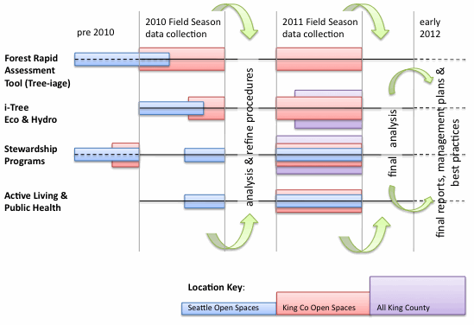
Integrated Urban Forest Assessments
June 2010 :: Study Plan for Multiple Studies
Cascade Land Conservancy – USFS Pacific NW Research Station

Slide 5
Integrated Urban
Forest Assessments:
Stewardship Capacity and Operations
Project Purposes
Methods
Data Analysis
Findings
‘the take-aways’
Collaboration
Cascade Land Conservancy – USFS Pacific NW Research Station
Notes:
Talk for 40 minutes, then Q&A, no more than 20 slides

Slide 6
Project Purposes
Civic Environmental Stewardship
Goals
Better understand the volunteer experience
Better understand organizational operations, relationships, and capacity
Reveal public benefits of the stewardship footprint - ecological, social, and economic
Individual
Participant
Host
Organization
action interface
event-based sampling
Cascade Land Conservancy – USFS Pacific NW Research Station
Notes:
To understand volunteer experiences -so that volunteer programs can more effectively engage citizens
To understand organizational capacity and operations -so that formal stewardship programs can optimize achievement of their goals and purposes

Slide 7
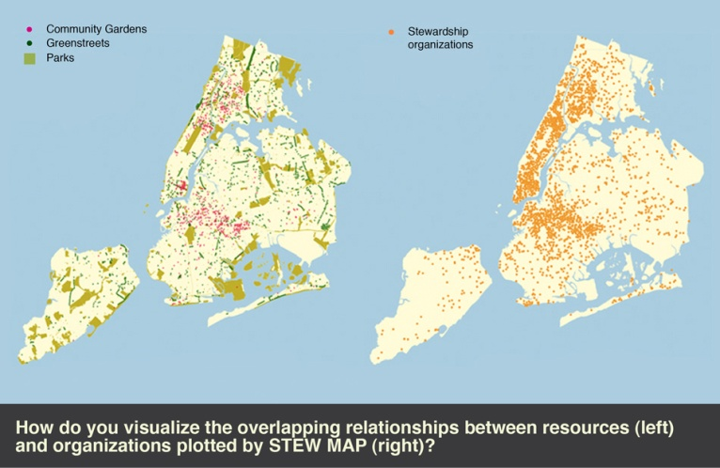
Project Purposes
Civic Environmental Stewardship
Products
Evidence-based recommendations for the stewardship community
Volunteer Engagement Best Practices
Social network analysis of organizations
(~700 in metro Seattle)
Stewardship
footprint map
Cascade Land Conservancy – USFS Pacific NW Research Station
Notes:
To understand volunteer experiences -so that volunteer programs can more effectively engage citizens
To understand organizational capacity and operations -so that formal stewardship programs can optimize achievement of their goals and purposes

Slide 8
Volunteer Stewardship Survey
Summer/Autumn 2010
Methods

Slide 9
Study Design
context
independent x dependent
variables variables
(descriptives) (outcomes)
Event Characteristics
Volunteer Characteristics
Volunteer History
Demography
Motivations
Skills and Contributions
Satisfactions
Personal Health &
Well-Being

Slide 10
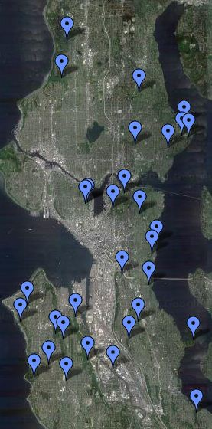


Place & Respondent Sampling
Population: All 188 organized volunteer environmental stewardship events on forested Seattle Parks’ lands Oct -Dec 2010. Estimated 3,000 individuals
Surveyed: 33 events, 155 volunteers
Events at random
People at random within events

Slide 11
Volunteer Stewardship Survey
Summer/Autumn 2010
Data Analysis and
Findings
Cascade Land Conservancy – USFS Pacific NW Research Station

Slide 12
Volunteer Characteristics
Age - 38 mean (17 sd)
Women/Men - 45%/46%
Education - college graduate or more 58%
(Seattle 54%)
Employment - full time 41%, retired 14%,
student 14%
Income - 26% < 30K, 15% 75-125 K, 13% >175K
(2000 Seattle median family income $62K)
Cultural Identity - 78% white
(2000 census 67%)
Cascade Land Conservancy – USFS Pacific NW Research Station

Slide 13
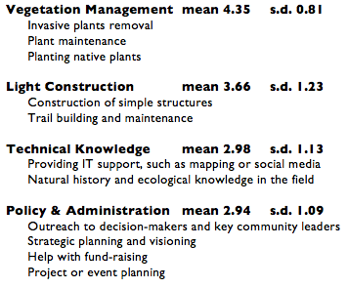
Willing to Contribute? dependent variables – rating 1-5
Cascade Land Conservancy – USFS Pacific NW Research Station

Slide 14
Satisfactions of volunteering? dependent variables – rating 1-7
Cascade Land Conservancy – USFS Pacific NW Research Station

Slide 15
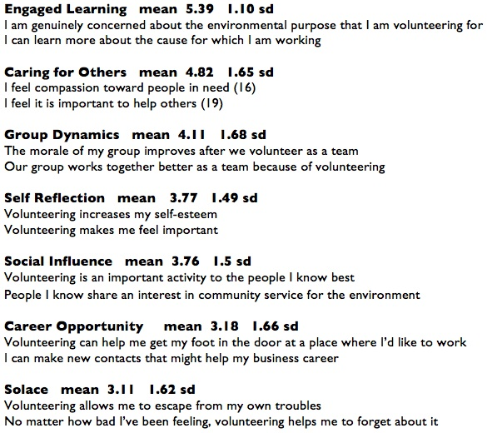
Why is volunteering important to you? dependent variables – rating 1-7
mean (sd)
Engaged Learning 5.39 (1.10)
Caring for Others 4.82 (1.65)
Group Dynamics 4.11 (1.68)
Self Reflection 3.77 (1.49)
Social Influence 3.76 (1.5)
Career Opportunity 3.18 (1.66)
Solace 3.11 (1.62)
Cascade Land Conservancy – USFS Pacific NW Research Station

Slide 16
Volunteer Stewardship Survey
Summer/Autumn 2010 key findings

Slide 17
Volunteer Characteristics
Age - 38 mean (17 sd)
Women/Men - 45%/46%
Education - college graduate or more 58%
(Seattle 54%)
Employment - full time 41%, retired 14%,
student 14%
Income - 26% < 30K, 15% 75K-125 K, 13% >175K
(2000 Seattle median family income $62K)
Cultural Identity - 78% white
(2000 census 67%)

Slide 18
Stewardship Participation
Event Size - 33 people mean (17 sd)
Travel Time – 27 min mean (33 sd)
Event in Neighborhood – yes 43%, no 52%
When did you first volunteer? 92 m mean (104 sd)
Times per year – 2 or less 32%, 10 or more 33%
Participating . . . . (more than school, work or civic group)
  as individual
  part of group of family and friends
  participant in a neighborhood event or project

Slide 19
1. Shared Experience independent variables x themes, p<.05
high agreement on importance of learning and caring for others
high satisfaction with the volunteer experience, particularly making a difference
high willingness to contribute effort to vegetation management
few differences based on education or employment

Slide 20
2. Organizations are Valued independent variables x themes, p<.05
high satisfaction with organization support for events
high likelihood of continued volunteering (from 6 months to 2 years)
obstacles to future volunteering more likely to be available time and family needs (49%), not satisfaction with event organization (7%)

Slide 21
3. Social Connections independent variables x themes, p<.05
event in neighborhood (43%) or not (55%)
in neighborhood, higher interest in:
  learning
  making a difference
  social interaction
higher satisfaction with organization support
more willing to contribute to org/projects
Cascade Land Conservancy – USFS Pacific NW Research Station

Slide 22
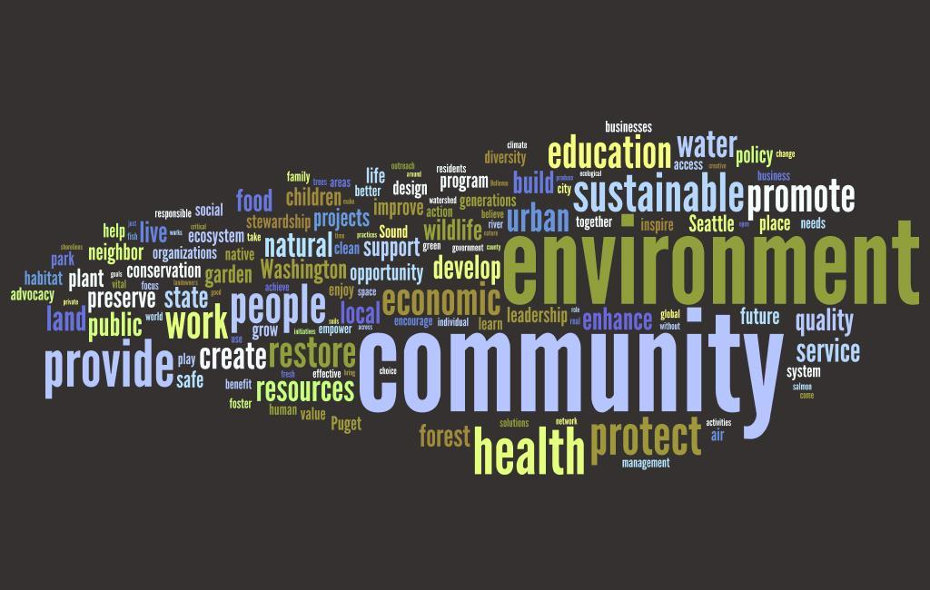
Stewardship Organization Mission
King/Pierce Counties ~ 600
Wordle tag cloud
Cascade Land Conservancy – USFS Pacific NW Research Station

Slide 23
Volunteer Stewardship Survey
Summer/Autumn 2010
Conclusions
Cascade Land Conservancy – USFS Pacific NW Research Station

Slide 24
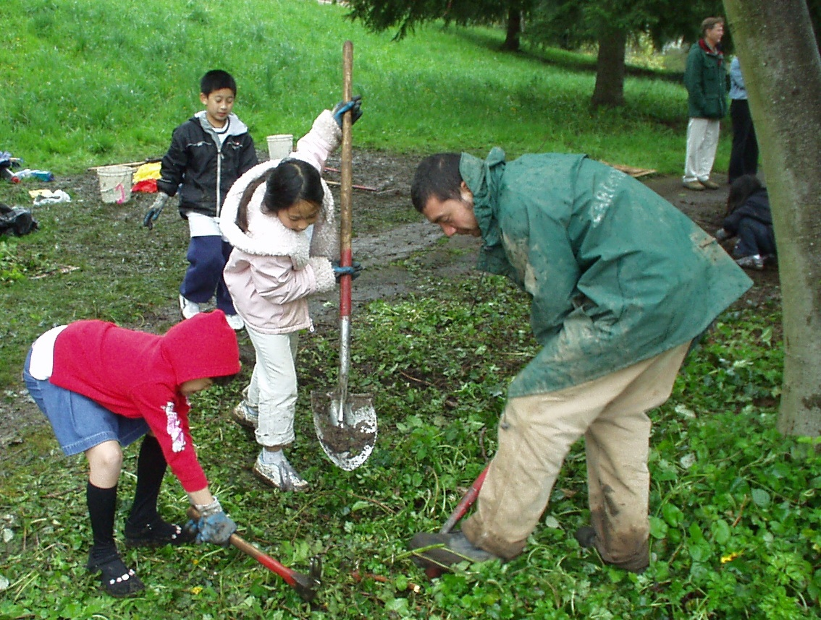
GCRA: multi-project collaboration
research projects including environmental stewardship
Stewardship Mapping to visualize the footprint of civic stewardship
Cascade Land Conservancy – USFS Pacific NW Research Station

Slide 25
Learned in 2010?
2nd phase in 2011 add legacy and health variables expand to King Co study area
Cascade Land Conservancy – USFS Pacific NW Research Station

Slide 26
Collaboration Opportunity your organization?
Field Data Collection
consistent survey tool is important
brief training for survey administration
sampling within events
consistent data handling
data will enter the common pool for analysis
MOU – let’s talk!
Cascade Land Conservancy – USFS Pacific NW Research Station
Notes:
(need 100 min to analyze, 200 optimal for an individual group)

Slide 27
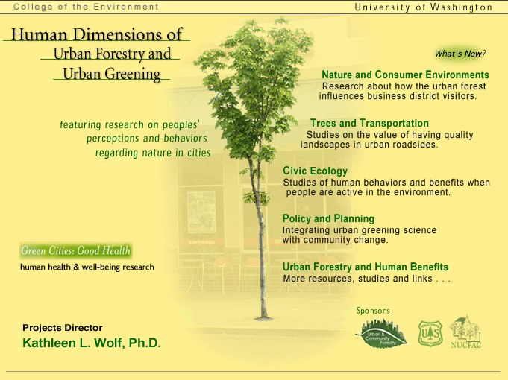
Thanks!
Questions or
Comments?
Integrated Urban
Forest Assessments:
Stewardship Capacity and Operations
presentation
available
on web site
www.naturewithin.info
Cascade Land Conservancy – USFS Pacific NW Research Station
Notes:
Talk for 40 minutes, then Q&A, no more than 20 slides

