Slide 1
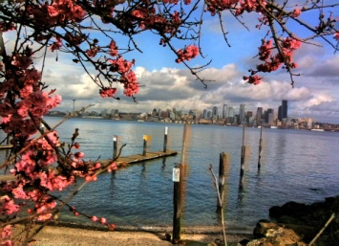
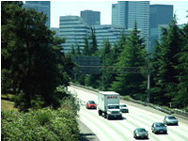
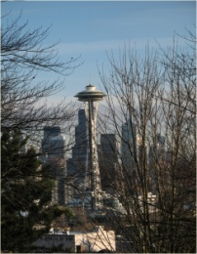
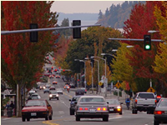
USDA Forest Service
Urban Natural Resource Stewardship
Green Cities Research Alliance
Landscape Assessment and Management
Organization Network Analysis
Univ. of Washington, Baltimore Ecosystem Study
Forest Landscape Assessment Tool
King County, Cascade Land Conservancy
Partnering for sustainable cities through science, policy, and citizen action
Civic Environmental Stewardship
Cascade Land Conservancy, Univ. of Washington, EarthCorps
Geospatial Analysis
Univ. of Washington
Community Sustainability
Ecosystem Services
Forest Ecosystem Values
Cascade Land Conservancy, City of Seattle, King County
Urban Foraging
Institute for Culture & Ecology
Residential Choice
Oregon State Univ.
Green Cities: Good Health
Univ. of Washington

