Slide 1
Supporting Partnerships for
Green Cities & Good Health
Kathy Wolf, Ph.D.
Research Social Scientist
University of Washington (Seattle) &
USDA Forest Service, Pacific NW Research
Partners in Community Forestry Conference
Orlando, Florida
November 2011

Slide 2
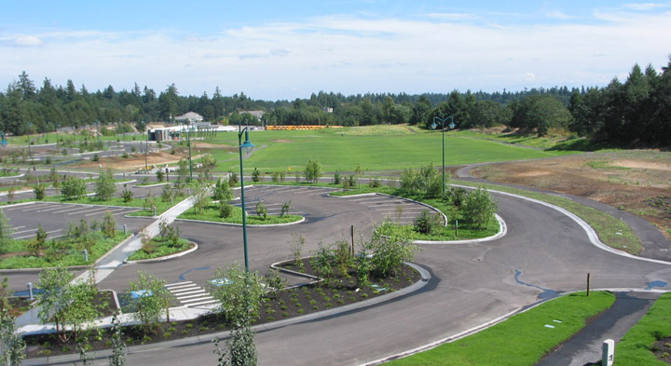
Green Infrastructure
Pierce County WA, Chambers Creek Properties

Slide 3
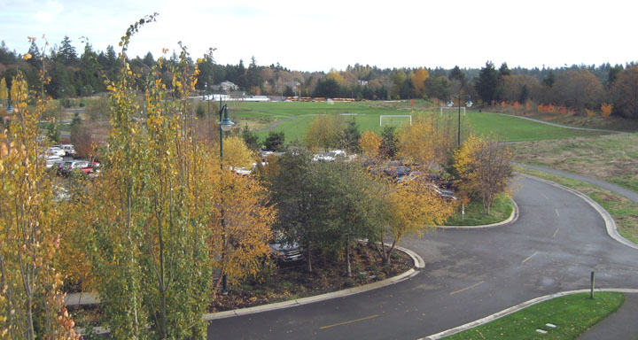
Pierce County WA, Chambers Creek Properties - 4 year growth

Slide 5
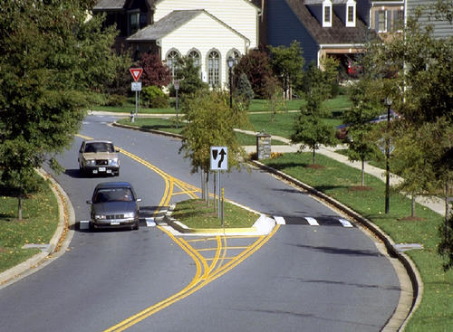
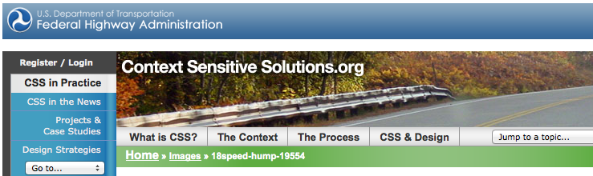
community context and collaboration in transportation design

Slide 6
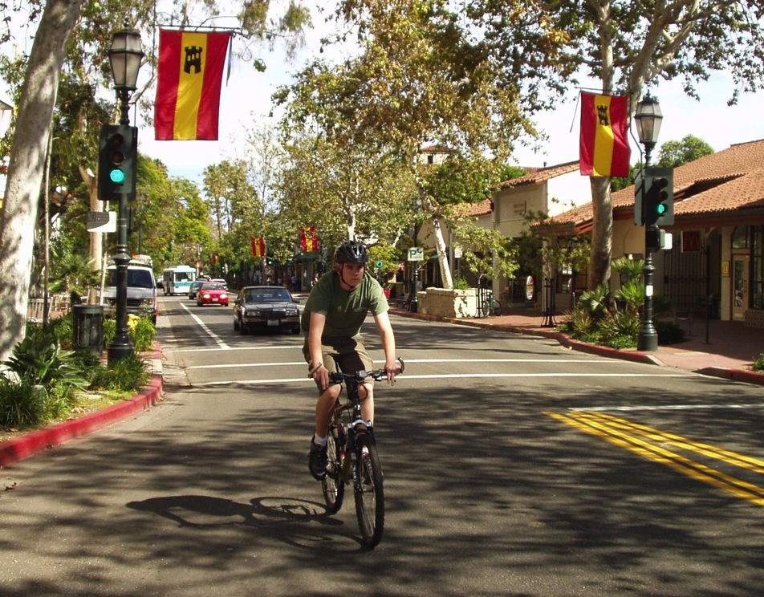

Complete the Streets! cars/pedestrians/bikes
multi-modal
systems
Notes:
State Street, Santa Barbara

Slide 7
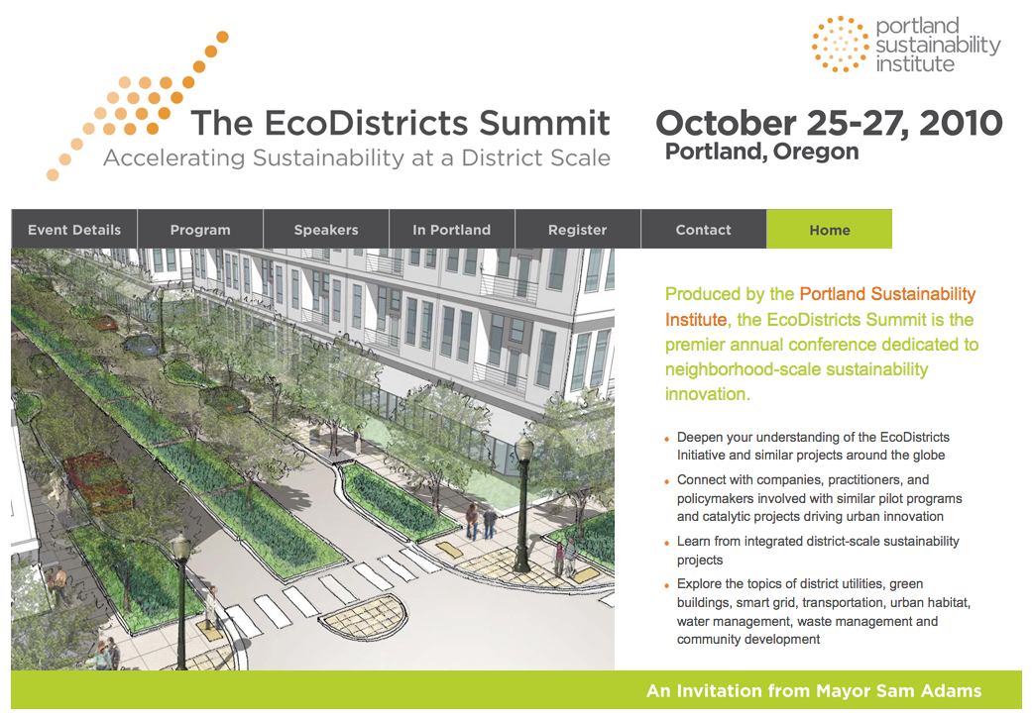
EcoDistricts

Slide 8
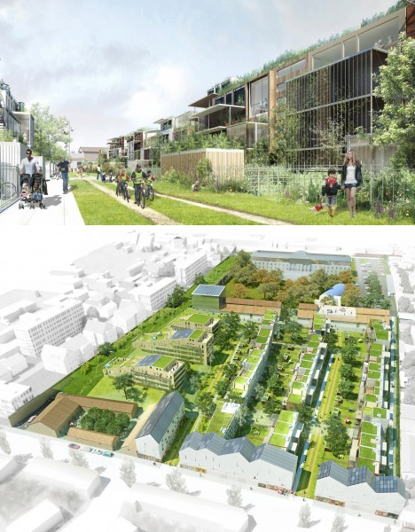
EcoDistrict
Land Use + Trees!

Slide 9
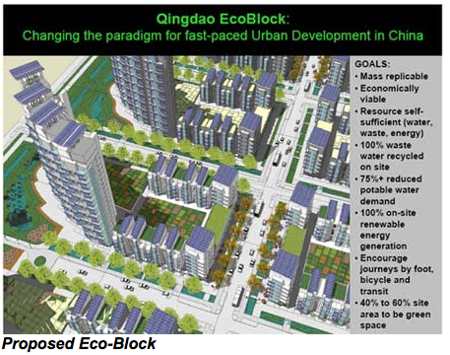

Slide 10
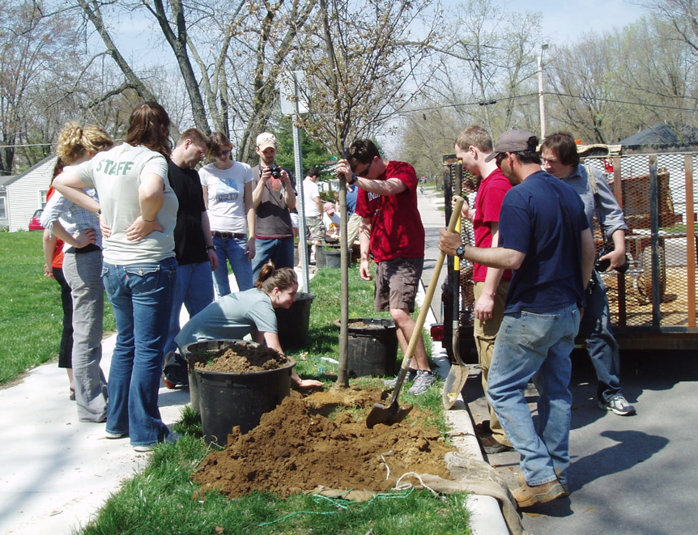
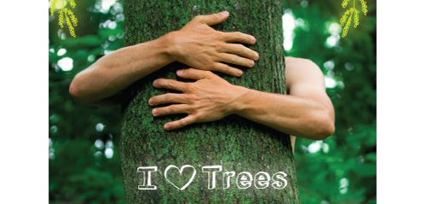
Why are city trees & urban greening important?
human health, functioning, & well-being

Slide 11
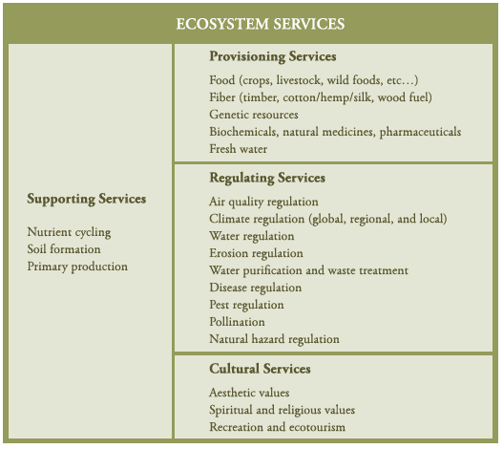
Ecosystem Services Framework
expand how we consider cultural services in the urban context
Milllennium Ecosystem Assessment 2005

Slide 12
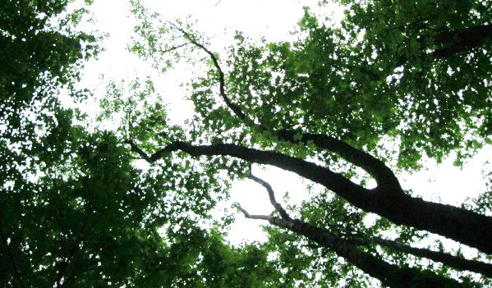
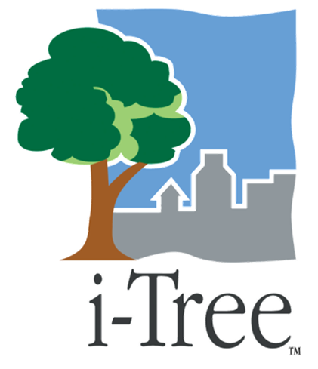
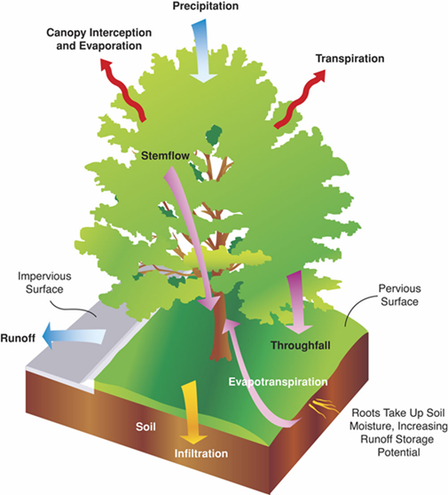
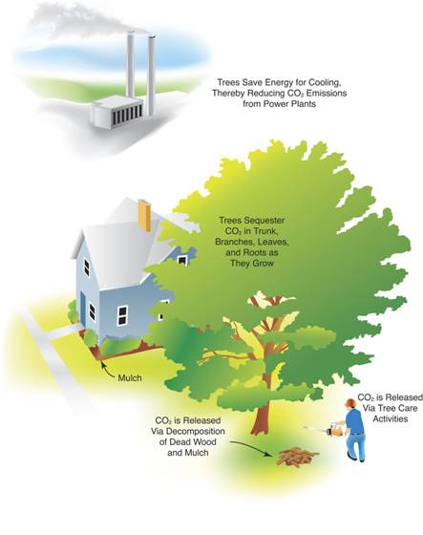
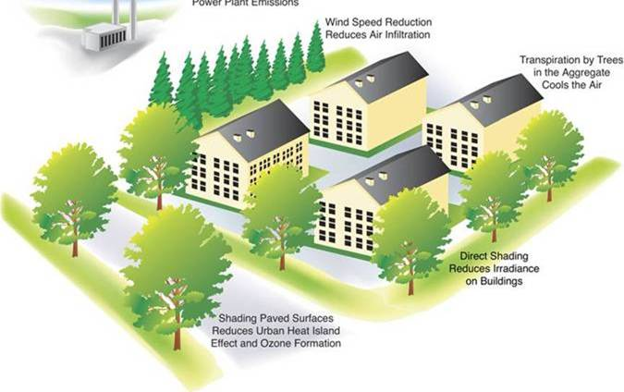
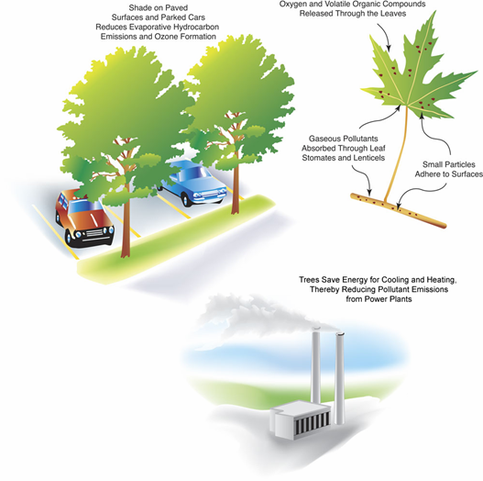
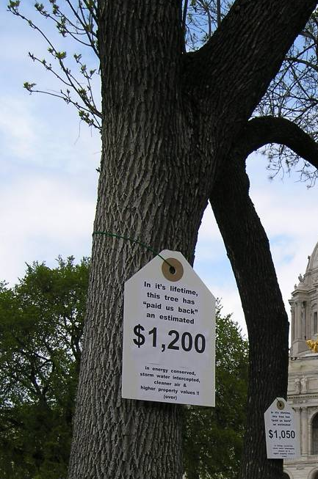
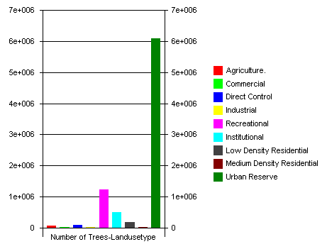
STRUCTURE
FUNCTION
FUNCTION
Eco (UFORE)
Streets (STRATUM)
Hydro
Vue
VALUE
MANAGEMENT
photo credits: Seattle i-Tree Training by Al Zelaya

Slide 13
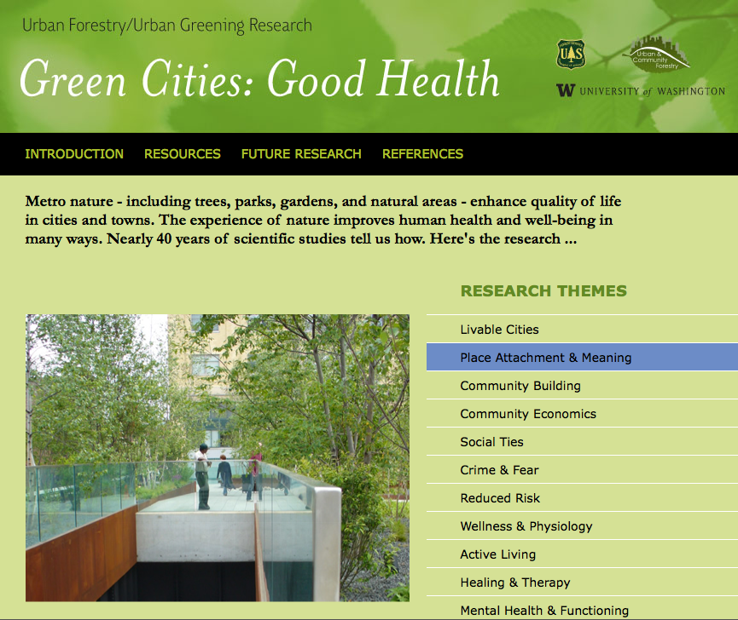
www.greenhealth.washington.edu
Research Reviews
first phase:
June 2010
summaries complete:
Feb 2012
additional
products

Slide 14
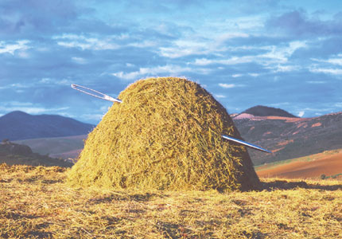
Finding that study . . . . . .

Slide 15
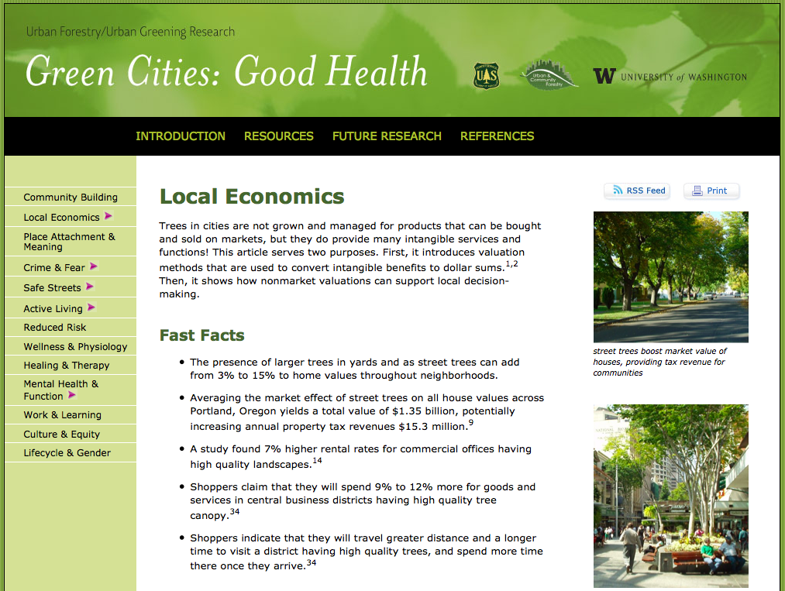

Slide 16
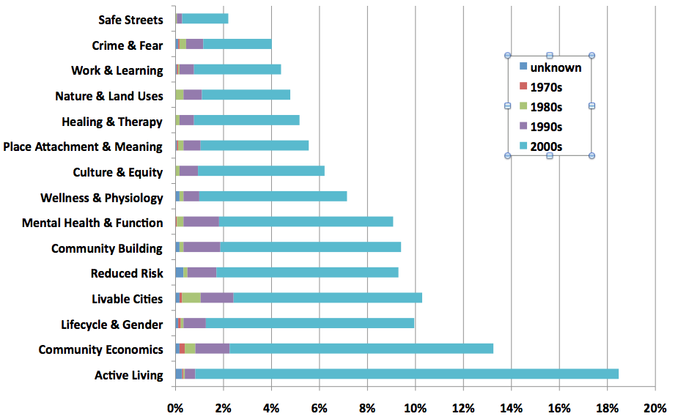
Urban Green :: Human Health & Well Being
> 1,800 articles
% distribution

Slide 17
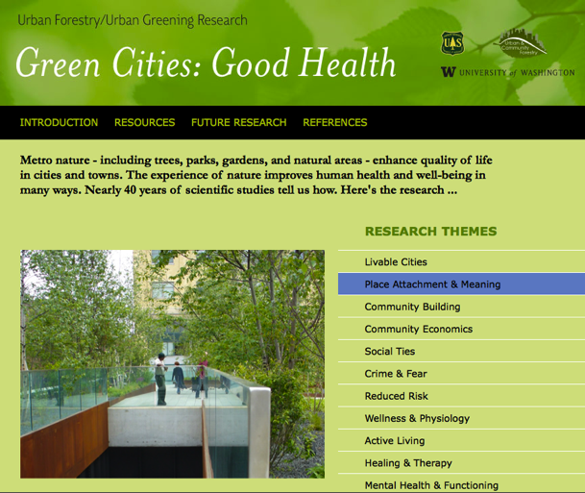
Research Reviews
sponsors:
University of Washington
USDA Forest Service, U&CF Program
ARRA funding
NGO partners

Slide 18
Physical Inactivity & Obesity
majority of Americans not active enough
goal-30 minutes per day of moderate activity
to reduce risk factors for chronic diseases
(heart, stroke, cancer, diabetes)
significant costs to national health services
$168 billion medical costs
17% of all U.S. medical costs
CDC 2010

Slide 19
Obesity Trends* Among U.S. Adults
1985
(*BMI ≥30, or ~ 30 lbs overweight for 5’ 4” person)
No Data <10% 10%–14%

Slide 20
Obesity Trends* Among U.S. Adults
2008
(*BMI ≥30, or ~ 30 lbs. overweight for 5’ 4” person)
doubling of U.S. obesity rate since 1980s
No Data <10% 10%–14% 15%–19% 20%–24% 25%–29% ≥30%

Slide 21
Obesity Trends* Among U.S. Adults
1990, 1999, 2009
(*BMI ≥30, or about 30 lbs. overweight for 5’4” person)
1990
1999
2009
doubling of U.S. obesity rate since 1980s
No Data <10% 10%–14% 15%–19% 20%–24% 25%–29% ≥30%

Slide 22
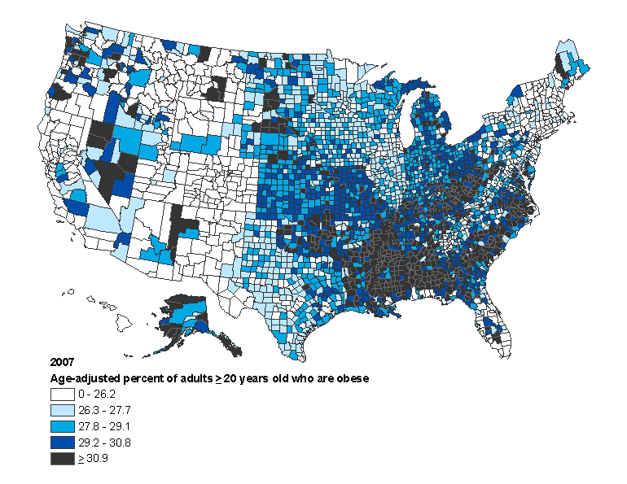
Age-adjusted % of adults aged ≥20 years who are obese, 2007
MMWR 58:1259-1263, 2009

Slide 23
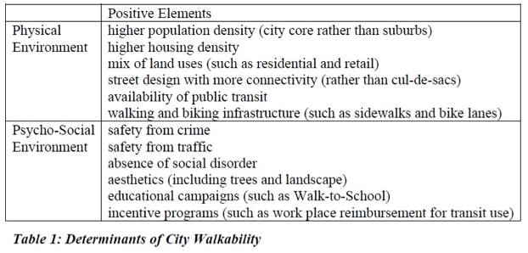
City Trees & Nature
Active Living

Slide 24
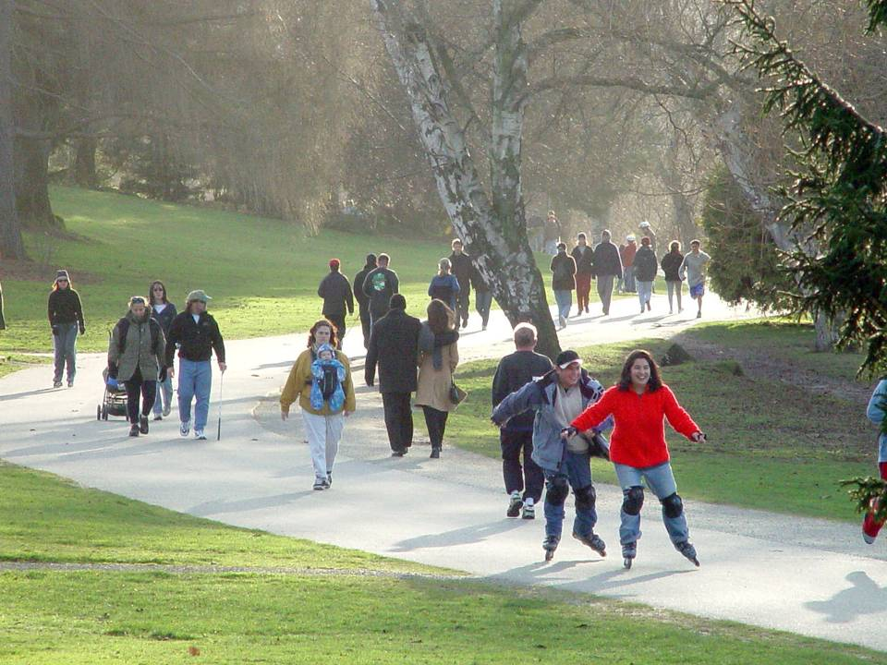
parks, open spaces & trails

Slide 25
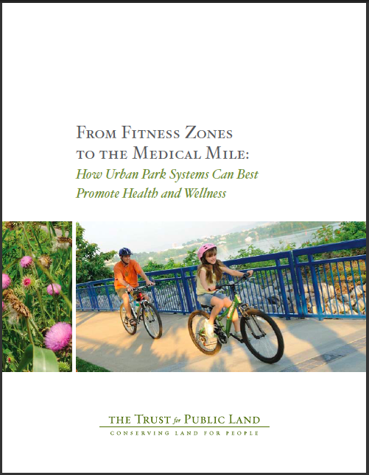
Parks Prescription
San Francisco
Albuquerque

Slide 26
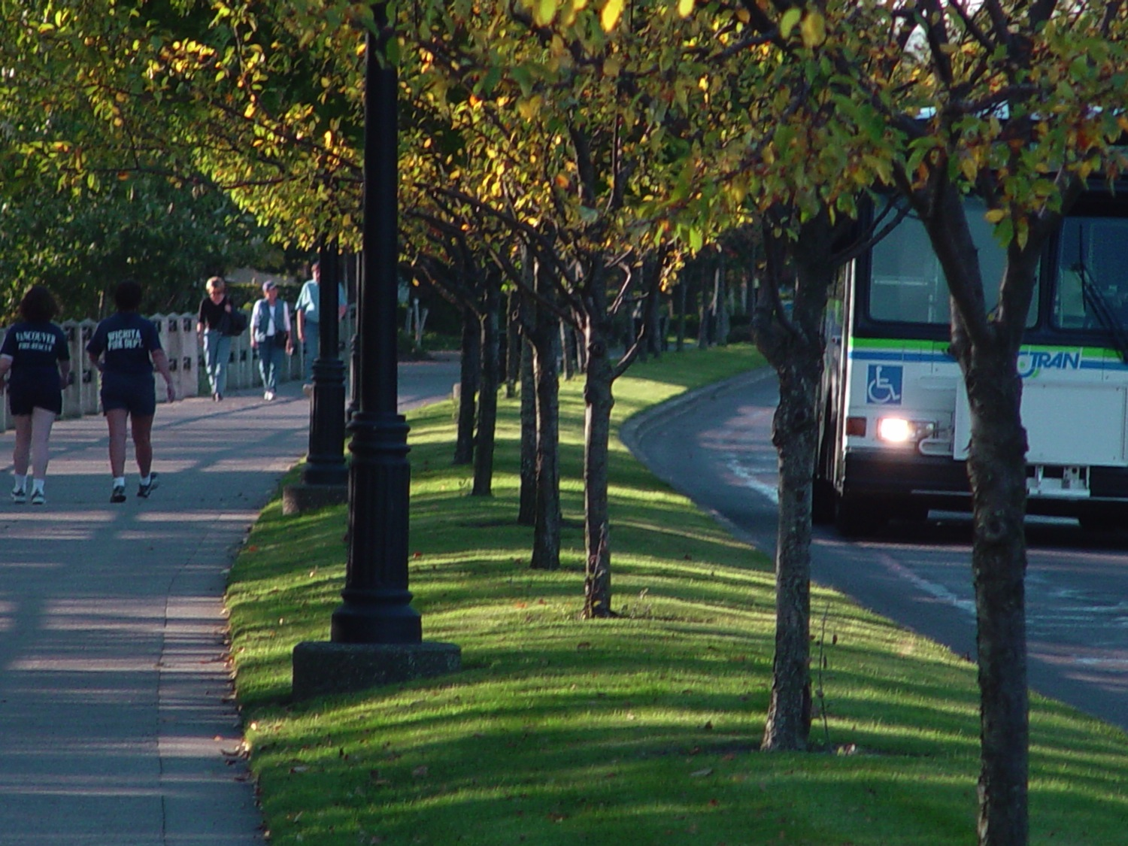
make room for pedestrians

Slide 27
Nature, Human Health &
Walkable Neighborhoods
Outcomes: Elderly People & Walking
  less illness
  lower mortality rate
Environments: Neighborhood Streets (Tokyo)
  tree - lined
  parks
Takano, Nakamura, Watanabe. 2002.
Journal of Epidemiology & Community Health

Slide 28
City Trees & Nature
Community Economics
Residential real estate values -
3-7% with trees in yard
Residential real estate values -
5-20%, proximity to natural open space
Commercial property rental rates - 7%
Increased rent values – ROW & yard trees (Donovan 2011)
Improved consumer environments in business districts - 9-12% product spending
Red Fields, Green Fields
urban neighborhood revitalization

Slide 29
Workplace Nature Views
Kaplan, R. 1993. Landscape
and Urban Planning.
Well-being
  desk workers without view of nature reported 23% more ailments in prior 6 months
Job Satisfaction
  less frustrated and more patient
  higher overall job satisfaction and enthusiasm

Slide 30
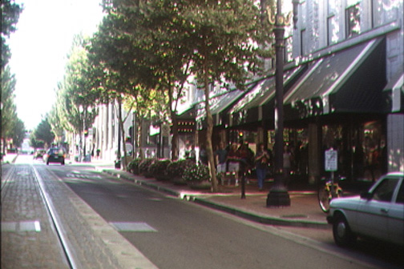
Trees & Retail Environments Research

Slide 31
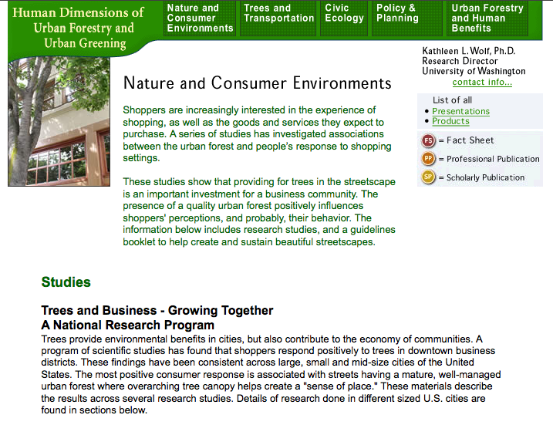
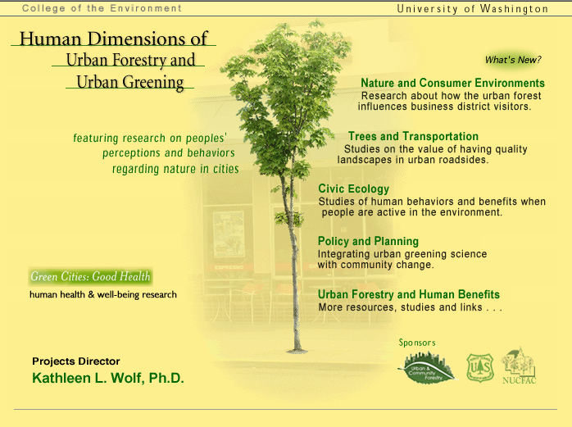
www.naturewithin.info

Slide 32
• Research Questions • trees and visual quality? trees and consumer behavior? trees and product pricing?
Trees & Shopper Environments Research
• Methods:
mail out/in surveys
national or local sample
residents/nearby city residents
partners: U of Washington, NGOs, business organizations
funded by USDA Forest Service

Slide 33
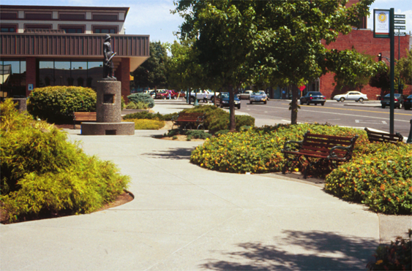
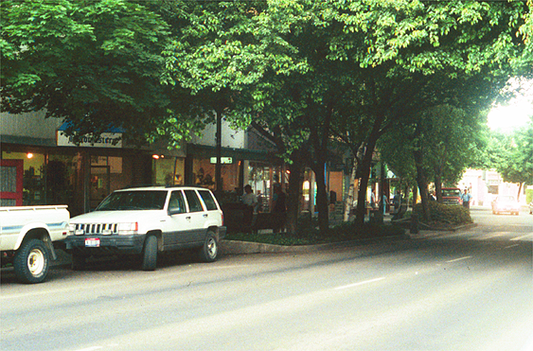
Image Categories (sorted by ratings)
Pocket Parks
mean 3.72
(highest)
Scale : 1=not at all, 5=like very much, 26 images
Full Canopy
mean 3.63

Slide 34
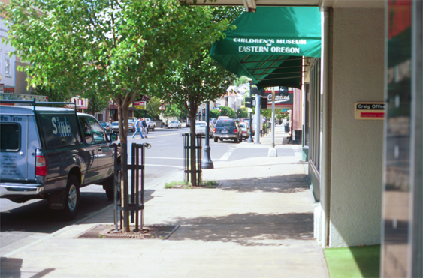
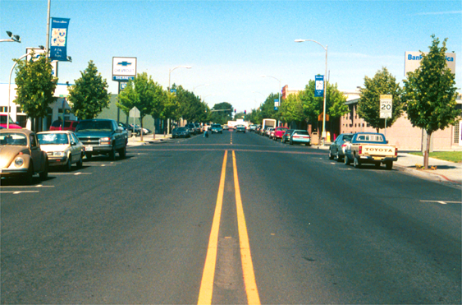
Enclosed
Sidewalk
3.32
Intermittent
Trees
2.78

Slide 35
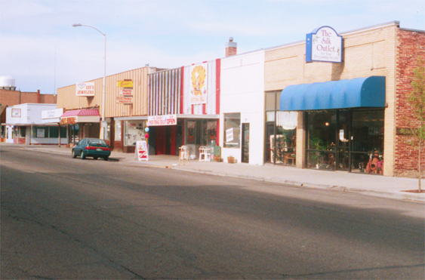
No Trees
mean 1.65
(lowest)
(high - 3.72)

Slide 36
Place Marketing
Relationship Marketing
1. Place Perceptions
  • Place Character
  • Interaction with Merchants
  • Quality of Products
2. Patronage Behavior
  • travel time, travel distance
  • duration & frequency of visits
  • willingness to pay for parking
3. Product Pricing
  • higher willingness to pay for all
  types of goods
  • higher in districts with trees – 9-12%
Notes:
explain contingent valuation
basket of goods - convenience, shopping, specialty
12% revenue boost - 2-4% profit margin for many retailers

Slide 37

retail & place marketing
“Companies stage an experience when they engage customers in a memorable way.”

Slide 38
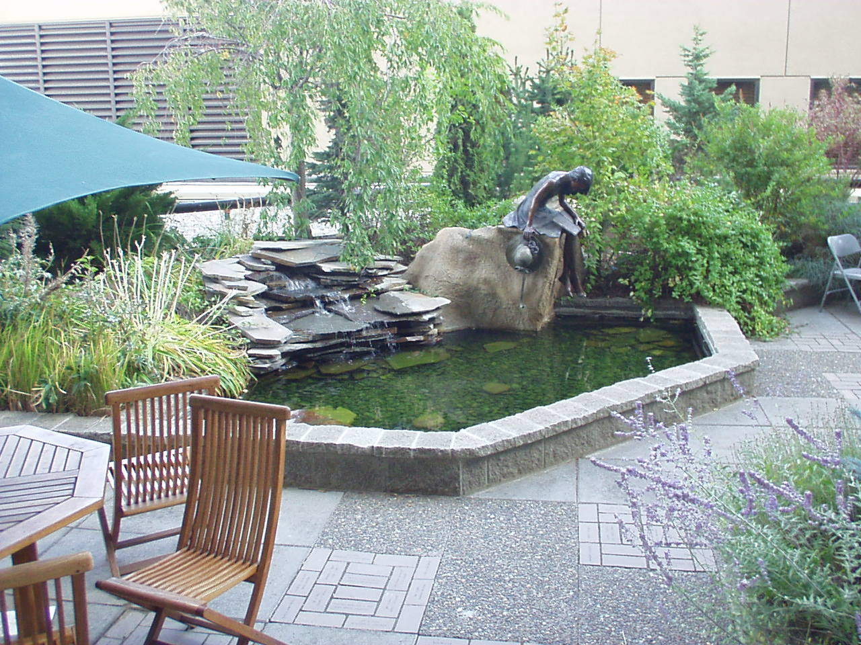
hospitals: healing gardens

Slide 39
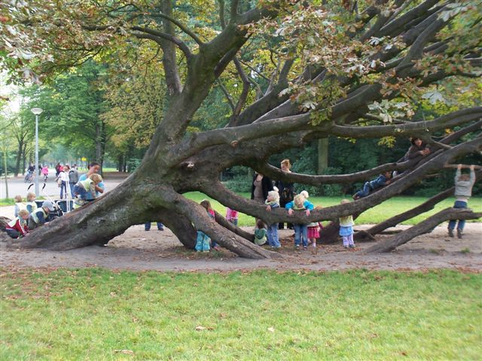
Nature & Psych Development children’s play & imagination

Slide 40
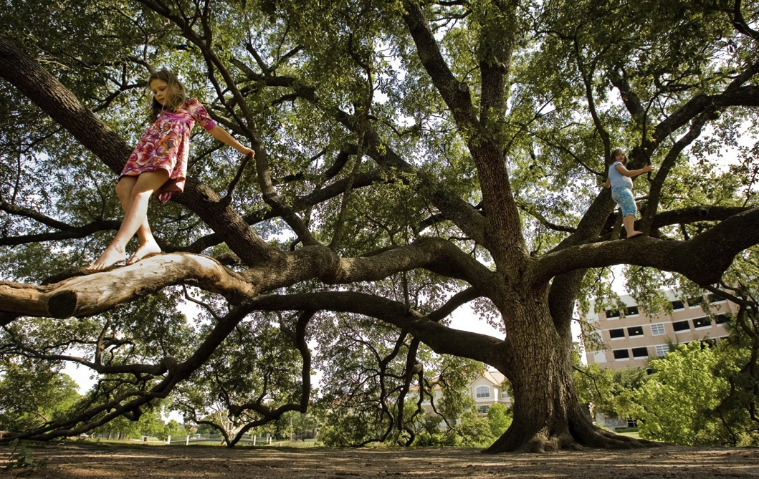
Nature Deficits
Richard Louv

Slide 41
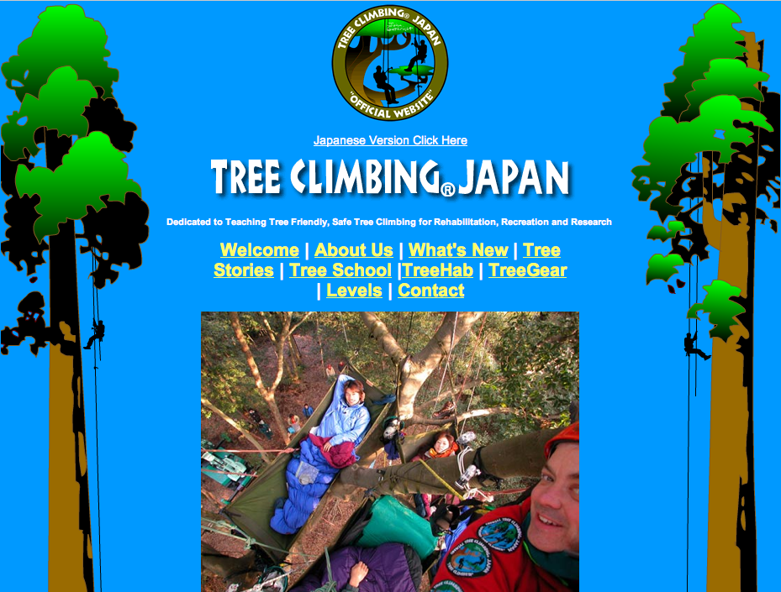
http://www.treeclimbing.jp/

Slide 42
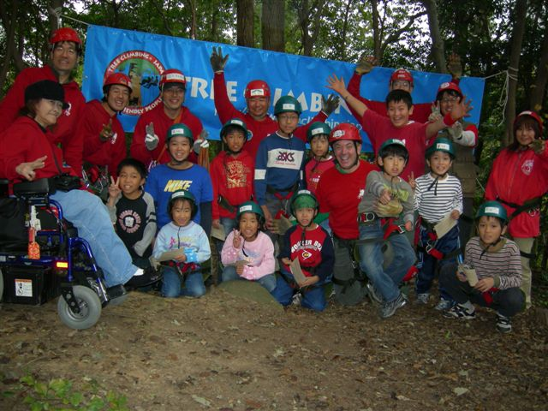
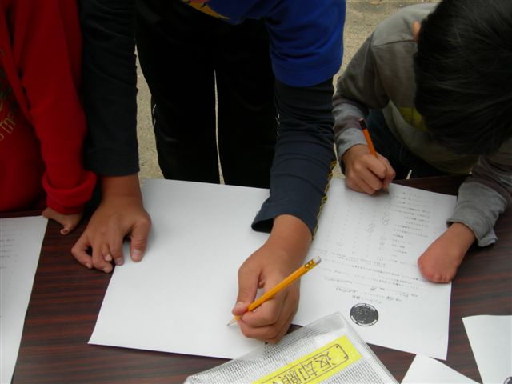
physically disabled & tree climbing!

Slide 43
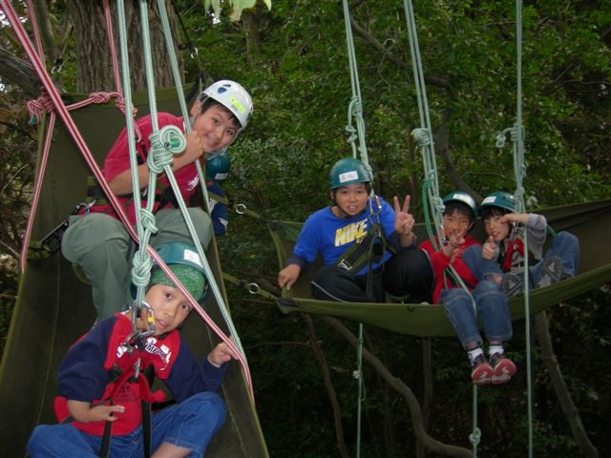
recreational tree climbing (& youth therapy)

Slide 44
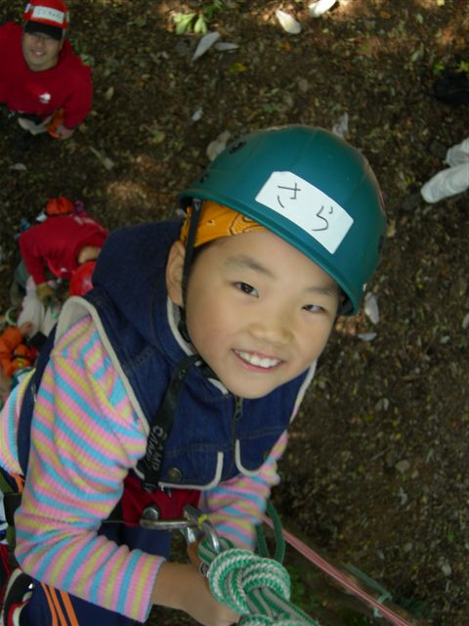
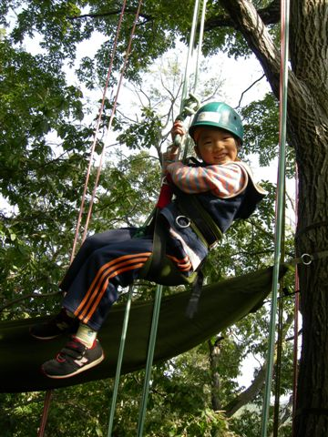
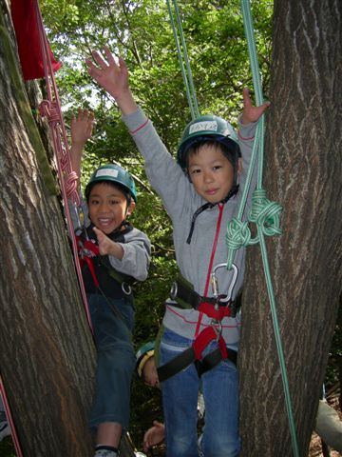

Slide 45
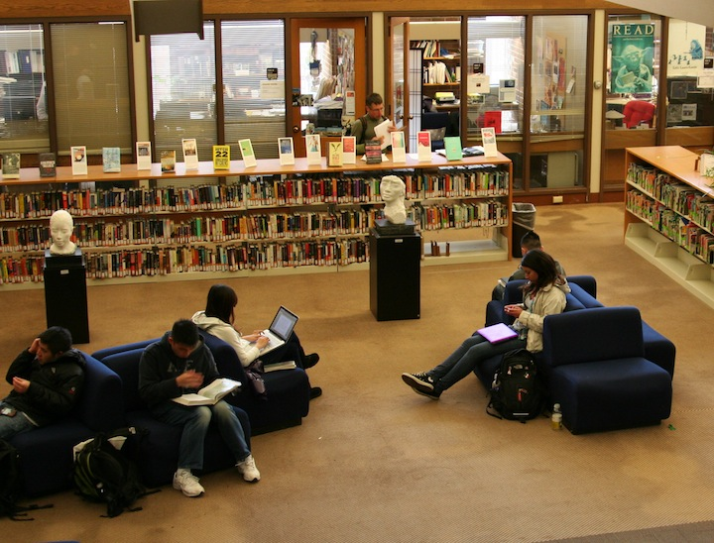
School & Learning

Slide 46
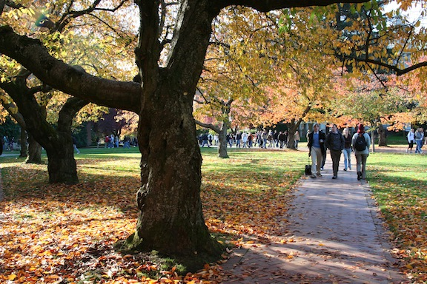
the nature advantage
College students with more natural views from their dorm windows
  scored higher on tests of capacity to direct attention
  rated themselves as able to function more effectively
Tennessen & Cimprich. 1995.
Journal of Environmental Psychology

Slide 47
Green High School Campuses
Matsuoka. 2010. Landscape & Urban Planning
cafeteria & classroom window views with greater quantities of trees and shrubs
  positively associated with:
  standardized test scores,
  graduation rates
  %s of students planning to attend a four-year college
  fewer occurrences of criminal behavior

Slide 48
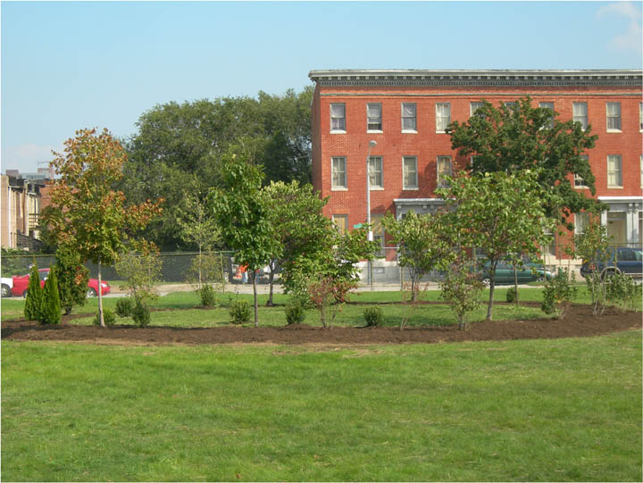
nature recovery & schools
Parks & People Foundation, Baltimore

Slide 49


nature recovery & schools
Parks & People Foundation, Baltimore

Slide 50

first phase - reading circle
Parks & People Foundation, Baltimore

Slide 51


depaving & nature recovery
Parks & People Foundation, Baltimore

Slide 52

Parks & People Foundation, Baltimore
planning skills & efficacy
school asphalt recovery

Slide 53



Urban Trees and Birth Outcomes
“We found that a 10% increase in tree-canopy cover within 50m of a house reduced the number of small for gestational age births by 1.42 per 1000 births. Results suggest that the natural environment may affect pregnancy outcomes and should be evaluated in future research.”
Donovan et al., Health & Place, 2011

Slide 54
www.greenhealth.washington.edu
Research Reviews
additional
products:
YouTube
powerpoint presentations
hard copy 2 page briefings

Slide 55



Slide 56
Volunteer Stewardship Survey
Summer/Autumn 2010
Cascade Land Conservancy – USFS Pacific NW Research Station

Slide 57














Green Cities Research Alliance
Partnering for sustainable cities through science, policy, and citizen action
USDA Forest Service
Pacific NW Research Station
UW Remote Sensing & Geospatial Lab
University of Washington
Parks & Recreation Division
City of Seattle

Slide 58

Civic Environmental Stewardship?
mostly volunteers, including event leaders
working on
public parks &
green belts
urban settings

Slide 59

Stewardship
“Footprint” Analysis units of analysis social scales

Slide 60



Place & Respondent Sampling
Population: All 188 organized volunteer environmental stewardship events on forested Seattle Parks’ lands Oct -Dec 2010. Estimated 3,000 individuals
Surveyed: 33 events, 155 volunteers
Events at random
People at random within events

Slide 61

Why is volunteering important to you? dependent variables – rating 1-7
mean (sd)
Engaged Learning 5.39 (1.10)
Caring for Others 4.82 (1.65)
Group Dynamics 4.11 (1.68)
Self Reflection 3.77 (1.49)
Social Influence 3.76 (1.5)
Career Opportunity 3.18 (1.66)
Solace 3.11 (1.62)
Cascade Land Conservancy – USFS Pacific NW Research Station

Slide 62

Stewardship Organization Mission
King/Pierce Counties ~ 600
Wordle tag cloud
Cascade Land Conservancy – USFS Pacific NW Research Station

Slide 63




Veteran/Soldier Stewards
stress disorders
disengaged (family, community)
green jobs
project start – early 2012
WA DNR

Slide 64

NUCFAC 2009 Annual Report
Trees & Nature Benefits
• messages • livability • quality of life •
• community competition • public values •

Slide 65
Reducing Atmospheric Carbon Dioxide
Image courtesy of the Center for Urban Forest Research

Slide 66

Reducing Atmospheric Carbon Dioxide
emissions sources?
carbon emissions
plant more trees!

Slide 67

Reducing Atmospheric Carbon Dioxide
emissions sources?
carbon emissions
plant more trees!

Slide 68

Reducing Atmospheric Carbon Dioxide
emissions sources?
carbon emissions
plant more trees!

Slide 69


Reducing Atmospheric Carbon Dioxide
compact cities!
reduced
emissions sources!
carbon emissions
plant more trees!

Slide 70

Reducing Atmospheric Carbon Dioxide
compact cities!
reduced
emissions sources!
Green Cities: Good Health
carbon emissions
plant more trees!

Slide 71
Reducing Stormwater Runoff
Image courtesy of the Center for Urban Forest Research

Slide 72







i-Tree Suite of Software

Slide 73

trees & green = health & happiness

Slide 74
More!
Partners in Community Forestry
evidence says! experience of nature in cities is profoundly important for public health and human well-being
who cares? who should?
translate the evidence into outreach and program ideas

Slide 75
www.naturewithin.info

