Slide 1




Global Exchange
USA-CUBA
Cuba: Energy and Development
Professor Mario Alberto Arrastía Ávila
Center of Information Management and Energy Development
Group of Energy Education and Outreach
Member of CUBASOLAR
marioalberto@cubaenergia.cu
537-2062059 y 537-2096691

Slide 2
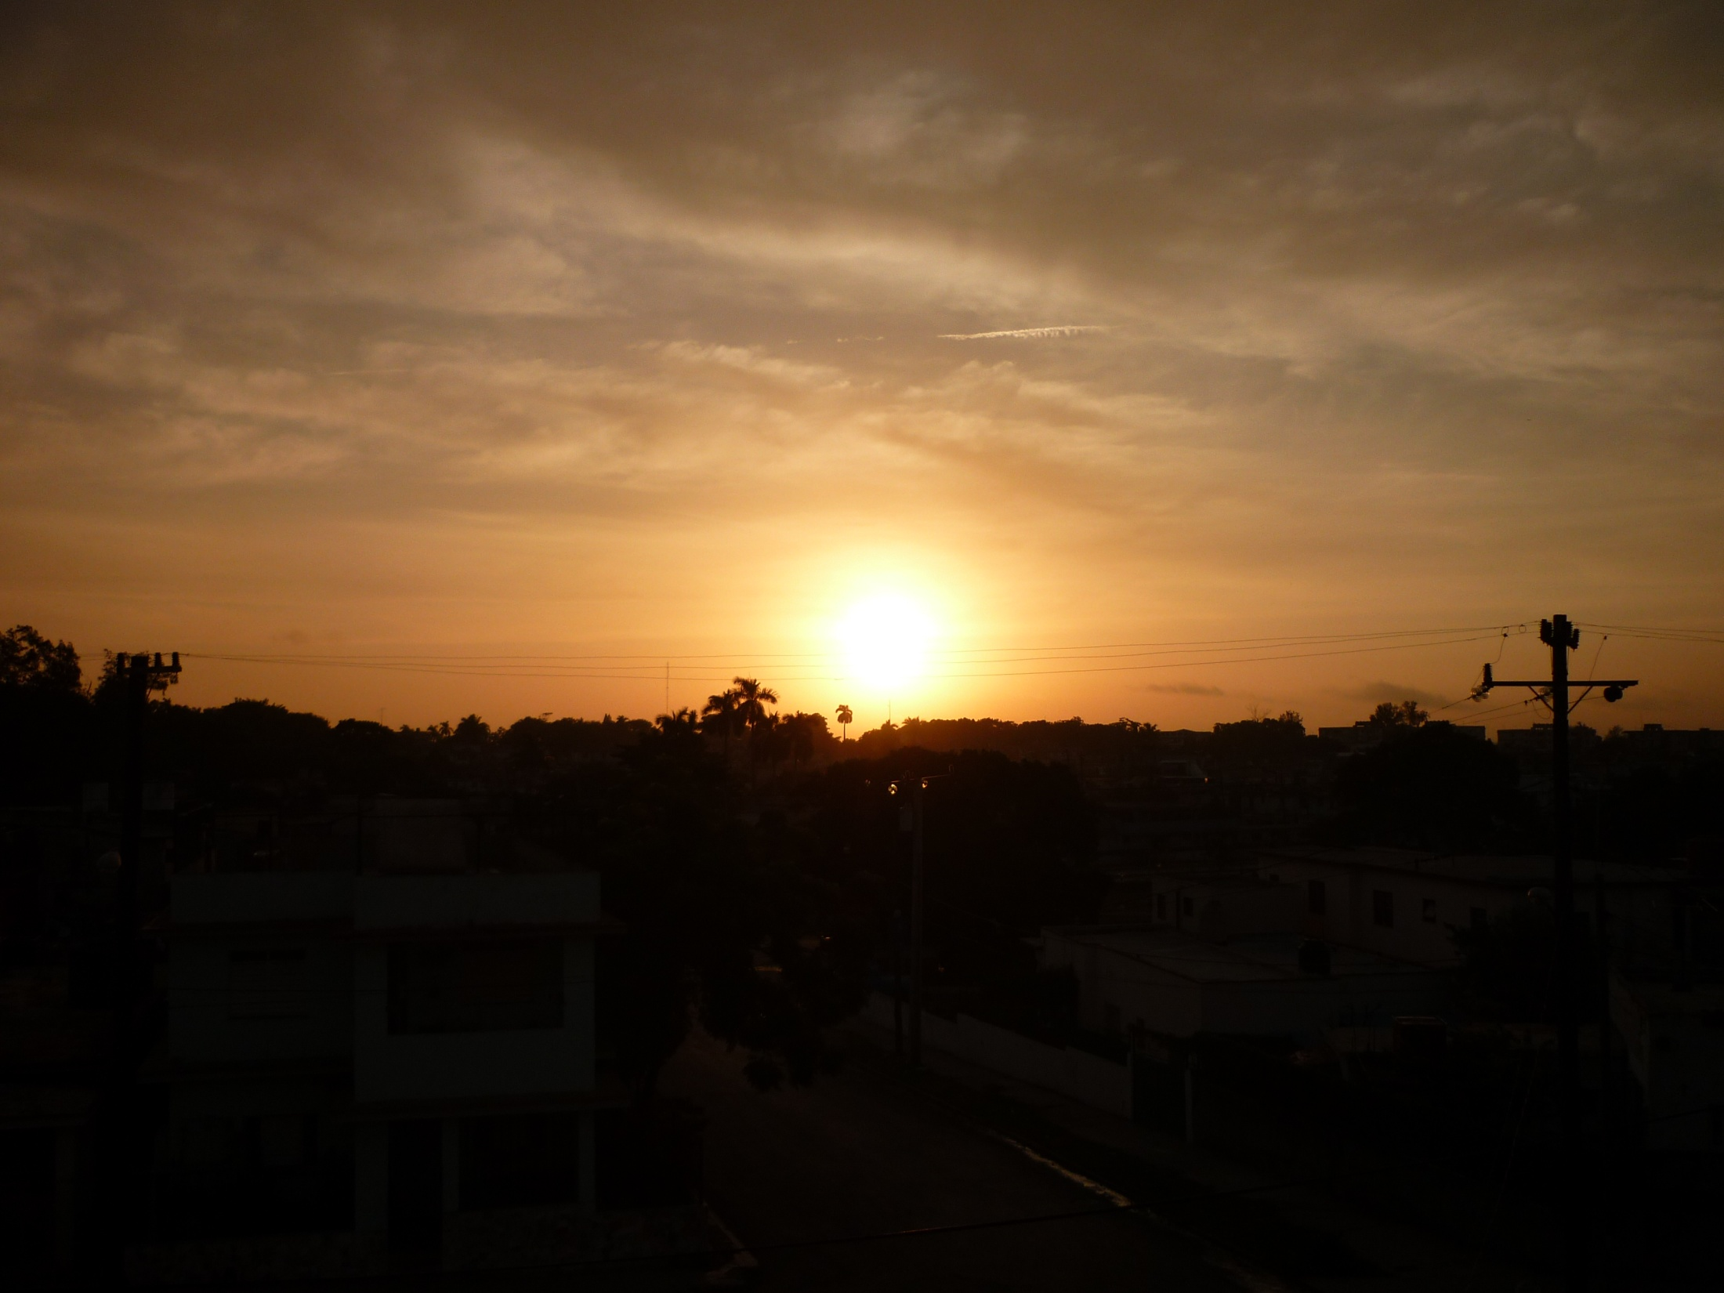
Introduction

Slide 3
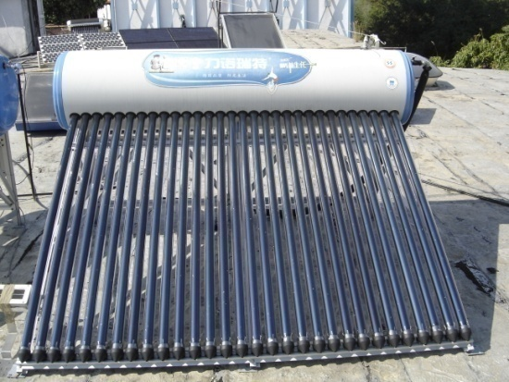
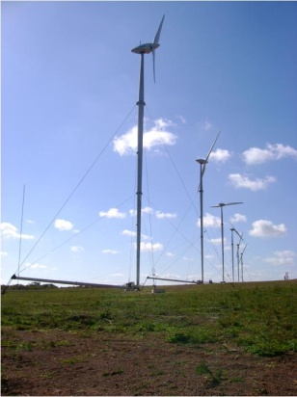
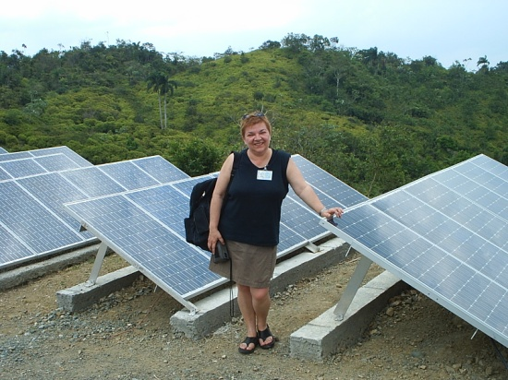
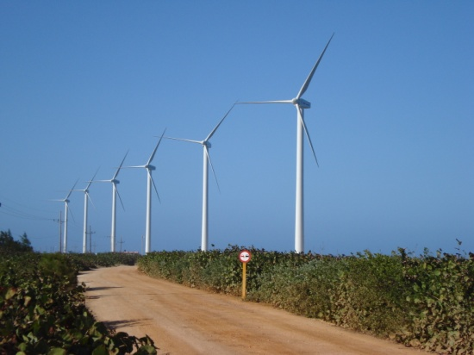
Cuba's energy mix is still characterized by an absolute dependence on nonrenewable sources of energy, specifically oil and natural gas. The use of solar energy directly and indirectly, has yet to achieve significant figures. The potential of sugarcane biomass and hydroelectricity for power generation, is not yet fully exploited. The use of solar photovoltaic panels and wind energy to generate electricity as well as solar thermal energy to heat water and other purposes is incipient.

Slide 4
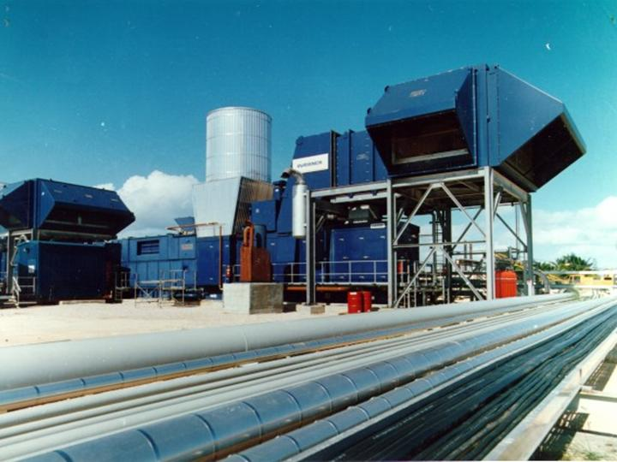
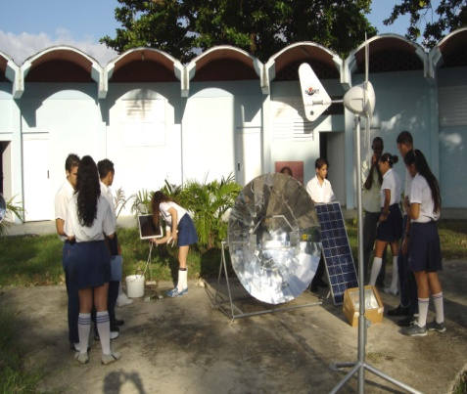

The basis of the use of energy resources in Cuba are:
Exploitation of indigenous sources of fossil fuels: Crude oil and natural gas
Efficiency, rational use of energy and education: Massive introduction of efficient technologies (generation and final use of energy). Deepening of an energy culture of environmental respect
Accelerated implementation of renewable energy technologies: Wind energy will play a key role within the national energy mix in the coming years. Installed new factory of vacuum tubes solar water heaters

Slide 5
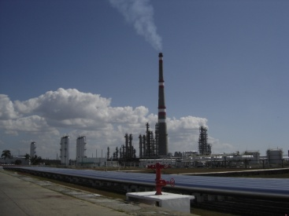
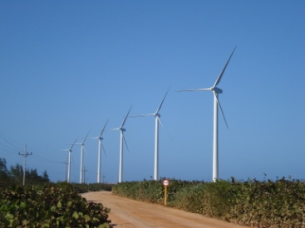
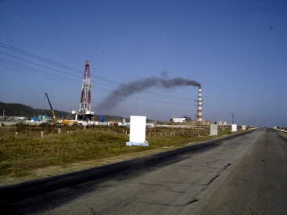
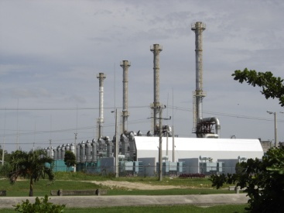
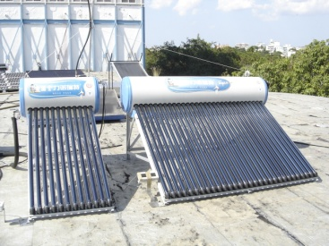
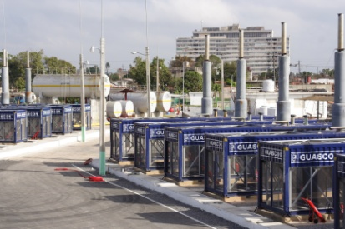
Cuban energy scenario
Generalization of Distributed Generation model
Studies to introduce massively wind power (in electricity generation) and solar water heaters
Estimation of the national potential of renewable energies
Maximizing the use of combined cycle
Increased energy efficiency in the whole chain of supply: generation, transmission, distribution and final use of energy
Support to other countries in energy developing and energy saving programs

Slide 6
Some remarks about the current energy situation in Cuba
Adjustment of the national electricity consumption plan due to fuel overconsumption in the generation of electricity and the impact of the international financial crisis.
19,9% of primary energy used in the country comes from renewable sources.
Only 3,8% of the electricity generated is based on renewable sources.
10,2% of the installed capacity for electric power generation is from renewable technologies.
Weaknesses in energy development in the state sector.
Detection of up 10% fraud in electricity consumption in the residential sector.
The gensets (fuel oil and diesel) cover 24,8% of electricity generation. Centralized generation (oil fired power plants and ENERGAS) cover 73,3%.

Slide 7
Historical Landmarks of Renewable Energies in Cuba
(up to 1959)

Slide 8
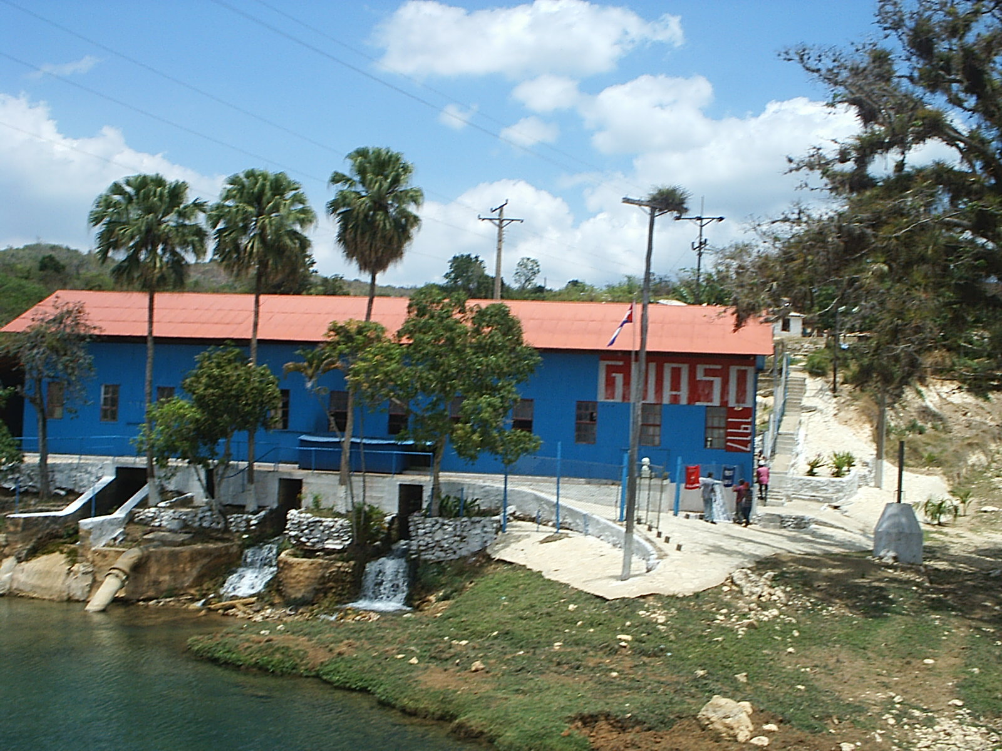
Hydroelectricity
El Guaso Hydroelectric Power Plant (Guantánamo Province) is the second oldest of its kind in Cuba and was inaugurated in 1917. It has an installed capacity of 1.75 MW with three Francis turbines. The oldest one is in Pinar del Río province and dates back to 1912.

Slide 9
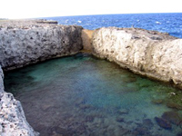
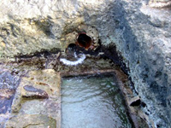
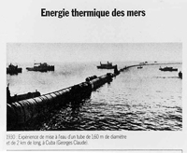
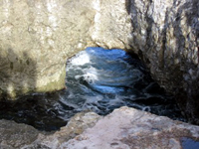
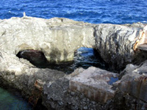
Ocean Thermal Energy Conversion
(OTEC)
Ocean Thermal Energy Conversion was first demonstrated in Cuba by two French scientists, Claude and Boucherot. They carried out the experiment at Matanzas Bay in 1930.
Ruins of the facilities of the world´s first OTEC power plant in Matanzas Bay, Cuba

Slide 10


The plant was able to pump 4000 m³ of water from a depth of 600 m. At the end the installation produced 22 kW for a temperature difference between bottom and surface of 15 °C.

Slide 11
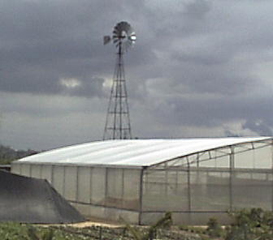
Wind energy
Puerto Padre in Las Tunas and Cruces in Cienfuegos, are disputing which was the first use of wind energy for water pumping. Surely many more towns in the whole country utilized it, but the certain thing is that before 1959 there were many wind mills after the first ones arrived in Cuba from the United States at the beginning of the 20th century according to the experts.

Slide 12
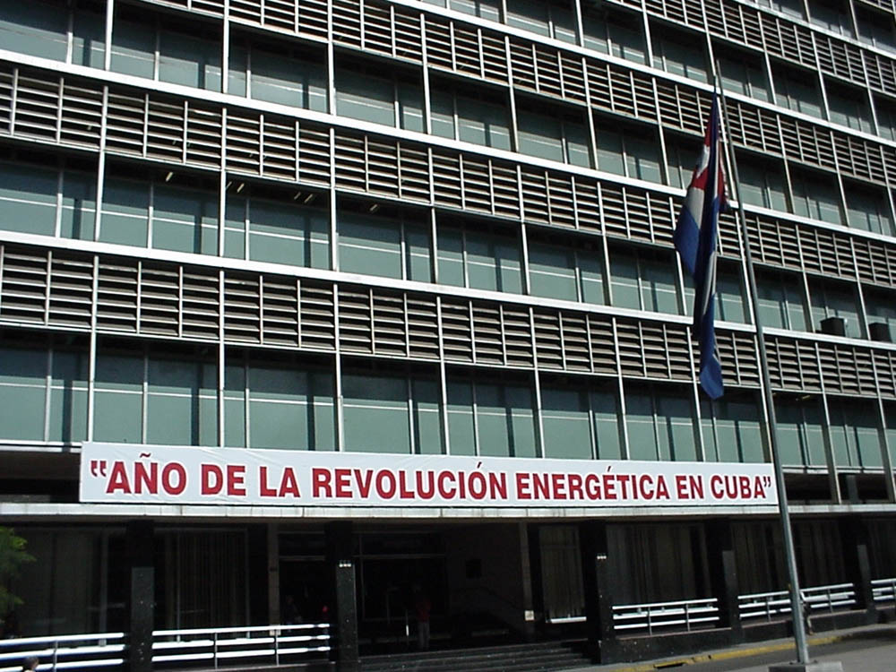
Passive Solar Energy
The former building of the Cuban Electricity Company, taken over by the Cuban Revolutionary Government in 1960, today is headquarters of the Ministry of Basic Industry, is an example of the application of the concept of passive use of solar energy that we can find in several buildings that were built in Havana during the 1950´s and 1960´s.

Slide 13
Development of Renewable Energy Technologies in Cuba
(from 1959 up to date)

Slide 14
Renewable energy technologies installed in the country
Year | Total
1999 | 6575
2000 | 8276
2001 | 11909
2002 | 15002
2003 | 15610
2004 | 18386
2005 | 15208
2006 | 15190
Technologies: windmills, biogas digestors and plants, hydroelectric power plants, solar water heating systems, photovoltaic systems, wind turbines, solar dryers, distilers, ram pumps, etc.
Source: Statistical Yearbook of Cuba 2006

Slide 15
Installation of Solar Water Heaters and PV Systems (1999-2004)
Source: Statistical Yearbook of Cuba 2004

Slide 16
Year | Biomass |  | Hydro |  | Total
 | E (GWh) | % | E (GWh) | %
1985 | 1 131,4 | 9,3 | 54,3 | 0,4 | 9,7
1986 | 1 184,7 | 9,0 | 59,3 | 0,5 | 9,4
1987 | 1 204,7 | 8,9 | 43,9 | 0,3 | 9,2
1988 | 1 317,3 | 9,1 | 72,8 | 0,5 | 9,6
1989 | 1 280,1 | 8,4 | 82,0 | 0,5 | 8,9
1990 | 1 449,1 | 9,6 | 90,9 | 0,6 | 10,2
1991 | 1 264,4 | 8,3 | 104,7 | 0,7 | 9,0
1992 | 1 337,2 | 11,6 | 80,5 | 0,7 | 12,3
1993 | 887,2 | 8,1 | 82,4 | 0,7 | 8,8
1994 | 896,9 | 7,5 | 48,5 | 0,4 | 7,9
1995 | 689,7 | 5,5 | 74,4 | 0,6 | 6,1
1996 | 922,1 | 7,0 | 95,2 | 0,7 | 7,7
1997 | 869,7 | 6,1 | 130,0 | 0,9 | 7,1
1998 | 779,1 | 5,5 | 96,7 | 0,7 | 6,2
1999 | 880,9 | 6,1 | 103,3 | 0,7 | 6,8
2000 | 944,2 | 6,3 | 89,0 | 0,6 | 6,9
2001 | 930,3 | 6,1 | 75,0 | 0,5 | 6,6
2002 | 938,5 | 6,0 | 106,4 | 0,7 | 6,7
2003 | 720,1 | 4,6 | 127,7 | 0,8 | 5,4
2004 | 788,6 | 5,0 | 87,6 | 0,6 | 5,6
2005 | 419,5 | 2,7 | 67,7 | 0,4 | 3,2
2006 | 406,1 | 2,6 | 93,6 | 0,6 | 3,2
Hydro
Share of renewable energies in electricity generation in Cuba
Source: Statistical Yearbook of Cuba 2004 and 2006
Biomass

Slide 17
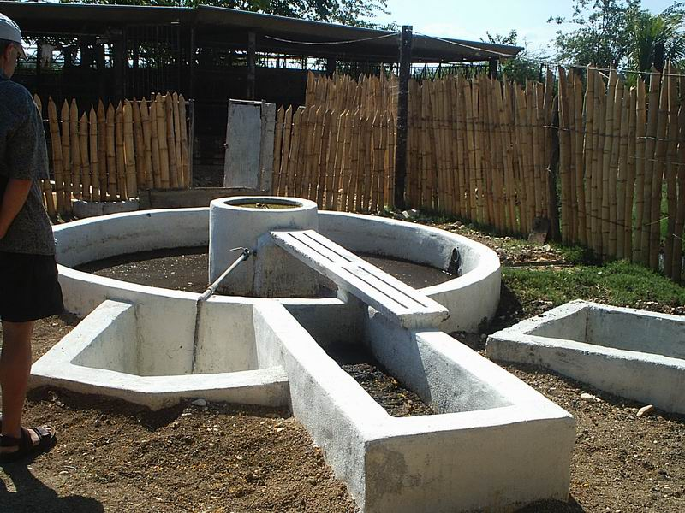
Bioenergy

Slide 18
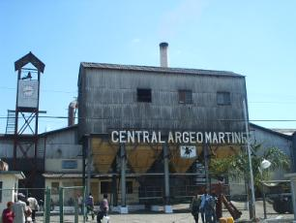
Historically, the sugar cane industry has played a key role in Cuba’s energy balance
Due to the high energy potential of baggase and other sugar cane residues, the sugar cane industry has the highest share among renewable energies in the country and still covers nearly 20% of Cuba’s final energy use.

Slide 19
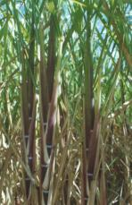
Sugar Cane Biomass
Share of the final energy use in Cuba
(%)
(year)
The decrease in biomass use is due to the reduction of sugar cane production. With the restructuring of the industrial sector in 2002, the use of biomass is expected to be even smaller in the future, and any increase will depend on a rise in productivity and efficiency in the sugar industry.

Slide 20
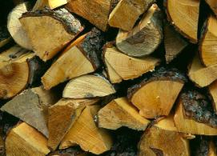
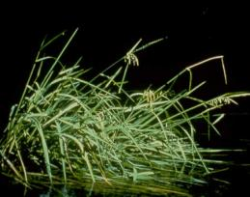
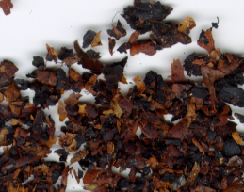
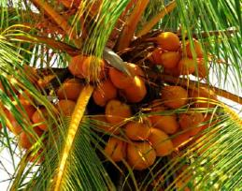
Other solid biofuels
Fuelwood exploitable potential available for energy uses, without endangering the ecological balance, is estimated at 3.5 million m³ per year.
Sawdust, wood chips
Rice hulls
Coffee bran
Coconut shells

Slide 21
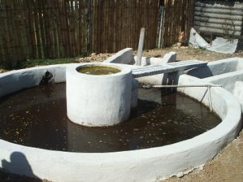
The treatment of agricultural residues has, in addition to its energy benefits due to the production of biogas, a positive environmental effect and besides, means an additional production of biofertilizers rich in potassium very useful to improve the quality of soils.

Slide 22
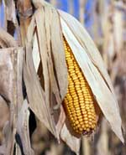
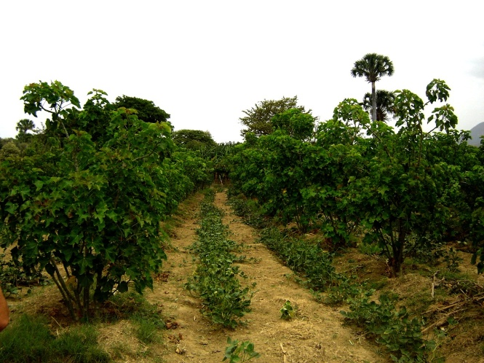
Cuba does not support the idea of converting food into fuels, while more than 800 million people suffer hunger.
Nevertheless, there are some liquid biofuel pilot projects. The best example is the cultivation of Jatropha Carcus which produces an oil that is not edible. For that reason it doesn't compete with human food consumption.

Slide 23
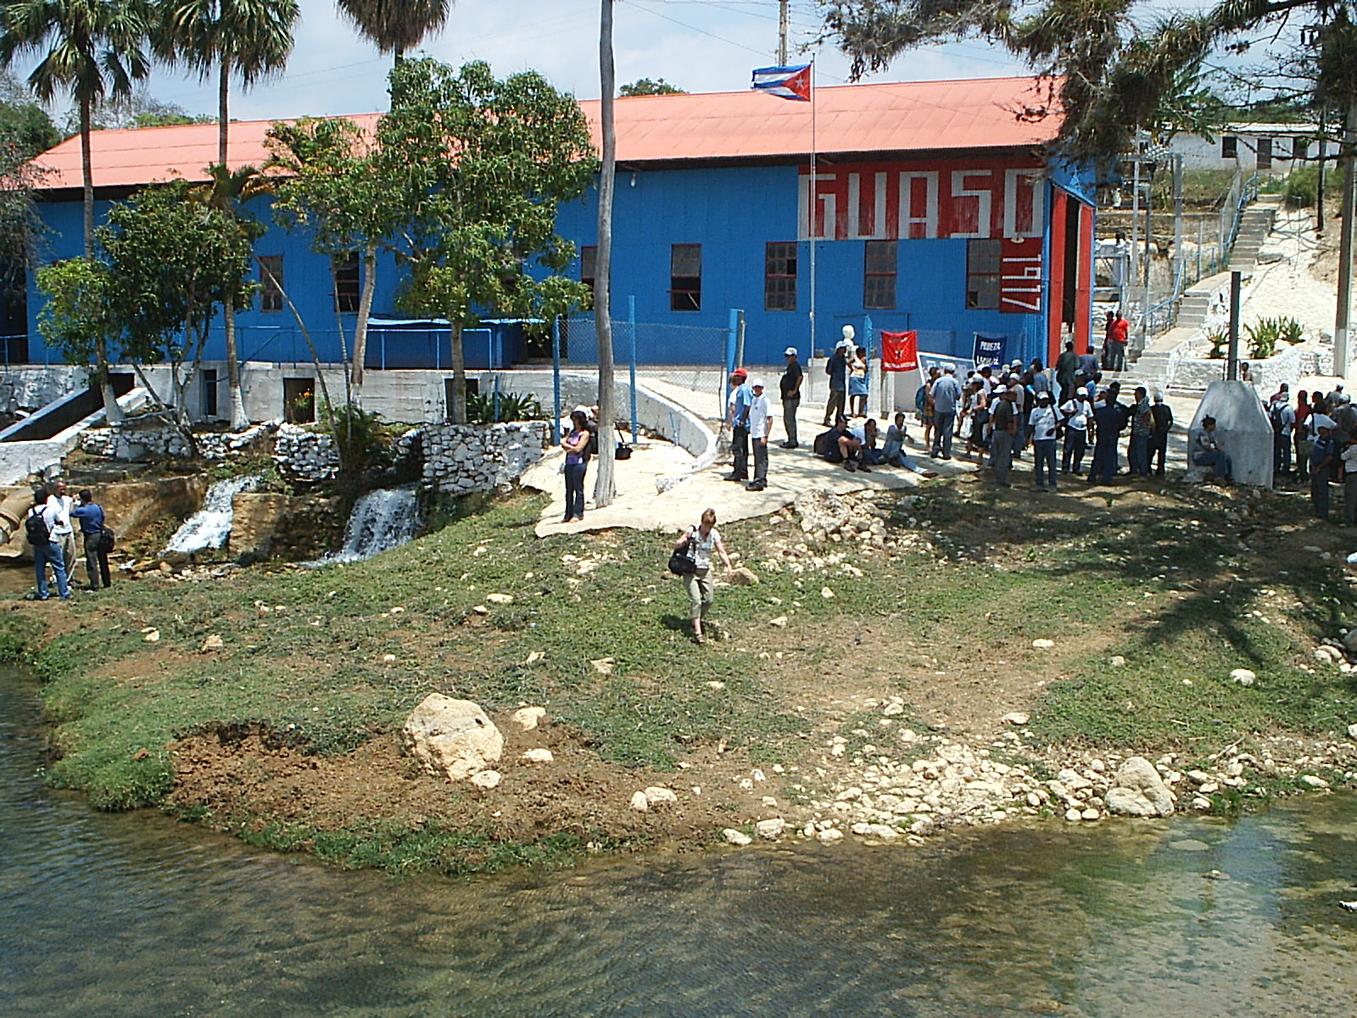
Hydropower

Slide 24
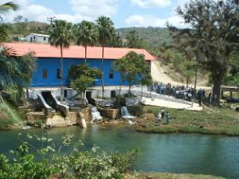
Cuba´s hydropower potential is estimated at 650 MW, with an annual generation of 1300 GWh. Out of this potential, Cuba only used 62 MW in 181 facilities producing around 128 GWh/year.
The second oldest hydroelectric power plant in Cuba (1917)
Around 50% of the hydropower potential of the country is located in the Toa-Duaba region. The political will of the Cuban Government in favor of the environment, led to the decision of not exploiting this potential because the region is a protected area and home to a large number of endemic species.

Slide 25
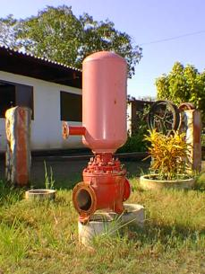
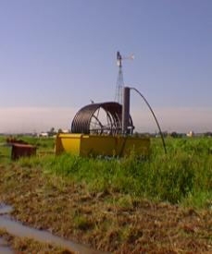
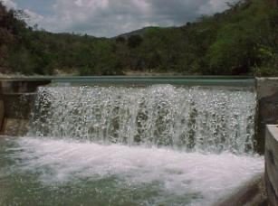
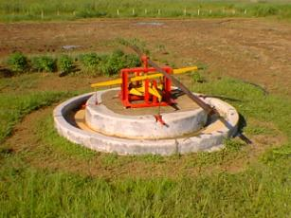
Other techniques under study and whose introduction are speeding up are: the irrigation and water supply by gravity, the use of siphons, ram pumps, rope pumps and a group of appropriate technologies, whose main contribution is saving fuel.

Slide 26
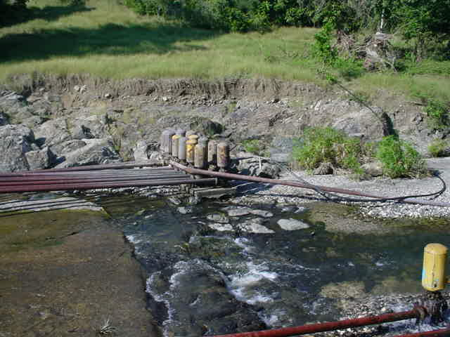
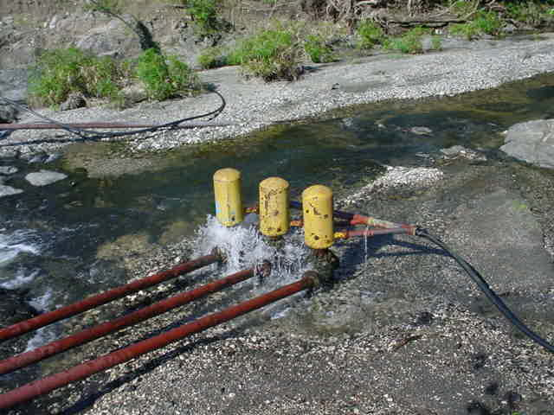
Ram pumps at Cazallas. Gibara. Holguín Province
This equipment can impel the water at very significant distances if we take into account that they only use the energy of water and air together. With the drive speed that reaches the water it is possible to feed sprinklers for the irrigation of crops that are more than 300 m away from the ram pumps.

Slide 27
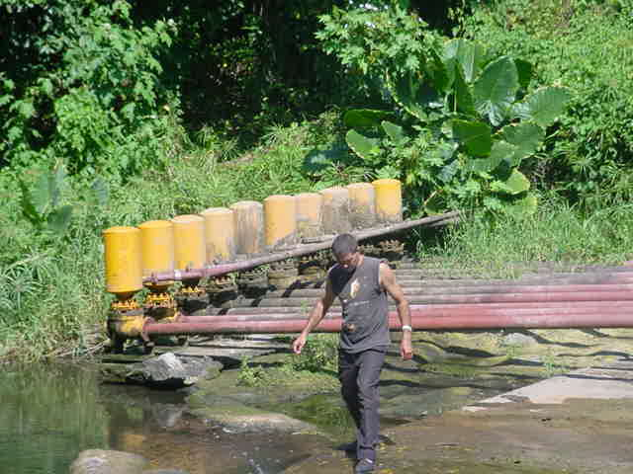
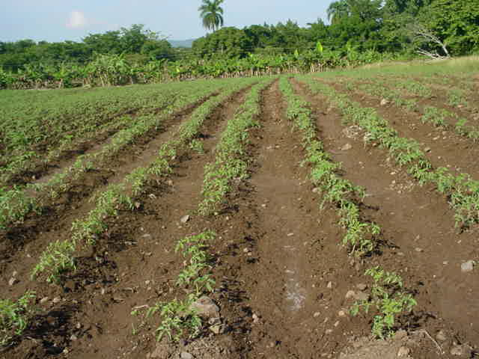
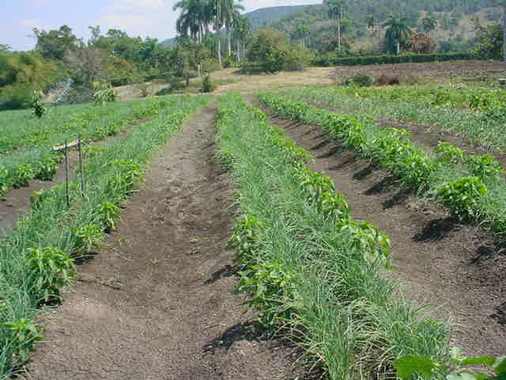
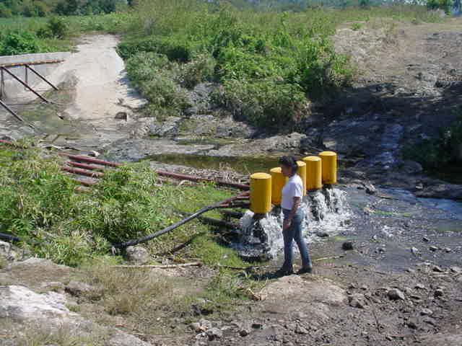
Ram pumps at La Palma. Rafael Freyre. Holguín Province

Slide 28
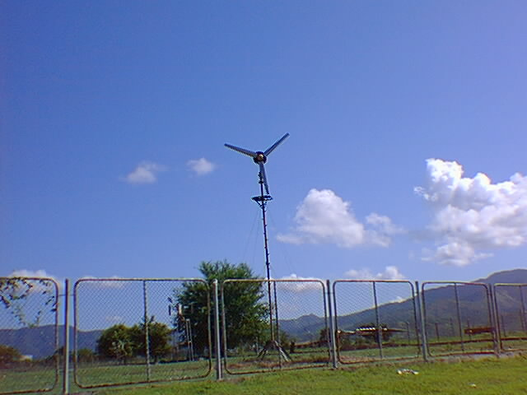
Wind Energy

Slide 29
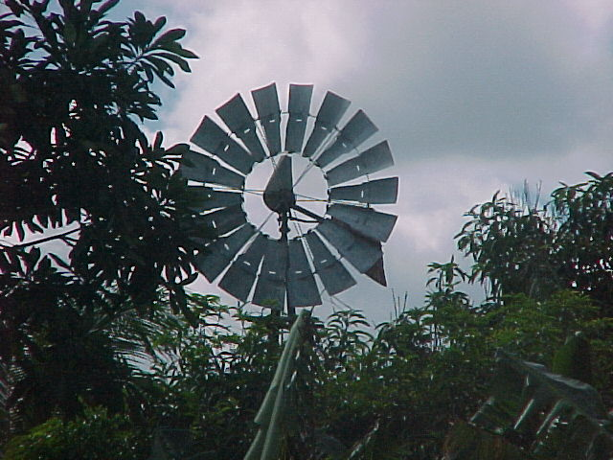
Wind mills have been used in Cuba long ago as a local solution for supplying water to livestock. There was a period when windmills were abandoned during the second half of the 20th century as the internal-combustion engines and electricity, provided more reliable and usually less expensive power for water pumping in the countryside. Today, nearly 7000 are installed all over the country. Nevertheless, wind energy could play a more important role in Cuba’s energy balance.

Slide 30
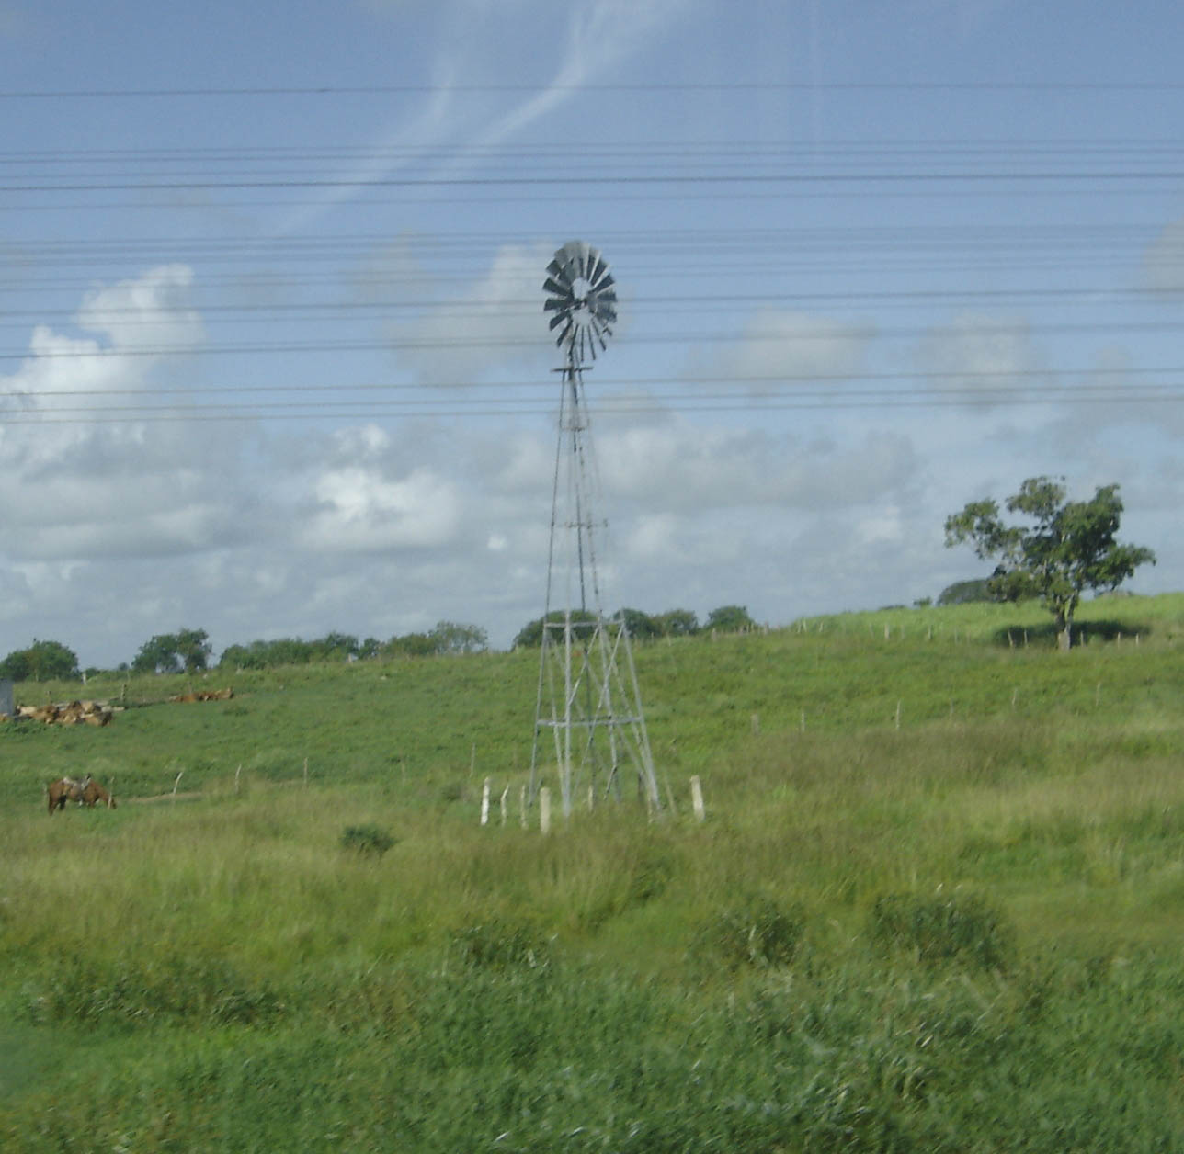
The two sectors most benefited by wind energy in Cuba are the Agriculture Ministry (MINAGRI) and the Ministry of Sugar Industry (MINAZ)
MINAGRI is operating 6700 windmills for raising cattle. At the moment, these windmills guarantee the supply of water to over 600 000 livestock saving 31624 t/yr of fuel. More than 4000 windmills should be installed by 2010 with an annual saving of 4.7 t of diesel per windmill.
MINAZ, on its part, is operating some 270 windmills. It is calculated, with an 85% of technical readiness, a fuel savings of 1383 t/yr. MINAZ plans to install 1958 windmills (2007-2008), for raising cattle and crops that will allow to save more than 10 thousand tons of diesel per year.

Slide 31
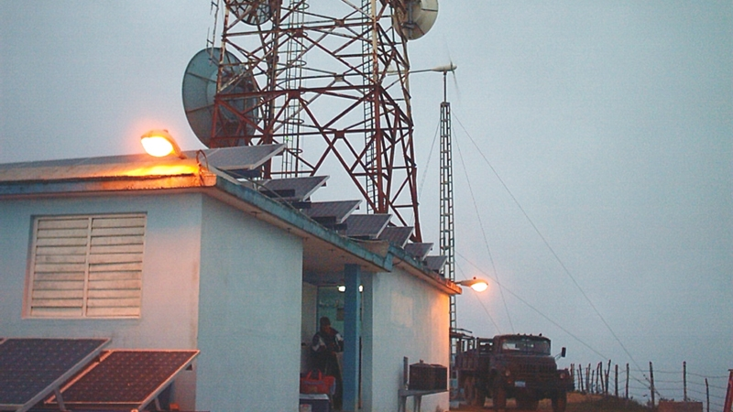
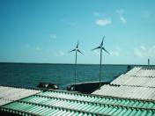
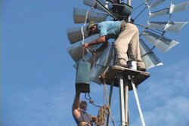
There are 23 small wind generators installed in isolated areas in Cuba. The total installed capacity is 25 kW.

Slide 32
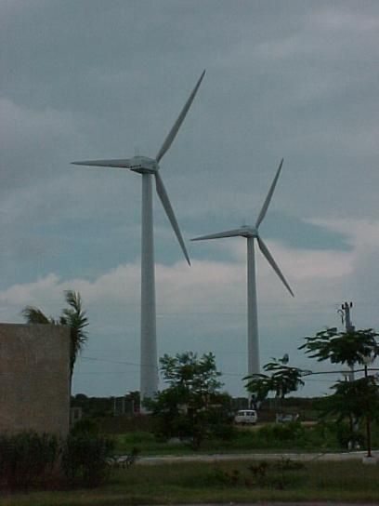
Turiguanó Wind Farm
In 1999, the first Wind Farm for Demonstration purposes was built in Isla de Turiguanó, in the northern coast of Ciego de Avila province, a region located in the eastern-center part of the country. The Wind Farm has two turbines, 225 kW each. The wind turbines are connected to the National Electric Grid.

Slide 33

Solar Thermal

Slide 34


Highly efficient solar compact water heaters have been produced and installed in the country during the last decade. According to some experts, these collectors are the most appropriate for the weather conditions and the characteristics of water in Cuba.
These solar heaters are used in rural hospitals, schools and tourism institutions.

Slide 35


Due to its high energy consumption, drying of agricultural products is another interesting use of solar energy.
Several designs and technologies for drying wood, seeds, grains and other products including plants for medical purposes harnessing solar energy, have been developed during the last two decades. The industrial use of solar dryers with great economical advantages, is possible.

Slide 36

Solar Photovoltaic

Slide 37


The direct transformation of solar radiation into electricity using photovoltaic conversion, is one of the most promising ways of harnessing solar energy.
Its sustained development at the international level allows its profitable use for stand alone systems in remote sites compared to the traditional sources.
In Cuba, there is a plant that produces high quality PV modules for both, domestic and exportation purposes.

Slide 38


Nearly 360 Family Doctor Consulting Houses and 5 hospitals located in mountainous sites and remote rural areas, have been provided with solar panels.

Slide 39





Photovoltaic system in a Family Doctor Consulting House
PV solar module 400-450 Wp, regulator, inverter,12 lamps of 15 W, TV set, refrigerator and radiocommunication equipment.

Slide 40


More than 95 % 0f the Cuban population has access to electricity services but there are 100 000 households in Cuba without electricity at this moment. Solar energy could be a solution in order to guarantee 100 % of electrification in the coming years.

Slide 41


There are 1864 Video Clubs that have been created and supplied with electricity using solar PV panels. The population of these isolated places now has access to the four Cuban TV channels, which increases their cultural level and improves their quality of life.

Slide 42

Video Club located in a mountainous area

Slide 43


Since 2001, 2364 rural schools have been supplied with electricity using solar photovoltaic panels, within the framework of the Audiovisual Program.

Slide 44

Today, thanks to the advantages of PV systems, 100 % of the learners in all Cuban schools, have access to the two Cuban Educational Channels.

Slide 45

With the use of PV systems, the teaching of computer classes have reached all learners, even those who study in the 51 elementary schools for only one learner in isolated places.

Slide 46

Passive use of solar energy

Slide 47

Fixed solar protection for vane and walls:
Overhangs, extended to give shade.
Horizontal awnings over windows.
Fixed plates, horizontal or vertical.
Trellises.
Building of the Faculty of Economy, University of Havana
During the 1950-1970 period, several buildings were built in Havana, following passive use of solar energy criteria.
Building of the National Center for Scientific Research, Havana

Slide 48

Trees and “heat island effect”
Planting trees in cities helps to prevent the so-called “heat island effect” providing comfort to the residents and also helping to save energy. In Havana there are two good examples: Paseo del Prado in Old Havana and Calle Paseo in Vedado.

Slide 49



Summary of the activities carried out in Cuba related to the implementation of renewable energies.
Installation of more than 8 000 PV systems with a total power of 3 MWp. This has allowed the electrification of the following social objectives:
2 361 primary schools.
275 isolated houses.
5 rural hospitals in mountainous places.
1882 community video rooms.
80 social clubs in rural communities.
More than 460 medical clinics.
Environmental Conservation Stations and Coastguard facilities have been electrified in several keys.
Photovoltaic projects have been carried out in other countries with an installed power a bit more than 1. 6 MWp.
Energy Education Classrooms have been equipped in two Pedagogical Universities.
Six towers of the National Television Network have been supplied with electricity from renewable energies.
Installation of 10 pumping systems using photovoltaic energy.
Installation of the First Demonstration Wind Park (Isla de Turiguanó, 1999, 0.45 MW) and the First Experimental Wind Farm(The Canarreos, 2006, 1,65 MW).
Developed the Wind Map of Cuba.
Electrification of three educational centers with wind-photovoltaic hybrid systems.
Electric service to systems of cellular telephony in remote areas.
The Center of Solar Studies has been created in Granma Province.

Slide 50
Cuban Energy Revolution
Ongoing Programs and Perspectives of Renewable Energies in Cuba

Slide 51

Background (2004-2005)
Antonio Guiteras power plant (330 MW)
Failures in two power plants caused great disruptions to the economy and population, as well as unavoidable difficulties in the availability of other units due to changes in their maintenance scheme.

Slide 52





Background (2004-2005)
Widespread use of poor quality fuel with high content of salts and sulphur, caused serious disruptions to the power plants that used it. Some of these PP were not adequately prepared for using it.
Presence of two large generating units for the country’s installed capacity (Antonio Guiteras 330 MW and Lidio Ramón Pérez 250 MW), which in case of failure, caused negative impacts on the electricity service something impossible to be solved by means of other measures.
Low growth rate of electricity generation from 1989, because of the final deactivation of a power similar to that introduced and the aging of the existing units and the consequent increase in failures.
Lack of adequate preparation to deal with the impact of hurricanes, which caused severe damages to transmission and distribution lines. Example: total isolation of Pinar del Rio and Trinidad in 2004.
Lack of adequate vision to introduce renewable generation sources on a commercial scale. Oil is running out in the world, new sources are required, especially renewable ones.
The actions of the Cuban Energy Saving Program (PAEC) were not comprehensive and systematic enough, and it was not preceded by a national thorough and comprehensive study that would allow its universal implementation at the required rate.

Slide 53






Background (2004-2005)
A large number of inefficient appliances in Cuban homes.
85% of the population cooked with kerosene.
Residential electricity tariff which not encouraged savings and inadequate savings culture.

Slide 54




Background (2004-2005)
Centralized base load generation installed capacity (inefficient power plants, 25 years of operation on average, 60% of availability, frequent failures and high inputs consumption).
Frequent blackouts, especially during peak demand hours.
High losses in transmission and distribution lines.
7000 km of transmission power lines
Generation concentrated in 11 power plants
Generation based in oil fired power plants
Transmition power lines
Distribution grids

Slide 55


Energy demand and supply (July 2005)
280 g/kWh
Thermal power stations
Blackout
72 %
18 %
Gas
8 %

Slide 56












Energy Revolution
The Energy Revolution of Cuba could be defined as a system of political, economic, technological, environmental, social and educational actions, aimed at ensuring the economic and social development, the invulnerability of the country in case of natural disasters and their transition to a more efficient energy economy characterized by a diversified energy matrix with a wide participation of renewable energy technologies, the implementation of concepts of distributed generation and energy solidarity and creation of an environmental culture based on the respect to the environment in Cuban society"

Slide 57







Programs of the Energy Revolution
International
Collaboration
Energy Efficiency
Increase the extraction of oil and natural
Renewable sources
of energy
Incremento Disponibilidad
Servicio Eléctrico
Biomass
Solar
Wind
Distributed Generation Model
Electric Grid Rehabilitation
Hidroenergíy

Slide 58











Energy Saving Program
Household sector: Appliances substituted
Household sector: New appliances
2 404 035
9 407 710
209 480
3 523 773
3 210 553
3 228 1973
91%
100%
69%
100%
92%
99%
Nueva
Tarifa
1 043 709
216 149
267 568
3 024 687
3 350 182
100%
21%
99,8%
93%
100%

Slide 59




Power installed capacity in Cuba by technology (MW)

Slide 60



A National Group aimed at supporting and promoting the accelerated development and penetration of renewable sources of energy and energy efficiency was created in February 2007. The fifteen comissions of this group (biogas, ocean energy, wind energy, photovoltaic energy, etc.) have a State mandate to study better ways for the introduction of renewable energies in the country.

Slide 61

Solar Water Heating Program

Slide 62

There is an ongoing experiment with solar water heating systems. The technology used is the so-called all-glass evacuated tubes. A number of systems have been installed in several social institutions.

Slide 63

Heat pipe solar collector is another technology that is being tested.
Solar water heating system in a school for children with special needs. Havana City.

Slide 64

Wind Energy Program

Slide 65

There is an ongoing Wind Energy Program in the country. In 2005, the Cuban State decided to acquire and install 88 stations for wind prospection with sensors up to 50 m and 12 meteorological stations of reference with sensors up to 100 m. Today, 8 stations accumulate data for more than one year, and there are promising results of the wind energy potential in areas of the north coast of the country, from Camagüey to Guantánamo.

Slide 66
Wind energy map of Cuba
Annual average wind power density on Cuba, calculated at 50 m using WAsP

Slide 67
From the analysis of the wind map, 26 geographical areas of the country were identified with wind potentials at 50 m higher than 400 W/m² and wind average speeds higher than 6.2 m/s. These areas are feasible for wind generation from medium to large scale. These areas are located essentially in coastal and mountainous sites. Experts have concluded that Cuba´s wind potential is between 5,000 and 14,000 MW, in an area of about 1,000 km².
Wind energy potential,
Holguín Province
Wind energy potential,
Guantánamo Province

Slide 68












Los Canarreos Wind Farm, Isle of Youth

Slide 69




There will be three test wind parks built to acquire direct experiences on the building, management, assembly and operation of different wind technologies. They were developed following the approach of “learning by doing” but avoiding the mistakes made by others.
Gibara Wind Farm, 6 aerogenerators 850 kW each, total installed capacity 5.1 MW.
On the whole, the mentioned test parks and the Demonstration Park in Isla de Turiguanó, that has been working since 1999, will add by the middle of 2008, a modest wind power installed capacity of 11.7 MW.

Slide 70

Gibara Wind Farm, Holguín

Slide 71

With regard to wind energy, the country is working unfailingly to characterize the national wind potential and to understand which technologies would allow us to achieve the highest possible wind generation penetration in our modernized electrical system, based on distributed generation.

Slide 72

Hydropower Program

Slide 73

Zaza Hydropower Plant
There is a program for the construction of 27 small hydropower plants with a total installed capacity of 46.1 MW. This would allow the country to generate an extra 202 GWh/yr. Up to date, only one plant has been completed and it is generating 3.2 GWh/yr.

Slide 74

Solid Waste Studies

Slide 75

Solid waste in Cuba
Volume (thousand of m³) 2004 | CH₄ generated (Gg) 2002
22.1 | 10.5
There are evaluations to take advantage of CH₄ from solid waste to produce electricity in one of the landfills in Havana, but assessment of the potential use of CH₄ for electricity generation in the country needs to be carried out.

Slide 76

Ocean Energy Studies

Slide 77

Cuba, surrounded by the North Atlantic Ocean and the Caribbean Sea, has many possibilities to take advantage of Ocean Energy in its differents forms. Tide currents, Ocean Thermal Energy Conversion and Wave Energy, are probably the most promissing ways to get energy from the sea waters around the island.
National Commission on Ocean Energy is conducting research on the ocean energy resources around the country and the technologies available in the world.

Slide 78


Nuevitas with its abundant beaches and keys is envisioned as a possible natural reservation for the use of tides to generate electricity.
This northern area of the Province of Camagüey has been chosen for the study of tide currents for having a special configuration.

Slide 79

Nuevitas Bay has 200 km² of territorial surface, but the studied area embraces the mouth of the channel with a monthly half width of tides of 0.433 m. The average speed of currents is 0.63 m/s, that is to say, approximately 1.22 knots. The calculations indicate that there are 88 million cubic meters of water in movement during the process of low tide.
Due to the high cost of the Ocean Energy technologies, the period 2007-2008 will be for preparing research projects mainly addressed to the characterization of the potential of these sources. Regarding Ocean Thermal Energy Conversion, the country is looking for a joint venture partnership to face the testing and implementation of this technology.

Slide 80

The National Group for the Development of Energy, Cubasolar, Cubaenergía and a network of Cuban institutions around the country, are working unfailingly for a sustainable and independent energy future for the country.
The Isle of Youth could be, in a few years, a testing ground for different kinds of renewable energy technologies and a 100 % renewable energy island.

Slide 81


Cubaenergía, the Center of Information Management and Energy Development, has a Laboratory for testing solar systems, both thermal and photovoltaic.
www.cubaenergia.cu

Slide 82

The Renewable Energies Group at Cubaenergía, is simulating and testing with the appropriate software, solar water heaters as part of the National Solar Water Heating Program.

Slide 83
Development & Climate Change

Slide 84
Key Development and Sustainability Indicators for Cuba and the USA
 | CUBA | USA
Life expentancy | 77.7 | 77.9
Literacy rate | 99.8 | 99
Infant mortality rate | 6 | 6
% children with low birth rate | 5 | 8
% of children enrolled in primary school | 97 | 92
Public expenditure in education (% GDP) | 9.8 | 5.9
Electricity consumption per capita (kWh) | 1,380 | 14,240
CO₂ emmissions (tons/year.person) | 2.1 | 20.1
Source: Data from the United Nations Human Development Index Report 2007/2008

Slide 85




¿What type of development model are we following?
Todays energy path
Nonrenewable energy sources
Concentrated energy carriers
High centralization in the production of electricity
High levels of environmental pollution
Relatively little awareness of environmental impacts and energy waste
Combustibles fósiles
Central nuclear
Freeway in Los Angeles, California
Hong Kong by night

Slide 86





United Nations and Climate Change COP 15
Many words and no political will from the rich countries.
What will happen after Kyoto expires in 2012?
?
Mohamed Nasheed, President of the Republic of Maldivas
Rajendra Pachauri, Chairman of IPCC
Barack Obama, President of the United States of America
Consumer based societies are incompatible with the saving of natural resources and energy that the development and preservation of our species require.
Fidel Castro, September 28th 2009

Slide 87



Today Energy Paradigm
Centralization
Fossil Fuels
Consumerism

Slide 88



New Energy Paradigm
Descentralization
Efficiency
Solar Energy
Education Culture

Slide 89

CUBA and the UNFCC
(United Nations Framework on Climate Change)
Adhesion Ratification
June 13th 1992 January 5th 1994

Slide 90


Slide 91

CUBA and the Kyoto Protocol
Adhesion Ratification
March 13th 1999 April 30th 2002

Slide 92

A true sustainable development can only be guaranteed with an energy supply that protects the climate and the environment.
Only if the world takes the Sun’s path will there be a sustainable future for humankind.

Slide 93

We don't inherit land from our parents but rather we borrow it from our children and grandchildren
Let’s take advantage of solar energy and protect the environment

Slide 94

Thank you for your attention
www.cubaenergia.cu

Slide 95

Thank you very much for your attention
Visit us at: www.cubaenergia.cu

