Slide 1
Managing Technology Change: Replace or ditch March 2017
Brian Arkills
Microsoft Solutions Architect
Microsoft Infrastructure Svc Mgr
Managed Workstation Svc Owner
UW-IT, Identity and Access Management
Microsoft Enterprise Mobility MVP 2012-2016

Slide 2
Goals
Identify and explore common causes of failure, friction, and deadlock related to technology change
Share and explore solution patterns related to technology changes
Leverage some first-hand experiences with large-scale technology refactoring and retirement

Slide 3
Agenda
Set Context
Review what ‘Change Experts’ say
Case study: NTLMv1 retirement
Interactive exercise
Case study: Managed Workstation “Hachet Man” refactoring
Round up lessons learned

Slide 4
Irrelevance – trigger for technology change
Terry Gray introduced a term to many of us: MTTI
Mean Time to Irrelevance
It refers to how long you expect a given thing to continue to be relevant.
In ITIL terminology, this is the utility.
The business doesn’t want to pay for irrelevant technology.

Slide 5
Cultivating attention
Some technologies are obviously irrelevant, and others are very relevant. But for those which are non-obvious, we must pay closer attention and exercise greater care.
Monitoring, metrics, customer demand management, and other service management practices may help us pay closer attention.
Exercising the greater care is what most of this presentation is about. ☺

Slide 6
Lifecycle terms
UW Enterprise Architecture (EA) program promotes specific terms to communicate technology lifecycle status: https://wiki.cac.washington.edu/x/RusnB
From those, I commonly use these terms:
I connect these terms with specific support, e.g. https://itconnect.uw.edu/wares/nebula/managed-workstation-service-design/operating-system-support/
Not available
Emerging
Baseline
Containment
Retired

Slide 7
Top reasons for org change to fail
Interviewed 1500 change leaders across 15 countries.
Only ~30% of change projects succeed.
These are top obstacles/reasons for failure:
Changing mindsets/culture – 55%
Complexity is underestimated – 35%
Shortage of resources – 33%
Lack of commitment of higher management – 32%
Lack of transparency – 18%
Technology/implementation execution – 15%
Summary of Source: http://www-03.ibm.com/press/us/en/pressrelease/25492.wss

Slide 8
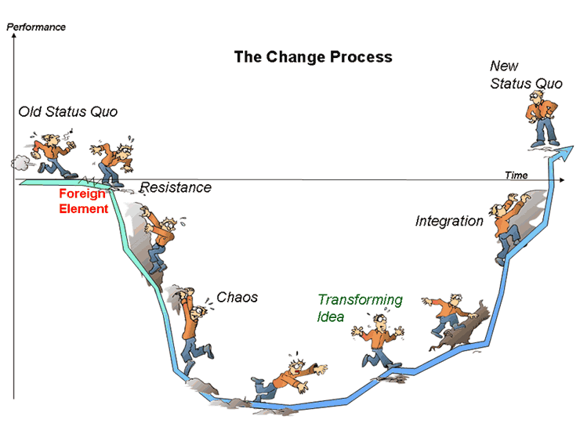
Change Models/Paradigms
William Bridge’s “Transitions”
Anatomy of Learning Experience and the “stupid zone”
Grief Cycle and “valley of despair”
Neuroscience’s SCARF Model (David Rock)

Slide 9
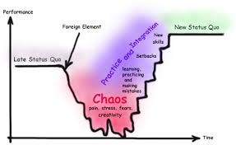
Despair and resistance
Lots of negative narratives people have for change:
“Nobody cares about us”
<Fantastical story about reason for change in absence of actual reason>
“This is being inflicted on us”
“Others are being treated better”
“This isn’t fair”

Slide 10
SCARF: Address threat of change
The most important factor for successful change
People (and emotions) are front and center
Things that can help:
Build trust – requires relationship or past history
Empathize – engage with those who are resistant, listen, and find ways to address concerns
Be transparent in communications
Manage expectations and meet promises
Our job as leaders of change is to help people move forward

Slide 11
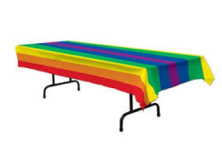
Case study #1: Retiring NTLMv1
Notes:
05:00 time check

Slide 12
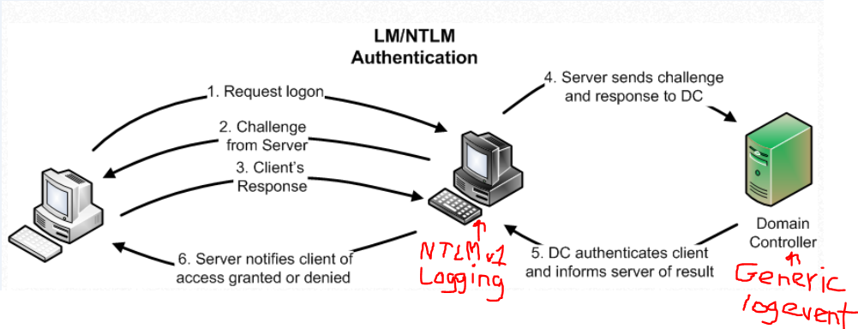
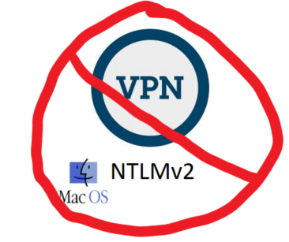
Tech - Stumbling Points
Notes:
You gotta understand how NTLM works, and especially the LMCompatibilityLevel setting. See http://technet.microsoft.com/en-us/magazine/2006.08.securitywatch.aspx. http://technet.microsoft.com/en-us/library/cc773178(v=WS.10).aspx (section NTLM Referral Processing) is good for cross-trusts. And http://digital-forensics.sans.org/blog/2012/09/18/protecting-privileged-domain-accounts-network-authentication-in-depth is good too.
You need to understand where NTLMv1 is logged. It’s logged at the server the client connects to. Not *ANYWHERE* else. That means looking at your DC logs won’t tell you who is using NTLMv1. You must get logs from other servers.
The MacOS doesn’t natively provide a NTLMv2 VPN client. 3rd party VPN client or VPN server are needed.
Non-Windows browsers don’t support NTLMv2. Chrome doesn’t. Firefox doesn’t. Safari on MacOs with an obscure setting does, but it’s the lone exception. For me, Windows Integrated AuthN is dead. You can either replace it with HTTPS & Basic. Or you can add a second site with the same content for non-Windows users that has HTTPS & Basic. Or move to federated AuthN.

Slide 13
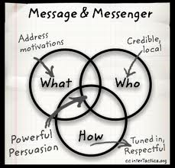
Change Mgmt – Stumbling Points
Notes:
Identify stakeholder partners and persuade them of need to proceed
Communicate clearly and often.
Provide ample workaround solutions.
Have a thick skin about not rolling back the Svc. Design change. Have clear sense of what conditions would trigger rollback.
Be willing to bend a little to accommodate partners or discovery of new known problems
Get your service desk staff on board with the known problems and workarounds

Slide 14
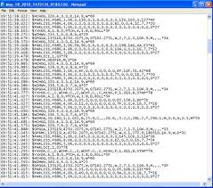
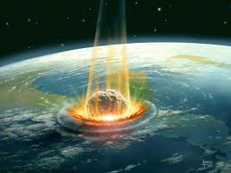
Keys to Success Retiring Old Tech
Notes:
Partners. Need folks who will help and champion. You can then leverage peer pressure to help speed up movement. ☺
Log data. Need to know what the current use is so you can target it. You might need to rely on your partners for this. Automate this as much as possible.
Workarounds. Customers often still have a business need, and you need to help route them on a permanent detour. Go the extra mile to inform customers of the alternatives.
Persistent Pestering. A large percent of customers will ignore you the first time you tell them they need to do something different. You become a pest, but ultimately this is better than breaking them later—and they have no excuse for missing many notices.
Imagined Impact. Having a good idea of how big the impact will be (both to the organization and to individuals) is invaluable in your communications. You might preliminarily try turning off the technology for an hour to gain this picture.

Slide 15
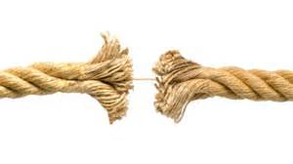
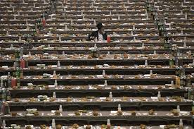
Loose Ends
Notes:
Obviously, there will be customers late to the party. They’ll need to get to something they infrequently access, and suddenly run into NTLMv2 problems. That’s where your service desk training helps.
We still see NTLMv1 events logged on our DCs *after* having explicitly turned off NTLMv1! These events are always computers—null sessions. We’ve successfully tracked some number of these oddities to the computers which are NetBios master browsers for their subnet, and stopped those events by turning off NetBios over TCP/IP on those computers. Still tracking down the rest of the oddities, but I suspect there’s a NetBios bug here that explains all of them.

Slide 16
1-2-room report exercise
Think about the largest technology change you’ve been involved in.
What was the toughest aspect of that change?
What helped the most?
Pair report out #1: problem was mostly technology or mostly people?
Pair report out #2: what was biggest help?
Time:
By yourself: 1 minute
Pair: 2 minutes
Room Report: 8 minutes
Notes:
12:00-24:00 time check

Slide 17
Case study #2: Managed Workstation & the hatchet

Slide 18
Mgd Workstation Personal History
2002: hired by UW to be an engineer for this service
2008: focused on AD & IAM, left Nebula
2014: indicated I was ready for new challenges. I got a couple big ones.
2014: Became service manager in late 2014
2015: Became service owner in late 2015
2016: Year of massive change
2017: Here I am. More change ahead. ☺

Slide 19
What Nebula provided 2002-2014
AD domain
Image
SCCM & software packaging
WSUS based patching
Samba File services, home directory & shared. Snapshots.
Phone call center
Unix shell account (reduced over this period)
Windows Server based VPN
Reporting (primarily email-based—details changed a lot over this period)
Support/Assistance (separate consulting cost after 2008)
Group pine email solution
Emulator key-mapping solution support
Printers both stand-alone and some via unix print queue
Your one-off kitchen sink thing

Slide 20
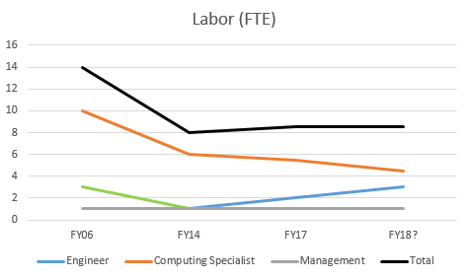
Cost & labor
Notes:
This is FTE count not people. I’ve classified FTE count by position type to make it helpful.
For example, we have 2 FTE of engineering split across 3-6 people depending on what’s needed, and 5.5 FTE of computing specialists split across 5-6 people, et cetera.

Slide 21
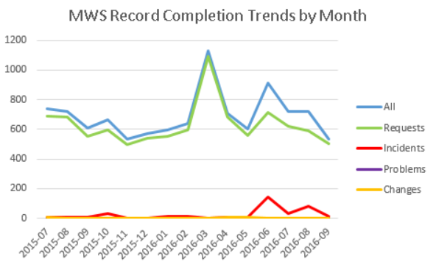
Usage
2800-3300 workstations between 2006 and 2016
~66TB of file service usage
Most administrative departments are customers, no schools (yet) or UW Medicine

Slide 22
Philosophy/Approach/Goal
Goal: Provide a workstation in a known state using mechanisms to keep it updated, functioning, and useful, but allow customer to change state
Philosophy: Provide workstation management at scale, with each managed workstation considered replaceable
IOW, customers should save data outside the workstation & ensure all business critical applications are packaged to be easily reinstalled

Slide 23
The “Hachet Man” road begins …
Nebula SO Oct 2014: Expected life of service: 2-3 years.
I decided to not share this expected life of the service with the team and start shutting it down. Instead, I decided to take the harder road of fixing it.

Slide 24
Problems: Friction and Deadlock

Slide 25
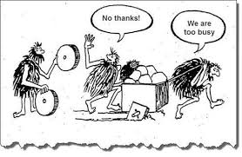
Problems: Technical debt
Long-standing issues of deferred technical design
Primary cause: misguided notions of minimizing impact to customers by prior decision makers + misbalanced team composition
Awareness: Medium

Slide 26
Tech debt details
Ancient servers:
customized Samba file services
Ancient SCCM
Ancient AV server
Ancient DB server
Domain migration in its 7th year, with no progress
Windows + Unix infra. components intertwined
Anti-agile to change
“Dumbed down” both Windows and Unix native features
Not integrated with central IT management mechanism
IT believed intertwined components were MWS
Not enough engineering staff for the amount of technical problems in need of solutions

Slide 27
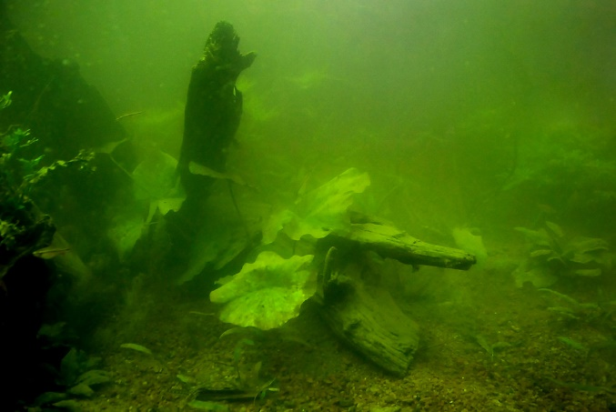
Problems: Service definition
During the first 3 months, I discovered how poorly defined the service was.
Cause: Lost in history I don’t know.
Awareness: Only customers perceived this as a problem.

Slide 28
Svc Def details
“If not everyone asks for that, it is consulting & costs more” ☹
Definition pretended we provide same value to Macs
Belief we’ll support anything; no differentiated support for preferred OS
Belief we do provisioning & access mgmt. for all IT services to on-board new user at no additional cost
Ill-defined Exch. support for 1000s that aren’t MW customers
Unclear software packaging responsibility boundaries

Slide 29
Problems: Straying from purpose
We were doing many things that had nothing to do with our core purpose
Cause: Lost perspective at mgmt. level, not enforcing boundaries. Unwillingness to tell customers that we don’t provide this
Awareness: Low

Slide 30
Purpose details
UW-IT Help Desk transfers calls directly to us
Lost consistency, >interruption. ☹
Customer budget tracking mechanism (consulting)
Finance should provide this.
Unix print queue, local printers, Unix shell, web publishing, mainframe key mappings, and other svcs unrelated to workstations
Open-ended IT consulting vs workstation consulting
Notes:
MWS Consulting is open-ended “we’ll do anything IT” instead of “we’re the workstation experts, who can provide one-time general IT help if you need something else”

Slide 31
Problems: Customer Management
Who are our customers and are they still here? What are their budget/users/resources?
Cause: poor design & no consequences for not doing this
Awareness: Low

Slide 32
Cust Mgmt details
No “department” or user lifecycle when a customer left ☹
No budget info automation by customer account
No key contacts for customer accounts
No mechanism to determine when a user moved depts
Poor customer security group management;
if any customer asks then we do it; no authority validation ☹
No mechanism to capture & prioritize unmet customer needs

Slide 33
Problems: Request fulfillment process documentation
Very little request fulfillment documentation;
almost everything was a custom one-off
quality depended on who you got
Cause: Unclear expectations, purpose and svc definition are contributing factors
Awareness: Low

Slide 34
REQ proc doc details
*No* standard requests defined
Have internal docs on various topics w/tech details, but not process focus
Meet cust needs consistently & efficiently=fail
Can’t easily transition any given standard REQ from internal fulfillment to customer self-svc fulfillment
Immaturity within team about writing process documentation

Slide 35
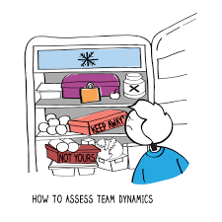
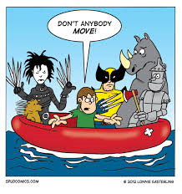
Problems: Roles, Responsibilities, Skills, & Team Dynamics
There were a number of issues here:
Friction within team b/w tiers
Not enough engineer staff
Lack of shared vision about roles and responsibilities
Cause: Philosophy/approach mismatch, UW-IT org boundaries, poor accountability to expectations
Awareness: Low. Of non-customers: Medium to high.

Slide 36
R, R, S, & D details – shared problems
Key details like impact of changes not communicated internally to avoid delays from poor approach buy-in
One person on entire team understands svc design
Sometimes: Failure to share
But also: Failure to comprehend & engage
Inadequate triaging info passed between tiers
Bottom line: Disagreement about direction …

Slide 37
R, R, S & D – personal aspect – hard truth
Technology services live & die on providing relevant value for low cost.
Only being skilled enough to keep trains running isn’t enough
Being unwilling to work with others or grow your skills won’t cut it

Slide 38
Change means friction, friction means HEAT
Notes:
39:00 time check

Slide 39
Heat: Signs that you are initiating significant amounts of change
Bad marks on collaboration in annual review
Sharp increase in emails from those against change
More escalations to your boss’s boss
Customers ask for more time or wonder which of your changes they should prioritize
You spend time thinking about how much change can be tolerated in a given period of time
You are publishing documentation more quickly
Internal team starts asking for change management ☺
Notes:
These are not success or failure indicators—they just are. Change creates friction which creates heat.

Slide 40
Fixes: Tech debt
Latest Samba version providing file services. Rushed b/c Samba Badlock; major INCs getting to stability ☹
New SCCM in both old domain and central domain
New AV server in central domain ☺
New DB server; redesign: future DB changes easy ☺
Domain end of life 4/3/2017 (maybe 5/15?)
Integrated with central IT management mechanism
Notes:
Also: Separated Windows/Unix components (covered on later slide)

Slide 41
Fixes: Service definition
Rewrote svc description in catalog
Published:
‘What does the MW rate include?’
‘What Exchange Support does MWS provide?’
‘OS Support Lifecycle’ note EA lifecycle terms
Separated File Svc costs from Managed Workstation rate.
Fixed file svc. abuse.
Leveraged this to fix unix/windows entanglement
Made customers responsible for managing their user’s access

Slide 42
Fixes: Customer Management
Created eligibility groups managed by each customer/dept. Automation based on this.
Added “authoritative” contacts for each dept:
Owner, Budget, Tech & tech alternate
Added “default” budget mechanism for MWS resources that don’t explicitly get a budget assigned
Purged 150+ dead departments & 5224 home directories & file access
Added self-service Windows 10 upgrade: wildly successful despite nay-sayers

Slide 43
Fixes: User-initiated OS upgrade

Slide 44
Fixes: Request process docs
Not done yet … growing practice led by svc mgr
Expect some time on Continual Service Improvement
Goal: internal process doc, then self-svc customer doc
10-15 Standard Request forms currently in flight
Buy-in has to happen team-wide, and momentum needs to be generated—might take 1-2 years more

Slide 45
Fixes: Straying from purpose
Dropped:
call center
printers
Macs - to re-add when we provide value
redundant internal tools
some Exch support - more to come
Renamed from “Nebula” to Managed Workstation
Tactical: Review latest high-volume consulting thing. If not in purpose, I figure out an exit strategy.
Strategic: Encourage holistic UW-IT approach to X
Published capability map, with “road map” of initiatives …
NOTE: Includes our future plans to divest/retire some capabilities

Slide 46
Capability Map

Slide 47
Fixes: Team dynamics
Communicate to everyone on the team:
Eliminated meetings with tier only attendance
Eliminated email lists with tier only membership
Several team discussions about prof. expectations: Participate, communicate, treat others as you’d like to be treated, support each other
Team-wide process of developing roles & responsibilities -> RACI of record
Oft-repeated principle: if you demonstrate initiative & responsibility, I will give you opportunities
Foster shared ownership/responsibility

Slide 48
Fixes: Roles, Responsibilities, & Skills
Leveraged organizational options for addressing friction and gaps
Promoted new svc mgr from w/i team
1 excellent junior engineer added 1 year in, will add another in FY18
Systemic: Framework to adjust roles and skills + continually re-assess needs

Slide 49
Lessons learned …

Slide 50
Service Mgmt Lessons Learned
Awareness:
Invest in Customer Demand Management & Metrics
Self-svc design goal is key: Power to the people!
Tools & docs
Align your service with your core purpose
Capability mapping!!
Hold others responsible to fill gaps. Involve customers
Don’t provide outside purpose b/c: REALLY costly to fix
Int. process docs: consistency + quality OR running blind
Question costs. Partial or delayed answers=bad
Don’t be afraid to raise ‘performance issues’: win-win

Slide 51
Leadership Lessons Learned
Is this the hill I want to die on?
No: compromise
Yes: justify and push forward
Transparency
Goals, intentions & reasons—esp. to customers
Philosophy/approach is separate from your purpose
Be clear on expectations and responsibilities
Let go
Delegate if you can (and let them fail)
Invest in people
Increasing your rate of failure is the way to increase your rate of success
Embrace & engage resistance

Slide 52
Goals
Tell our organizational story around workstation management; entertain & touchpoint for others
Identify and share solution patterns related to organizational and technical debt

Slide 53
Questions?
Key slides:
Lifecycle Terms
SCARF: Address threat of change
Keys to Success Retiring Old Tech
Capability Map
Leadership Lessons learned
Service Mgmt Lessons Learned

Slide 54
The End
Brian Arkills
barkills@uw.edu
@barkills
@brian-arkills
http://blogs.uw.edu/barkills
https://itconnect.uw.edu/wares/nebula/
Author of LDAP Directories Explained

