Slide 1
Managed Workstations: The Hachet Man’s Story October 2016
Brian Arkills
Microsoft Solutions Architect
Microsoft Infrastructure Svc Mgr
Managed Workstation Svc Owner
UW-IT, Identity and Access Management
Microsoft Directory Services Enterprise Mobility MVP 2012-2016

Slide 2
Goals
Tell our organizational story around workstation management; entertain & touchpoint for others
Identify and share solution patterns related to organizational and technical debt

Slide 3
Overview
Orientation to our Managed Workstation service
Problems as of 2 years ago
Fixes in past 2 years
Lessons learned
Questions & discussions on any of this

Slide 4
Jump ☺
Leadership Lessons learned
Service Mgmt Lessons Learned

Slide 5
Mgd Workstation Personal History
2002: hired by UW to be an engineer for this service
2006: Gave presentation on “Nebula” here
2008: focused on AD & IAM, left Nebula
2014: bored with my career and indicated I was ready for new challenges. I got a couple big ones.
2014: Became service manager in late 2014
2015: Became service owner in late 2015
2016: Here I am ☺

Slide 6
What Nebula provided 2006-2014
AD domain
Image
SCCM & software packaging
WSUS based patching
Samba File services, home directory & shared. Snapshots.
Phone call center
Unix shell account (reduced over this period)
Windows Server based VPN
Reporting (primarily email-based—details changed a lot over this period)
Support/Assistance (separate consulting cost after 2008)
Group pine email solution
Emulator key-mapping solution support
Printers both stand-alone and some via unix print queue
Your one-off kitchen sink thing

Slide 7
What Managed Workstation provides 2016
Managed Workstation rate $34.50
AD domain (will be gone in 2017, adopt central service)
Image + lite-touch network deployment
SCCM & software packaging (will transfer this to central service in 2017)
WSUS based patching
Phone call center (leveraging central help desk)
Unix shell account
Windows Server based VPN (may eliminate this in favor central offering)
Reporting (Self-service web portal)
Training room, first come-first served
Samba file services, home directory & shared. Snapshots. $.15/GB/month
Windows file services. $.37/GB/month
Support/Assistance consulting $98.50/hour
Group pine email solution (to be retired in next year)
Emulator key-mapping solution support
Printers both stand-alone and some via unix print queue
Your one-off kitchen sink thing ONLY if:
No one else is the SME for that capability
You don’t expect us to support it in the future, i.e. this is a one-time thing
We haven’t explicitly documented we won’t do this

Slide 8
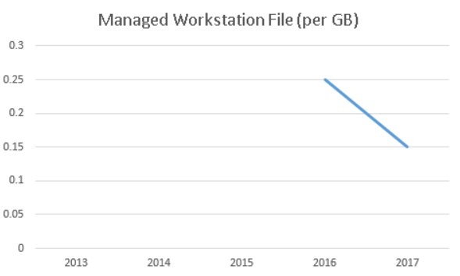
Service $ rate over time

Slide 9
Labor (FTE): 2006, 2014, 2016
Labor in FY06
3 engineers
10 computing specialists
Labor in FY14
1 engineer
6 computing specialists
1 management
Labor in FY17
2 engineers
3.5 computing specialists
1 management
Notes:
This is FTE count not people. I’ve classified that FTE count by position type to make it helpful.
For example, we have 2 FTE of engineering split across 3-6 people depending on what’s needed, and 3.5 FTE of computing specialists split across 5-6 people, et cetera.

Slide 10
Usage over time
Between 2006 and 2014, managed workstation count varied between 2800 and 3000
Today it’s ~3200
File service usage has grown over time with a purge early this calendar year. Current total usage is ~66TB
https://graphs.s.uw.edu/grafana/dashboard/db/nebula-service-metrics

Slide 11
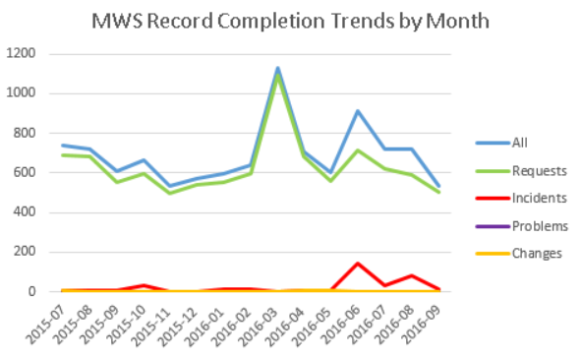
Record rates

Slide 12
Change/Incident/Problem

Slide 13
The “Hachet Man” road begins …

Slide 14
The “Hachet Man” road begins …
Terry Gray has a term I really like: Mean Time to Irrelevance. One of the first things I asked the service owner (UW-IT CTO) when accepting the service manager role was what the expected life of this service was. The answer I got surprised me: 2-3 years.
This set the stage for how I approached the service.
I decided to not share this expected life of the service with the team and start shutting it down. Instead, I decided to take the harder road of fixing it.

Slide 15
Problems: Friction and Deadlock

Slide 16
Problem list, high level
Technical debt
Service definition
Straying from purpose
Customer management
Request fulfillment process documentation
Team dynamics
Personnel

Slide 17
Problems: Technical debt
Long-standing issues of deferred technical design
Primary cause: misguided notions of minimizing impact to customers by prior decision makers
Awareness: Only one perceived this as a problem

Slide 18
Tech debt, details 1
Ancient customized Samba version providing file services
Ancient SCCM
Ancient AV server
Ancient DB server
Slow domain migration in its 7th year, with almost no progress. Holding up many of the other items on this list, plus future imagined enhancements

Slide 19
Tech debt, details 2
Windows + Unix infra. components intertwined
Anti-agile to change
“Dumbed down” both Windows and Unix native features
Not integrated with central IT management mechanism
IT believed intertwined components in MWS
Not enough engineering staff for the amount of technical problems in need of solutions

Slide 20
Problems: Service definition
During the first 3 months, I discovered how poorly defined the service was.
Cause: Lost in history I don’t know.
Awareness: Team and customers had a poor model to understand what customers were paying for. Only customers perceived this as a problem.

Slide 21
Svc Def details
Best definition anyone could give me is “if not everyone asks for that thing, it is consulting” ☹
Definition pretended we provide same value to Macs. Reality: we treat them as one-offs ☹
No details about OS or web browser support; belief we’ll support anything; no differentiated support for preferred OS
Belief we do provisioning & access mgmt. for all IT services to on-board new user at no additional cost
Out of control Exch. support for 1000s with no relationship to MW (past artifact based on awful decision by AVP + friction from Exch svc)
Software Packaging responsibility boundaries are unclear

Slide 22
Problems: Straying from purpose
During the first 6 months, I realized we were doing things that had nothing to do with our core purpose.
Cause: Leadership losing perspective, not enforcing boundaries. Unwillingness to tell customers that we don’t provide this
Awareness: No one perceived this as a problem.

Slide 23
Purpose details
Help Desk transfers phone calls to “our” call center instead of taking basic info and routing ticket—like *every* svcs. Lost consistency, >interruption. ☹
Mechanism to track customer budget for consulting purposes. Finance should provide this.
Unix Print queue & Local printers-Print Svcs is expert
Unix shell, web publishing, and other funny things. What do these have to do with workstations?
Consulting is open-ended “we’ll do anything IT” instead of “we’re the workstation experts, who can provide one-time help if you need something else”

Slide 24
Problems: Customer Management
Who are our customers? Are they still here? Major gap in ability to track customer account info (budget/users/resources). Change Paralysis.
Cause: Lost in history I don’t know, but …
Awareness: Only one was aware
Notes:
Cause speculation: Apathy, poor design putting customers in driver’s seat, no consequences for not doing this

Slide 25
Cust Mgmt details
No “department” lifecycle mgmt when a customer left
No user lifecycle management when a user left ☹
No automated mechanism for budget info by customer account
No mechanism to track key contacts for a department/customer
No mechanism to determine when a user moved departments
Customer security group management lacks sense; if customers asks then we do it ☹
No mechanism to capture & prioritize unmet customer needs

Slide 26
Problems: Request fulfillment process documentation
During the first 3 months, I also discovered how little request fulfillment documentation we had; almost everything was a custom one-off and quality depended on who you got.
Cause: Lost in history I don’t know, but ….
Awareness: Only one perceived this as a problem.
Notes:
Cause speculation: I believe personnel and team dynamics contributed

Slide 27
REQ proc doc details
*No* standard requests defined
Internal docs on various topics w/tech details. meet cust needs consistently & efficiently=fail
Can’t easily transition any given standard REQ from internal fulfillment to customer self-svc fulfillment
Worse problem: most team members can’t or won’t write process documentation. Few bright spots.

Slide 28
Problems: Team dynamics
Long-standing issues of friction within svc team between engineers and support specialists.
Cause: Philosophy/approach mismatch + poor accountability to expectations. Friction was indirectly supported by organizational boundaries.
Awareness: All but two were in denial about these issues.

Slide 29
Dynamics details
Two strong personalities in conflict
Key details like impact of changes not communicated to avoid delays from poor approach buy-in
Only one person on entire team understands service design
Sometimes: Failure to share
But also: Failure to comprehend
Inadequate triaging info passed between tiers
Tier2 wants more interesting work + doesn’t follow Tier3 direction = frustrated when work is taken away
Bottom line: Disagreement about direction …

Slide 30
Problems: Personnel
There were a number of issues here:
Wrong mix of position types (+engineers –computing specialists)
Individuals needing more qualifications for their position
Lack of shared vision about roles and responsibilities
Cause: Poor boundaries + poor svc def + poor clarity about philosophy/approach
Awareness: Within the team, only two saw this. Of customers, only a few saw this. Of non-customers, many seem to know this.

Slide 31
Personnel details
Details here are too personal for me to publicly share and would be inappropriate.
That said, I will say one general thing:
Cost-recovery svc lives & dies on providing relevant value for low cost. It is not just keeping trains running, it is finding new ways to do things cheaper & better. Only being skilled enough to keep trains running isn’t enough.

Slide 32
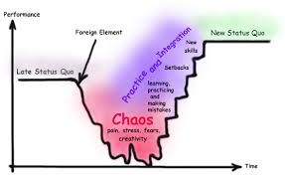
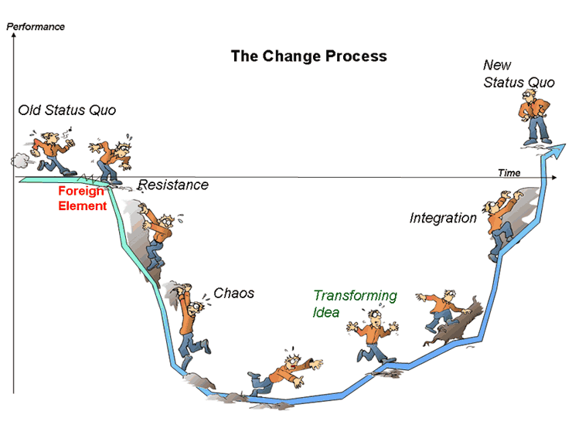
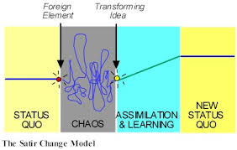
Change means friction, friction means HEAT

Slide 33
Heat: Signs that you are initiating significant amounts of change
Bad marks on collaboration in annual review
Sharp increase in emails from those against change
More escalations to your boss’s boss
Customers ask for more time or wonder which of your changes they should prioritize
You spend time thinking about how much change can be tolerated in a given period of time
You are publishing documentation more quickly
Internal team starts asking for change management ☺
Notes:
These are success or failure indicators—they just are. Change creates friction which creates heat.

Slide 34
Fixes: Tech debt
Latest Samba version providing file services. But this wasn’t planned; major INCs getting to stability ☹
New SCCM in both old domain and central domain. Central domain SCCM still needs work
New AV server in central domain ☺
New DB server; redesign: future DB changes easy ☺
Domain end of life 4/3/2017. Check back next year
Separated Windows/Unix components
Integrated with central IT management mechanism

Slide 35
Fixes: Service definition
Rewrote svc description in catalog. Dropped Macs
Published:
‘What does the MW rate include?’
‘What Exchange Support does MWS provide?’
‘OS and Browser Support’ note EA lifecycle terms
Separated File Svc costs from Managed Workstation rate. Fixed file svc. abuse. Note: this was a huge lift.
Made customers responsible for managing their user’s access
Explicitly told customers, we don’t support:
Group management—Lots of transition outstanding
Printers

Slide 36
Fixes: Customer Management
Created idea of eligibility groups managed by each customer/dept. Automation based on this.
Added “authoritative” contacts for each dept:
Owner, Budget, Tech & tech alternate
Worked with mega-depts on above
Purged 150+ dead departments & 5224 home directories & file access
Added “default” budget mechanism for MWS resources that don’t explicitly get a budget assigned
Added self-service Windows 10 upgrade: wildly successful despite nay-sayers

Slide 37
Fixes: User-initiated OS upgrade

Slide 38
Fixes: Request process docs
Not much positive to share here yet …
Continual Service Improvement emphasis & expectation that all spend some time on this
Growing practice mostly led by svc mgr
Growing use of ServiceNow templates, especially for things we decide *not* to support
Goal here is internal process doc exists, then self-svc customer doc exists
Buy-in has to happen team-wide, and momentum needs to be generated—might take 1-2 years more

Slide 39
Fixes: Straying from purpose
Review latest high-volume consulting thing. If not in purpose, I figure out an exit strategy
Dropped call center, duplicate record system for consulting, printers
Dropped Macs, re-add when we provide value
Will drop some Exch support (~18 mon investment)
Consolidated customer doc platforms
Dropped redundant internal tools, forcing use of PS
Renamed from “Nebula” to Managed Workstation
Published capability map, with “road map” of initiatives

Slide 40
Fixes: Team dynamics
You communicate to everyone on the team:
Eliminated meetings with tier only attendance
Eliminated email lists with tier only membership
Several team discussions about prof. expectations. Participate, communicate, treat others as you’d like to be treated, support each other
Team-wide process of developing roles & responsibilities -> RACI of record
Oft-repeated rule: if you demonstrate initiative & responsibility, I will give you opportunities

Slide 41
Fixes: Personnel
Exhausted my options: Pursued org directors, management chains, got HR advice, worked within broken frameworks, had critical conversations, noted that I could find other resourcing options
1 really excellent junior engineer added 1 year in
2 people left in past year. > scrutiny of new hires
If others leave, re-assess needs
There’s more details, but I’m limited in what I can say ☹

Slide 42
Leadership Lessons learned
Is this the hill I want to die on?
If not, compromise what isn’t important
If it is, do your homework, justify, and push forward
Transparency
Comm. goals, intentions & reasons—esp. to customers
Your philosophy/approach is separate from your purpose
Be clear on expectations and responsibilities
Let go
Delegate if you can (and let them fail)
Invest in people
Increasing your rate of failure is the way to increase your rate of success

Slide 43
Service Mgmt Lessons Learned
Customer Demand Management is under valued
Power to the people!: Self-svc design goal is key
Tools & docs
Align your service with your core purpose
Capability mapping!!
Don’t provide/run stuff outside your purpose
Hold others responsible to fill gaps. Involve customers
REALLY hard/costly to fix after the fact
Int. process docs: consistency + quality OR running blind
Question costs. Partial or delayed answers=bad
Don’t be afraid to raise ‘performance issues’
Jump back

Slide 44
What’s Next
Domain migration
Scalable Windows File Svc, w/ Azure RMS encryption
‘High Security’ Managed Workstation
Transfer SCCM to MS Infrastructure
Retire Samba File services (major transition)
Mac mgd solution (InTune or Casper?)
Scalable cust demand mgmt mechanism (1h mtg/yr w/ each department = 10% cost increase)
Share more of our sunk-cost solutions via no-cost MS Inf. service

Slide 45
Goals
Tell our organizational story around workstation management; entertain & touchpoint for others
Identify and share solution patterns related to organizational and technical debt

Slide 46
Questions?
Key slides:
What Managed Workstation provides 2016
Leadership Lessons learned
Service Mgmt Lessons Learned
What’s Next

Slide 47
The End
Brian Arkills
barkills@uw.edu
@barkills
@brian-arkills
http://blogs.uw.edu/barkills
https://itconnect.uw.edu/wares/nebula/
Author of LDAP Directories Explained

