Slide 1
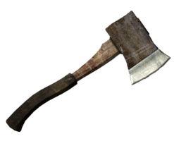
Managed Workstations: The Hachet Man’s Story October 2016
Brian Arkills
Microsoft Solutions Architect
Microsoft Infrastructure Svc Mgr
Managed Workstation Svc Owner
UW-IT, Identity and Access Management
Microsoft Directory Services Enterprise Mobility MVP 2012-2016

Slide 2
The “Hachet Man” road begins …

Slide 3
Goals
Update on http://staff.washington.edu/barkills/managedWorkstationsTheHachetMansStory.pptx
Slides limited to key changes

Slide 4
What Managed Workstation provides 2016
Managed Workstation rate $34.50
AD domain (will be gone in 2017, adopt central service)
Image + lite-touch network deployment
SCCM & software packaging (will transfer this to central service in 2017)
WSUS based patching
Windows Server based VPN (may eliminate this in favor central offering)
Reporting (Self-service web portal)
Training room, first come-first served
Samba file services, home directory & shared. Snapshots. $.15/GB/month
Windows file services. $.37/GB/month
Support/Assistance consulting $98.50/hour
Group pine email solution (to be retired in next year)
Your one-off kitchen sink thing ONLY if:
No one else is the SME for that capability
You don’t expect us to support it in the future, i.e. this is a one-time thing
We haven’t explicitly documented we won’t do this

Slide 5
Service $ rate over time
Notes:
Previous rate deliberations were driven by central IT finance, this year I seized control
Had 4 new rates to propose
Put together detailed cost breakdown, assigning each cost (including labor) to rates
This gave a starting point for a rate, which I then tweaked for a variety of reasons that the pure numbers didn’t reflect
First year we got >10% reduction in rate, despite running up a surplus every year for ~5 years

Slide 6
Labor (FTE)
FY06
3 engineers
10 computing specialists
FY14
1 engineer
6 computing specialists
1 management
FY17
2 engineers
6.5 computing specialists (only got 5.5)
1 management
FY18
3 engineers (only 2 today)
4.9 computing specialists (only 3.9 today)
1.2 management

Slide 7
Labor (more)
Lost two tier 2 folks over past 3 months, one of which had been on medical leave for 9 months
Signaled intention to shift team labor make-up early in FY18 budgeting process, adding one engineer, subtracting one from T2
Took months for executives involved to figure out how to shift, but this is critical for future success
More of this kind of shift may be needed in the future

Slide 8
OS over time

Slide 9
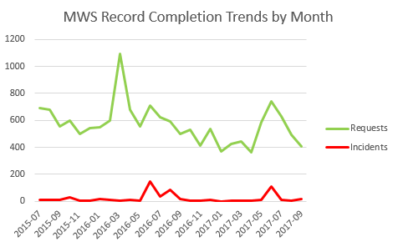
Record rates

Slide 10
Heat: Signs that you are initiating significant amounts of change
Bad marks on collaboration in annual review
Sharp increase in emails from those against change
More escalations to your boss’s boss
Customers ask for more time or wonder which of your changes they should prioritize
You spend time thinking about how much change can be tolerated in a given period of time
You are publishing documentation more quickly
Internal team starts asking for change management ☺
Notes:
These are success or failure indicators—they just are. Change creates friction which creates heat.

Slide 11
Improvements
All workstations migrated to central AD! ☺
Our first ADMT failure
James creates PS based migration in flight
SCCM in central domain
Refreshed group policy & new firewall settings
Deployed LAPS
Updating OS lifecycle support policy & implementing new, shorter cycle practices
Half-dozen standard request forms
Team dynamics

Slide 12
Tough problems
Still “unnoodling” consulting “ownership” within central IT
Org soul-searching re: Executive/VIP support
Encouraging central IT finance to provide adequate billing capabilities
Managing to the organization’s poor labor budgeting practices
Vendor Intel Fix

Slide 13
Success factors
Transparency
Failure is OK: increasing your rate of failure is the way to increase your rate of success
Align with customer needs
Design to scale; self-service
Value & cost are very important; consider them in all communication

Slide 14
What’s Next
Scalable Windows File Svc
LastPass Enterprise
Up our security game (M365 A5?)
Defender ATP
Add AIP encryption
Other MS security enhancements …
Transfer SCCM & OS imaging to MS Infrastructure
Meet with all customers to hear needs
Retire Samba File services (FY19)
Kumo

Slide 15
The End
Brian Arkills
barkills@uw.edu
@barkills
@brian-arkills
http://blogs.uw.edu/barkills
https://itconnect.uw.edu/wares/nebula/
Author of LDAP Directories Explained

