Slide 1
FERPA and Active Directory
Brian Arkills
Software Janitor, LDAP geek, AD bum, and Associate Troublemaking Officer ☺
Notes:
>

Slide 2
Agenda
Me
What is FERPA? What has changed?
Educational records and directory info
Opt out
What does FERPA mean for AD implementations?
AD users
FERPA-related groups
Exchange-enabled FERPA-related groups
Notes:
>

Slide 3
Who I am
Pesky poster on windows-hied list
Worked at Stanford
At the UW, I:
avoid problems that James Morris identifies
help engineer a managed desktop service
help engineer other Windows platform services
bungle my way through code writing
Wrote a geeky book
Good with AD
Have pretty good research skills
Notes:
>

Slide 4
Notes:
>

Slide 5
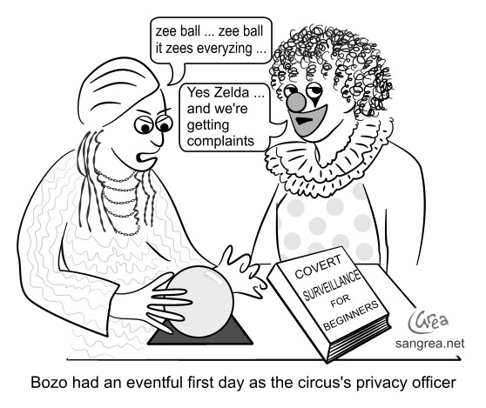
Who I am not:
Legal authority
From the feds
An expert on FERPA
Your magic crystal ball
Notes:
I’m more of a layman on FERPA

Slide 6
FERPA is about privacy, right?

Slide 7
FERPA history, related legislation, and related events
Family Educational Rights and Privacy Act (20 U.S.C. § 1232g; 34 CFR Part 99) federal law enacted in 1974.
Student Right to Know Act of 1990
HIPAA (1996) has relationship (student treatment records)
Campus Sex Crimes Prevention Act (2000)
Patriot Act (2001)
Solomon Amendment (2002)
Your state laws
2007 Virginia Tech shooting findings pointed at confusion around privacy laws as significant barrier
This prompted DoEd rework of regulations just released (2009)
Notes:
SRTKA=general stats about a university that an applying student may want to know. May require access to student educational records to collate these stats, but no direct info is revealed.
SA=Military recruitment requests can get FERPA protected info.

Slide 8
What is FERPA?
Provides access to students (or their guardians) to their educational records.
Provide students with a process to amend educational records
Provide students some control over release of their educational records
Applies to all (US) educational institutions, not just universities.
See http://www.ed.gov/policy/gen/guid/fpco/index.html for links to final FERPA regulations.
Notes:
Apologies to our canadian and german attendees

Slide 9
So info goes in but doesn’t go out

Slide 10
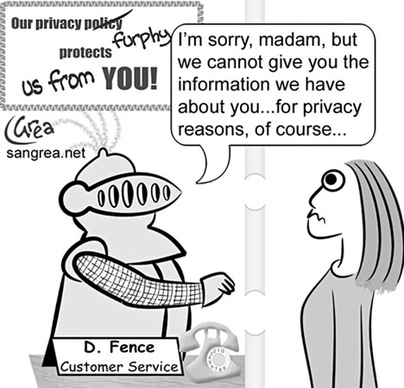
Ferpa protects students from this

Slide 11
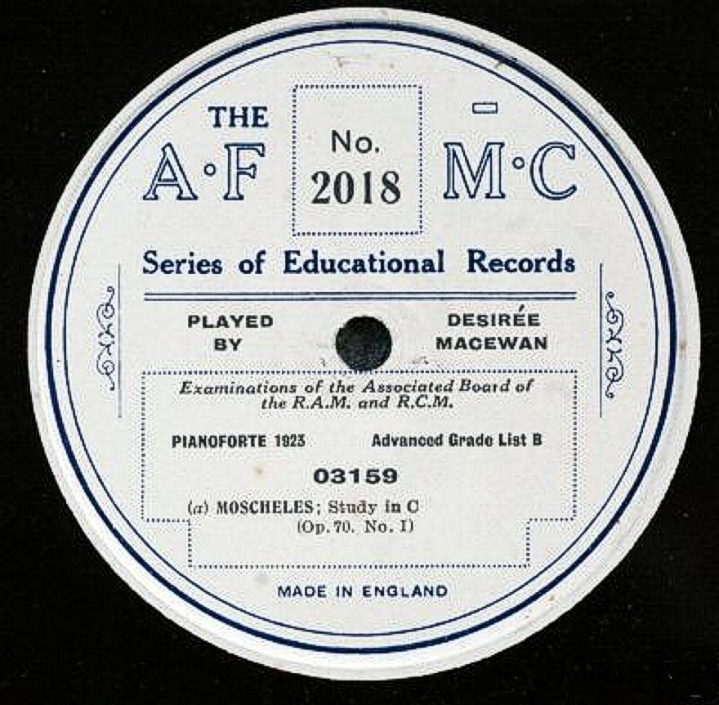
Educational record: what is it?

Slide 12
Education records-what it isn’t
Not sole possession records i.e. individual memory aids
Not personal knowledge, i.e. a custodian knows that student X throws up repeatedly
Not law-enforcement records
Not scrubbed education records, e.g. SRtKA stats
Not alumni records or info related to person after graduation/enrollment termination.
Not treatment records from campus health centers (see next slide)
Notes:
Alumni records not covered, but alumni records are: info not related to student academic record, i.e. when student was active
From Federal Register/Vol. 73 No 237, p.74845

Slide 13
Education records-what it is
Info kept as part of official student record, e.g.:
Course enrollment, grades, GPA, academic awards, athletic involvement, contact info, major, degrees, past educational history, attendance dates
Disability records
Personal info and directory info is part of educational record, but has special status.
Special case: Covers medical/psychological treatment records from campus centers, *superceding* HIPAA. Not education records, but are covered by FERPA; student does *not* have a right to review treatment records. University hospital records are HIPAA covered.

Slide 14
Exceptions
Faculty, staff, contractors, and students acting on the institution’s behalf can be granted full access if they need access to do their job.
Other educational institutions, if student has applied /enrolled there.
Published “directory information”, unless student opts out.
Disciplinary offense announcements
Court subpoena, usually requires student notification.
Parental disclosure in limited situations, e.g. alcohol/drug violations (if under 21)
To “appropriate parties” (includes parents) in a health or safety emergency
Military (recruitment requests per Solomon Act)
Attorney General per Patriot Act
Various local authorities AND victims per Campus Sex Crimes Prevention Act (2000)

Slide 15
Enforcement

Slide 16
Enforcement and penalties
US Family Policy Compliance Office (FPCO) enforces compliance
No provision requiring notification of a breach*
Individuals can not be prosecuted for a breach
Students can not sue for damages
Federal money can be withheld from a violating institution, but this has never happened
Emergency health-or-safety issue now addressed, has had several lawsuits. MIT, Allegheny College.
Shady universities can hide behind FERPA lack of enforcements. See http://www.ferpa.us/about.html
Notes:
From Federal Register/Vol. 73 No 237, p.74843: "The Department does not have the authority under FERPA to require that agencies or institutions issue a direct notice to a parent or student upon an unauthorized disclosure of education records. FERPA only requires that the agency or institution record the disclosure so that a parent or student will become aware of the disclosure during an inspection of the student’s education record."

Slide 17
Directory info
Annually each institution defines what it considers public info
Each student can choose to limit release of their directory info. This choice must be respected after graduation/past enrollment.
Some personal ID info can not be released without explicit written consent, e.g. SS#s, race, ethnicity, nationality, gender
Some educational info can not be directory info, e.g. transcripts, grade reports
Notes:
Must honor request to opt-out after student leaves, but don't have to notify about changes to practices
From Federal Register/Vol. 73 No 237, p.74849

Slide 18
Directory info examples
Name, address, telephone listing, email address, photograph, date and place of birth, major of study, grade level, enrollment status, dates of attendance, participation in offical activities/sports, degrees, honors and awards, most recent educational institution attended.
May NOT include: social security number
May or may not include: student ID number, user ID, other university ID numbers. Depends on how access to educational records is provided. DoED estimates are <5% of teachers publish grades using just ID.

Slide 19
UW Directory Info
Student's name
Street address
Email address
Telephone number
Date of birth
Dates of attendance
Degrees and awards received
Major and minor field(s) of studies
Class
Participation in officially recognized activities and sports
Most recent previous educational agency or institution attended by the student
Weight and height, if student is a member of an intercollegiate athletic team
Notes:
http://www.washington.edu/students/reg/ferpa.html

Slide 20
Sharing time
Call out your most interesting bit of info that is defined as “directory info”.
Notes:
>
Backup: call out how many students or percentage that opt out. Feel free to raise hand and interrupt later.

Slide 21
FERPA does not guarantee anonymity
"... opting out does not prevent disclosure of the student’s name, institutional e-mail address, or electronic identifier in the student’s physical or electronic classroom."
From Federal Register/Vol. 73 No 237, p.74847

Slide 22
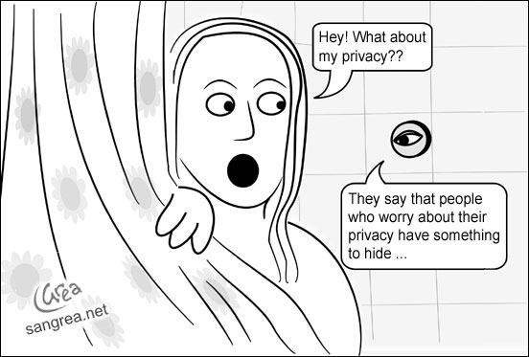
Desire for privacy depends on what

Slide 23
FPCO: Opt Out should happen infrequently
Estimates .1% (one tenth of one percent)
May carry implications that student can not use “simple” FERPA processes
May carry implications that student can not use electronic communications or have digital identity
At UW, ~15% of students choose to opt-out.
Please call out opt-out rates at your university.
Notes:
I suspect that many schools do a poor job explaining what a directory opt out means, and having an adequate level of controls for opting out of only part of their “directory info”.
I also suspect they have underestimated the rate, re: basic concerns about privacy (especially in the face of identity theft)

Slide 24
Opt out happens too often

Slide 25
Better Opt out guidance needed
My coworker calls opt out the “ruin your life” button.
Guidance on what it means is usually cursory or poor
Students don’t realize that this means that future employers will not be able to validate their degree status

Slide 26
An example of good opt out guidance
“Students who wish to restrict directory information should realize that their names will not appear in the commencement bulletin and other university publications. Also, employers, credit card companies, loan agencies, scholarship committees and the like will be denied any of the student's directory information and will be informed that we have no information available about the student's attendance at MIT. Students who wish to have specific directory information released may do so by providing a written authorization to the Registrar's Office.”
Notes:
Comes from MIT ☺

Slide 27
Beyond Background to Analysis
Each university has a different landscape with the following significant variables:
Legal counsel interpretation
Directory information definition
How your university handles access to educational records, e.g.
How do faculty post grades?
How do faculty return graded papers, exams, etc.?
What process does someone go through to get access to educational record? What are the authorization factors required? (there might be different factors for different portions)

Slide 28
Biggest pain point (for IT) is “Opt Out”
New regulations talk about “Reasonable methods” which includes administrative policy (as opposed to technological controls)
Regulations say reasonableness (i.e. strength) should vary depending on:
the likelihood of targeting for compromise
the harm that could result
Examples
Notes:
Chelsea Clinton at Stanford had extreme level of protection.
Vs.
Info that is more likely to be in the public record can have less controls around it.

Slide 29
Microsoft Help?
Microsoft IT Compliance Management Guide (a solution accelerator) covers:
Sarbanes-Oxley Act (SOX)
Gramm-Leach-Bliley Act (GLBA)
European Union Data Protection Directive (EUDPD)
Payment Card Industry Data Security Standards (PCIDSS)
Health Insurance Portability and Accountability Act (HIPAA)
But not FERPA. But there really aren’t detailed solutions in this guide. Instead a framework.
Does reference:
Microsoft Exchange Server 2007 Compliance Tour
and
Windows Server 2008 Security & Compliance Technologies
But neither is really useful to FERPA
Doesn’t reference:
Windows Server 2008 Security Guide, which is another solution accelerator (but it should)
Notes:
>
Exchange compliance tour: http://www.microsoft.com/exchange/evaluation/compliance/compliance-tour.mspx
WS2008 Compliance (slide deck from MS partners):
http://go.microsoft.com/fwlink/?LinkId=130616
WS2008 Security guide:
http://technet.microsoft.com/en-us/library/cc264463.aspx

Slide 30
Where rubber hits road: AD
General approach is to put all or most AD related info into your definition of directory info.
Opt out only a problem if you publish info that can be publicly correlated to educational record info, i.e. can someone connect the dots and determine something about their educational status/record?

Slide 31
Problem points on user accounts
eduPersonAffiliation=student *
memberOf=2009win-physics101
Anything related to PII
Anything related to directory info
Anything related to educational record
Notes:
Can name be published anyway? No, but if no other AD attributes lead to educational record, and that info also comes via another relationship then maybe you can
eduPersonAffiliation=student is a violation, unless the entire attribute is private OR someone can’t tie a given directory entry back to a person (unlikely)
eduPersonAffiliation=alumni seems to be a loophole

Slide 32
User account info
What to do on AD user when student opts out:
Get student consent to publish critical part of dirInfo
Use netid only, assuming there is no other directory which links identity to netid
For high-risk students, allow a second set of bogus dirInfo that is not publicly correlated to other identifiers, to enable account
Don’t give them an account
Other ideas?
Notes:
#4 comes from discussion on FR Vol. 73, No. 237, p.74811

Slide 33
Course, student major, and other educational record groups
Two known solutions presented last year. See http://www.windows-hied.org/Conf2007/HiEdConf2007FillInTopics-Barkills.pptx . Either: change user and group objectclass definitions to exclude default ACLs OR: Empty “pre-windows 2000 compatible access group” and use inherited deny ACE.
NOTE: Privacy on these may be subject to whether you have opt out, and whether the relevant data is in your DirInfo
Notes:
Keys are:
-both group member and user memberOf attributes must be addressed
-can’t ignore default ACLs via schema
May need to address consequences, e.g. giving admin staff access to read user objects.
Does anyone have open course groups, b/c all opt-out students don’t have user accounts?
How many people have AD course groups?
How many want AD course groups?

Slide 34
Exchange enabled course groups
Exchange enabled course groups haven’t been attempted until the past year. Problem is that Exchange needs access, but can leak information via interfaces like OWA Address Book.
Since last year two solutions have emerged:
Use dynamic distribution groups to target a private user attribute value pair that indicates course enrollment.
Exchange enable the security groups from above and mark them as ‘hidden from all address books’.
Notes:
How many have exchange course groups?
How many want exchange course groups?
How many would never have exchange course groups?

Slide 35
The End
Brian Arkills
barkills@washington.edu
http://www.netid.washington.edu
http://sharepoint.washington.edu/windows
Author of LDAP Directories Explained

