Slide 1
Azure Active Directory: In the middle of organizational friction October 2016
Brian Arkills
Microsoft Solutions Architect
Microsoft Infrastructure Svc Mgr
Managed Workstation Svc Owner
UW-IT, Identity and Access Management
Microsoft Directory Services Enterprise Mobility MVP 2012-2016

Slide 2
Goals
Review Azure AD Architecture & features
Tell our organizational story around AAD; entertain & touchpoint for others
Call out AAD pitfalls vs. solvable problems; share lessons learned

Slide 3
What is this thing!?

Slide 4
Azure Active Directory
AD revised to Internet-scale multi-tenant identity service
Extends AD into cloud; cloud –based identity
Connect from any platform, and device
Connect hundreds of SaaS apps or your on-premises apps
Cloud App
SharePoint
Online
Exchange
Online
Cloud App
Azure
AD
Lync
Online
Your
Custom IT App
AD
Notes:
General diagram. Shows relationships between AAD, SO AD, EO AD, LO AD. Includes public interfaces to each.

Slide 5
Azure AD Architecture
https://itconnect.uw.edu/wares/msinf/design/arch/aad-arch/
Jump

Slide 6
AAD Graph & MS Graph
RESTful web svc AAD interface; LDAP but modern ☺
AAD Graph has deeper AAD capabilities; MS Graph has broader product data
New AAD PS module connects to this
https://graphexplorer.cloudapp.net/ = LDP.exe
Will demo AAD Graph Explorer in demo fest … ☺

Slide 7
AAD STS & OAuth server
STS does not do OAuth2—that’s the AAD OAuth server, but minor point ☺
Appendix: O365 AAD STS dance with federation. Note: Don’t include OAuth2 to get an access token
Protocol | Purpose | Details
REST/HTTP directory access | Create, Read, Update, Delete directory objects and relationships | Compatible with OData V3 Authenticate with OAuth 2.0
OAuth 2.0 | Service to service authentication Delegated access | JWT token format
Open ID Connect | Web application authentication Rich client authentication | JWT token format
SAML 2.0 | Web application authentication | SAML 2.0 token format
WS-Federation 1.3 | Web application authentication | SAML 1.1 token format SAML 2.0 token format JWT token format

Slide 8
AAD Connect, AAD Dirsync & others
Y’all know about these … these are over-covered so let’s move on ☺
One often overlooked point:
Bi-directional sync

Slide 9
AAD Device Registration Service
This is an under-emphasized AAD system; does what its name suggests
Responsible for:
AAD device join
AAD workplace join
Some MDM capabilities
Certificate issuance related to the above for the purposes of Enterprise Data Protection
NOTE: only one MDM provider per tenant; must contact MS to change it.

Slide 10
Conditional Access
Provides access control on act of issuing logon token. If X=true then issue token or if Y=true, then don’t issue
Requires AADp
We haven’t yet used this, but it is a powerful feature, and we are exploring using this for scenarios where we need to lock down access b/c of legal or risk instead of disabling user account

Slide 11
RBAC, Roles, AUs
This is an under-emphasized feature of AAD that allows delegation of permissions
Works just like Exchange RBAC “triangle of power”:
Define scope of affected objects = Administrative Units
Define scope of permissions = Roles
Assign RBAC permissions connecting AUs to Roles
Assign users to Roles
Built-in Roles handle #1-3 for you; but
you can create your own
PIM, Privilege Identity Management for ‘just in time’
Ever growing # of AAD, O365, Azure built-in roles

Slide 12
AAD App Proxy
Cloud based endpoint that MS secures
Can add Conditional Access & Azure MFA goodness in front of existing apps
Can easily re-invigorate existing IWA apps w/o touching their code
Only requires AAD basic ☺
Downsides: doesn’t yet support RD Gateway
Piloting this, but: solution looking for customers

Slide 13
Group based licensing
Assign AAD and EMS licenses to AAD users via a group
Requires AADp (on which users?)
We are using this with our EMS licenses and may also use it for AAD Basic (if dedicated groups are supported)

Slide 14
AAD Cloud App Discovery
Allows discovery of what SaaS apps are being used/accessed by your population
Client agent or Proxy-based
Enables better mgmt decisions, e.g. invest app X integration? mitigate risks with app Y?
Legal or “creepy” issues … proceed with caution
Requires AADp, may be a O365 version (Ignite announcement)
We aren’t using this yet, but highly interesting

Slide 15
Risk Reporting & Auditing APIs
Variety of canned risk reports, with mitigation actions in portal
Little documentation of what goes into evaluation ☹
Raw audit and signin events events now available via audit API (public preview)
We don’t use canned reports; we are actively building integrations to APIs
Note: MS has lots of new stuff here I haven’t evaluated

Slide 16
AAD B2C
Separate directory in your tenant
Primary Use: Identity solution for a single web app
Same AAD capabilities, but also provides identity registration and accepts some “social” identities. Expect these to grow.
Pricing is per-authN + per-user. Pretty cheap.
Huge potential. There is a good reason this is where Stuart Kwan is spending his time …

Slide 17
UW’s story

Slide 18
Shouldn’t Office 365 own AAD?

Slide 19
Resolution: Ownership
Enterprise Architecture brings IAM, O365 and AD teams together for 12 hours.
Acknowledge overlapping capability interests.
AD team continues to own.
AAD governance team of 9-10 to resolve sticky issues.
Governance team charter with specific goals: utility, capability, recommended uses, config decisions.
Gov team meets biweekly for 3 months to get up to speed, then monthly. 9 months later, Change Advisory Board spun up.
Outcome: Broader understanding of AAD technology & issues. ☺ But high cost—I spent tons on this. ☹

Slide 20
AAD Governance Work Products
Technical architecture diagram (both the generic one you’ve already seen and a UW specific one)
Capability map – EA & stakeholders wanted this, but no standard approach. These are intended to facilitate conversations with customers. We are one of only two UW-IT services to publish ours.
AAD tenant utility guidance – What is it good for? When do you get one?
Customer orientation documentation – Terminology and FAQ
Many decisions about specific capabilities & settings
Jump

Slide 21
UW’s AAD Capability Map
https://itconnect.uw.edu/wares/msinf/design/azure-ad-capability-map/
Jump

Slide 22
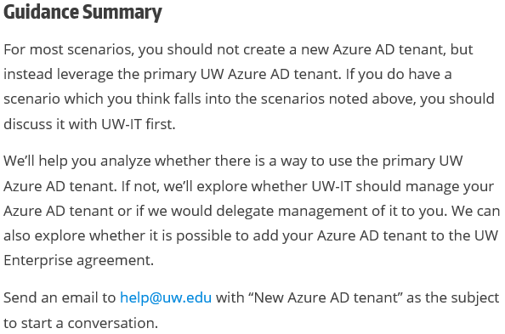
When should a new AAD tenant be Created?
https://itconnect.uw.edu/wares/msinf/aad/new-aad-tenant/
Visit this page—good discussion section which may help your university
Jump

Slide 23
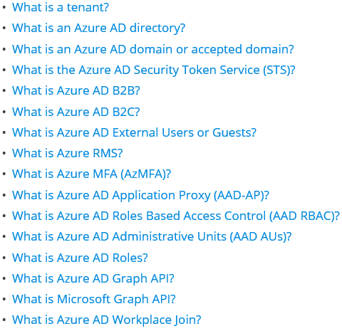
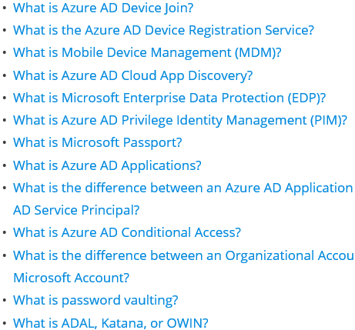
AAD Terminology & FAQ
https://itconnect.uw.edu/wares/msinf/other-help/faq/aad-terms/
Jump

Slide 24
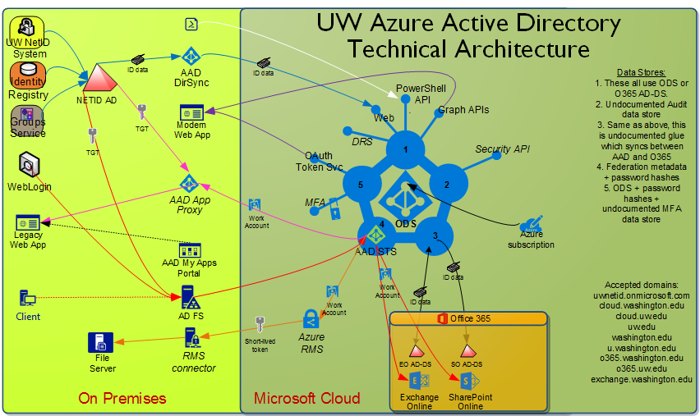
UW’s AAD Architecture Guide
https://itconnect.uw.edu/wares/msinf/design/arch/aad-arch/
Jump

Slide 25
Azure VMs: AAD Domain Services or DCs in Azure? Or …?
First question we heard about Azure & AD
Continues to be a source of broad confusion: don’t we need a cloud AD for Azure based VMs?
We think AAD Domain Services isn’t particularly useful in its current form
We’ve thought about sticking a DC or two in Azure as a VM. MS added VM encryption=good. We haven’t prioritized this, but I expect we’ll end up doing this in the next couple years.

Slide 26
AAD-DS: AAD Domain Services
You end up with something like AD-DS, but in the cloud. Has LDAP and Kerberos endpoints.
It is automatically provisioned based on AAD data
You can’t administrate this like AD-DS
No ACLs,
No ability to directly create users/groups,
Only 1 GPO!! ☹
The endpoints are on a single Azure VNET
Requires AAD Premium (but how many?)
Bottom line: it’s cheaper to stick DCs in Azure & you remain in control

Slide 27
AAD-DS: GA 10/12/2016
Significant features added:
LDAPS support, including option to open up this endpoint to internet
Custom OUs possible
AD-integrated DNS management
Non-Windows domain join
Automated sidHistory in provisioning sync
Azure virtual network peering support
MS resumes “lift and shift” pitch
Still lacks flexibility and control, but looking more interesting

Slide 28
OAuth2 & AAD Apps!!!
How could we possibly trust users?

Slide 29
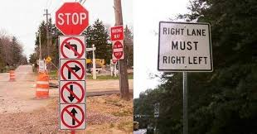
How do Azure AD apps work?

Slide 30
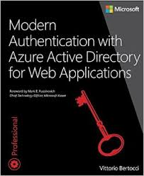
Azure AD app answers
https://itconnect.uw.edu/wares/msinf/aad/apps/
Note: We still have some open questions that MS has not answered. We suspect these are one-offs used by specific product teams (Office).

Slide 31
AAD App key knowledge
This is an IDENTITY, not code!!
There are at least two objects for every AAD app:
Application
Service principal
Application object lives in “home” tenant of developer (or for MS gallery, in MS’s tenant)
SP object lives in “your” tenant
App object defines required OAuth2 perms
SP object lists granted OAuth2 perms
2 levels of OAuth2 permissions: User or Admin

Slide 32
AAD App key knowledge, part 2
Authenticator for code: Password or certificate
URIs registered; many pieces of code can re-use same app identity
Group based assignment to limit access (AADp)
Multi-tenant or single-tenant
Role definition possible (roll-up of defined permissions)
Lots more … an entire book’s worth ☺

Slide 33
AAD Apps: the problem
Default tenant config allows any user to add Apps + any user to allow a given app access to their data in other AAD apps. So self svc creation + consent.
When several that required perms to EO & SO showed up, alarms were raised by our O365 folks who wanted to provide a HIPAA compliant solution for our giant hospital system. Possibility of HIPAA data flowing through non-BAA covered apps!!

Slide 34
AAD Apps: Disable it until we can make it conform …

Slide 35
AAD Apps: Gatekeeper approach
All AAD apps go through request, risk analysis, approval process.
Outcome: Only a few go through process, don’t like how long it takes. Many apps desired but not available. Business is not happy.

Slide 36
AAD Apps: But wait …
SO/SM consistently advocate for ‘Monitor and Mitigate’ approach, matching our approach for *every* other type of application
Over time …

Slide 37
AAD Apps: A happy ending?
New O365 service owner prefers ‘monitor and mitigate’ approach, so we should soon next week move back to the tenant defaults. Yay!!
This still means AAD apps which require “elevated” app permissions need a tenant admin, and will go through our more extended risk analysis approval process. But that’s a 80/20 thing – or more likely a 99/1 thing.

Slide 38
AAD Apps: Monitor and Mitigate
Move back to AAD tenant app defaults, i.e. self-svc creation + consent=on
Build app that watches AAD for new apps and SPs with “risky” perms
Allow stakeholders to identify new risky perms
Disable new risky apps for full risk review
Build tool for stakeholders to audit consent permissions by individuals
“Risky” apps -> Prior approach used, unless stakeholder for “appB” accepts risk
https://wiki.cac.washington.edu/x/YTWIB

Slide 39
Azure MFA: the only way for AAD apps?
At face-value, it appears that:
If you federate with AAD, you can’t use your MFA solution for your on-premises IdP without requiring all AAD apps to do MFA or use Azure MFA
We believe there is a solution here:
Azure AD Conditional Access + special “MFA” claims issued by your IdP + tricky details = per AAD app MFA w/o Azure MFA.
Note: AAD Conditional Access requires AADp1 license.

Slide 40
AAD B2B , i.e. external users
Acronym hell. ☹
This is the ability to invite users from another AAD tenant or Microsoft Accounts to have a “SID” in your tenant, and thus be able to share resources that require an AAD logon token from your tenant
This is extremely-not-mature (Ask Brian Puhl how he feels about this)
But it also is the only way to share without owning identity credentialing for those outside your university

Slide 41
AAD B2B, part 2
We deliberated extensively, getting confused on the difference between SO vs AAD configuration
We talked with the product team about what we thought was missing. List of ~30 items, mostly around UX and lifecycle management, but also “golden ticket”
We felt we had no choice but to allow this, despite known problems. This is technical debt, and we assume MS will help us pay that debt.
MS seems clued into “external user attestation” & “golden ticket”, but not the UX ☹

Slide 42
AAD Device Join: Great, right? Uh …
No value here—yet
Our BYOD users have other existing ways to integrate
MS notes that AAD device join isn’t yet appropriate for enterprise managed devices
No new significant capability offered
So after quite a bit of research into the difference between AAD device join, AAD device registration, and AAD workplace join, we blocked AAD device join, but allow the others
Future changes are dependent on MDM futures
Note: Device sync from AAD -> AD requires AADp1
https://jairocadena.com/

Slide 43
AAD licensing
As an AAD with more than 500K objects and some unknown number of O365 licenses, are we out of compliance? No joke: I spent 2 years asking the product teams this.
Resolution: Asked Alex Simons in person + follow-up “marketing PM” phone call. Within 2 months, documentation updated to clarify. Also got email documentation that Microsoft believes we can ask for O365 licenses for any individual we give an identity to.

Slide 44
AAD licensing: but wait, there’s more …
We can’t afford AADp1 licenses for all 800K users, nor do we think it is anywhere near worth that money
Context: that’s 10x our total MS spend at the deepest discount we know MS has ever offered on that SKU
Something is deeply broken here, and the way MS is organized I don’t see it getting fixed soon
Resolution (for now): Heavily leverage AAD Basic capabilities, sprinkle in some judicious use of AADp1 licenses for admin scenarios, cost-recovery for others
Means BYO for AADp only solutions: some sync scenarios, some security reporting

Slide 45
AAD Groups
This is a worse mess than AAD apps ☹
The issues:
No member privacy, except for non-Yammer Office groups
Office group namespace controls
Office group sync non-existent
Office groups are not “security groups”
Attractive features like Planner rely on Office groups
AAD external users can be in AAD groups, but not AD groups; how do you manage that!?
Various nested group scenarios don’t work + poor docs
MS assumes it’s only group management game in town
Back sync to AD for AAD created groups
Office team and AAD team need to get on same page as customers—may take long time ☹

Slide 46
AAD Groups, part 2
I have no resolution here. This depresses me deeply.
OK … I have some potential resolution, but it is painful & costly:
Build custom group sync engine against AAD graph. Have it do the right things & connect to our Grouper.
Stop doing *all* group sync via AAD Connect.
Drop all AAD users except students + employees & convince data custodians to allow some broad categories of member private groups to go in AAD
Can’t really recommend at this time but give it a year.

Slide 47
IdP/STS Wars: ADFS vs Shib -> AAD vs Shib?
For application integration, which identity provider is preferred?
The tension point used to be ADFS vs. Shibboleth. Now the tension point is AAD vs. Shibboleth
Resolution: We don’t have one yet, but I suspect the resolution will be to document ‘by scenario’ recommendations, with Shibboleth continuing to be the answer 95% of the time for the next 3 years. Beyond that, I suspect cloud-based IdPs will rule.

Slide 48
Early AD Lessons Re-learned
Ownership wars -> Leadership buy-in
Utility guidance needed
# of Admins … unfortunately MS needed to relearn this first ☹
Gov team: sustained invest -> momentum + insurance i.e. Trust in configuration decision-making is earned over time; best to build governance with concerned parties until they trust
Constructive talks re: MS licensing=mythical pink unicorn – it may exist, but we haven’t seen it yet
Notes:
ITIL term – Utility: what is it good for?

Slide 49
New Lessons Learned
Develop and publish guidance
AAD app risks – be aware and make others aware
New cloud & hybrid models deserve careful/critical thought
“Presume breach”—Aggressive MS innovation means:
Active discovery or unprepared, e.g. nested groups
Analyze(lite) shiny against your needs: share results
Turn things off that MS deploys enabled -> evaluate
Many design assumptions don’t fit HiEd; + voices needed
poor cross MS prod team practices mean must engage Office+
Flexibility
new arch approaches re: cloud-based IAM vs on-premises IAM

Slide 50
What’s Next
Complete & share AAD App approach
AAD DirSync -> AAD Connect
Watch & agitate re: AAD groups
Call out broken AADp cost approach for Ed sector; + pressure by sharing workaround solutions
Develop AAD audit API based solutions
User login reporting & Last logon for inactive user initiative
AAD App, Role, Policy change event alerting
AAD user consent reporting (e.g. HIPAA regulated employee granted access to what apps?)
License automation + integration

Slide 51
Goals
Review Azure AD Architecture & features
Tell our organizational story around AAD; entertain & touchpoint for others
Call out AAD pitfalls vs. solvable problems; share lessons learned

Slide 52
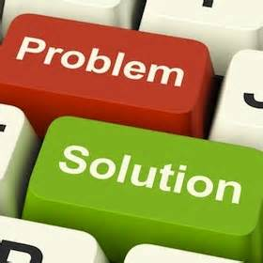
Questions?
Key Slides:
AAD Architecture
AAD Gov Work Products:
Capability Map
Tenant Guidance
Terminology
Architecture Drawing

Slide 53
The End
Brian Arkills
barkills@uw.edu
@barkills
@brian-arkills
http://blogs.uw.edu/barkills
https://itconnect.uw.edu/wares/msinf/
Author of LDAP Directories Explained

Slide 54
AuthN flow (Passive/Web profile)
Customer
Microsoft Online Services
User
Source ID
Azure Active Directory
Logon (SAML 1.1) Token
UPN:user@contoso.com
Source User ID: ABC123
Auth Token
UPN:user@contoso.com
Unique ID: 254729

Slide 55
AuthN flow (MEX/Rich Client Profile)
Customer
Microsoft Online Services
User
Source ID
Azure Active Directory
Logon (SAML 1.1) Token
UPN:user@contoso.com
Source User ID: ABC123
Auth Token
UPN:user@contoso.com
Unique ID: 254729

Slide 56
AuthN Active flow(Outlook/Active Sync)
Customer
Microsoft Online Services
User
Source ID
Azure Active Directory
Logon (SAML 1.1) Token
UPN:user@contoso.com
Source User ID: ABC123
Auth Token
UPN:user@contoso.com
Unique ID: 254729
Basic Auth Credentilas
Username/Password

Slide 57
AuthN Regroup/Review
EO/SO/LO only trust logon tokens issued by AAD
In “bouncy slides” token issued b/c AAD trusts ADFS
AAD knew user@upn.com meant your ADFS server
Some clients/protocols can’t do federated authN, so service does them on behalf of client. Note: pwd sent over wire to service
Just as easily could not federate, with pwd in AAD (pwd would always go over wire then)
Multiple places to layer additional authN interactions (e.g. MFA or consent). Also multiple places to troubleshoot, if things go wrong

Slide 58
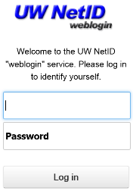
UW: Example AuthN flow
UW
Microsoft Online Services
User
Source ID
Logon (SAML 1.1) Token
UPN:user@uw.edu
Source User ID: XYZ987
Logon (SAML 1.1) Token
UPN:user@uw.edu
Source User ID: ABC123
Auth Token
UPN:user@contoso.com
Unique ID: 254729

