Slide 1
Azure Active Directory: In the middle of organizational friction October 2016
Brian Arkills
Microsoft Solutions Architect
Microsoft Infrastructure Svc Mgr
Managed Workstation Svc Owner
UW-IT, Identity and Access Management
Microsoft Directory Services Enterprise Mobility MVP 2012-2016

Slide 2
Goals
Update on http://staff.washington.edu/barkills/aadInMiddleOfOrgFriction.pptx
Slides limited to key changes + a couple key slides

Slide 3
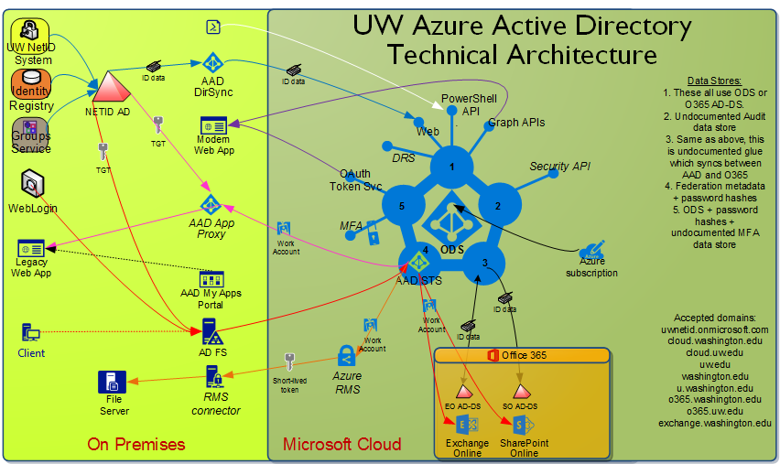
UW’s AAD Architecture Guide
https://itconnect.uw.edu/wares/msinf/design/arch/aad-arch/
Jump

Slide 4
OAuth2 & AAD Apps!!!
How could we possibly trust users?

Slide 5
AAD Apps: A happy ending?
New O365 service owner prefers ‘monitor and mitigate’ approach, so we should soon next week move back to the tenant defaults. Yay!!
This still means AAD apps which require “elevated” app permissions need a tenant admin, and will go through our more extended risk analysis approval process. But that’s a 80/20 thing – or more likely a 99/1 thing.

Slide 6
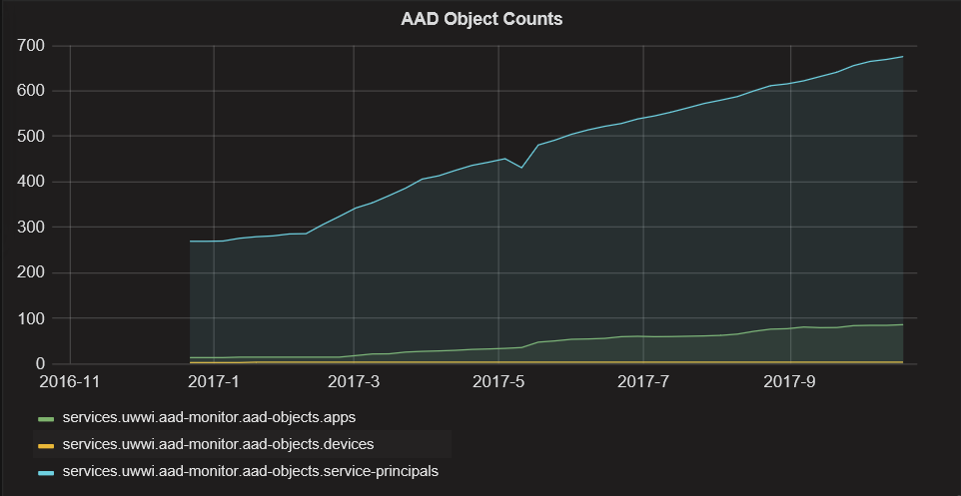
AAD Apps: Monitoring

Slide 7
AAD Groups
Old Office group namespace controls fail
New Office group namespace controls enabled
Office groups enabled via gating process
Office group membership privacy fixed
Thinking about course groups as office groups
Thinking about shifting our group architecture so some groups do not follow Grouper -> AD -> AAD path; instead Grouper -> AAD or AAD -> Grouper

Slide 8
IdP/STS Wars: ADFS vs Shib -> AAD vs Shib?
Still suspect cloud-based IdPs will rule
Shibboleth continues to be best option for most
Azure AD is great option if need provisioning, but only if your tenant isn’t too big

Slide 9
What’s Next
Complete & share AAD App approach
AAD DirSync -> AAD Connect
Watch & agitate re: AAD groups
Call out broken AADp cost approach for Ed sector; + pressure by sharing workaround solutions
Develop AAD audit API based solutions
User login reporting & Last logon for inactive user initiative
AAD App, Role, Policy change event alerting
AAD user consent reporting (e.g. HIPAA regulated employee granted access to what apps?)
License automation + integration

Slide 10
What’s Next - 1 year later
Refresh ADFS 2 -> ADFS 2016
Reevaluate AAD authN: PTA or hash sync?
PIM
Inactive user proposal: 900K users -> ~200K users

Slide 11
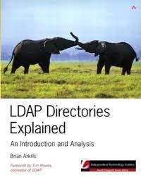
The End
Brian Arkills
barkills@uw.edu
@barkills
@brian-arkills
http://blogs.uw.edu/barkills
https://itconnect.uw.edu/wares/msinf/
Author of LDAP Directories Explained

